Slide 1
CASE STUDY 3
Lakeview College of Nursing
Holistic Health Promotions (N306B)
Nicole Steele & Michael Kruse

Slide 2
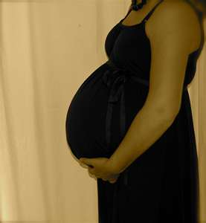
Patient History
25 yr. old female delivering twins
Uncomplicated pregnancy
Mother of 3
Smoker of 1 PPD x 10 yrs.
Refuses to quit because it makes her gain weight

Slide 3
Patient History (cont’d.)
Began taking herbal diet supplements 2 weeks ago
Does not like to exercise because it is “embarrassing”
Store clerk claimed the pills were “just as good as ephedra”
Assessment of pt. during delivery is normal except for diminished lung bases
CXR and labs are normal
B/P 154/88; EKG reveals possible 1st degree heart block

Slide 4
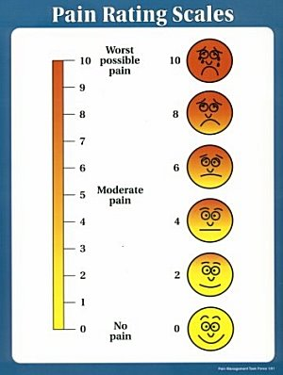
Signs and Symptoms
Pain is subjective (Kyle & Ricci, 2009)
Physical pain can be caused by: cervical stretching, hypoxia of the uterine muscle, pressure on the urethra, bladder, and rectum, and distention of pelvic floor muscles (Kyle & Ricci, 2009)
The amount of pain one feels can be increased by previous experiences with pain, fatigue, anxiety, lack of support system, cultural expectations, and stress (Kyle & Ricci, 2009)

Slide 5
Primary Medical Diagnosis
Pain related to labor induction secondary to active labor contractions
Pain during the 1st stage of labor is usually a result of the dilation of the cervix and stretching of those structures
Contractions usually occur every 5-10 minutes lasting 30-45 seconds
In the active phase contractions usually occur every 2-5 minutes and last for 45-60 seconds
In the transition phase contractions are stronger, more painful, more frequent, and last longer
(Kyle & Ricci, 2009)

Slide 6
Primary Medical Diagnosis (cont’d)
2nd Stage of Labor:
Contractions occur every 2-3 minutes
Last for 60-90 seconds
Strong palpitations
Pushing begins
3rd Stage of Labor:
After birth, uterus still contracts to expel placenta

Slide 7
Primary Nursing Diagnosis
Potential for acute pain related to contractions related to the natural process of childbirth
Pain through labor may be prevented or aided if patient knew of various resources that were available to help control the pain
It is up to the nurse to explore what the patient knows and doesn’t know
Then it is up to the nurse to educate the patient

Slide 8
Education
The best type of prevention is primary prevention
Best provided through education
Pt. did not attend any childhood development or birthing classes
Ephedra has been proven to induce anxiety which can increase the effects of pain and it should not be used during pregnancy (Mayo, 2011)
Pt. did not get enough nutrients during her pregnancy- she did not list any prenatal vitamins or folic acid as medication which are beneficial to a health pregnancy (Deglin, 2005)
Smoking during pregnancy increases the risk of problems in the mother during birth and problems with the baby (March of Dimes, 2010)
Pt. is not aware of various pharmacologic and non-pharmacologic techniques that can lessen strain of labor

Slide 9
Traditional Approaches

Slide 10
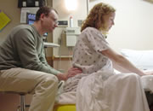
CAM Approaches
1.) Massage
Releases endorphins, serotonin, dopamine, and oxytocin (Fontaine, 2009)
Relieves muscle tension, promotes deeper breathing, eases headaches (Fontaine, 2009)
Induces a relaxed state and reduces stress; reduces anxiety (Fontaine, 2009)
Acupressure involves massage at the point of pain to reduce the pain sensation-pressure is important (Kyle & Ricci, 2009)

Slide 11

CAM Approaches (cont’d)
2.) Attention Focus and Imagery
Focus on tactile stimuli: touch, massage, or stroking (Kyle & Ricci, 2009)
Focus on auditory stimuli: music, humming, verbal encouragement (Kyle & Ricci, 2009)
Focus on visual stimuli: on the beach, a mountaintop, a happy memory (Kyle & Ricci, 2009)
Mental activity: counting backwards, chanting, deep breathing, singing a song (Kyle & Ricci, 2009)

Slide 12
CAM Approaches (cont’d)
3.) Breathing Techniques
Produces relaxation and decreases pain (Kyle & Ricci, 2009)
Uses controlled breathing to reduce pain experienced though a stimulus-response conditioning (Kyle & Ricci, 2009)
Breathing becomes an automatic response to pain (Kyle & Ricci, 2009)
Steady rhythm is calming (Kyle & Ricci, 2009)
Brings purpose to each contraction, making them more productive (Kyle & Ricci, 2009)
4.) Prayer
Enhances relaxation, decreases heart rate, lowers metabolic rate, slows brain waves, slows respiratory rate (Fontaine, 2011)
Becomes a focus other than the pain

Slide 13
Conclusion
Pain may have been prevented during this patient’s labor and delivery if proper pain medication had been administered.
Pain also may have been prevented if patient knew of various alternative techniques that help to reduce the stress of labor.
It is the nurse’s duty to assess the patient’s knowledge and make her aware of options.

Slide 14
References
Ackley, B. & Ladwig, G. (2008). Nursing diagnosis handbook: An evidence-based guide to planning care. St. Louis, MO: Mosby Elsevier.
Fontaine, K. (2009). Complementary and alternative therapies for nursing practice. Upper Saddle River, New Jersey: Pearson Education, Inc.
March, P. & Caple, C. (2011). Smoking cessation and pregnancy. Clinical Information Systems. Retrieved from Ebscohost.
Ricci, S. & Kyle, T. (2009). Maternity and pediatric nursing. Philadelphia, PA: Lippincott, Williams, & Wilkins.
Deglin, J. (2005). Davis Drug Guide for Nurses. Philadelphia, PA: FA Davis and Company

Slide 15
References (cont’d.)
American College of Obstetricians and Gynecologists (2002). Smoking cessation during pregnancy. Retrieved July 28 ,2010 from http://www.acog.org/from_home/departments/smoking/smokingLectureGuide.pdf
Ignatavicius, D. (2006). Medical surgical nursing: Critical thinking for collaborative care. St Louis, MO: Saunders Elsevier
March of Dimes. (2010). Smoking during pregnancy . Retrieved July 28,2011 from http://www.marchofdimes.com/Pregnancy/alcohol_smoking.ht ml
Mayo Clinic (2011) Ephedra (Ephedra sinica) / ma huang .Retrieved July 28, 2011 from http://www.mayoclinic.com/health/ephedra/NS_patient-ephedra/DSECTION=safety

