Slide 1
Prevention
Watch cholesterol, blood pressure
Eat healthy foods
Exercise 30 min a day
Don’t smoke
Control Diabetes
Early Detection
Notes:
Choose a diet rich in fruits, vegetables, and whole grains.
Choose lean proteins, such as chicken, fish, beans and legumes.
Choose low-fat dairy products, such as 1% milk and other low-fat items.
Avoid sodium (salt) and fats found in fried foods, processed foods, and baked goods.
Eat fewer animal products and foods that contain cheese, cream, or eggs.
Limit how much alcohol you drink. This means 1 drink a day for women and 2 a day for men.
Avoid cocaine and other illegal drugs.
Talk to your doctor about the risk of birth control pills. Birth control pills can increase the chance of blood clots, which can lead to stroke. Clots are more likely in women who also smoke and who are older than 35.
Don’t smoke
http://www.ncbi.nlm.nih.gov/pubmedhealth/PMH0004669/

Slide 2
Recovery After Stroke
Self-care
Speech (aphasia)
Thinking, Memory and Behavior
Bladder and Bowel care
Muscle, joint and nerve problems
Swallowing and eating
Sexual function
Notes:
http://www.ncbi.nlm.nih.gov/pubmedhealth/PMH0004663/
Self-care : Can you take care of yourself? Can you get around your home safely? Will you need home care?
Speech: Speech therapy?
Thinking and Memory: Changes in behavior? Depression?
Bladder and Bowel care: Medications to help bladder control? Bladder or Bowel specialist?
Muscle, joint and nerve problems: physical therapy? Occupational therapy? Pain meds?
Swallowing and eating: Speech therapist?
Sexual function: Medication?

Slide 3
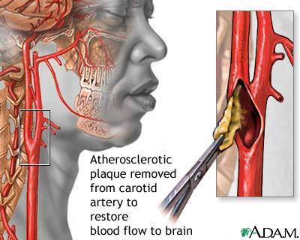
Treatment
Med Route:
(examples)
Atorvastatin
Losartan
Coumadin (Warfarin)
Clopidogrel, Asprin, Ticlopidine
Heparin Injection
Surgical Route:
Angioplasty & Stenting
Carotid endarterectomy
Notes:
Medicine and diet to lower your cholesterol: Atorvastatin (Statin-slows production of cholesterol)
Control your blood pressure: Losartan (angiotensin II receptor antagonist: blocks natural substances that tighten the blood vessel)
Coumadin (Warfarin): Blood thinner ; anticoagulants
Clopidogrel, Asprin: Antiplatelet
http://www.ncbi.nlm.nih.gov/pubmedhealth/?cmd=link&linkname=pubmedhealth_pubmedhealth_adam_ahfs&uid=1740&report=medinfo
http://www.ncbi.nlm.nih.gov/pubmedhealth/PMH0000009/
http://www.ncbi.nlm.nih.gov/pubmedhealth/PMH0000040/
http://www.ncbi.nlm.nih.gov/pubmedhealth/PMH0001740/
http://www.ncbi.nlm.nih.gov/pubmedhealth/PMH0000972/

