Slide 1
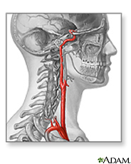
Carotid Artery Disease and Stroke
Shawna Storm
Khoa Nguyen
Lois Syse
Katie Chamberlain

Slide 2
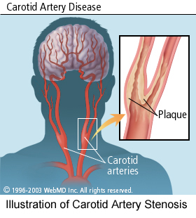
Carotid Artery Disease (CAD)
Carotid artery disease is also called carotid artery stenosis
  Narrowing of the carotid arteries.
Carotid artery occlusion refers to complete blockage of the artery.
Notes:
2nd point: This narrowing is usually caused by the buildup of fatty substances and cholesterol deposits, called plaque.
3rd point: When the carotid arteries are obstructed, you are at an increased risk for a stroke, the third leading cause of death in the U.S.
2

Slide 3
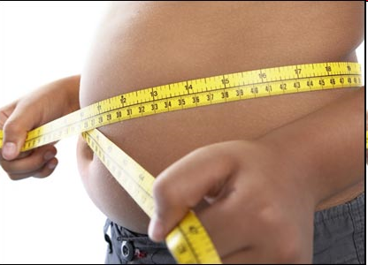
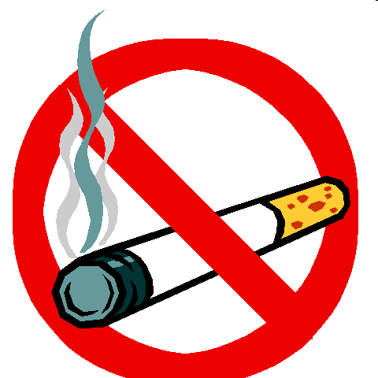
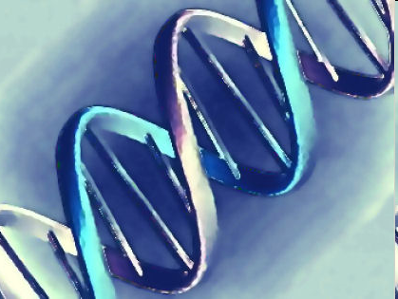
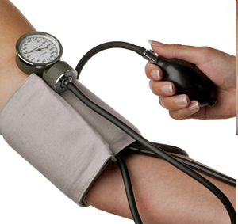
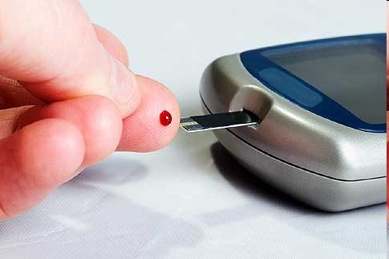
Risk Factors
Age
Heredity
Sex
Obesity
Smoking
High Blood Pressure (hypertension)
Cholesterol- abnormal lipids or high cholesterol
Diabetes
Heart disease
Notes:
Obesity-physical activ people appear less likely to develop coronary disease than those who are sedentary
Smoking-Avoid cigarettes may be the single most important step toward preventing coronary disease
List the risk factors that relate to coronary artery disease.
Age: Men under the age of 75 have a greater risk than women. Women have a greater risk over the age of 75.
Heredity: If one of your parents had it before 50, your risk is significantly increased
Gender (Sex): Men are more likely to be affected than women before the age of 50
Obesity: Distribution of excess weight (abdominal girth, or “pot belly”)
Smoking: Smoking among young women may be one explanation for increased CAD in females
3

Slide 4
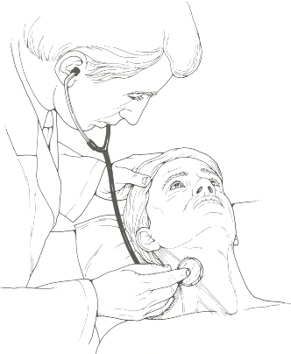
Signs and Symptoms
Symptoms
Weakness in one part of your body
Blurred vision
Confusion
Loss of memory
Problems with speech and language
Loss of sensation
Signs
Health care provider may hear bruit sound when placing a stethoscope to listen to the blood flow in the neck

Slide 5
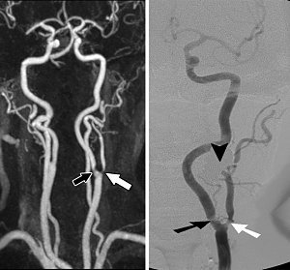
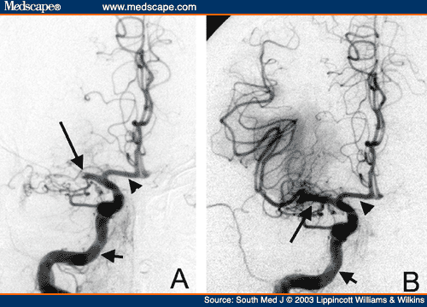
CAD Testing
Blood tests to check cholesterol and triglycerides
Blood sugar (glucose) test
Ultrasound of the carotid arteries to see how well blood is flowing through the carotid artery
Magnetic resonance angiography (MRA)
Computerized tomographic angiography (CTA)
Carotid or cerebral angiography
Magnetic resonance angiography (MRA)
Cerebral angiography

Slide 6
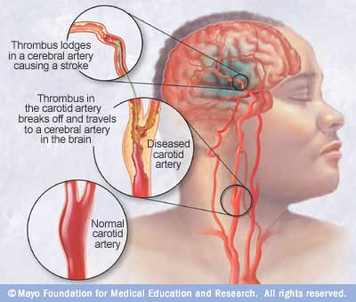
Stroke
Definition:
Types:
Stroke sometimes called a “brain attack”
It results from disease of the blood vessels supplying the brain.
Cerebral hemorrhage
Cerebral thrombosis
Cerebral embolism
Notes:
Name the 3 types of strokes and the symptoms
Definition-Stroke: is similar to a heart attack. It occurs when blood flow is cut off from part of the brain
Cerebral hemorrhage: cause by rupture of a blood vessel, with bleeding into the brain (intracerebral hemorrhage)
Cerebral thrombosis: stems from obstruction of a cerebral blood vessel when a blood clot forms w/n the walls
Cerebral embolism: obstruction of a cerebral artery by a blood clot or a foreign body that usually has migrated from another part of the body circulation.
6

Slide 7
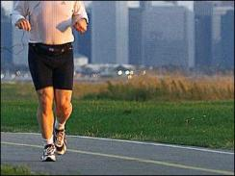
CAD and Stroke Prevention
Watch cholesterol, saturated fat intake and blood pressure
Eat healthy foods
10 lbs weight loss
Exercise 30 min most days of the week
Don’t smoke
Control Diabetes
Early Detection
Notes:
Controlling blood pressure is one of most important things you can do to reduce your risk of stoke
Choose a diet rich in fruits, vegetables, and whole grains.
Choose lean proteins, such as chicken, fish, beans and legumes.
Choose low-fat dairy products, such as 1% milk and other low-fat items.
Avoid sodium (salt) and fats found in fried foods, processed foods, and baked goods.
Eat fewer animal products and foods that contain cheese, cream, or eggs.
Limit how much alcohol you drink. This means 1 drink a day for women and 2 a day for men.
Avoid cocaine and other illegal drugs.
Talk to your doctor about the risk of birth control pills. Birth control pills can increase the chance of blood clots, which can lead to stroke. Clots are more likely in women who also smoke and who are older than 35.
Don’t smoke
Exercise 30 min most days of the week (walking or some activity it doesn’t need to be vigorous)
http://www.ncbi.nlm.nih.gov/pubmedhealth/PMH0004669/

Slide 8
Recovery After Stroke
  Self-care
  Speech (aphasia)
  Thinking, Memory and Behavior
  Bladder and Bowel care
  Muscle, joint and nerve problems
  Swallowing and eating
  Sexual function
Notes:
http://www.ncbi.nlm.nih.gov/pubmedhealth/PMH0004663/
Self-care : Can you take care of yourself? Can you get around your home safely? Will you need home care?
Speech: Speech therapy?
Thinking and Memory: Changes in behavior? Depression?
Bladder and Bowel care: Medications to help bladder control? Bladder or Bowel specialist?
Muscle, joint and nerve problems: physical therapy? Occupational therapy? Pain meds?
Swallowing and eating: Speech therapist?
Sexual function: Medication?

Slide 9
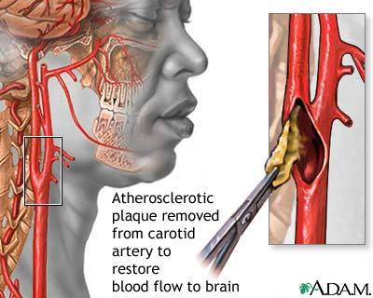
Treatment for CAD and Stroke
Med Route:
(examples)
  Atorvastatin (Lipitor) (PO)
  Losartan (PO)
  Furosemide (Lasix) (PO, IV, IM)
  Coumadin (Warfarin) (IV, PO)
  Asprin (PO)
  Heparin Injection (IV, SubQ)
  Nitroglycerin (Sublingual)
Surgical Route:
  Angioplasty & Stenting
  Carotid endarterectomy
Notes:
Medicine and diet to lower your cholesterol: Atorvastatin (Lipitor) (Statin-slows production of cholesterol)
Control your blood pressure: Losartan (angiotensin II receptor antagonist: blocks natural substances that tighten the blood vessel), Lasix (furosemide)
Coumadin (Warfarin): Blood thinner ; anticoagulants , Asprin
Nitroglycerin: Vasodilator
http://www.ncbi.nlm.nih.gov/pubmedhealth/?cmd=link&linkname=pubmedhealth_pubmedhealth_adam_ahfs&uid=1740&report=medinfo
http://www.ncbi.nlm.nih.gov/pubmedhealth/PMH0000009/
http://www.ncbi.nlm.nih.gov/pubmedhealth/PMH0000040/
http://www.ncbi.nlm.nih.gov/pubmedhealth/PMH0001740/
http://www.ncbi.nlm.nih.gov/pubmedhealth/PMH0000972/

