Slide 1
Cardiac Circulatory System
Daphne Piercy RN, MSN/APN
Lakeview College of Nursing

Slide 2
Overview Circulatory System
Functions
Move oxygen and nutrients
Circulate electrolytes and hormones
Move waste to elimination sites
Pulmonary Circulation
Right Heart
Systemic Circulation
Left Heart
Hemodynamic

Slide 3
Heart
Mediastinum
Heart wall
Pericardium
Parietal and visceral
Pericardial cavity and fluid
Myocardium
Endocardium
Endothelium
Multifunctional organ
Essential to normal vascular physiology
Dysfunction contributes to vascular disease

Slide 4
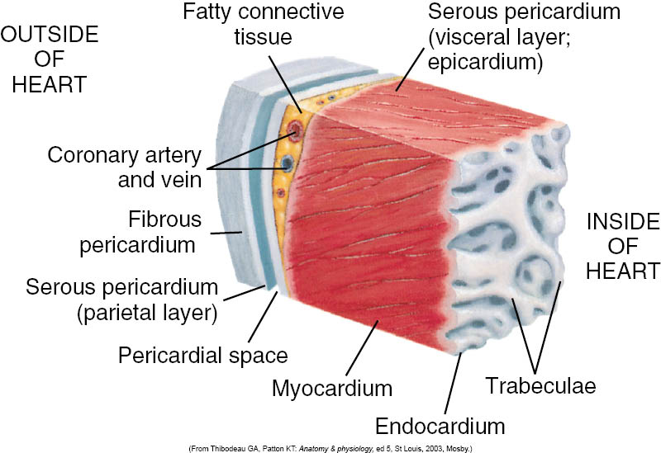
The Heart Wall

Slide 5
Heart Chambers
Right atrium
Left atrium
Right ventricle
Left ventricle
Thickness of each chamber depends on the pressure or resistance it must overcome to eject blood

Slide 6
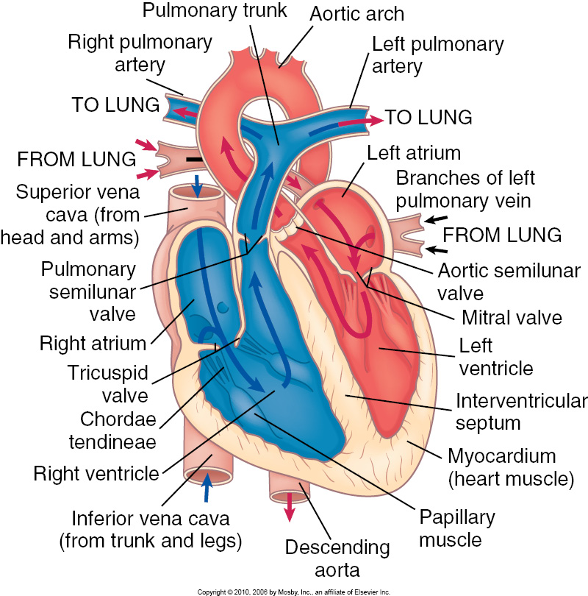
Chambers

Slide 7
Heart Valves
Atrioventricular valves
Tricuspid valve
Bicuspid valve
Semilunar valves
Pulmonic semilunar valve
Aortic semilunar valve

Slide 8
Hemodynamics
Pressure
Resistance
Vessel size
Viscosity
Flow
Cardiac pump potential
Volume

Slide 9
Blood Vessel Components
Arteries
Higher pressure
More muscular
Arterioles
Regulatory values
Capillaries
Sites of most exchange
Venules
Collect blood from the capillaries
Veins
Lower pressure
More distendable

Slide 10
Distribution of Blood
Average adult has 5 liters of blood.
9% Pulmonary circulation
7% in the Heart
84% is moving systemically
Majority is in the veins (64%)
Arterial blood 20-30 %

Slide 11
Blood Flow
To move the force driving the flow must be greater than the force resisting the flow.
Move from higher to lower pressure.

Slide 12
Cardiac cycle
Diastole
Systole
Phases of the cardiac cycle
Atrial systole
Ventricular systole
Ventricular ejection (semilunar valves open)
Ventricular relaxation (closure of aortic valve)
Ventricular filling (opening of mitral valve)

Slide 13
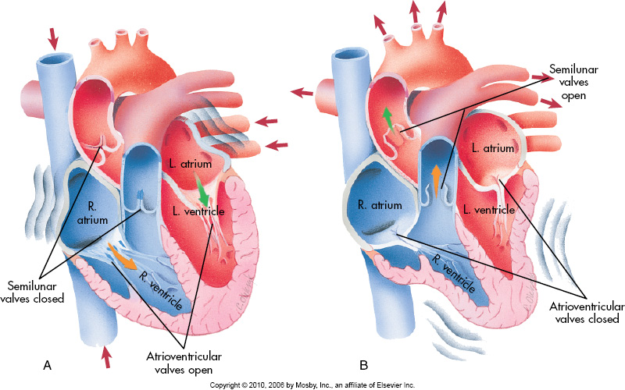
Blood Flow in the Heart

Slide 14
Venous Return
Negative pressure
Smooth muscle contraction
Skeletal muscle contraction

Slide 15
Cardiac Output
Heart rate (HR) * Stroke Volume (SV)
Heart rate 70 beats/min
Stroke Volume 70 ml/min
490 ml /min (4.9 Liters)

Slide 16
Cardiac Output Factors
Heart Rate
SA node
Autonomic Nervous System
Parasympathetic Nervous System
Stroke Volume
Cardiac Contractility
Preload
Force of venous return
Afterload
Arterial pressure

Slide 17
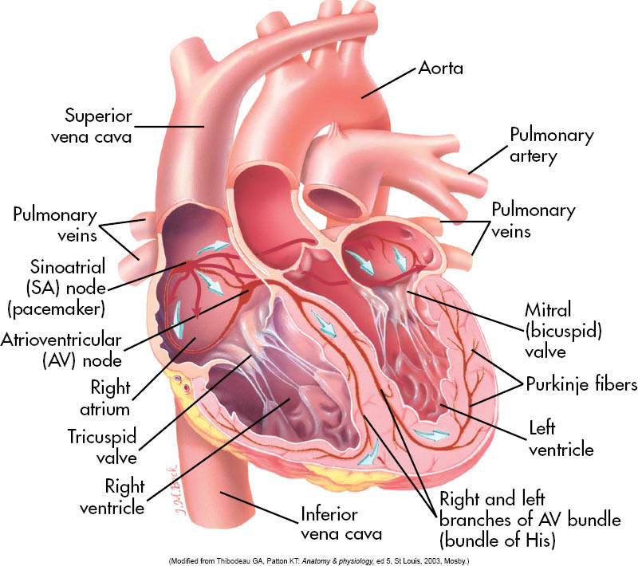
Cardiac Conduction

Slide 18
Preload or Afterload
Dehydration
GI bleed
Angiotensin II (vasoconstrictor)
Fluid volume overload
Use of Diuretics/Antihypertensives

Slide 19
Starling’s Law
Force of Contraction is proportional to the cardiac muscle fiber length.
The muscle fiber length is proportional to the ventricular diameter.
Output and venous volume should be the same.
Breakdowns in the system???

Slide 20
Arterial Pressure
Peripheral Resistance * Cardiac Output
Regulation
Sympathetic branch of the ANS
Renin-angiotensin-aldosterone system
Kidneys
Primary organ of blood pressure control.

Slide 21
ANS Regulation
Increases cardiac tone and heart rate
Baroreceptors
Low pressure sensors
Located in the Aorta and Carotid arteries.
Also located in the Renal Afferent arterioles.

