Slide 1
Cardiac Circulatory
System
Daphne Piercy RN, MSN/APN
Lakeview College of Nursing

Slide 2
Overview
Circulatory System
Functions
  Move oxygen and nutrients
  Circulate electrolytes and hormones
  Move waste to elimination sites
Pulmonary Circulation
  Right Heart
Systemic Circulation
  Left Heart
Hemodynamic

Slide 3
Heart
  Mediastinum
  Heart wall
    Pericardium
      Parietal and visceral
      Pericardial cavity and fluid
    Myocardium
    Endocardium
  Endothelium
    Multifunctional organ
    Essential to normal vascular physiology
    Dysfunction contributes to vascular disease

Slide 4
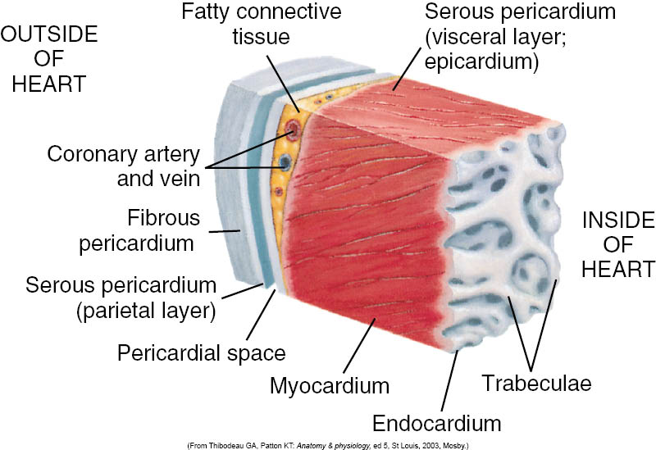
The Heart Wall

Slide 5
Heart Chambers
Right atrium
Left atrium
Right ventricle
Left ventricle
Thickness of each chamber depends on the pressure or resistance it must overcome to eject blood

Slide 6
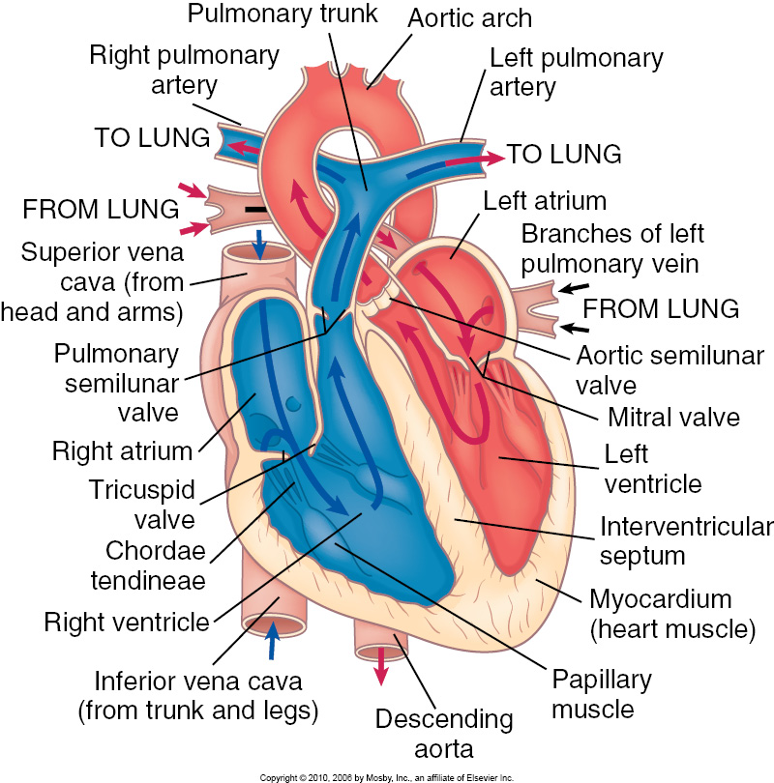
Chambers

Slide 7
Heart Valves
Atrioventricular valves
  Tricuspid valve
  Bicuspid valve
Semilunar valves
  Pulmonic semilunar valve
  Aortic semilunar valve

Slide 8
Hemodynamics
Pressure
Resistance
  Vessel size
  Viscosity
Flow
  Cardiac pump potential
  Volume

Slide 9
Blood Vessel Components
Arteries
  Higher pressure
  More muscular
Arterioles
  Regulatory values
Capillaries
  Sites of most exchange
Venules
  Collect blood from the capillaries
Veins
  Lower pressure
  More distendable

Slide 10
Distribution of Blood
Average adult has 5 liters of blood.
9% Pulmonary circulation
7% in the Heart
84% is moving systemically
  Majority is in the veins (64%)
  Arterial blood 20-30 %

Slide 11
Blood Flow
To move the force driving the flow must be greater than the force resisting the flow.
Move from higher to lower pressure.

Slide 12
Cardiac cycle
Diastole
Systole
Phases of the cardiac cycle
  Atrial systole
  Ventricular systole
  Ventricular ejection (semilunar valves open)
  Ventricular relaxation (closure of aortic valve)
  Ventricular filling (opening of mitral valve)

Slide 13
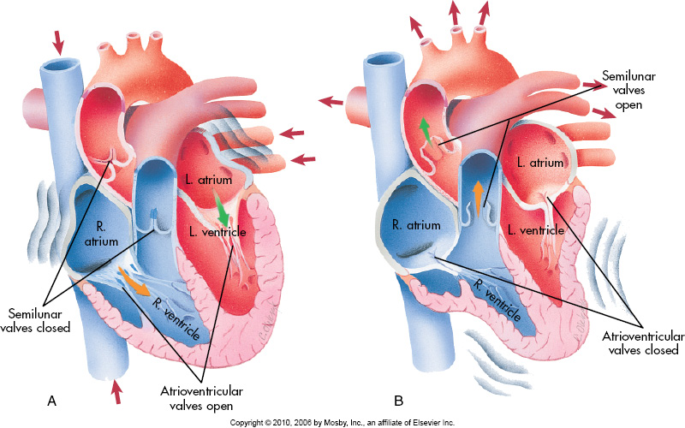
Blood Flow in the Heart

Slide 14
Venous Return
Negative pressure
Smooth muscle contraction
Skeletal muscle contraction

Slide 15
Cardiac Output
Heart rate (HR) * Stroke Volume (SV)
Heart rate 70 beats/min
Stroke Volume 70 ml/min
490 ml /min (4.9 Liters)

Slide 16
Cardiac Output
Factors
Heart Rate
  SA node
  Autonomic Nervous System
  Parasympathetic Nervous System
Stroke Volume
  Cardiac Contractility
  Preload
    Force of venous return
  Afterload
    Arterial pressure

Slide 17
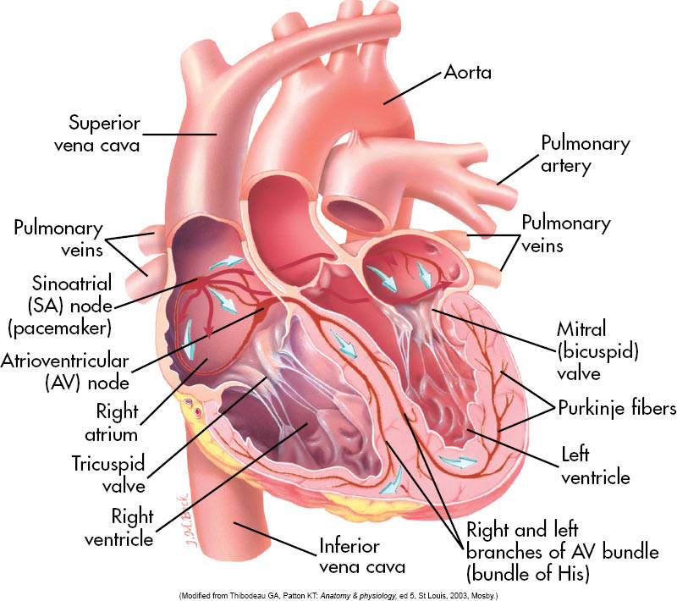
Cardiac Conduction

Slide 18
Preload or Afterload
Dehydration
GI bleed
Angiotensin II (vasoconstrictor)
Fluid volume overload
Use of Diuretics/Antihypertensives

Slide 19
Starling’s Law
Force of Contraction is proportional to the cardiac muscle fiber length.
The muscle fiber length is proportional to the ventricular diameter.
Output and venous volume should be the same.
Breakdowns in the system???

Slide 20
Arterial Pressure
Peripheral Resistance * Cardiac Output
Regulation
  Sympathetic branch of the ANS
  Renin-angiotensin-aldosterone system
  Kidneys
    Primary organ of blood pressure control.

Slide 21
ANS Regulation
Increases cardiac tone and heart rate
Baroreceptors
  Low pressure sensors
  Located in the Aorta and Carotid arteries.
  Also located in the Renal Afferent arterioles.

