Slide 1
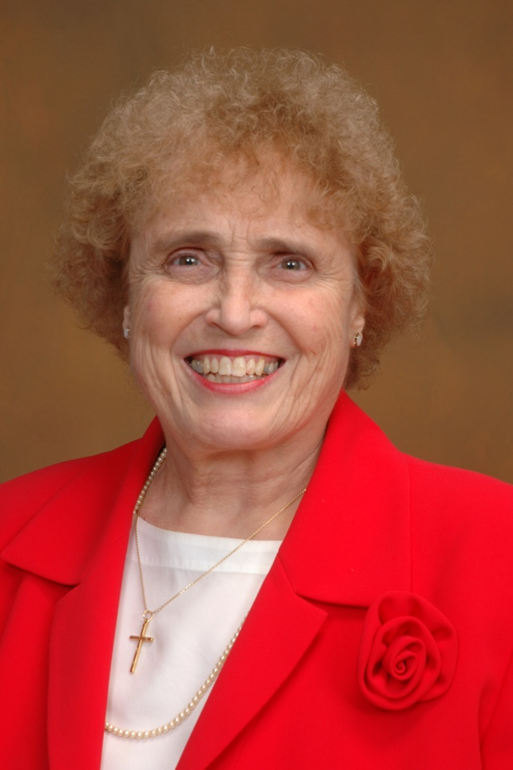
Sister Callista Roy
Pictured in 2010

Slide 2
Who Roy Really Is
Sr. Callista Roy, PhD, RN, FAAN, is a Professor and Nurse Theorist at the William F. Connell School of Nursing, Boston College.
Roy is highly educated, having worked in many hospitals and universities around the world, starting her work at 14 years old. She has 130 published works, including twelve books.
Roy has been described as having given “significant contributions to the community, commitment to spiritual values, a belief in the potential of women, esteem for diversity, and respect for liberal arts education” (American Academy, 2010)

Slide 3
Roy’s Focusing Ideas
Roy is very focused on education, family, and religion.
Roy believes that clinical experience is a critical role in nursing education
Roy considers excellent mentors as she had crucial to nursing
Roy possesses a strong passion for nursing and helping women succeed (Jones, &Bartlett).
These aspects were a major influence on developing the Roy Adaptation Model.

Slide 4
Roy’s Main Concepts
Humans are bio-psychosocial adaptive systems.
Humans cope with environmental change through the process of adaptation.

Slide 5
Roy’s Great Developments
4 Modes of Adaptation
Physiologic, Self-Concept, Role Function, and Interdependent Modes
4 Domain Concepts are Present
Person, Health, Environment, Nurses
6 Step Nursing Process
Assessment of Behavior, Assessment of Stimuli, Nursing Diagnosis, Goal Setting, Intervention, and Evaluation

Slide 6
What Roy is Really Know For
Roy is best known for her Adaptation Model.
Roy developed this model as a graduate student at the University of California-Los Angeles.
Inspired by a seminar speakers challenge, asking Roy to come up with her own conceptual nursing model.
The model was first published in 1970 in Nursing Outlook.
Roy gives credit to Harry Helson’s model for shaping the way she thought early on in her nursing career.
The Roy Adaptation Model is currently one of the most widely used conceptual nursing models around the world (Jones, & Bartlett).

Slide 7
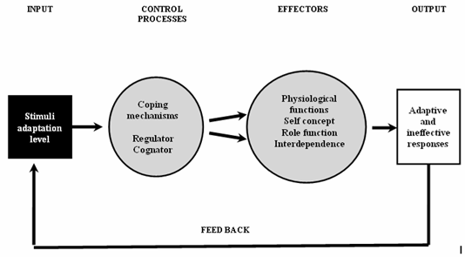
Roy’s Adaptation Model

Slide 8
Roy’s Real Thoughts
Providing a comprehensive understanding of nursing from the prospective of adaptation
A person is an open and adaptive system that uses coping skills to deal with stressors
The “environment” is all circumstances, influences, and conditions that affect and surround the behavior and development of a person
The belief that the individual and the environment are sources of stimuli that require modification to promote adaptation in the person
If the demands of the environmental stimuli are too high or the person’s adaptive mechanism are too low, the person’s behavioral responses are ineffective for coping
Effective adaptive responses promote the integrity of the individual by conserving energy and promoting the survival, growth, reproduction and mastery of the human system
Nursing promotes the person’s adaptation and coping with progress toward integration

Slide 9
Roy’s Impact on Personal Care
Part of the theory uses demonstrations with the six step nursing process
Manipulating the stimuli and not the person will enhance the interaction of the person with their environment
The adaption model assesses all of the persons’ behaviors
Emphasis is placed on identifying and reinforcing positive behaviors which will lead to a speedy recovery
Nursing emphasizes on strengthening, expanding, and improving upon the person’s coping abilities to improve the their wellness
The 4 adaptive modes contribute to health, quality of life, and dying with dignity
Nurse’s are able to review the behaviors and other factors of the person that may influence their adaption

Slide 10
Roy’s Impact on Nursing
Manipulation of the stimuli is not overlooked
The adaption theory can be used in many other settings
Promotion of the 4 modes of adaptation in any situation relating with health and illnesses
Increased interaction with the person
Nurses will be able to help the person cope and recover quickly

Slide 11
Reflections on Roy
Roy is still actively involved in nursing after more than 40 years
Roy has been a Sister at St. Joseph of Carondelet for more than 50 years
Roy forever impacted nursing
Roy will be an inspiration to all nurse’s similar to that of Florence Nightingale

Slide 12
Sister and Doctor Callista Roy
Thank you from nurses everywhere.

