Slide 1

Take a Stand!
Brad Olwhyne, Omololu Kafisanwo,
& Adam Moon

Slide 2
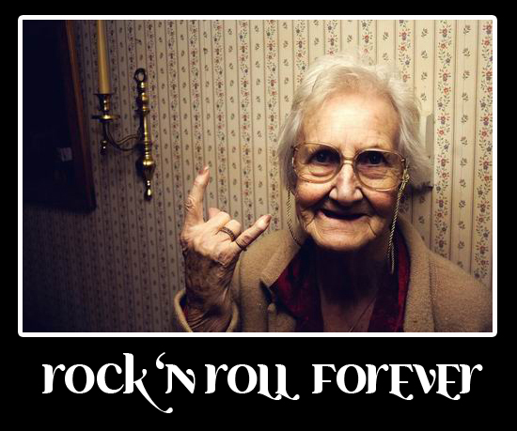
Project Goal and Activity
Draw awareness to bullying amongst teenagers (esp. in Junior high and High School)
Anti-bullying education via
rock n’ roll concert
Fund a local anti-bullying
organization
Campaign against bullying via
social media, posters, pamphlets
etc.

Slide 3

Mission Statement
“Sweep bullying out of our junior high and high schools!”

Slide 4

Vision
Visit local schools and promote anti-bullying campaign
Educate bullies and victims through rock and roll!
Create safe environment for teachers and students

Slide 5

Values
Respect
Love
Equality
Tolerance
Education
Partnership

