Slide 1
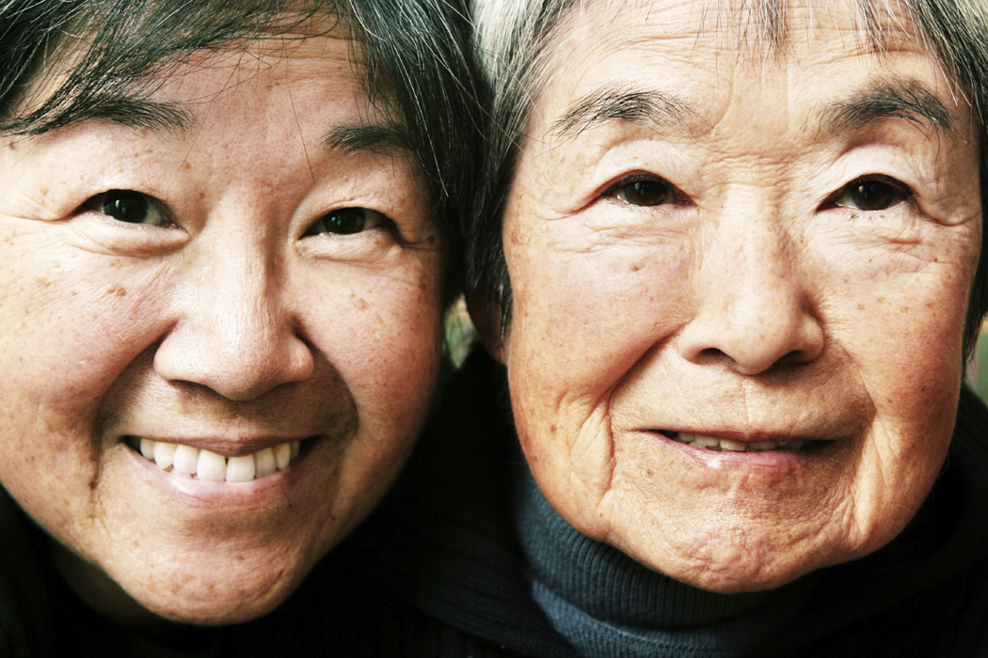
Cultural Preferences: Asian Americans
By: Ashley Winnett, Sara Upoff, Gentry Scott, Theresa Pollum, Amanda Michaelec, and Adam Moon

Slide 2
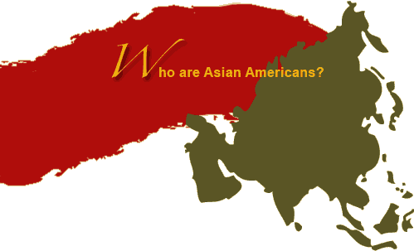
Introduction
Purpose
Goal
Background
(Asian American Health Initiative, 2005)
Notes:
The purpose of this presentation is to demonstrate how important it is to practice as a culturally competent nurse. Cultural competence is becoming an important quality to possess in order to become an effective nurse due to the nation’s dramatic demographic change. It is important to recognize that cultural sensitivity begins with the health care provider. Nurses who do not care for patients with cultural competence often cause a strain in the patient nurse relationship. Understanding one’s culture will help provide a respectful, understanding, and dignified care to patients. This presentation will give information regarding the demographic representation of Asian American culture in the U.S, an overview of culture’s health preferences, the impact of preferences on nursing care, and a summary of these topics. (Chitty and Black, 2011, p. 393)
Asian Americans face cultural and linguistic barriers that may discourage them from accessing health care services available to them. Asian Americans deal with illness different from the general population. Many Asian Americans who have trouble speaking English believe that doctors and nurses do not understand their culture. They also have trouble understanding the health care systems and have problems communicating with health care workers. These restraints can cause individuals from seeking proper care. Asian Americans may not perceive the value or identify the purpose or necessity in obtaining care. (Asian American Health Initiative, 2005)

Slide 3
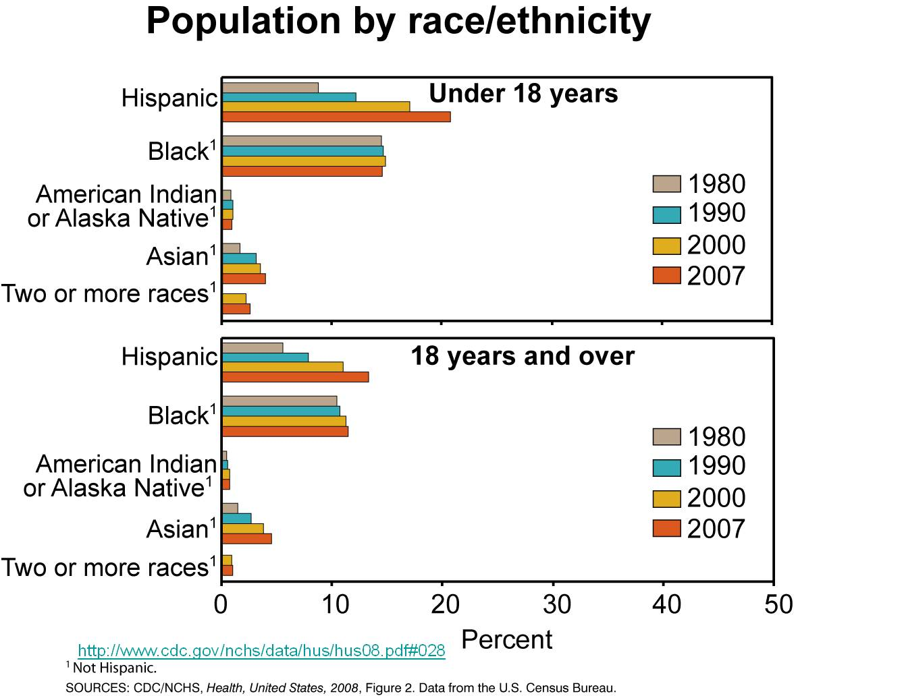
Cultural Overview In America
Notes:
Earth video from http://www.youtube.com/watch?v=hq92BI8FuW4&feature=related
Graph from Center for Disease Control: http:/www.cdc.gov/nchs/data/hus/hus08.pdf#028

Slide 4
Demographic Representation
Asian Americans -original peoples of the Far East, Southeast Asia, or the Indian subcontinent.¹
2000 U.S. Census-identify only as Asian-American = 3.6 percent of the American population (10 million individuals)
Census Bureau -Asian-American population will grow to 37.6 million individuals by 2050 (9.3 percent of the population)
Asian Americans including those of more than one race estimated at 15.5 million (5 percent of population) Census Bureau July 1, 2008 Census Bureau.
Asian-American populations - generally concentrated in the western states, the Northeast, and parts of the South. Greatest concentration: Hawaii, California, Washington, New Jersey, and New York
Notes:
Center for Disease Control http://www.cdc.gov/omhd/populations/AsianAm/AsianAm.htm

Slide 5
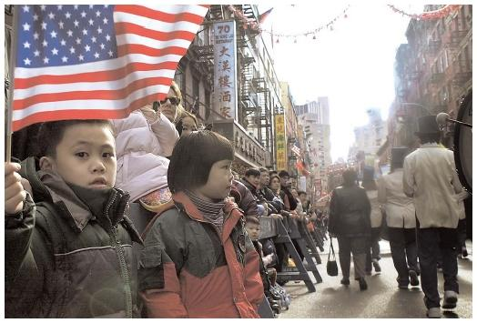
Asian American’s
Health Preferences

Slide 6
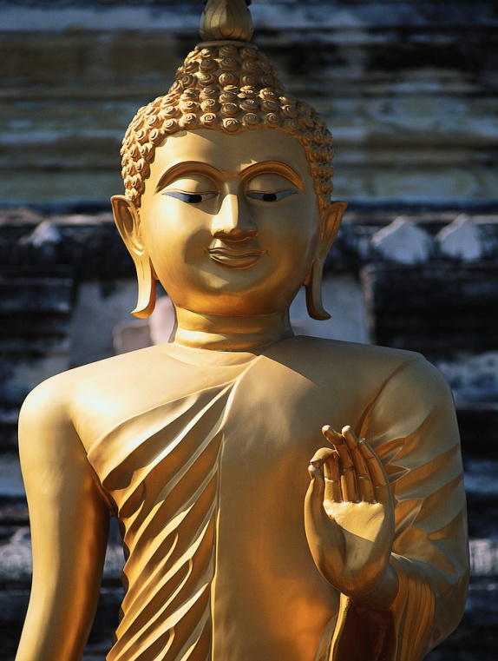
Factors for Health
Spirituality
  Karma
Religion
  Buddhism
Philosophy
  Respect
  Cycle of life
Notes:
Asian Americans are a diverse ethnic group with many different religious backgrounds. Among them are: “Christian, Muslim, Hindu, and a host of others, but many follow Buddhist concepts” (Leadership Management Institute, 1990). Within religion, the belief in karma is introduced with spirituality. Karma is the “law of cause and affect over countless lifetimes”. (Leadership Management Institute, 1990) Asian Americans who follow Buddhism are also taught that “art and science can exist in an always changing context and events and objects depend on the perception of the beholder as much as their own qualities.” (Leadership Management Institute, 1990) Therefore, healing is both spiritual in which it is something to guided by as well as scientific where measures of the environment are included (Leadership Management Institute, 1990). The philosophy that Asian Americans tend to adopt with the belief in Buddhism also impacts “health care beliefs and practices” (Leadership Management Institute, 1990). Of this philosophy, respect and the cycle of life are centered around. A respect of elders and those in authority are encouraged. Health care providers are also looked upon with respect. (Leadership Management Institute, 1990) They are someone who can bring healing and restoration to the body and the mind. The cycle of life teaches that “life is a cycle of suffering and rebirth” (Leadership Management Institute, 1990). Oftentimes, in a time of suffering, “pain and illness are endured and health seeking remedies are delayed.” (Leadership Management Institute, 1990) For in the cycle, their must be a time of suffering for their to be a time of rebirth.

Slide 7


Health and Healing
Mind/Body/Spirit
Ayurveda
Acupuncture
Herbal Medicines
Notes:
Each culture has its own health and healing remedies. For Asian Americans, the idea of unison between mind, body, and spirit is the “belief that each part influences the others” (Leadership Management Institute, 1990). In this belief, balance between the person and environment is key to curing illness and disease. Also, the belief in forces of “hot” and “cold”, which are countering forces meant to align the environment of the person. Factors such as pregnancy, fatigue, and diet can tip the scale and lead to an imbalance of these forces. (Leadership Management Institute, 1990)
According to Hussain and Cochrane (2002) some illnesses, such has depression are often times diagnosed based on “not only the severity but also the visibility it shows” and how it affects the “social obligations of that culture” (Hussain & Cochrane, 2002, p. 286).
Ayurveda is termed “knowledge of life” and is a system that works to prevent. (Leadership Management Institute, 1990) In this system, the body is make up of three forces and imbalance is the illness or disease. Equilibrium between the body’s forces causes good health. Any upset between the forces can lead to disease. (Leadership Management Institute, 1990)
A healing remedy used by Asian Americans is acupuncture. It is believed that this healing maneuver assists in preserving homeostasis. (Management Sciences for Health, p. 4) It is used more by women than men and offers a traditional healing technique in which the Asian culture of medicine can be implemented (Management Sciences for Health, p. 9).
Herbal medicines are also used within Asian American culture. In fact, “about 1400 plants are used in the Ayurveda medicine”. (Leadership Management Institute, 1990) In this idea, Asian Americans see humans as part of the environment or universe. Humans are natural. Therefore, it would make sense that someone needing healing would look to something nature made-a plant.

Slide 8

Diet
Rice
Dairy, veggies
Freshness is key to healthiness
Eating is a part of social matrix
Notes:
Rice is the mainstay of the Asian diet and is commonly eaten at every meal.
Meals primarily consist of grains, vegetables and fruit. They commonly don’t eat much dairy, but rather substitute soy milk and tofu as sources of protein and calcium. Fish, pork and poultry may also be eaten, but only a few times a month and only in small quantities.
Most Asian Americans like to use fresh food for most of their cooking. They are likely to make frequent trips to the local market place for seafood, vegetables and fruits that are seasonal.
Asian cuisine is prepared more meticulously than the typical American cuisine. They view eating as part of their socialization in a more formal manner. The meal must not only be nutritious, but visual appeal is appreciated.

Slide 9


Challenges to Gaining Health
Cardiovascular disease
Carcinomas
Depression
Drug/Alcohol abuse
Notes:
Asian Americans face many barriers to their health because of language and cultural differences. They may find it hard to communicate with American health care providers. Asian Americans may not feel that their personal care is of value because of cultural beliefs.
These factors lead to later diagnosis of disease, which makes it more difficult to treat successfully.
Two leading causes of death for Asian Americans in the US are cancer and cardiovascular disease.
Asian American women have the lowest cancer screening rates and therefore are less likely to find disease at an early stage. Therefore cancer is the leading cause of death in this group.
Asian American women age 65 years and over have the highest suicide rate in the country when compared to other populations of the same age.
Asian American girls also have the highest rates of depressive symptoms compared to girls of other ethnicities.
Increased drug and alcohol abuse among Asian Americans is thought to be related to the stress of adjusting to the vastly different life styles and challenges of living in the US.

Slide 10


Impact of Preferences on Nursing Care
Overall experience
Education
Health Care satisfaction
Notes:
Asians assessed their experience as worse than that of whites in 6 out of 8 indicators. They feel that the experience that they are given is lacking in what they believe it should be more than any other ethnic race. Asians tend to have higher levels of educations than those of other races. As a result, they tend to question others more often. The overall satisfaction in the health care system is lowest for Asians. There were the lowest scare for those satisfied with the USC staff

Slide 11

Impact of Preferences on
Nursing Care
Unequal treatment???
Notes:
Asians have higher odds of having to wait more than 30 minutes with an appointment. Asians are also more likely to report that their provider did not ask about other treatments.

Slide 12



Impact of Preferences on
Nursing Care
Improvements
Relations
Notes:
There have been efforts to provide ethnically and culturally competent care and address language and culture gaps.

Slide 13

Summary
Population
Cultural
Preferences
Notes:
Asian Americans are peoples from far east, southeast asia, or the Indian subcontinent. There are approximately 10 million Asian American’s living in the United States and that number is expected to grow to 37.6 million people by 2050. Asian’s believe in the idea of unison between the mind, body, and spirit so in order for a person to be healthy according to this belief, a person must maintain balance between themself’s and their environment. Some remedies that are used to help maintain this balance include herbal medicines and acupuncture. It is of utmost importance to be able to recognize and respect these cultural differences when providing healthcare to Asian American’s in your nursing practice. Not only will it help the client feel comfortable and be more open to you the nurse, it will also help physically heal the person if they are in the right mental frame of mind. We must always respect our client’s wishes and understand that every culture has their own opinions and outlooks when it comes to their healthcare.

Slide 14

Summary
Nursing Implications
Notes:
It is of utmost importance to be able to recognize and respect these cultural differences when providing healthcare to Asian American’s in your nursing practice. Not only will it help the client feel comfortable and be more open to you the nurse, it will also help physically heal the person if they are in the right mental frame of mind. We must always respect our client’s wishes and understand that every culture has their own opinions and outlooks when it comes to their healthcare and it is our jobs as nurses to provide quality healthcare and implement our practice in regards to any individual’s wishes.

Slide 15
References
Asian American Health Forum, Inc. (1990). Asian americans and specific islanders: Health disparities. Reducing Health Disparities in Asian American and Pacific Islander Populations: A Provider’s Guide to Quality & Culture Seminar San Francisco: AAHF. Retrieved from http://erc.msh.org/provider/informatic/AAPI_Disparities_CAM.pdf
Asian American Health Initiative. (2005). Cultural barriers. Retrieved from http://www.aahiinfo.org/english/asianAmericans.php
Center for Disease Control http://www.cdc.gov/omhd/populations/AsianAm/AsianAm.htm
Chitty, K., & Black, B. (2011). Professional nursing: Concepts & challenges. Maryland Heights, MO: Saunders Elsevier.
Hussain, F. A. & Chochrane, R. (2002). Depression in south asian women: Asian women’s beliefs on causes and cures. Mental Health, Religion & Culture, 5(3), 286. Retrieved from http://proxy.library.eiu.edu:2053/ehost/pdfviewer/pdfviewer?vid=4&hid=110&sid=89cc4 74c-87a2-4cf3-b439-bdf8cfa1dc95%40sessionmgr114
Kim, K., Chen, E., Cross, N, Kim, J., & Brintnal, R. (2000) Nutritional status of Korean Americans: Implications for cancer risk. Oncology nursing forum. 27(10), 1573-1583.
Lutsy, P., Diez Roux, A., Jacobs, D., Burke, G., & Shea, S. (2008) Association of acculturation and socioeconomic status with subclinical cardiovascular disease of the multi-ehnic study of artherosclerosis. American Journal of Public Health. 98(11), 1963-1970.
Madrigal, L., Brady, J., Raxter, M., Ruiz, E., Oturola, F., & Blell, M. (2011). Obesity,
hypertension, & migration: A meta-analysis of populations of the South
Asian diaspora. Human Biology: An international record of research. 83(1), 71-86.
Spencer, M., Chen, J., Gee, G., Fabian, C., & Takeuchi, D. (2010). Discrimination & mental
Health-related service used in a national study of Asian Americans. American Journal of
Public Health, 100(12), 2410-2417.

