Slide 1
The Amish
By Carolyn Horin, Jenna Kreke, Erica Ochs, & Lindsay Rhodes

Slide 2
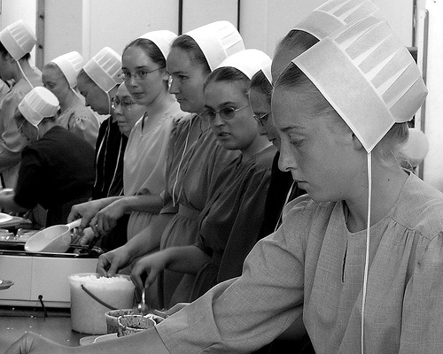
Health care practices vary considerably across Amish communities and from family to family. Many Amish use modern medical services, but others turn to alternate forms of treatment. They cite no biblical injunctions against modern health care or the latest medicines, but they do believe that God is the ultimate healer.

Slide 3
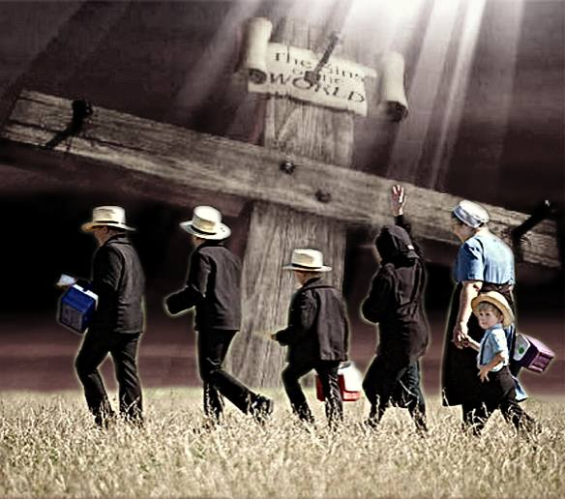
The Amish (Roots)
Are a Christian Church that trace its roots back to the Protestant Reformation in sixteenth century Europe
Accept basic Christian beliefs but also have special interpretations that have been emerged throughout their history
Migrated from Europe to North America in the 18th and 19th centuries

Slide 4
Beliefs
The beliefs the Amish have are currently shaped by their interpretation of the bible as well as several written sources
In addition to Luther’s German bible, the Martyrs Mirror, the Ausbund, and the Dordrecht Confession of Faith are key sources for their beliefs
The Amish are more concerned with practicing their faith than teaching formal theological doctrines

Slide 5
Beliefs cont’d
Seek to follow the teaching of Jesus in daily life by loving their enemies and forgiving insults
Have been shaped by a martyr tradition: many of their forefathers were persecuted for their religion
The 1,100 page Martyrs Mirror records the religious persecution and martyr stories continue to influence the Amish today

Slide 6
Beliefs cont’d
The Amish emphasize the teaching of mutual aid, urging church members to help each other in times of need
Thus, they do not participate in Social Security and commercial insurance coverage
They believe this to be undermining their faith in God and dependence on the church community

Slide 7
Values
The core value of the Amish is captured in oneword: Gelassenheit (Gay-la-sen-hite)
The Amish harbor pride: attidudes and actions that clamour for attention and recognition, and at the same time teach humility
Humility and obedience are twin virtues in the Amish community

Slide 8
Community & Tradition
Welfare of the community ranks above an individual’s rights and choices
Communal wisdom (accumulated over the decades) is more valued over the knowledge of one person
Traditional beliefs are practices are esteemed over scientific findings

Slide 9
Rumspringa
Means “running around” in the Pennsylvania German Dialect
Beginning at age 16, youth socialize with their friends on weekends
Between age 16-mid-twenties, youth decide whether or not they will be baptized and join the church or leave the Amish community
Over half of the Amish community is under the age of 18

Slide 10
Health Beliefs
Many use modern medicine and services of hospitals, but tend to stay away from high risk or expensive medical procedures
Members of the more traditional societies prefer homeopathic or alternative forms of medical treatment
There are no religious restrictions against any certain type of medicine or procedure; the variability of healthcare varies from family to family

Slide 11
Insurance and Healthcare Access
Exempt from social security benefits
Exempt from medicare/medicaid benefits
Reject health insurance
Live in rural areas with little access to modern medicine facilities
Believe in caring for themselves and others at home not in modern doctors’ offices or hospitals (some do seek treatment at these facilities)

Slide 12
Preventative
No religious restrictions to immunizations
Only 16-26% of children receive immunizations
Do not believe in birth control
Reject preventative medicine-believe to be due to low educational status
Believe in herbs and healthy eating from local Amish grocery stores

Slide 13
Pregnancy and Birth
Do not use any modern birth control practices
Reject typical prenatal vitamins and care (more modern Amish cultures do practice prenatal care)
Large support from other females in the Amish community during pregnancy and birth
Females give birth to an average of 7 babies in their lifetime
Life expectancy of females is less than that of male due to high number of births per female

Slide 14
Childbirth
Majority of children are born at home
Amish midwives from the community assist with delivery
Allows for all of the family to be present
Convenient
Comfort
Less expensive
Birthing centers is larger communities

Slide 15
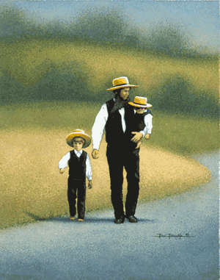
Birth Facts
No medical support at home
Midwives are not always licensed
No monitoring of baby during pregnancy
Cannot predetermine complications or problems
Have a higher prevalence of genetic disorders
Forbid abortions even if life-threatening to the mother

Slide 16
Depression
Not talked about among the community
Many women suffer from post-partum depression
Not diagnosed because of stereotype
Overall, less depression among this culture compared to other cultures
Non-pharmaceutical remedies used to reduce stress and depression
Ex: Herbal teas, relaxation techniques

Slide 17
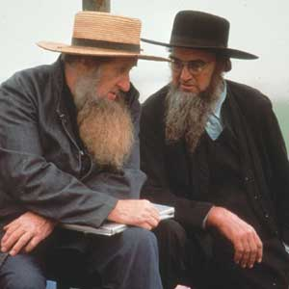
Elderly
Granted respect by the Amish
Live independently as possible
Grossdawdy house
Eventually, their children will take care of them

Slide 18
Death and Dying
Have well established rituals associated with death
Appears to associated with less stress than most societies
Life should not be prolonged
Should die at home
Once death has occurred, family members are relieved of their usual tasks and obligations and neighbors prepare their home and do their chores

Slide 19
Health Risks
Health risk are quite significant
Amish do not practice birth control
Most marry young
Large families are encouraged
Increased risk for difficult pregnancies
Complications due to pregnancies with late age

Slide 20
Health Risks
Incest is a major problem
Amish tend to marry within their community
Intermarry only with other Amish
Not allowed to marry first cousins but can marry second and third cousins
Most are related in some way
Increased risk for genetic diseases
Prevalence of recessive genetic disorders
Down syndrome and mental retardation

Slide 21
Health Risks
Only educated to the 8th grade
Knowledge of medical practices is limited
Isolated from mainstream American society
Live in rural areas away from healthcare facilities
Travel great distances for medical treatment
Delay seeking medical care
Increased risk for complications secondary to initial problem

Slide 22
Health Risks
Decreased use of prescription medication & vaccines
Believe in fate and prefer natural remedies
Herbal medication is encouraged
Higher pain threshold
Faith healing provided by one who has inherited a power to heal.
Participate in chiropractic or podiatric treatment
Often do not have medical insurance and prefer to pay with medical bills with cash.

Slide 23
Top facts healthcare providers should know about the Amish
Limited education
Limited resources
Utilize folk medicine practice
Risk for genetic diseases
Family values
Gender of caregiver same as patient

Slide 24
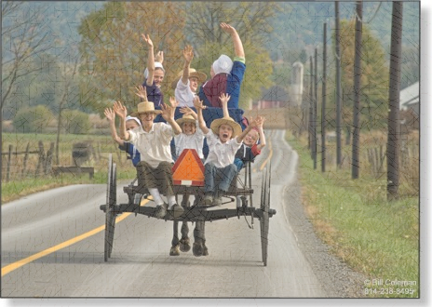
References
Etown.edu. (2012). Amish Studies. Retrieved from http://www2.etown.edu/amishstudies/
Unknown. (2010). The American Amish. Retrieved from http://nursing322sp10.wordpress.com/the-american-amish/
Greksa, L., & Korbin, J. (n.d.). Amish. Retrieved from http://www.case.edu/artsci/anth/documents/Amish.pdf

