Slide 1
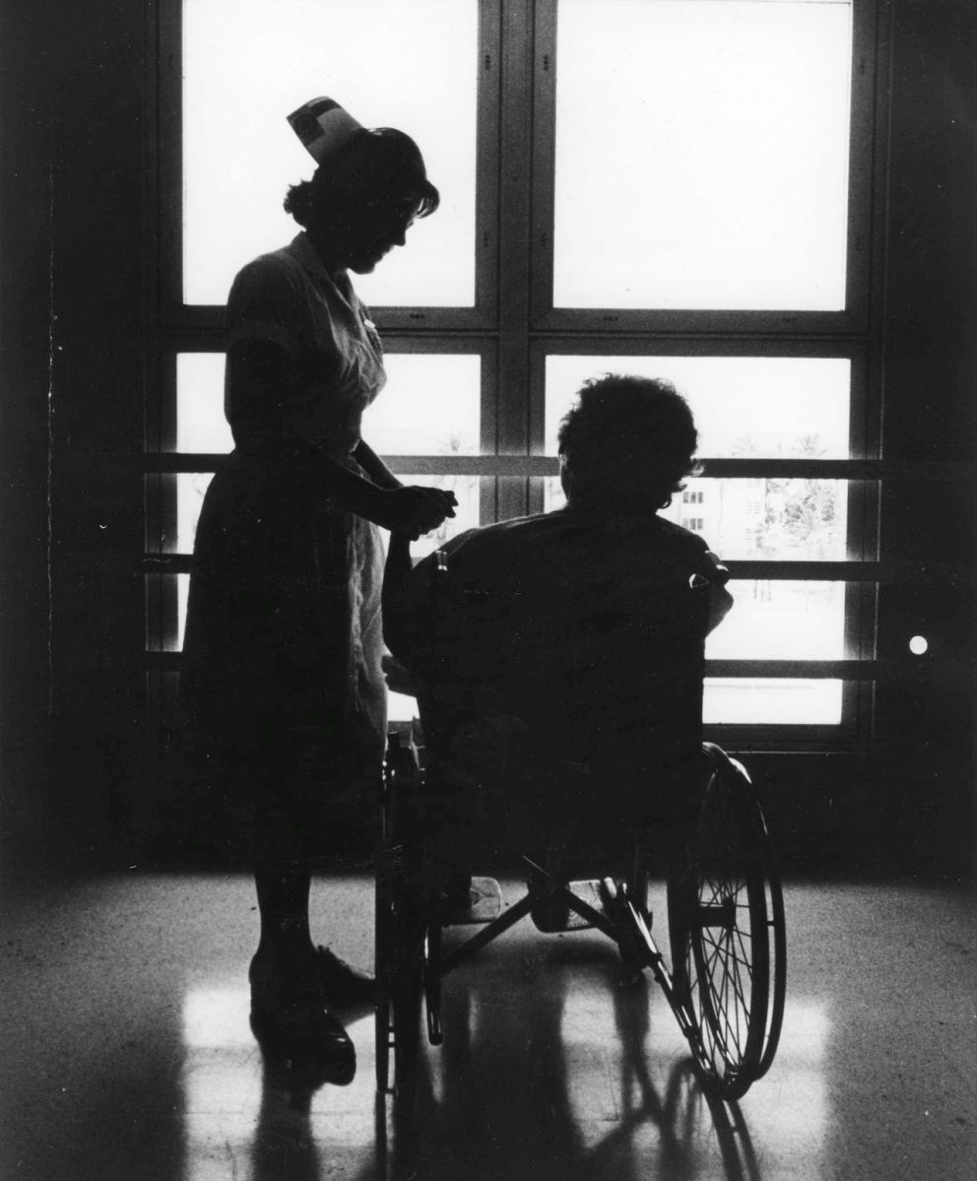
Existing Views
Little to no patient involvement
“what shall be done for and to him, but rarely, with him” Barbara G. Schutt
Authoritarian Attitude
Orlando’s Views
Art and Science of medicine practice
+
Nursing Responsibility
Patient needs must be met
Patient is involved in recovery and rehabilitation
Nurse-Patient relationship must exist
Notes:
Attitudes in healthcare during the 60s were considerably different than that of the present day. This was evident in the role of a patient in recovery and rehabilitation. Schutt (1963) states that any form of patient participation was discouraged by staff attitude and the physical setting of care delivery. The patient’s role was that of a “childlike creature, devoid of judgment, expected to submit himself without protest or understanding to medical and administrative manipulation” (Schutt, 1963, p. 51). Ida Orlando did not share such authoritarian views on patient roles. She believed that along with the “art and science” (Orlando, 1963, p.53) of practicing medicine, the nurse holds the responsibility to help a patient meet his needs. Needs, when fulfilled, “relieves or diminishes immediate distress or improves immediate sense of adequacy or well-being” (Orlando, 1963, p.53).
The differentiating factor, in Orlando’s view and later theory, is the role that patients play in meeting their needs. Orlando (1963) observed that patients receiving medical treatment are able to notify their complaints and symptoms to the doctor, follow prescribed care procedures and take medications, and research methods to preserve their health. The nurse, she states, should aide when the patient is in need of help. In order to achieve this the nurse must interact with the patient and “ascertain the patient’s immediate need and help the patient to meet the need directly or indirectly” (Orlando, 1963, p.53). In this regard a good nurse-patient relationship is crucial. This viewpoint is the foundation upon which Ida Orlando’s Nurse-Patient Relationship theory was formed.
Orlando, I. J. (1963). The meaning and purpose of nursing. The American Journal of Nursing, 66(8), 59.
Schutt, B. B. (1963). The Patient a Partner in His Care [Editorial]. The American Journal of Nursing, 66(8), 51.
[nurse and patient] . Retrieved June 27, 2012, from: http://specialcollections.fiu.edu/sfna/digital/school_nursing_collection/archive/nurse%20and%20patient%20%20warm%20hands.JPG

Slide 2

Development of Theory
Integration of Mental Health Concepts in a Basic Nursing Curriculum
Nursing action and Patient needs
The Dynamic Nurse - Patient Relationship 1962
The Discipline and Teaching of Nursing Process 1972
Notes:
Between 1951 and 1961 Ida Orlando was “an associate professor and director of the Graduate Program in Mental Health Psychiatric Nursing at Yale University” (Tyra, 2008). During this time she participated in a federal grant called the “Integration of Mental Health Concepts in a Basic Nursing Curriculum”. As the principle investigator for the National Institute of Mental Health, Orlando looked into the possibility of incorporating psychiatric health principles into nursing education. Orlando observed and analyzed 2000 nurse-patient interactions and labeled them as either good or bad nursing practices (Tyra, 2008). This allowed her to conclude that nursing action was based on fulfilling a patient’s needs.
In 1961 Orlando published The Dynamic Nurse-Patient Relationship outlining her findings. In 1962 Orlando was able to put her theory to practice at Mclean Hospital in Belmont, Massachusetts. As a clinical nursing consultant she aided the “hospital nursing staff, supervisors, and instructors in learning to use deliberative nursing process to understand patients and their needs for help” (Tyra, 2008). The nurses at Mclean participated in a research study conducted by Orlando to access her theory. The information that she gathered resulted in her publishing The Discipline and Teaching of Nursing Process in 1972 (Tyra, 2008). To this day Orlando’s nursing process is essential to the nursing profession.
Orlando, I.J. (1961). The dynamic nurse-patient relationship: Function, process and principles. New York: G. P. Putman.
Orlando, I.J. (1972). The discipline and teaching of nursing process: An evaluative Study. New York: G. P. Putman.
Tyra, P. A. (2008). Ida Jean Orlando Pelletier. Journal of The American Psychiatric Nurses Association, 231(2).
[supporting hands] . Retrieved June 27, 2012, from: http://www.pnhfoundation.org/yahoo_site_admin/assets/images/support_hands.22785415_std.jpg

Slide 3
References
Orlando, I.J. (1961). The dynamic nurse-patient relationship: Function, process and principles. New York: G. P. Putman.
Orlando, I. J. (1963). The meaning and purpose of nursing. The American Journal of Nursing, 66(8), 59.
Orlando, I.J. (1972). The discipline and teaching of nursing process: An evaluative Study. New York: G. P. Putman.
Schutt, B. B. (1963). The Patient a Partner in His Care [Editorial]. The American Journal of Nursing, 66(8), 5.
Tyra, P. A. (2008). Ida Jean Orlando Pelletier. Journal of The American Psychiatric Nurses Association, 231(2).
[nurse and patient] . Retrieved June 27, 2012, from: http://specialcollections.fiu.edu/sfna/digital/school_nursing_collection/archive/nurse%20and%20patient%20%20warm%20hands.JPG
[supporting hands] . Retrieved June 27, 2012, from: http://www.pnhfoundation.org/yahoo_site_admin/assets/images/support_hands.22785415_std.jpg

