Slide 1

Abstinence
Presented by Caprice Hudson, Lynette Hosier, and Tearra Mcdade
Lakeview College of Nursing

Slide 2
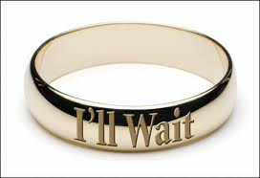
What is it?
Abstinence consist of not engaging in sexual intercourse or sex play beyond hugging or kissing.
Notes:
Typically this means waiting to have sex until marriage.

Slide 3
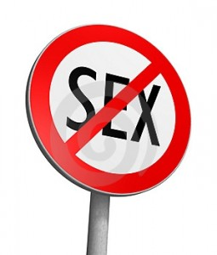
What is Sex?
People differ in their opinion of what “sex” is.
Common misinterpretations of Sex
  If there is no vaginal penetration is it still considered sex?
  Do the risks vary depending on whether it is vaginal , oral , or anal sex?
Notes:
If it is not a penis going into a vagina

Slide 4
Consequences of Sex
Sex increases your risk of STDs
Sex can lead to pregnancy.
  Everyone thinks it won’t happen to them
  Fifty percent of pregnancies are unplanned
Notes:
Prom? Think again.
Graduate high school? Probably not. Most teen mothers never graduate high school.
College? Not likely.
Who is going to take care of the baby?
Do you have a car to get to and from work? If you don’t have a job, who is going to pay for the baby’s diapers, food, clothes?

Slide 5
Boundaries
Avoid being alone with the opposite sex
Talk to your partner
Avoid high pressure situations
Say “No” Like you mean it
Learn about your body

Slide 6
Myths vs. Facts
Sexual assault is an impulsive act
Perpetrators of rape are usually psychopaths who do not know their victims
Persons who dress or act in a “sexy” way are asking to be sexually assaulted
All women secretly want to be rape
In most cases, black men rape white women

Slide 7
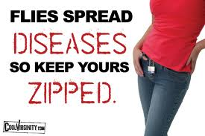
Psychological effects
Sex can have long term psychological effects if done when either partner is not ready.
Sex can lead to diseases.
  Curable: Gonorrhea, Chlamydia, Syphillis
  Treatable: Genital warts, HPV,
  Non-treatable: HIV/AIDS, Herpes,

Slide 8
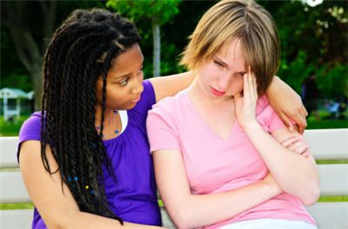
Emotional Effects
Guilt is a lingering doubt of thinking that some act was wrong.
It demoralizes your character, self-esteem and dignity.
Sex is a selfish act done for personal satisfaction or gain
Notes:
Common Quotes used
“He said he loved me”
“ If you love me, then you will have sex with me”

Slide 9
Reasons to abstain from sex
Religious reasons:
  In the bible it says”Flee sexual immorality. Every sin that a man does is outside the body; but he who commits sexual immorality sins against his own body" (I Corinthians 6:18).
Notes:
Sex before marriage is a sin against the body, takes away from God’s plan for our happiness and most importantly separates us from God as a whole.

Slide 10

Benefits Long term of being Abstinent
Waiting to have sex allows you to choose the right partner
Avoid STDs/HIV
Pursue other interests (academics, sports etc.)
Avoid unwanted pregnancy
Save money
Notes:
Better relationships with significant other built on trust, real love
Being abstinent cost nothing versus Birth control being expensive.
Allows you to be less prone to cervical cancer or being infertile

Slide 11
Conclusion
ABSTINENCE has a 100% success rate; that will save you from regrets, emotional and psychological problems, unplanned pregnancies and a life free of STD’s.
Notes:
Avoid regrets, pregnancy, sexually transmitted diseases that you could possibly live with for the rest of your life:
ABSTINENCE
So the only way to ensure that you do not engage in an activity you will later
It is never to late to start a life of abstinence regardless of your sexual history

