Slide 1

Abstinence
Presented by Caprice Hudson, Lynette Hosier, and Tearra Mcdade
Lakeview College of Nursing

Slide 2
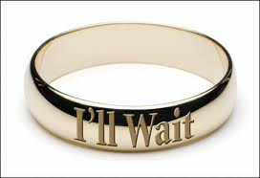
What is it?
Refraining from engaging in sexual intercourse.
Typically this means waiting to have sex until marriage.
Teen abstinence consist in not engaging in sexual intercourse or sex play beyond hugging or kissing.

Slide 3

What is Sex?
People differ in their opinion of what “sex” is.
Common misinterpretations of Sex
If it is not a penis going into a vagina is it still considered sex?
Do the risks vary depending on whether it is vaginal , oral , or anal sex?

Slide 4
Consequences of Sexual Intercourse
Sex leads to babies.
Everyone thinks it won’t happen to them.
Fifty percent of pregnancies are unplanned
Just because Teen Mom makes it look fun or cool, it’s really not.
Prom? Think again.
Graduate high school? Probably not. Most teen mothers never graduate high school.
College? Not likely.
Who is going to take care of the baby?
Do you have a car to get to and from work? If you don’t have a job, who is going to pay for the baby’s diapers, food, clothes?

Slide 5
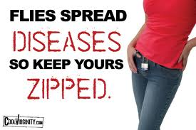
Psychological effects
Sex can have long term psychological effects if done when either partner is not ready.
Sex can lead to diseases.
Curable: Gonorrhea, Chlamydia, Syphillis
Treatable: Genital warts, HPV,
Non-treatable: HIV/AIDS, Herpes,

Slide 6

Emotional Effects
Guilt is a lingering doubt of thinking that some act was wrong.
It demoralizes your character, self-esteem and dignity.
Sex is a selfish act done for personal satisfaction or gain
Common Quotes used
“He said he love me”
“ If you love me, then you will have sex with me”

Slide 7
Reasons to abstain from sex
Religious reasons:
In the bible it says”Flee sexual immorality. Every sin that a man does is outside the body; but he who commits sexual immorality sins against his own body" (I Corinthians 6:18).
Sex before marriage is a sin against the body, takes away from God’s plan for our happiness and most importantly separates us from God as a whole.

Slide 8

Benefits Long term of being Abstinent
Waiting to have sex allows you to choose the right one
Avoid having STDs/HIV
Pursue other interests academically and sports
Avoid unwanted preganancy
Better relationships with significant other built on trust, real love
Allows you to be less prone to cervical cancer or being infertile
Being abstinent cost nothing versus Birth control being expensive.

Slide 9
Conclusion
So the only way to ensure that you do not engage in an activity you will later regret, have a baby you are not ready to raise, or get any sexually transmitted diseases that you could possibly live with for the rest of your life:
ABSTINENCE

