Slide 1
Abruptio Placentae
Nursing of the Childbearing Family N305
Lynette Hosier
Michael Hoke
Lakeview College of Nursing

Slide 2
Introduction
“Abruptio Placentae is a life threatening condition that occurs in 1% of pregnancies.” (Kornusky & Pravikoff, 2012, p. 1)
Increases the risk of depleting clotting factors and developing disseminated intravascular coagulopathy (DIC).
Concealed hemorrhage occurs in 10% of abruptions.
(Kornusky & Pravikoff, 2012, p. 1)

Slide 3
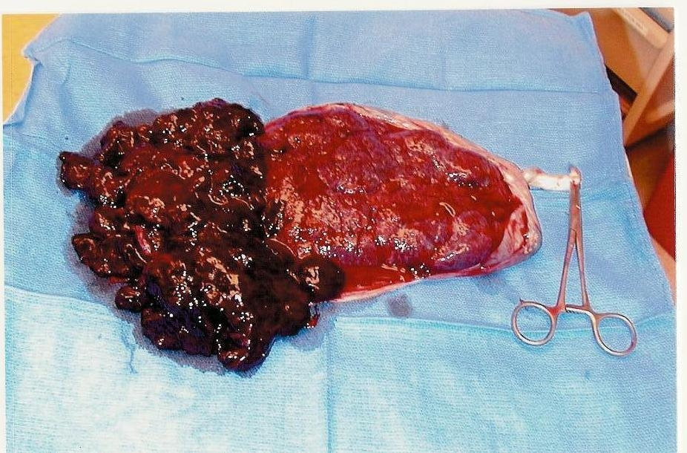
Definition
“Premature separation of an implanted placenta from the uterine wall prior to delivery of the fetus.”
http://www.gfmer.com
(Chapman & Durham, 2010, p. 119)
Notes:
Usually occurs after 20 weeks.

Slide 4
Etiology of Diagnosis
Typically occurs during second and third trimesters
Requires immediate medical attention due to possible maternal or fetal death
Causal factors are mainly unknown
Occult bleeding is present in 10% of cases.
There are two types of abruption
  Central
  Behind the placenta.
(Buckley & Schub, 2011)

Slide 5
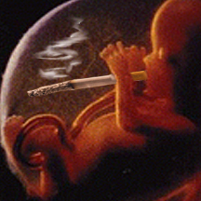
Risk Factors
Maternal abdominal trauma
Maternal hypertension
Age
Short umbilical cord
Smoking and illicit drug usage
Alcohol
Multiparity
Multiple fetus pregnancy
http://amodernmilitarymother.com
(Buckley & Schub, 2011)
Notes:
Hypertension is associated with half of cases
History of cesarean section and abruptio placentae regardless of severity
Older maternal age

Slide 6
Risk Factors Cont.
Retro placental bleeding from needle puncture
Thrombophilia
Retroplacental fibromyoma
Uterine malformation
Ethnicity
Diabetes Mellitus
Low socioeconomic status
History
  C-Section
  Previous abruption
(Buckley & Schub, 2011)
Notes:
Women who have previously encountered abruption have 4-12% chance of recurrence. Women who have had PA twice have a 25% of recurrence.

Slide 7
Symptoms
Severe acute abdominal cramping
Elevated heart rate
Hypotension
Uterine tenderness
Rigid uterus
Back pain
Uterine contractions
Central: Fetus will show late decelerations. There may be no bleeding.
Behind the placenta: Couvelaire uterus that does not contract after delivery.
(Chapman & Durham, 2010, p. 119

Slide 8

Medical Treatment
It is not possible to stop placental separation or reattach the placenta once it has separated.
Immediately after admission, patients are put on an NPO order until the need for cesarean section is ruled out.
Management is based upon:
  amount of bleeding present
  gestational age and; and
  response of both mother and fetus to treatment.
www.metzgerwickershamblog.com
(Chapman & Durham, 2010, p. 120

Slide 9

Medical Treatment Cont.
Administration of IV fluids and blood products as necessary
Blood tests ordered:
  CBC
  Prothrombin time
  Blood type and cross match
  Kleihauer-Betke test to assess for presence of fetal blood in maternal circulation.
If it is determined that mother is to deliver, administration of RHoD immune globulin is needed if mother is Rh negative.
http://mrbellzon.blogspot.com
(Buckley & Schub, 2011)

Slide 10
Maternal Consequences
  Anemia
  Disseminated intravascular coagulation (DIC) which may be reason for mother to have hysterectomy to resolve hemorrhage
  Amniotic fluid embolism
  Hemorrhagic shock
  Respiratory distress
  Renal failure
  Myocardial infarction
  Stroke
  Death
(Tikkanen, 2010)

Slide 11
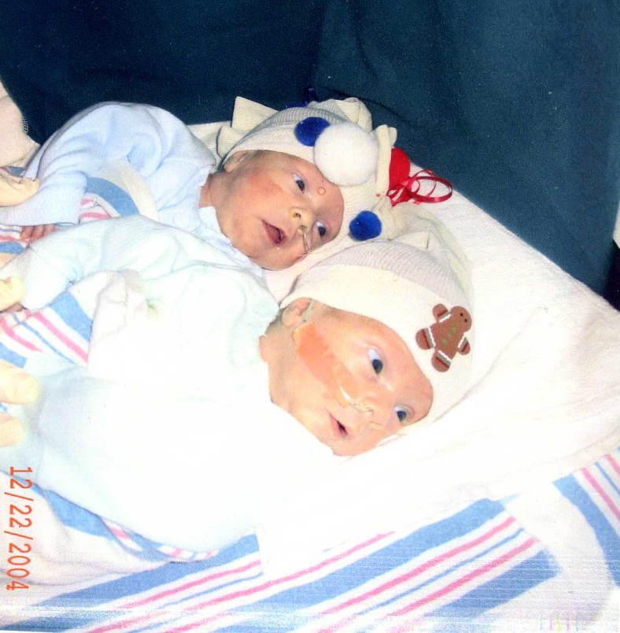
Fetal Consequences
  Low birth weight
  Neurologic impairment
  Death related to hemorrhage (15% death rate)
  Preterm birth
  Hypoxia or anoxia
  Intrauterine growth restriction
www.delmarvablood.org
(Buckley & Schub, 2011)
Notes:
When Alex K. and his twin brother William of Middletown were born 3 months early, they each weighed less than 3 pounds. Alex suffered an abruption, which means the placenta began to separate from the wall of his mother's uterus before he was born. After birth, Alex was rushed to intensive care at Christiana Hospital and needed blood transfusions to survive.

Slide 12

Nursing Diagnoses
Deficient Fluid Volume
Risk for Injury: Maternal and Fetal
Risk for Impaired Gas Exchange
Deficient Knowledge
http://your-nursing-guide.com
(Hogan, 2013, p.144)

Slide 13

Interventions
Monitor maternal blood pressure, pulse and respirations for shock.
Monitor the fetus continuously for signs of distress (increased fetal movement, decreased FHR variability, changes in baseline FHR, or late decelerations).
Start and maintain IV fluids.
Monitor intake and output.
Provide oxygen as needed
Monitor labs (CBC for clotting factors)
www.nurseatcall.com
(Hogan, 2013, p.145)

Slide 14

Conclusion
If a mother experiences sudden severe abdominal cramping she should seek medical attention immediately regardless of whether bleeding is present or not.
In pregnancy, signs of shock will not appear until 25-30% of maternal blood loss has occurred. By this time, it may be too late to save the baby.
http://www.natural-homeremedies.com
(Kornusky & Pravikoff, 2011)

Slide 15
References
Buckley, L. L., & Schub, T. (2011, October 28). Placental Abruption. Cinahl. Retrieved from http://web.ebscohost.com.ezproxy.lakeviewcol.edu:2048/ehost/pdfviewer/pdfviewer?sid=4b6ef90c-a5e9-49f5-8f69-763a4aa1d61b%40sessionmgr12&vid=8&hid=17
Chapman, L., & Durham, R. (2010). High-risk antepartum nursing care. In S. Kuhn’s Maternal-Newborn Nursing: The Critical Componenets of Nursing Care. Danvers, MA: Davis Company, pp. 119-121.
Hogan, M. (2013). The complicated prenatal experience. In J. Farthing’s Maternal-Newborn Nursing Pearson Reviews and Rationals (3rd). Saddle River, NJ: Pearson Education Inc. pp. 144-146.
Kornusky, J, & Pravikoff, D. (2011). Abruptio Placentae: providing patient care. Nursing Reference Center. Retrieved from Ebscohost
Tikkanen, M. (2010, October 10). Placental abruption: epidemiology, risk factors, and consequences. Nordic Federation of Societies of Obstetrics and Gynecology, 90, 140-149. doi:10.1111/j.1600-0412.2010.01030.x

