Slide 1
Abruptio Placentae
Sydney Bailey
Jessica Gragert

Slide 2
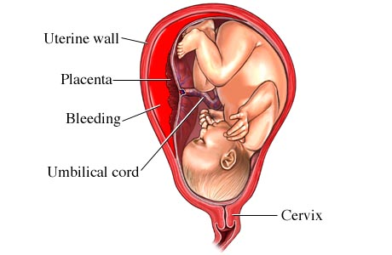
Introduction
Pregnancy is a fragile time when a woman’s body goes through extensive changes in order to create a viable new life. Sometimes the miracle of life takes place with little to no maternal or fetal problems. Unfortunately, this isn’t always the case.
http://www.ncbi.nlm.nih.gov/pubmedhealth/PMH0001903/

Slide 3
Definition
Abruptio placentae, also known as placental abruption, is the separation of the placenta from the uterine wall before the baby is delivered. This can result in compromised blood flow to the fetus.
Classified according to amount of separation and maternal blood loss.
  -Mild (Grade 1): Blood loss less than 500mL, marginal separation
  -Moderate (Grade 2): 1000-1500mL blood loss, moderate separation, mild shock
  -Severe (Grade 3): Absent to moderate bleeding, more than 1500mL, separation of 50% or more, profound shock
  Separation can be partial or complete
  Bleeding can be concealed or apparent

Slide 4
Etiology
Exact causes of placental abruption are usually unknown, except when the abruption can be linked directly to traumatic events such as:
-Falls
-Automobile accidents
Or instances of sudden significant loss of uterine volume such as:
-Rupture of membrane with loss of amniotic fluid
-Between delivery of twins

Slide 5
Etiology Cont’d
Blood clotting disorders
Cigarette smoking
Cocaine use
Diabetes
Consuming more than 14 alcoholic drinks per week during pregnancy
High blood pressure during pregnancy
History of placental abruption
Increased uterine distention (such as with multiple pregnancies or very large volume of amniotic fluid)
Large number of past deliveries
Advanced maternal age
Premature rupture of membranes (before 37 weeks of pregnancy)
Uterine Fibroids

Slide 6
Medical Treatment
Assess, control, and restore amount of blood loss
In preterm cases of mild abruption, the ideal treatment is to observe the mother for signs of shock and correct fluid volume deficits.
Strict bed rest
Oxygen therapy
Pregnancies approaching full term may find the mom receiving steroids to speed the development of the baby’s lungs on account of the imminent nature of delivery.
The only full treatment for abruptio placentae is delivery of the baby.
Vaginal births can be attempted in mild cases of abruption in full term pregnancies. However, C-Section is most likely.

Slide 7
Maternal Consequences
Hypovolemic Shock
Blood Transfusion
Emergency Hysterectomy
Disseminated Intravascular Coagulation
Acute Renal Failure
Death (6%)
Anxiety & Distress

Slide 8
Fetal Consequences
Preterm Birth
Growth Restriction
Anemia
Hyperbilirubinemia
Malformations: Central Nervous System & Heart
Low Birth Weight
Distress
Cerebral Palsy
Death (20-40%)
Sudden Infant Death Syndrome

Slide 9
Nursing Diagnoses
Primary: Risk for Deficient Fluid Volume
Secondary: Impaired Fetal Gas Exchange

Slide 10
Nursing Interventions
Place woman in a left lateral position
Administer oxygen therapy via nasal cannula
Assess fundal height
Continuous electronic fetal monitoring
Calm, reassuring demeanor

Slide 11
Conclusion
As you can see, Abruptio Placentae is a medical emergency! It is important for nurses to recognize the signs, symptoms, and risks associated with placental abruption to provide the best outcome for mom and baby.

Slide 12
References
Green, C. (2011). Maternal newborn nursing care plans (2nd ed.). Burlington, MA: Jones & Bartlett.
Mayo Clinic. (2012). Placental abruption. Retrieved from http://www.mayoclinic.com/health/placental- abruption/DS00623
National Institute of Health. (2010). Placenta abruptio. In A.D.A.M. medical encyclopedia. Retrieved from http:// www.ncbi.nlm.nih.gov/pubmedhealth/PMH0001903/
Ricci, S. S., & Kyle, T. (2009). Maternity and pediatric nursing (1st ed.). Philadelphia, PA: Lippincott Williams & Wilkins.
Tikkanen, M. (2011). Placental abruption: epidemiology, risk factors and consequences. Nordic Federation of Societies of Obstetrics and Gynecology, 90, 140-149. doi:10.1111/j.1600-0412.2010.01030.x

