Slide 1
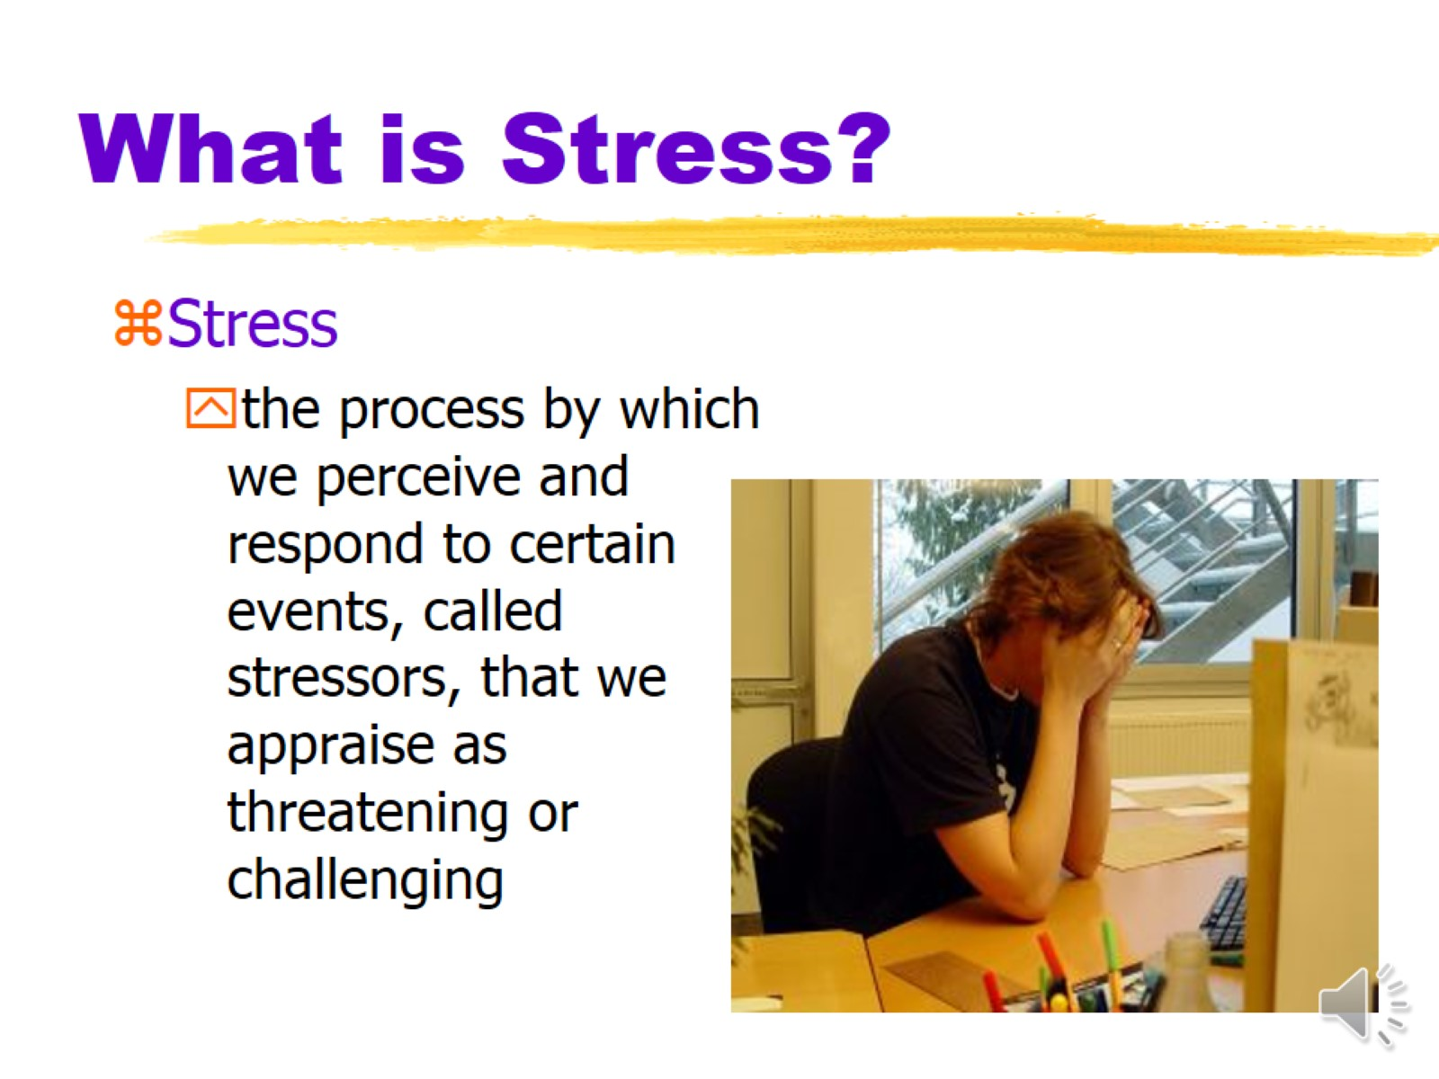

What is Stress?

Slide 2
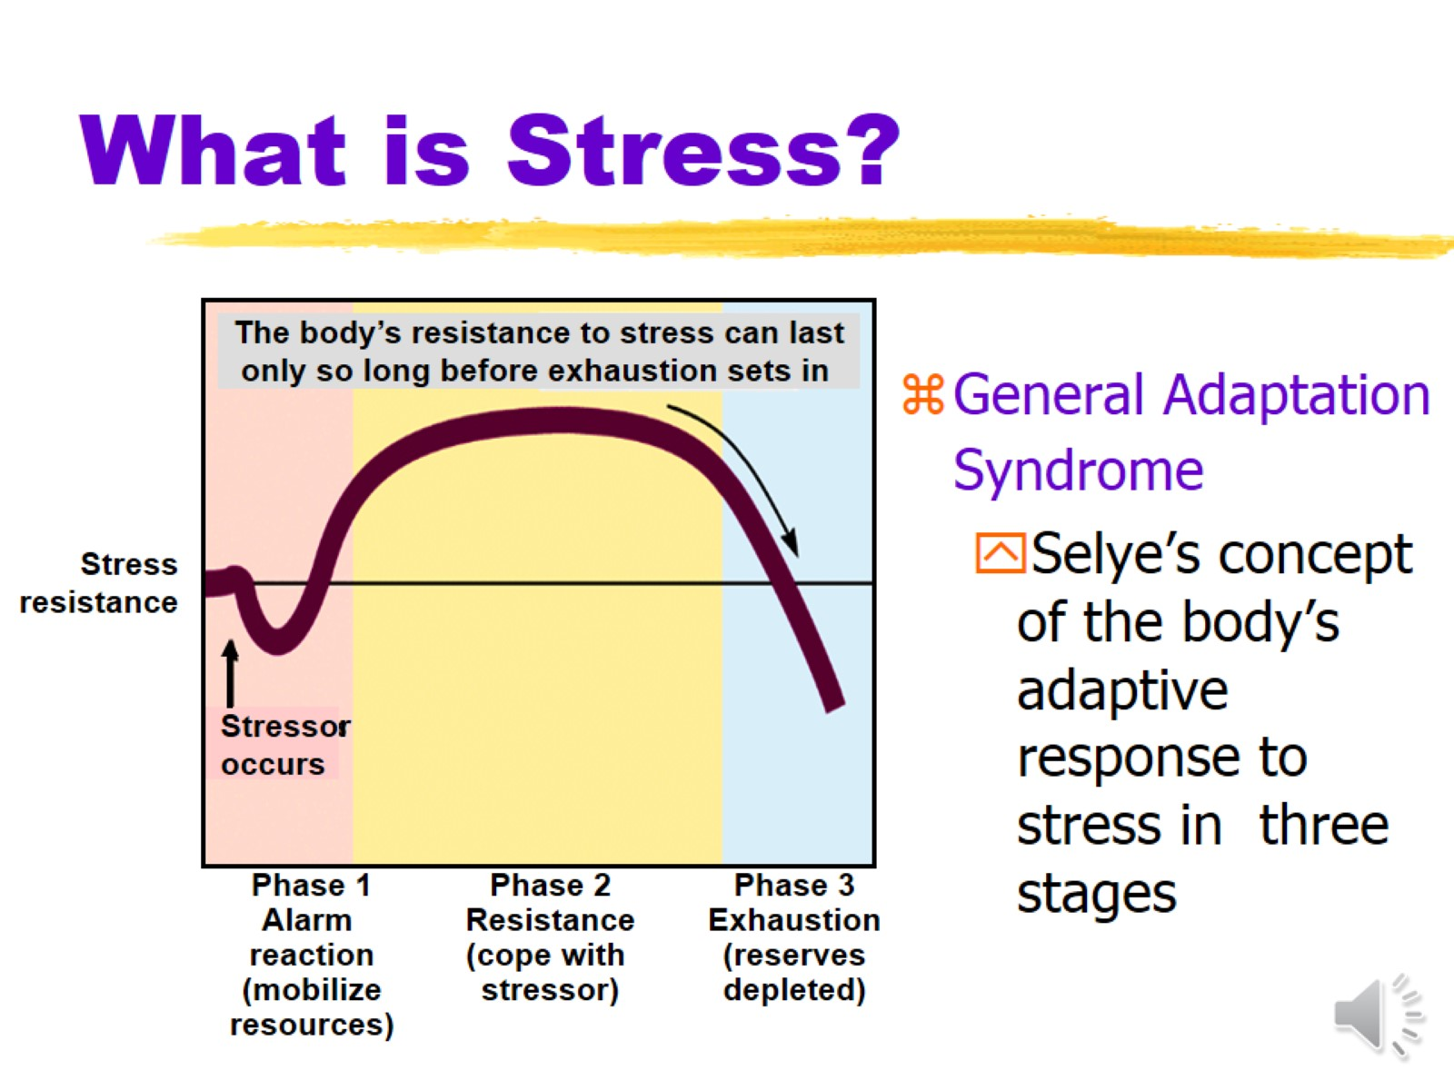
What is Stress?

Slide 3
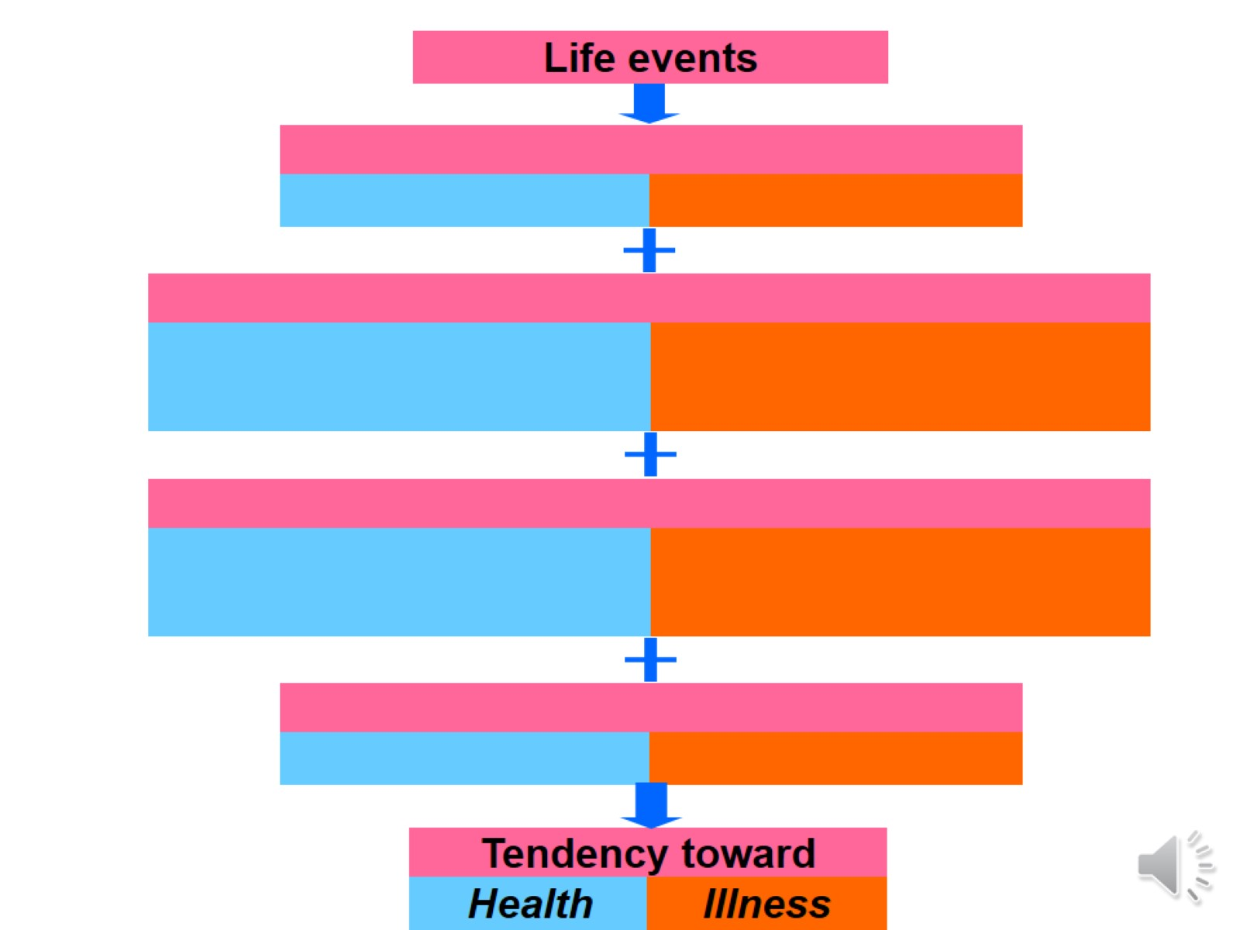
Life Events Effect on Health/Illness Part 1

Slide 4
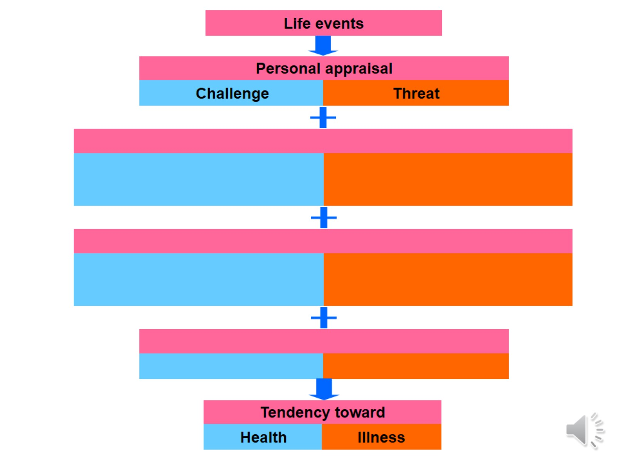
Life Events Effect on Health/Illness Part 2

Slide 5
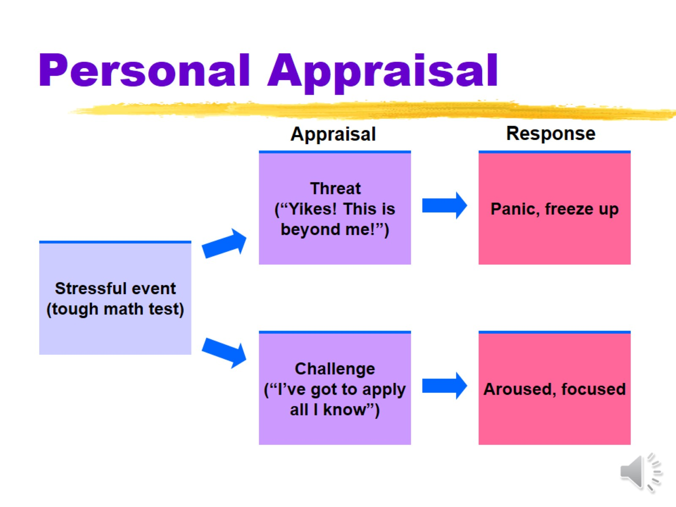
Personal Appraisal

Slide 6
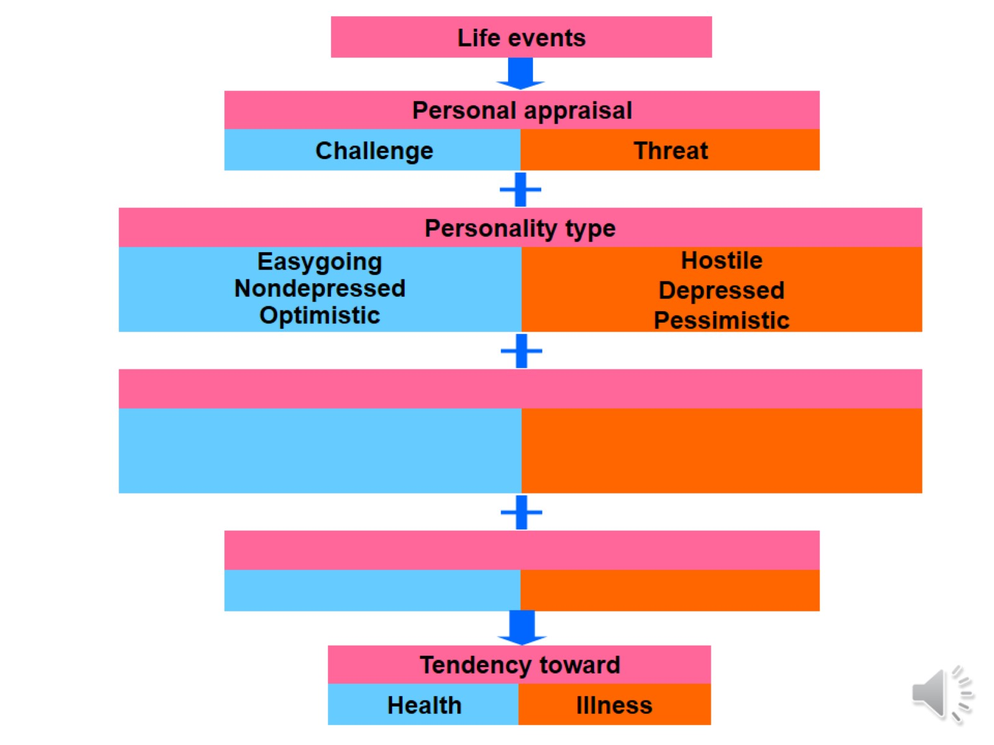
Life Events Effect on Health/Illness Part 3

Slide 7
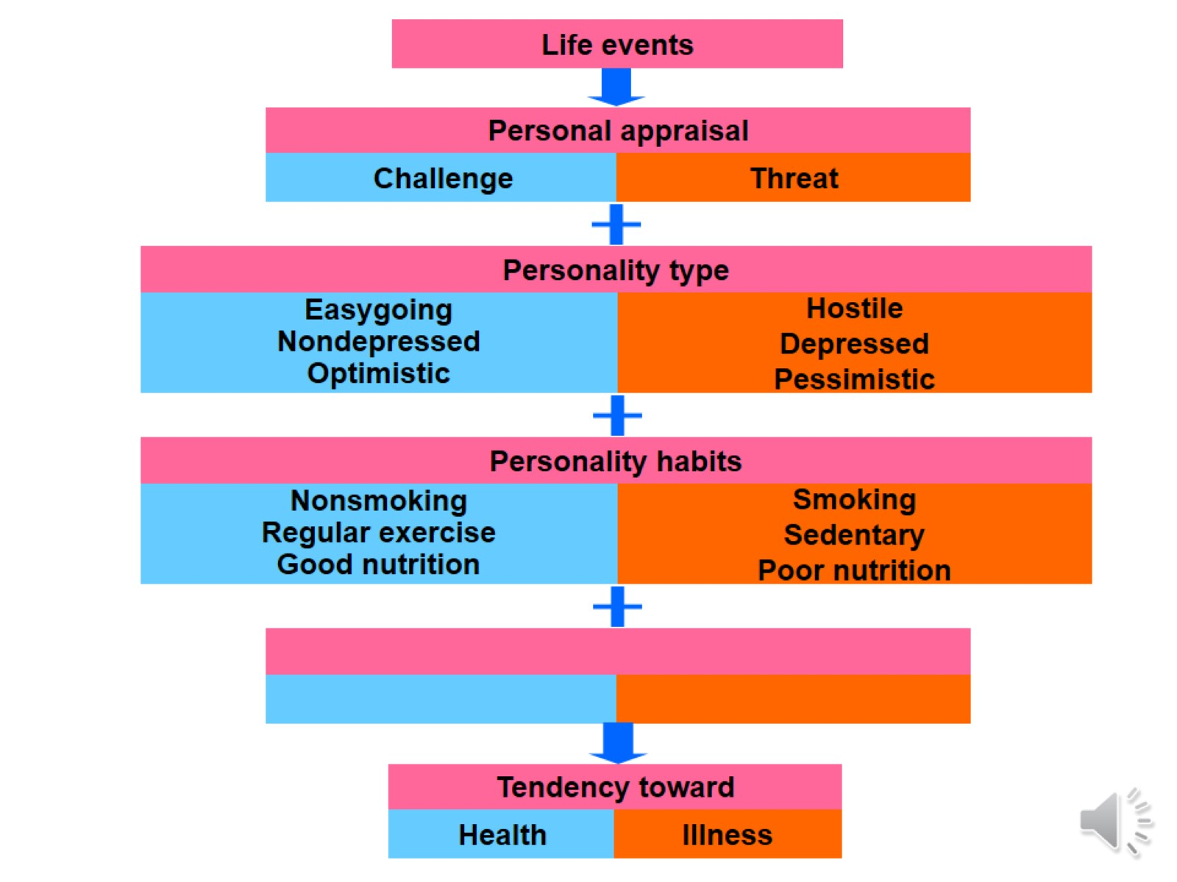
Life Events Effect on Health/Illness Part 4

Slide 8
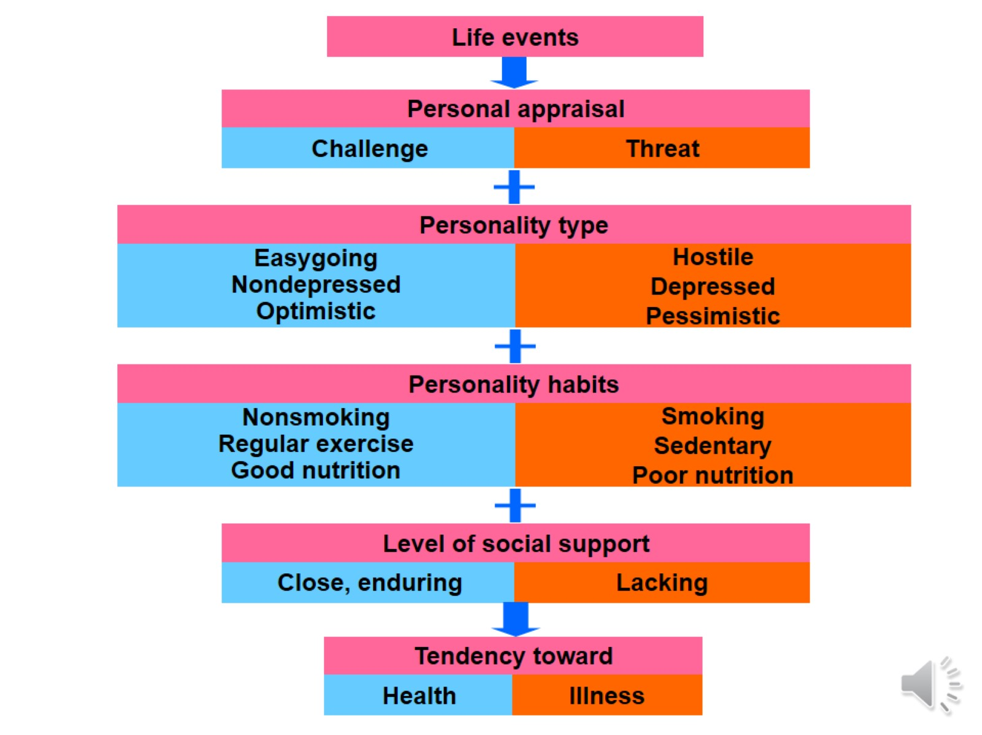
Life Events Effect on Health/Illness Part 5

Slide 9
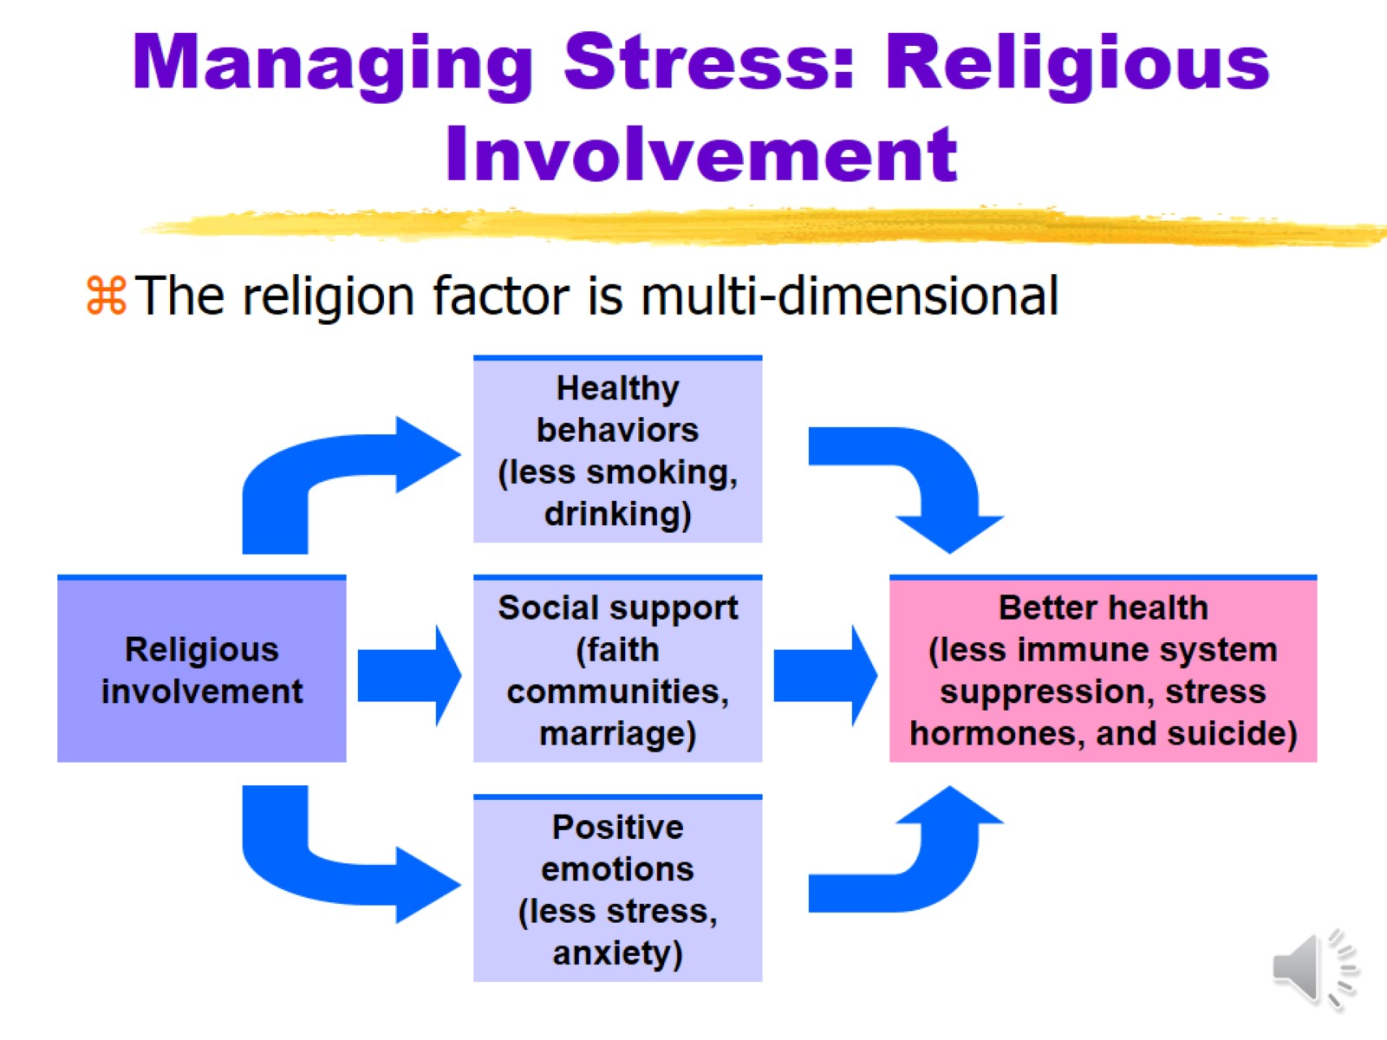
Managing Stress: Religious Involvement

