Slide 1

Social Psychology

Slide 2
Social Psychology
“the scientific study of how we think about, influence, and relate to one another”

Slide 3
Social Relations- Attractiveness
Proximity
mere exposure effect-repeated exposure to novel stimuli increases liking of them (or conversely, decreases liking)
Similarity
friends share common attitudes, beliefs, interests

Slide 4
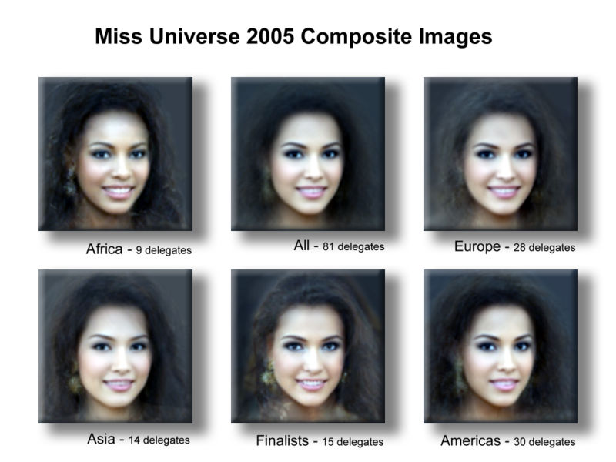
Social Relations- Attractiveness
Physical Attractiveness
youthfulness may be associated with health and fertility

Slide 5
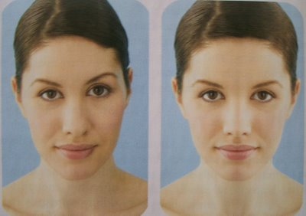
Facial Symmetry

Slide 6
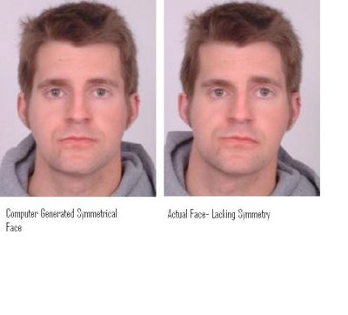
Facial Symmetry

Slide 7
Social Relations- Attractiveness
Equity
a condition in which people receive from a relationship in proportion to what they give to it
Self-disclosure
revealing intimate aspects of oneself to others
Liking
We tend to be attracted to those who communicate liking for us

Slide 8
Social Relations- Attractiveness
Genuineness/Realness
Anderson (555 characteristics)
Top 5: sincere, understanding, honest, loyal, faithful
Bottom 5: liar, phony, cruel, cheater, unfaithful
Altruism
unselfish regard for the welfare of others

Slide 9
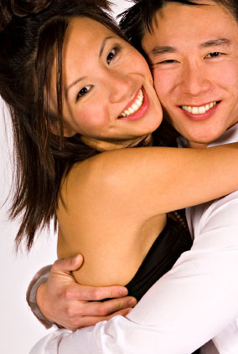
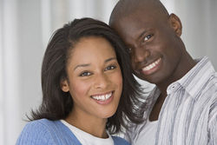
Social Relations- Passionate Love
Passionate Love
an aroused state of intense positive absorption in another
usually present at the beginning of a love relationship (lasts 6 weeks to 30 months)

Slide 10
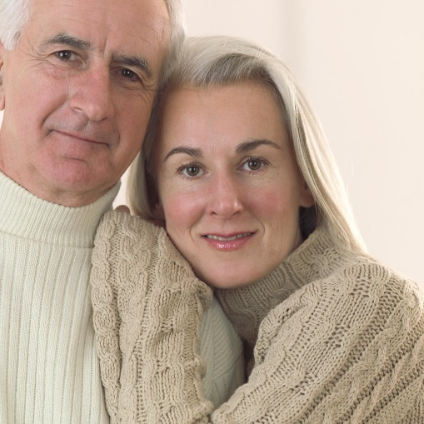
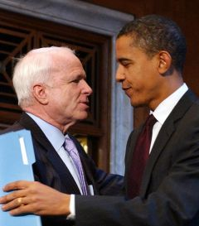
Social Relations
Companionate Love
deep affectionate attachment we feel for those with whom our lives are intertwined
Less intense than passionate love, but more secure
More “realistic”; less idealistic

Slide 11
Why do Marriages Last?
Top 7 reasons for Both Men and Women
1. My spouse is my best friend
2. I like my spouse as a person
3. Marriage is a long-term commitment

Slide 12
Why do Marriages Last?
4. Marriage is sacred
5. We agree on aims and goals
6. My spouse has grown more interesting
7. I want the relationship to succeed

