Slide 1



The Psychology of Motivation

Slide 2
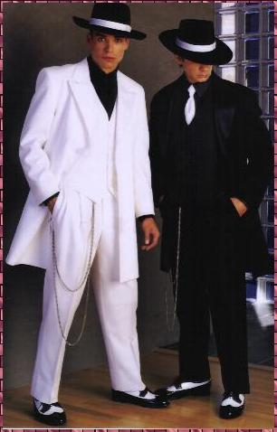

Motivation
Why do we do WHAT we do (instead of nothing or something else)?
Why did you come to class today?
Why did you chose to wear the clothes you wore today?

Slide 3
Motivation
Motivation
“a need or desire that energizes and directs behavior”
Motivation
From the Latin word “motere” which literally means ”to move”

Slide 4
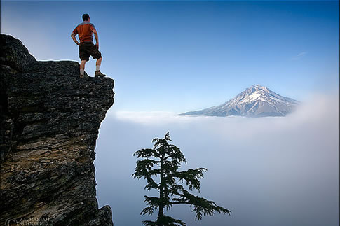
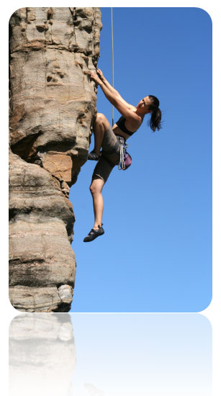
Motivational Sequence
# 1. STIMULUS → …
An internal or external cue
# 2. MOTIVE → …
An need or desire that energizes behavior
# 3. BEHAVIOR → …

Slide 5

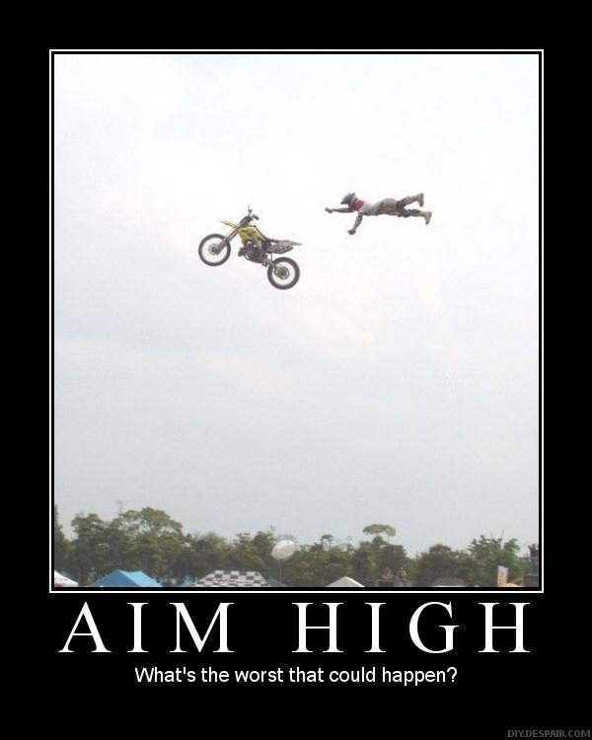
Motivational Sequence
# 4. GOAL ATTAINMENT → …
Motive satisfied
# 5. REST → …
Usually temporary decrease in need or desire

Slide 6

Motivational Sequence
STIMULUS → … MOTIVE → … BEHAVIOR → … GOAL ATTAINMENT → … REST. . . → STIMULUS → … MOTIVE → … BEHAVIOR → … GOAL ATTAINMENT → … REST … (and so on . . . )

Slide 7
Motivation--Drive Theory
1. Drive-Reduction Theory
the idea that a physiological need creates an aroused tension state (a drive) that motivates an organism to satisfy the need
Need
(e.g., for
food, water)
Drive-reducing
behaviors
(eating, drinking)
Drive
(hunger, thirst)

Slide 8

Motivation
Homeostasis
tendency to maintain a balanced or constant internal state
regulation of any aspect of body chemistry around a particular level

Slide 9
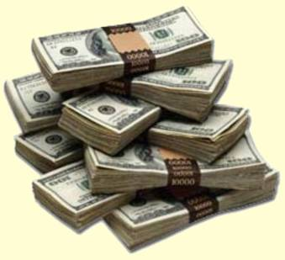


Motivation
Incentive
a positive or negative environmental stimulus that motivates behavior (reward)

Slide 10
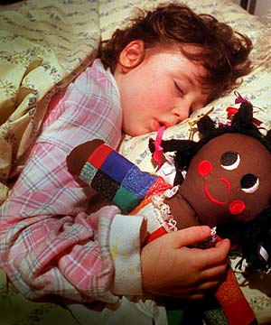
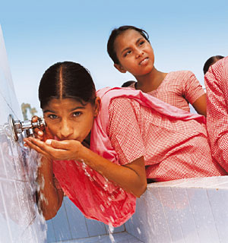
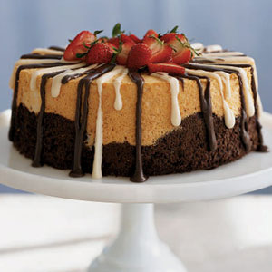
PRIMARY DRIVES
Anything that allows an individual (or species) to maintain survival)
Hunger
Thirst
Sleep
Oxygen
Shelter
Sex

Slide 11

Food and Learning
Hunger (Glucagen and Insulin) is NOT the only motivation for eating
CULTURE
PREFERENCE
LEARNING
AVAILABILITY
TIME
SEASON
TEMPERATURE

Slide 12

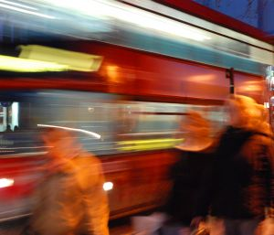
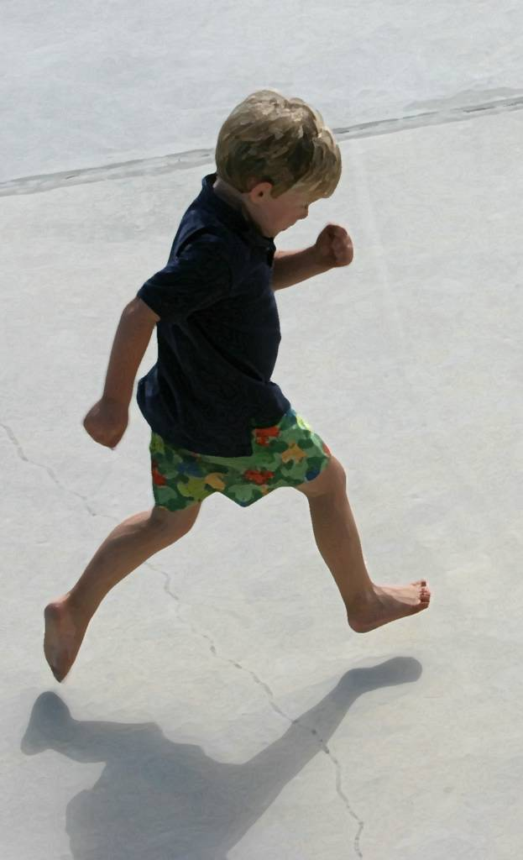

STIMULUS DRIVES
ACTIVITY
Movement and busyness
Dynamic vs. static

Slide 13
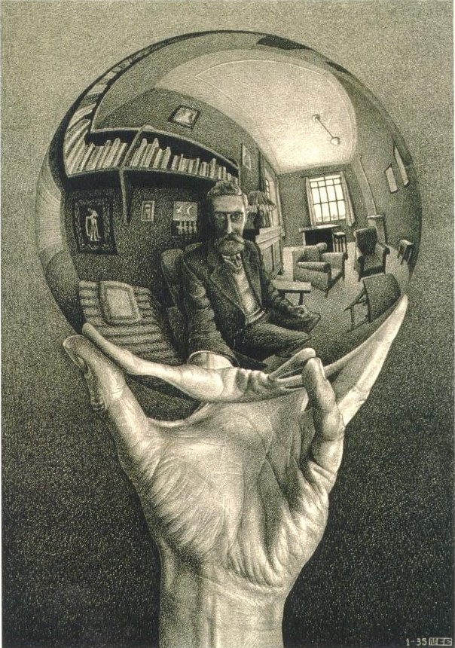
STIMULUS DRIVES
EXPLORATION AND CURIOSITY
Drive toward the new and unknown

Slide 14


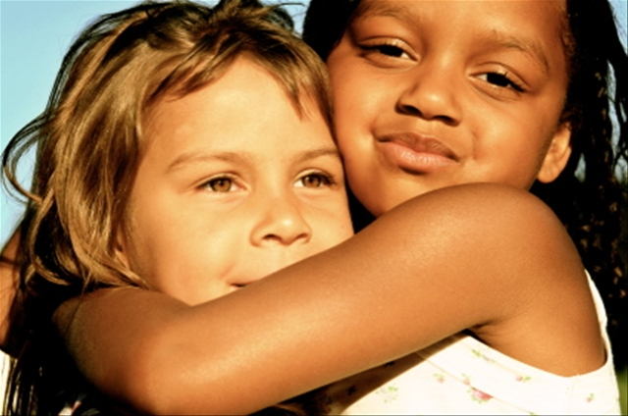
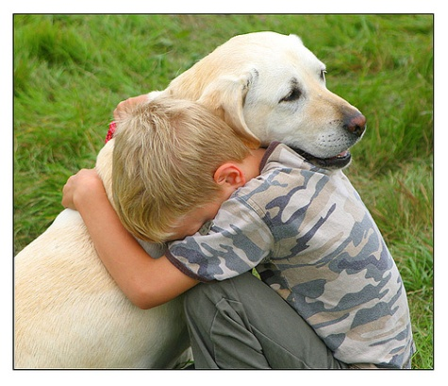
STIMULUS DRIVES
MANIPULATION
Drive to touch, handle, feel
CONTACT
Drive toward physical contact

Slide 15
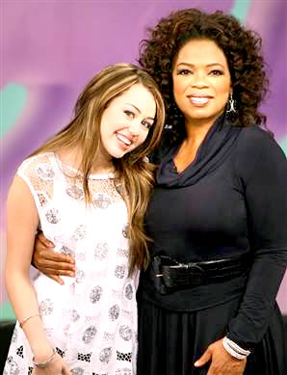
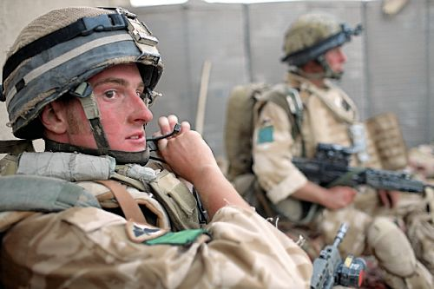
SOCIAL DRIVES
POWER
Drive to influence and control others

Slide 16
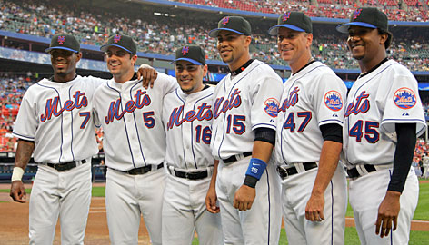
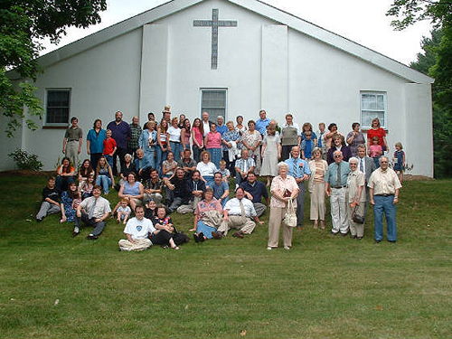

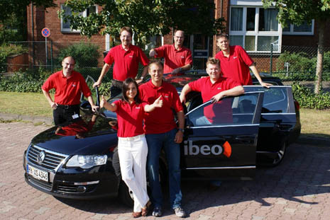
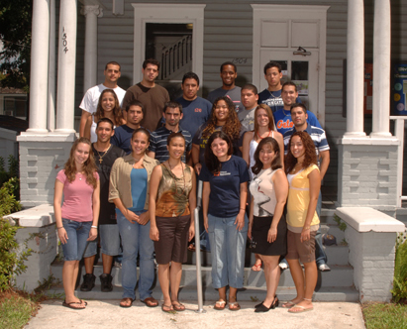
SOCIAL DRIVES
AFFILIATION
Drive to belong and be a part of a larger group

Slide 17
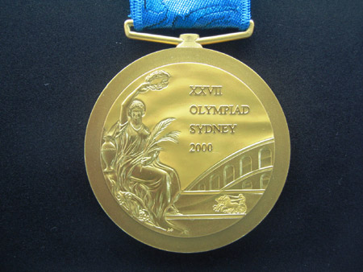
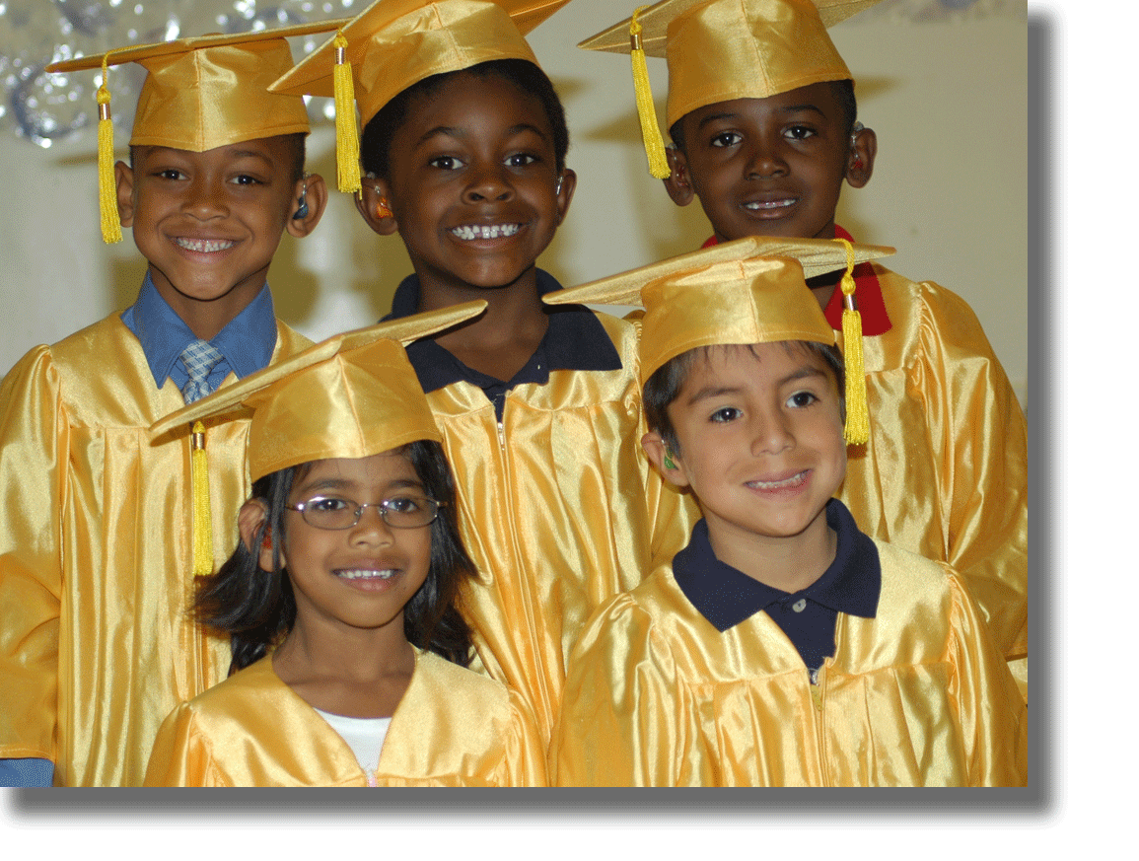
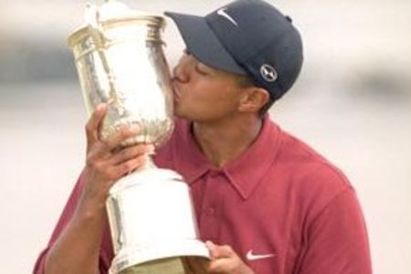
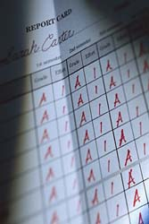
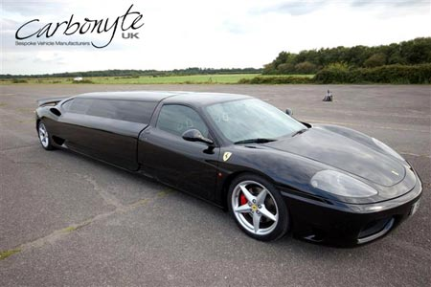
SOCIAL DRIVES
ACHIEVEMENT
a desire for significant accomplishment
for mastery of things, people, or ideas
for attaining a high standard

