Slide 1


Psychology
Chapter 4 STATE OF CONSCIOUSNESS
PowerPoint Image Slideshow

Slide 2

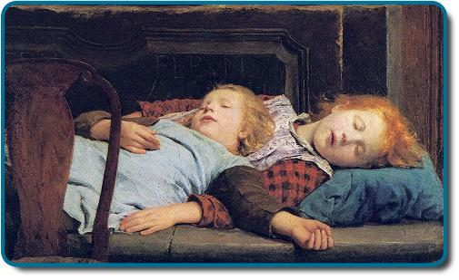
What is consciousness?
Consciousness – awareness of internal and external stimuli such as feelings of hunger and pain or detection of light.
Wakefulness – high levels of sensory awareness, thought, and behavior.
Sleep, which we all experience, is a quiet and mysterious pause in our daily lives.
Figure 4.1 Two sleeping children are depicted in this 1895 oil painting titled Zwei schlafende Mädchen auf der Ofenbank, which translates as “two sleeping girls on the stove,” by Swiss painter Albert Anker.)

Slide 3
BIOLOGICAL RHYTHMS
A biological rhythm is an internal cycle of biological activity including:
Fluctuation of body temperature.
An individuals menstrual cycle.
Levels of alertness.
Circadian rhythm – biological rhythm that occurs over approximately 24 hours.
Generated by the suprachiasmatic nucleus (SCN).
The sleep-wake cycle, one of our main circadian rhythms is linked to our environments natural light-dark cycle.
What controls our biological rhythms?
The hypothalamus is responsible for maintaining homeostasis, the tendency to maintain a balance, or optimal level, within a biological system.

Slide 4
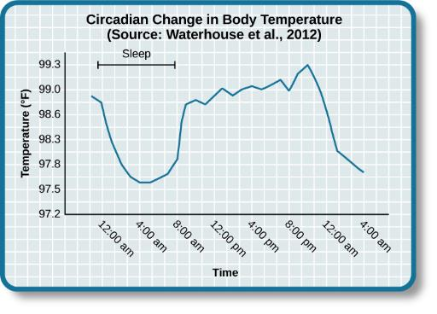
Circadian rhythms
Figure 4.2
This chart illustrates the circadian change in body temperature over 28 hours in a group of eight young men. Body temperature rises throughout the waking day, peaking in the afternoon, and falls during sleep with the lowest point occurring during the very early morning hours.

Slide 5
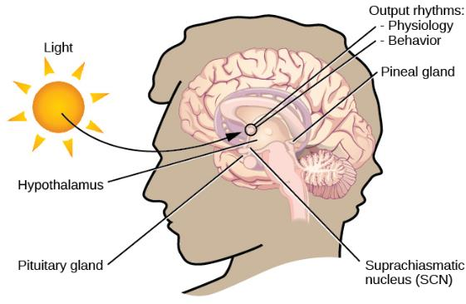
The suprachiasmatic nucleus (SCN)
Figure 4.3
The suprachiasmatic nucleus (SCN), located in the hypothalamus, serves as the brain’s clock mechanism.
The clock sets itself with light information received through projections from the retina, allowing it to synchronize with the outside world.

Slide 6
Melatonin and sleep regulation
Our sleep—wake cycle is also regulated by other factors such as the hormone melatonin.
Melatonin release is stimulated by darkness, making us sleepy, and inhibited by daylight.
Melatonin is released by the pineal gland.
Sleep regulation – the brain’s control of switching between sleep and wakefulness as well as coordinating this cycle with the outside world.
Each person has an individual circadian pattern of activity known as a person’s chronotype.
(Credit: How sleep works - Luke Mastin)

Slide 7
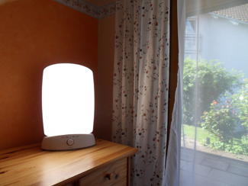
DISRUPTIONS OF NORMAL SLEEP
Certain circumstances can throw off our circadian rhythms.
Jet lag – Symptoms resulting from the mismatch between our internal circadian cycles and our environment.
Fatigue, sluggishness, irritability and insomnia.
Rotating shift work – A work schedule that changes from early to late on a daily/weekly basis.
Becomes difficult for a normal circadian rhythm to be maintained.
Can result in persistent feelings of exhaustion and agitation, sleeping problems and can lead to signs of depression and anxiety.
Bright light can be used to realign our biological clocks with the external environment.
Figure 4.4
Devices like this are designed to provide exposure to bright light to help people maintain a regular circadian cycle. They can be helpful for people working night shifts or for people affected by seasonal variations in light.

Slide 8
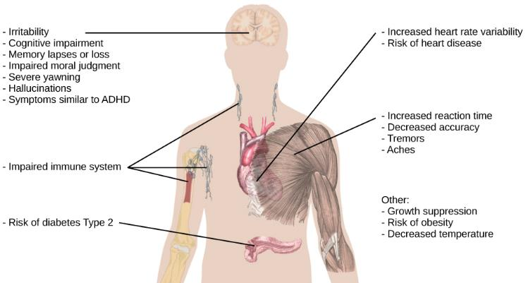
Sleep deprivation
Sleep debt – result of insufficient sleep on a chronic basis.
Sleep rebound – a sleep-deprived individual will tend to take a shorter time to fall asleep during subsequent opportunities for sleep.
This figure illustrates some of the negative consequences of sleep deprivation. While cognitive deficits may be the most obvious, many body systems are negatively impacted by lack of sleep.
Figure 4.5 (credit: modification of work by Mikael Häggström)

Slide 9
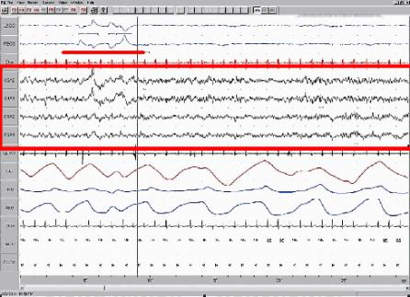
What is sleep?
Sleep is a state marked by relatively low physical activity and a reduced sense of awareness.
Sleep-wake cycles seem to be controlled by multiple brain areas including the thalamus and hypothalamus (slow-wave sleep) and the pons (REM sleep).
Sleep is associated with the secretion and regulation of many hormones including:
Melatonin
Follicle stimulating hormone
Luteinizing hormone
Growth hormone.
Figure 4.6 This is a segment of a polysonograph (PSG), a recording of several physical variables during sleep. The x-axis shows passage of time in seconds; this record includes 30 seconds of data. The location of the sets of electrode that produced each signal is labeled on the y-axis. The red box encompasses EEG output, and the waveforms are characteristic of a specific stage of sleep. Other curves show other sleep-related data, such as body temperature, muscle activity, and heartbeat.

Slide 10
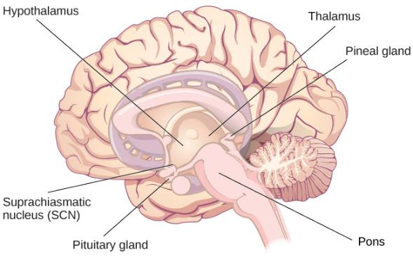
Brain areas involved in sleep
Figure 4.7
The pineal and pituitary glands secrete a number of hormones during sleep.

Slide 11
Why do we sleep?
Adaptive Function (Evolutionary Hypotheses)
Sleep is essential to restore resources that are expended during the day.
Sleep is an adaptive response to predatory risks, which increase in darkness.
There is little evidence to support these explanations.
Cognitive Function
Focuses on sleeps importance for cognitive function and memory formation.
Research shows that sleep deprivation results in disruptions in cognition and memory deficits.
These impairments become more severe as the amount of sleep deprivation increases.
Slow-wave sleep appears to be essential for effective memory formation.
Benefits of sleep
Maintaining a healthy weight, lowering stress levels, improving mood, increased motor coordination as well as many benefits related to cognition and memory formation.

Slide 12
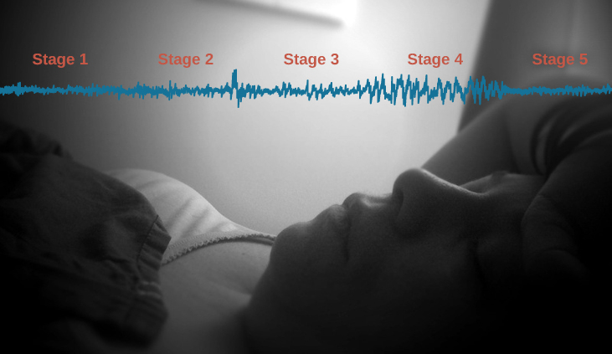
Stages of sleep
Figure 4.8 (credit “sleeping”: modification of work by Ryan Vaarsi)

Slide 13
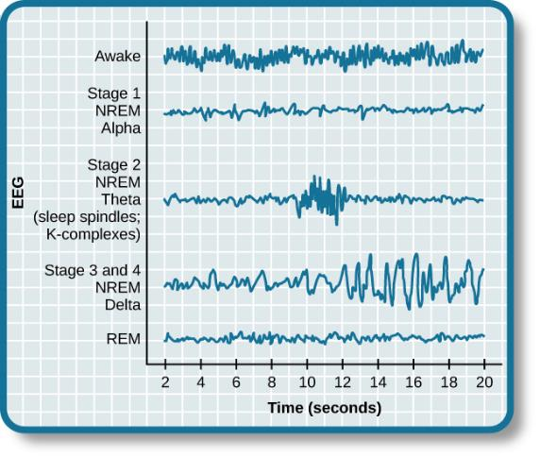
Brainwaves during sleep
Brainwave activity changes dramatically across the different stages of sleep.
Changes in brain wave activity can be visualized using EEG.
Alpha – relatively low frequency, relatively high amplitude, synchronized.
Theta – low frequency, low amplitude.
Delta – low frequency, high amplitude, desynchronized.
Figure 4.9

Slide 14
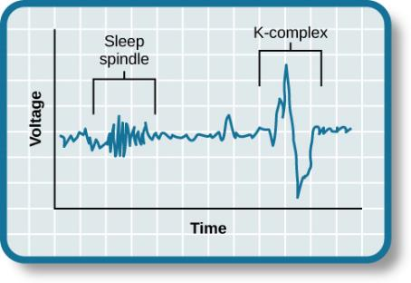
Stages 1 and 2
STAGE 1
Transitional phase occurring between wakefulness and sleep.
Rates of respiration and heartbeat slow down.
Overall muscle tension and core body temperature decrease.
Alpha waves.
STAGE 2
The body goes into deep relaxation.
Theta waves
Characterized by the appearance of both sleep spindles and K-complexes.
Sleep spindles – rapid burst of high frequency brainwaves.
K-complexes – very high amplitude pattern of brain activity.
Figure 4.10

Slide 15
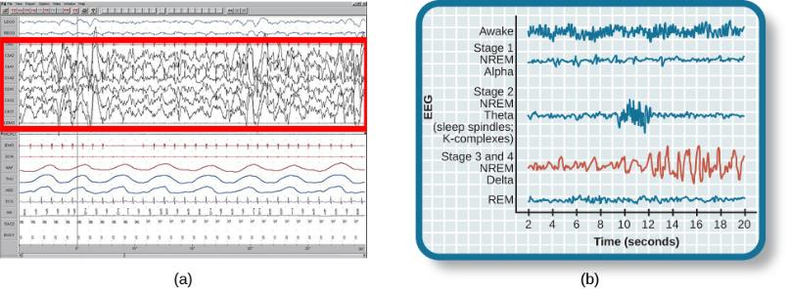
Stages 3 and 4
Known as slow-wave sleep.
Delta waves.
Respiration and heart rate slow down further.
Delta waves
Slow-wave stage 3 and stage 4 sleep.
Figure 4.11

Slide 16
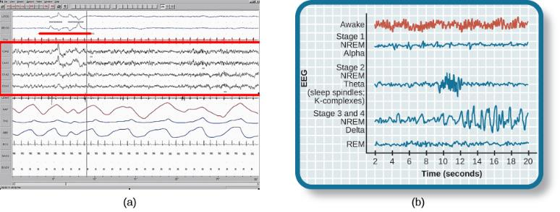
Rapid eye movement (rem)
Rapid eye movements.
Paralysis of voluntary muscles.
Dreams.
Brain waves are similar to those seen during wakefulness.
Figure 4.12 (a) A period of rapid eye movement is marked by the short red line segment, which looks very similar to brainwaves seen (b) during wakefulness.

Slide 17
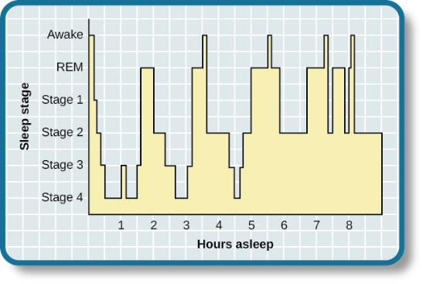
Hypnogram of sleep stages
Figure 4.13
A hypnogram is a diagram of the stages of sleep as they occur during a period of sleep.
This hypnogram illustrates how an individual moves through the various stages of sleep.

Slide 18
DREAMS
There are many theories on the meaning of dreams that vary across different cultures and periods of time.
Sigmund Freud:
Saw dreams as a way to gain access to the unconscious.
Manifest content – the actual content of the dream.
Latent content – the hidden meaning of the dream.
Carl Jung:
Believed that dreams allowed us to tap into the collective unconscious.
Collective unconscious – theoretical repository of information shared by all people across cultures.
Believed that certain symbols in dreams reflected universal archetypes.
Research:
Dreams may represent life events that are important to the dreamer.
Dreaming may represent a state of protoconsciousness, or a virtual reality, in the mind that helps a person during consciousness.
Lucid dreams – certain aspects of wakefulness are maintained during a dreaming state. A person becomes aware that they are dreaming.

Slide 19
INSOMNIA
Defined by difficulty falling or staying asleep - for at least 3 nights a week for at least one month’s time.
The most common sleep disorder.
Man be associated with symptoms of depression.
Contributing factors include:
Age
Drug use
Exercise
Mental status
Bedtime routines
Treatment:
Stress management techniques.
Changes in problematic behaviors that could contribute to insomnia.
Cognitive-behavioral therapy which focuses on cognitive processes and problem behaviors.

Slide 20
Parasomnia
Parasomnias involve unwanted motor behavior/experiences throughout the sleep cycle. They include:
Sleep walking:
Usually occurs during slow-wave sleep.
REM sleep behavior disorder:
Occurs when the muscle paralysis associated with REM sleep does not occur.
Includes high levels of physical activity during REM sleep.
Often treated with Clonazepam (an anti-anxiety medication).
Restless leg syndrome:
Involves uncomfortable sensations in the legs when trying to fall asleep that are relieved by moving the legs.
Can be treated with a variety of medications.
Night terrors:
Sleeper experiences a sense of panic and may scream or attempt to escape.
Occur during NREM sleep.

Slide 21
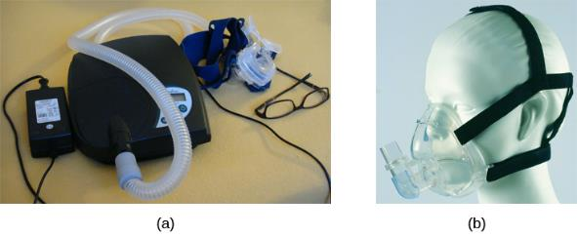
SLEEP APNEA
Occurs when individuals stop breathing during their sleep, usually for 10-20 seconds or longer.
Repeated disruptions in sleep lead to increased levels of fatigue.
Common in people that are overweight.
2 types:
Obstructive – airway becomes blocked and air is prevented from entering the lungs.
Central – CNS fails to initiate breaths.
Treatment can include a continuous positive airway pressure (CPAP) device which pumps air into the person’s airways.
Figure 4.14

Slide 22
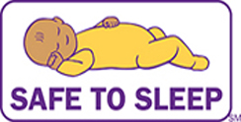
SUDDEN INFANT DEATH SYNDROME (SIDS)
Occurs when an infant stops breathing during sleep and dies.
Infants younger than 12 months are at the highest risk.
Boys have a greater risk than girls.
Contributing factors:
Premature birth.
Smoking within the home.
Hyperthermia.
The Safe to Sleep campaign educates the public about how to minimize risk factors associated with SIDS. This campaign is sponsored in part by the National Institute of Child Health and Human Development.
Figure 4.15

Slide 23
narcolepsy
Involves an irresistible urge to fall asleep during waking hours.
Often triggered by states of heightened arousal or stress.
Shares many features of REM sleep including:
Cataplexy – loss of muscle tone while awake or in some cases complete paralysis of the voluntary muscles.
Hypnagogic hallucinations - vivid, dream-like hallucinations.
Treatment – psychomotor stimulant drugs.
(Credit: Valley Sleep Center)

Slide 24
SUBSTANCE USE disorders
Substance use disorder is a compulsive pattern of drug use despite negative consequences (DSM-5 definition).
Involves physical and psychological dependence.
Physiological dependence - involves changes in normal bodily functions and withdrawal upon cessation of use.
Psychological dependence – emotional need for the drug.
Tolerance – occurs when a person requires more and more of a drug to achieve effects previously experienced at lower doses; linked to physiological dependence.
Withdrawal – negative symptoms experienced when drug use is discontinued.
(Credit: DSM5)

Slide 25
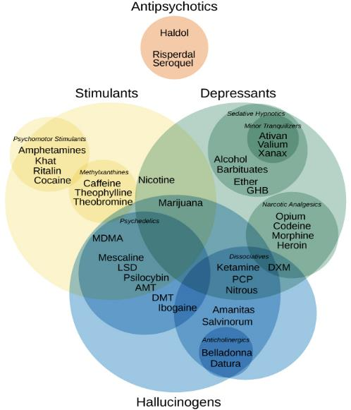
DRUG CATEGORIES
Figure 4.16 (credit: modification of work by Derrick Snider)

Slide 26
DEPRESSANTS
Depressants – drugs that suppress the central nervous system activity.
Usually GABA agonists which have a quieting effect on the brain.
Work by binding to GABA receptors which makes the neuron less likely to fire.
Include:
Alcohol
Barbiturates (anticonvulsant medication)
Benzodiazepines (anti-anxiety medication)
Alcohol:
Decreases reaction time and visual acuity.
Lowers levels of alertness.
Reduces behavioral control.
Can result in complete loss of consciousness.

Slide 27
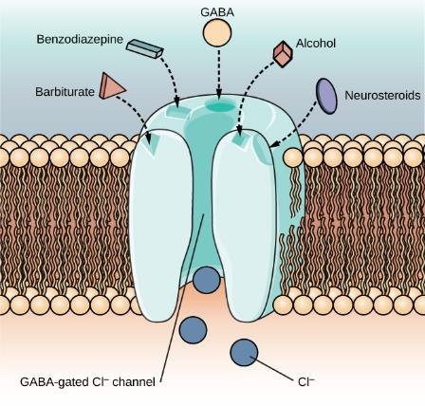
gaba
Figure 4.17
The GABA-gated chloride (Cl-) channel is embedded in the cell membrane of certain neurons. The channel has multiple receptor sites where alcohol, barbiturates, and benzodiazepines bind to exert their effects. This opens the chloride channel, allowing negatively-charged chloride ions (Cl-) into the neuron's cell body. Changing its charge in a negative direction pushes the neuron away from firing; thus, activating a GABA neuron has a quieting effect on the brain.

Slide 28
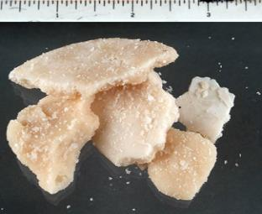
STIMULANTS
Stimulants – Increase overall levels of neural activity.
Usually dopamine agonists which work by preventing the reuptake of dopamine.
Dopamine activity is associated with reward and craving, therefore these drugs can be highly addictive.
Include:
Cocaine
Amphetamine
Cathinones (i.e., bath salts)
MDMA
Side effects can include nausea, elevated blood pressure, increased heart rate, feelings of anxiety, hallucinations and paranoia.
Crack rocks like these are smoked to achieve a high. Smoking a drug allows it to enter the brain more rapidly, which can often enhance the user’s experience.
Figure 4.18 (credit: modification of work by U.S. Department of Justice)

Slide 29
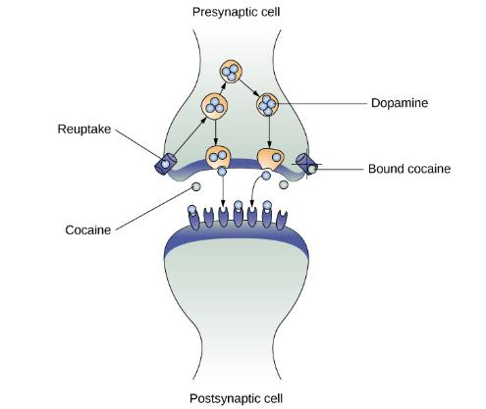
Dopamine agonists
Figure 4.19
As one of their mechanisms of action, cocaine and amphetamines block the reuptake of dopamine from the synapse into the presynaptic cell.
This results in a larger amount of dopamine in the synapse.

Slide 30
Nicotine and caffeine
Caffeine and nicotine are also stimulants.
Caffeine:
Involves antagonizing adenosine activity.
Increases levels of alertness and arousal.
Nicotine:
Interacts with acetylcholine receptors.
Highly addictive.
Plays a role in arousal and reward mechanisms.
(Credit: Wikipedia)

Slide 31
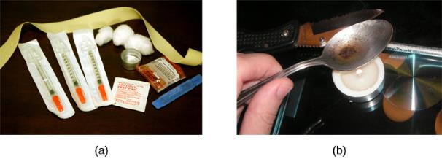
OPIOIDS
Serve as analgesics (decrease pain) through their effects on the endogenous opioid neurotransmitter system.
Highly addictive.
Includes:
Heroine
Morphine
Methadone
Codeine
Figure 4.20

Slide 32
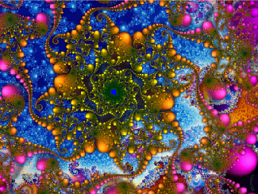
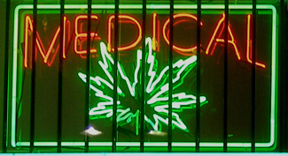
HALLUCINOGENS
Cause changes in sensory and perceptual experiences.
Can involve vivid hallucinations.
Variable with regards to the specific neurotransmitter systems they affect.
Mescaline and LSD (serotonin agonists).
PCP and ketamine (NMDA glutamate receptor antagonists).
Figure 4.21 Psychedelic images like these are often associated with hallucinogenic compounds. (credit: modification of work by “new 1lluminati”/Flickr)
Figure 4.22 Medical marijuana shops are becoming more and more common in the United States.(credit: Laurie Avocado)

Slide 33
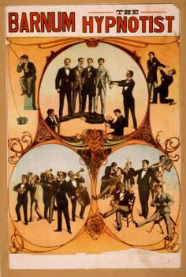
Other states of consciousness: Hypnosis
Hypnosis is an extreme focus on the self that involves suggested changes of behavior and experience.
Clinicians may use relaxation and suggestion in an attempt to alter the thoughts and perceptions of a patient.
Has been used to draw out information believed to be buried in someone’s memory.
Unlike portrayals in the media, individuals undergoing hypnosis are in control of their own behaviors.
People vary in their ability to be hypnotized.
Uses include pain management, treatment of depression and anxiety, quitting smoking and weight loss.
Figure 4.23 Popular portrayals of hypnosis have led to some widely-held misconceptions.

Slide 34
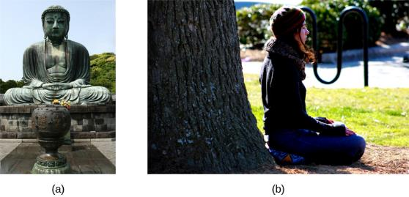
Other states of consciousness: meditation
Meditation is the act of focusing on a single target such as breath or a repeated sound to increase awareness of the moment.
Meditation involves relaxed, yet focused, awareness.
Shows promise in stress management, sleep quality, pain management and treatment of mood and anxiety disorder.
This is a statue of a meditating Buddha, representing one of the many religious traditions of which meditation plays a part.
People practicing meditation may experience an alternate state of consciousness.
Figure 4.24 (credit a: modification of work by Jim Epler; credit b: modification of work by Caleb Roenigk)

