Slide 1
Kevin
Mcintire
Servant leader

Slide 2
Growing up
Born on April 6, 1982 to Dave and Velma McIntire in San Jose, California
Was the second son, Kevin’s older brother who was 3 years older is named Brian
Went to Valley Christian Elementary, Jr High and High School in San Jose
Attended De Anza Community College and then attended UCSB.
Best friends since high school: Dan St Clair, Neil Kurtz, Ryan Zeid and Brian Plunkett

Slide 3
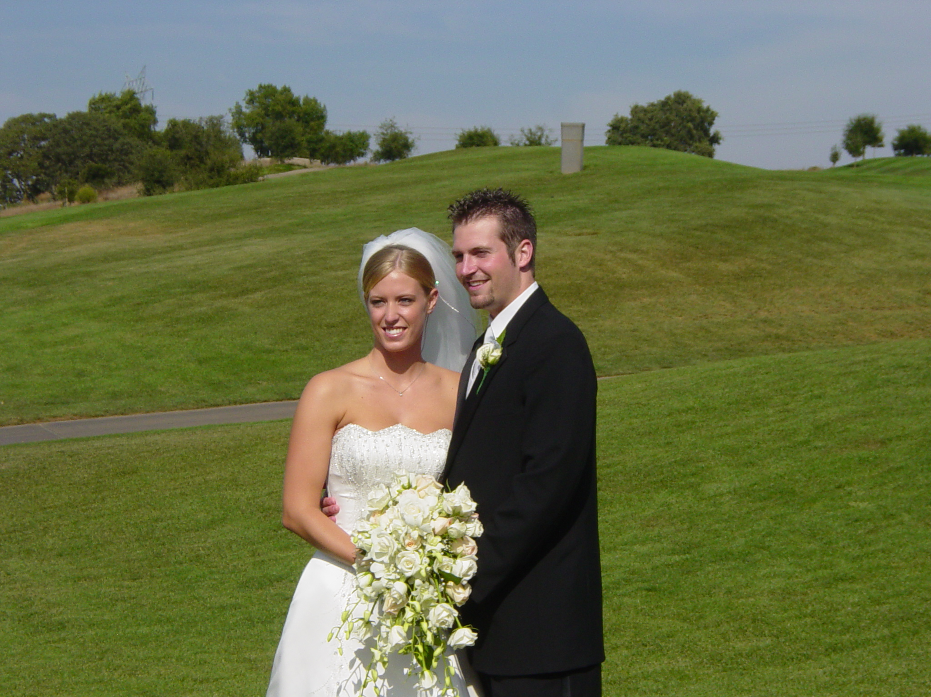
Husband and father
Married his high school sweetheart, Becky on Aug 21, 2004
Has 4 kids: 3 boys and a girl
  Caleb 10; Cheyenne 8; Preston 6; and Hunter 2.
Works at Pacific Surfacing Inc.
Fellowships at Venture Christian Church
Spends every spare moment with his wife and kids- favorite thing to do= family vactions

Slide 4
Jobs
Former youth pastor at a church in Santa Barbara, CA
Worked at Venture Christian Church
Currently a consultant at Pacific Surfacing Inc.
  Kevin consistently served at servant leader in his ministry positions, but to financially support his family had to find a better paying job.
  As he consults on his job, the hope is to give the best advice not what costs the most.

Slide 5
trials
In December, 2016 was diagnosed with Stage 4 double hit lymphoma all over his body
6 rounds of chemotherapy over 7 months at the hospital where he spent 5 full days every round in the hospital
  When he arrived home from chemo treatment his immune system was so shot he could not be around his children.
Due to the strenuous and intense treatment plan was not be able to have regular time and energy with his wife, kids and job
Despite the trial, he was joyful and focused on giving God the glory through the process

Slide 6
Being a blessing through the trials
Kevin starting a blog journaling his journey through the trial. https://www.caringbridge.org/visit/evenifhedoesnot#tributes
  Hundreds of people started following his journey and throughout the entire process he focused on the Lord and His provision through it all. He titled his blog- Even If He Does Not
Would spend his days at the hospital praying and sharing Jesus with the other patients, nurses and doctors
  The nurses at the hospital loved working Kevin because he brought so much joy to a usually depressing field of medicine.
Deemed cancer free in July of 2017
The pastor at his church did a sermon on The Power of Hope that featured Kevin and Becky’s journey. http://venture.cc/sermons/2017/9/24/the-power-of-hope

Slide 7
Best Friend
We have been best friends since 1996.
In the midst of some my hardest times in high school, college and life he has always been there to pray and encourage me in my walk with the Lord
I was ministered to so much as I walked with him through his lymphoma treatment
Our group of friends all live in different places in the United States, but still talk every day, and see each other as often as we can through out the year.

