Slide 1
Videos in the LMS
Aaron Van Wormer
Evan P. Tanner

Slide 2
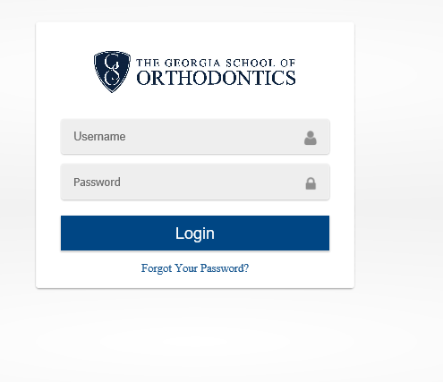
Edvance360
https://gso.edvance360.com/
Username is first part of email
(nlin)
Password is
1234

Slide 3
Change Password
Login
Click Person in upper right corner
Drop Down to Profile
On the left navigation bar, click Change Password
Old is 1234
New
Confirm
Save

Slide 4
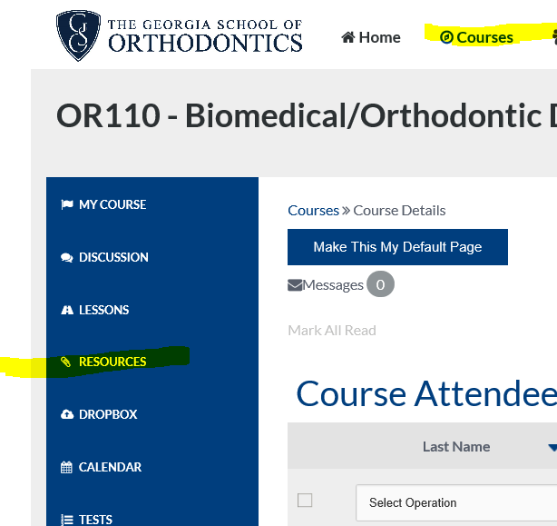
Click Courses on the top row
navigation bar
Click OR110 or OR120 in main
navigation section
Click Resources on the left
navigation bar

Slide 5
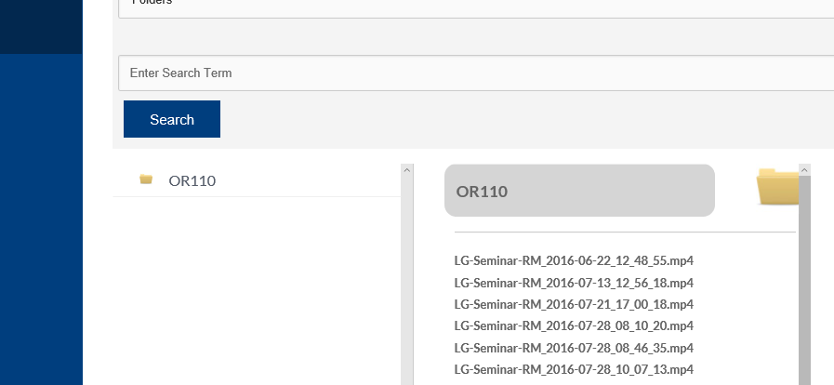
Click the folder OR110
Click the video name
New window pops
Click triangle to begin play

Slide 6
Naming Convention – For now
This will change in the future, when videos are INLINE with the lessons.
Currently, named by date, and the start time of day.
Each video is clipped into approximately one hour segments.
Hour 1 --- 2016-10-28-07_52_28.mp4
Hour 2 --- 2016-10-28-08_54_33.mp4

Slide 7
E360 – the future
Videos will be in line with lessons.
And may have names that are more descriptive.
Much more work to be done with E360.
This is just a start to get you the videos for these first two semesters!

Slide 8
HELP
We have support from E360 BUT, as we are just rolling it out….
Please email: help@gaorthodontics.org
This will reach Aaron, and Evan and they will provide assistance to you promptly.
We will contact E360 as needed.

