Slide 1
Tuberculosis in Kenya
Danielle Preston
Carrie hinckley

Slide 2
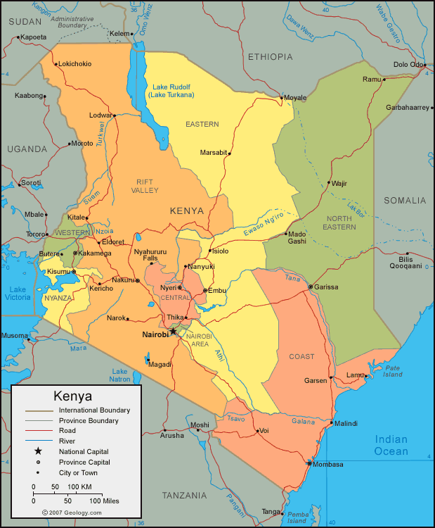


Slide 3
Demographics of Kenya
Kenya is the located in central Eastern Africa
  About twice the size of Nevada
The capital is Nairobi.
The climate is hot and tropical with little rainfall. Only 11% of the land is farmable.
  Natural resources : Lime Stone, Gemstones, zinc gypsum
Population 41 million

Slide 4
Interesting Statistics!
Primary Language : English, Kishwahilli
Religion : 45% Catholic 33% Muslim 10% Muslim
Population: 43,031, 341
Median Age 18.8 years
Birth Rate 31.9/1000 people
Infant Mortality Rate 43.61 deaths/ 1000 live births
Life Expectancy 63.6 years
Cell Phones: 28.08 million (comparison to world 36)
  United States ranked 3rd
Notes:
https://www.cia.gov/library/publications/the-world-factbook/geos/ke.html

Slide 5
Yearly Financials
Education $176537.00
  Enrolled in college 117.7 girls and 80.6 boys
  1 teacher for every 56 children in primary school
Health and Social work $74979.00
  32,941 Registered Nurses (83 per 100,000 people)
    ONE NURSE PER 1,204.8 PEOPLE
    One nurse per 117.6 people in the United States
  7,549 doctors (19 per 100,000 people)
  8,006 hospitals

Slide 6
Health Care Statistics
12.2%GDP spent on Health Expenditures
0.14 physicians per 1000 patients
1.4 beds per 1000 patients
Ranked 6th in HIV/AIDS death in the world
  1.5 million people are living with the disease.

Slide 7
Tuberculosis
Is an infectious disease caused by Mycobacterium tuberculosis. It usually involves the lungs but can also affect other parts of the body.
TB is the worlds 2nd largest cause of death following HIV/AIDS
Total TB cases notified (2010): 106,083
Treatment Success Rate for new smear-positive TB cases (2009): 85.86%
  The high amount of cases is directly related to Kenya’s high HIV rate

Slide 8
Treatment of TB
There are many private organizations that are working to spread the awareness of TB in Kenya
It costs about $35,700 to treat a single case of TB
In 1980 they developed the NLTP(National Leprosy and Tuberculosis Programme) with special staff to monitor and treat cases of TB. The treatment is done in major health care settings.
The priority is now to expand outreach to urban slums and hard to reach places.
Notes:
http://www.worldbank.org/en/country/kenya

Slide 9
Treatment and Prevention of TB
The world health organization (WHO) suggested the patients with TB should also be tested for HIV to help gain control of the spread of TB. With these additional tests they found that by 2009, the number of patients infected with HIV and TB decreased from 52% to 44%. These patients were also started on an antibiotic called cotrimoxazole prophylaxis for prevention of further infection. Though not every patient with HIV and TB are being they are tightening the guidelines in hopes to further decrease the amount of active cases.
Notes:
http://www.cdc.gov/mmwr/preview/mmwrhtml/mm5946a3.htm

Slide 10
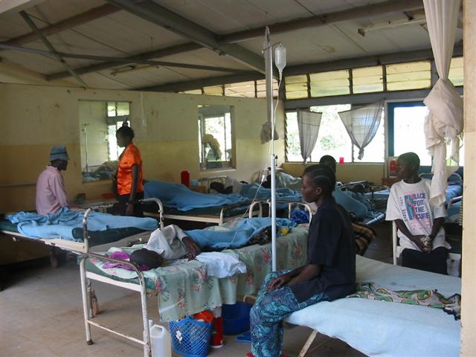

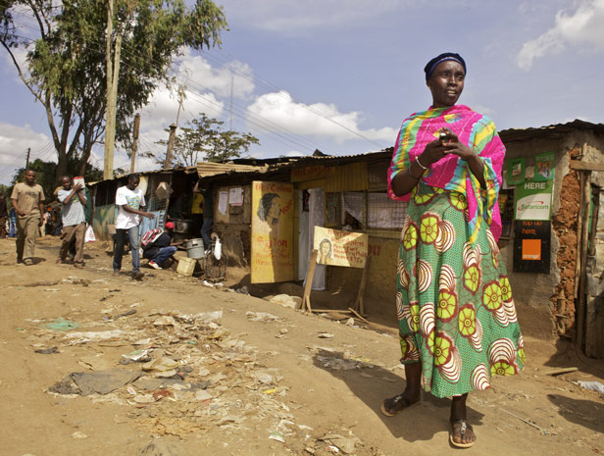
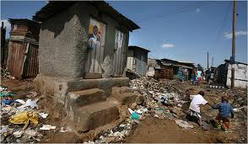
<A typical hospital or clinic for Kenyans.
> The main hospital of Kenya
Only 16% of Kenyans have access to electricity as of 2009.

Slide 11
Citations
World Bank Group. Kenya Home. Retrieved January 21, 2012=3, from http://www.worldbank.org/en/country/kenya
Kenya. CIA The World Factbook. Retrieved January 19, 2013, from http://World Bank Group. Kenya Home. Retrieved January 21, 2012=3, from www.worldbank.org/en/country/kenya

