Slide 1
Tetanus (lockjaw) Crystal Steible 4-11-13

Slide 2
What is tetanus?
It is an extremely severe polyradiculitis and polyneuritis affecting spinal and cranial nerves.
It is a potent neurotoxin released by anaerobic bacillus Clostridium tetani.
The toxin interferes with the function of the reflex arc by blocking inhibitory transmitters at the presynaptic sites in the spinal cord and brainstem.

Slide 3
What is tetanus?
Spores are found in soil, garden mold, and manure.
The number of cases per year worldwide are estimated to be 1 million.
United States 50-70 cases each year.
Majority of patients are over age 40, however the number under 40 is increasing which is most likely due to IV drug use.
Mortality rates are declining and are 10% in the US.

Slide 4
Pathophysiology
Clostridium tetani enters the body through a traumatic wound which provides appropriate low-oxygen environment for organisms to mature and produce toxin.
Other possible sources are dental infection, chronic otitis media, injections of heroin, human and animal bites, frostbite, open fractures, and gunshot wounds.

Slide 5
Pathophysiology
Incubation period is usually 7 days but can range from 3 to 21 days.
Symptoms usually appear after the original wound is healed.
In general, the longer the incubation period the milder the illness is and prognosis is better.

Slide 6
Clinical Manifestations
Stiffness in the jaw and neck, fever and symptoms of general infections.
Generalized tonic spams occur because of the lack of reciprocal innervation.
As it progresses, neck, back, abdominal muscles and extremities become progressively rigid.

Slide 7
Clinical Manifestations
In severe forms continuous tonic convulsions may occur with extreme arching of the back and retraction of the head.
Laryngeal and respiratory spasms cause apnea and anoxia(low levels of oxygen).
Profuse diaphoresis, labile hypertension, episodic tachycardia, hyperthermia, and dysrhythmias.
Slightest noise, light can set off seizures which are very painful.
Mortality rate is almost 100% in the severe form.

Slide 8
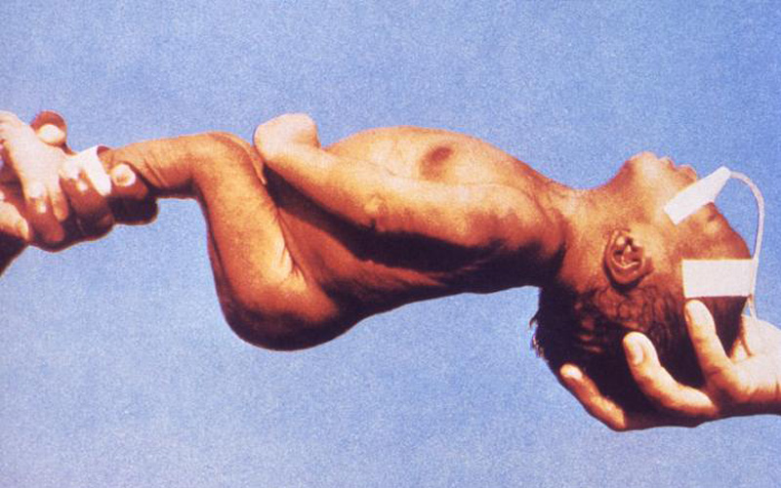
Tetanus: This baby has neonatal tetanus. His body is rigid. Infection can occur when the newly cut umbilical cord is exposed to dirt. Most newborns who get tetanus die. Photo courtesy of the Centers for Disease Control and Prevention (CDC)

Slide 9
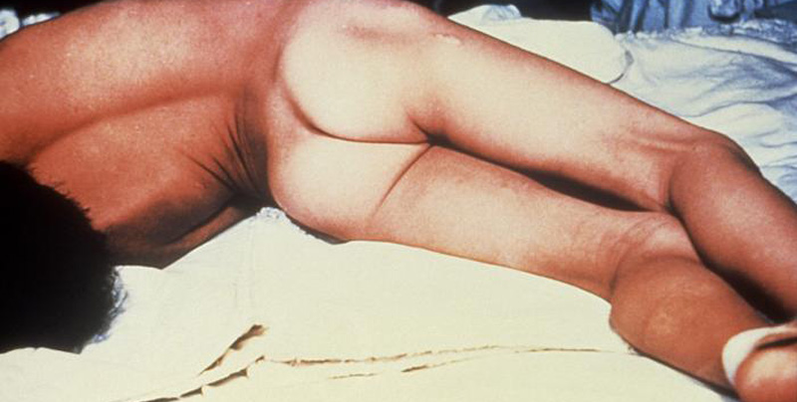
Extreme arching of the back and retraction of the head.
Photo courtesy of the Centers for Disease Control and Prevention (CDC)

Slide 10
Nursing and Collaborative Management
#1 Health teaching to ensure tetanus prophylaxis most important factor influencing the incidence of this disease.
Adults should get a tetanus and diphtheria toxoid booster every 10 years.
If a wound has occurred and it has been 5 years since the last booster contact care provider for booster.
Teach the patient to thoroughly clean the wound with soap and water.

Slide 11
Nursing and Collaborative Management
Management includes administration of tetanus and diphtheria toxoid booster (Td) and tetanus immune globulin(TIG) in different sites before onset of symptoms to neutralize circulating toxins.
A much larger dose of TIG is given to patients with manifestations of clinical tetanus.

Slide 12
Nursing and Collaborative Management
Control spasms is essential managed by deep sedation, skeletal muscle relaxation with Valium, barbiturates and in severe cases neuromuscular blocking agents Norcuron which acts to paralyze skeletal muscles.
Pain management by opioids such as morphine or fentanyl.
10-14 day course of PCN, metronidazole, tetracycline, or doxycycline to inhibit further growth of C. tetani.

Slide 13
Nursing and Collaborative Management
Tracheostomy is usually performed early because of laryngospasm and potential need for neuromuscular blocking drugs and maintained on mechanical ventilation.
Wound should be debrided or abscess drained.
Recovery from tetanus does not guarantee natural immunity must get still get vaccines.

Slide 14
Diagnostics
There is no diagnostic test.
It is based on clinical signs and symptoms.
Lab diagnosis is not useful because the bacteria usually can not be recovered from the wound.

Slide 15
Nursing Diagnosis
Ineffective airway clearance related to the accumulation of sputum in the trachea and respiratory muscle spasms
Breathing pattern disorders related to impaired airway due to spasm of respiratory muscles
Increased body temp related to the effects of toxins
Changes in nutrition less than body requirements related to the mastication muscle stiffness

Slide 16
Nutrition
Food is not given by mouth who are having muscle spasms because of risk of aspiration.
During this time they are fed via IV.

Slide 17
Bacteria that causes tetanus is very common and the disease is so serious that protection against acquiring tetanus outweighs any risks associated with vaccination.
This a preventable disease by getting vaccinated.
Side effects from the vaccine include fever, redness, swelling at the site, and soreness are common

