Slide 1
Globalization in Health Care
NCA I
1/22/13
Katy Pennell
Amanda Reinhart

Slide 2
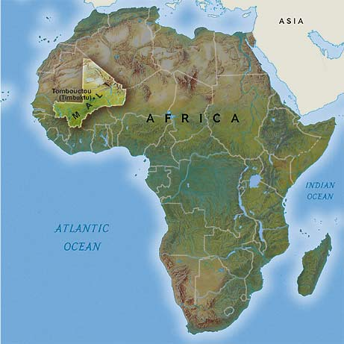
Tuberculosis in Mali
Notes:
Mali is a landlocked country in West Africa. Most of the country lies in the southern portion of the Sahara.
Capital City is Bamako. The majority of the people who reside in Mali are Muslim.
The country's economic structure centers on agriculture. Large exporter of cotton.
Some of Mali's prominent natural resources include gold, the third largest producer of gold in the African continent, and salt.
About half the population lives below the international poverty line of US$1.25 a day.
Mali faces many health challenges related to poverty. Malnutrition, inadequate hygiene and sanitation are commonplace.
2010 estimates that 62-65% of the population does not have access to safe drinking water.
85-91% of Mali’s girls and women have experienced female genital mutilation.

Slide 3
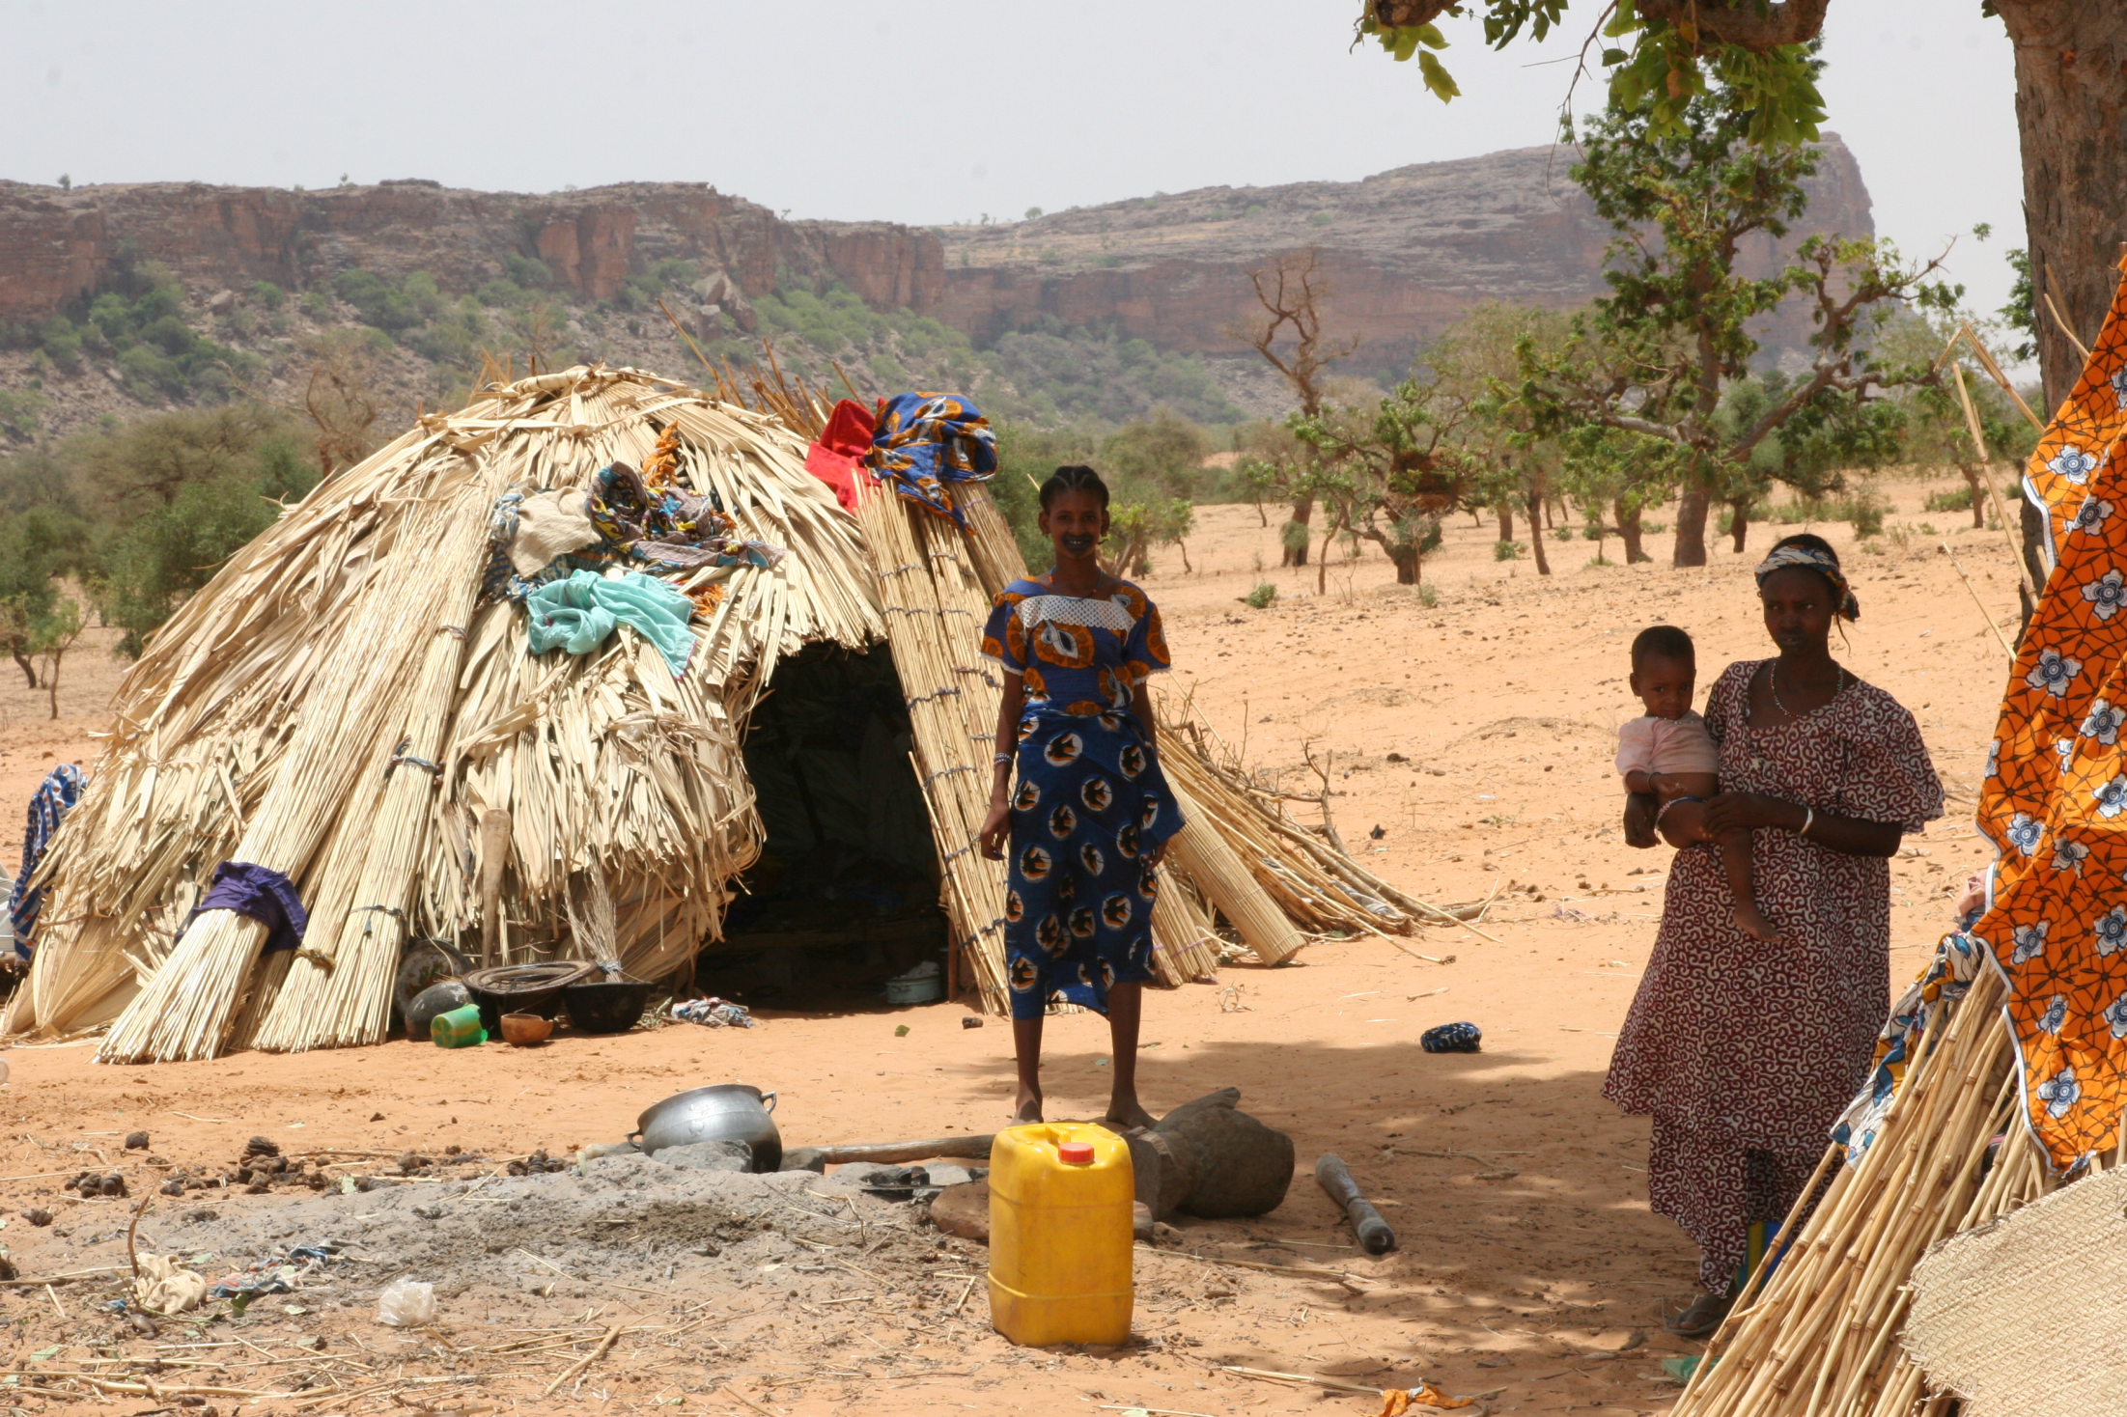

Slide 4
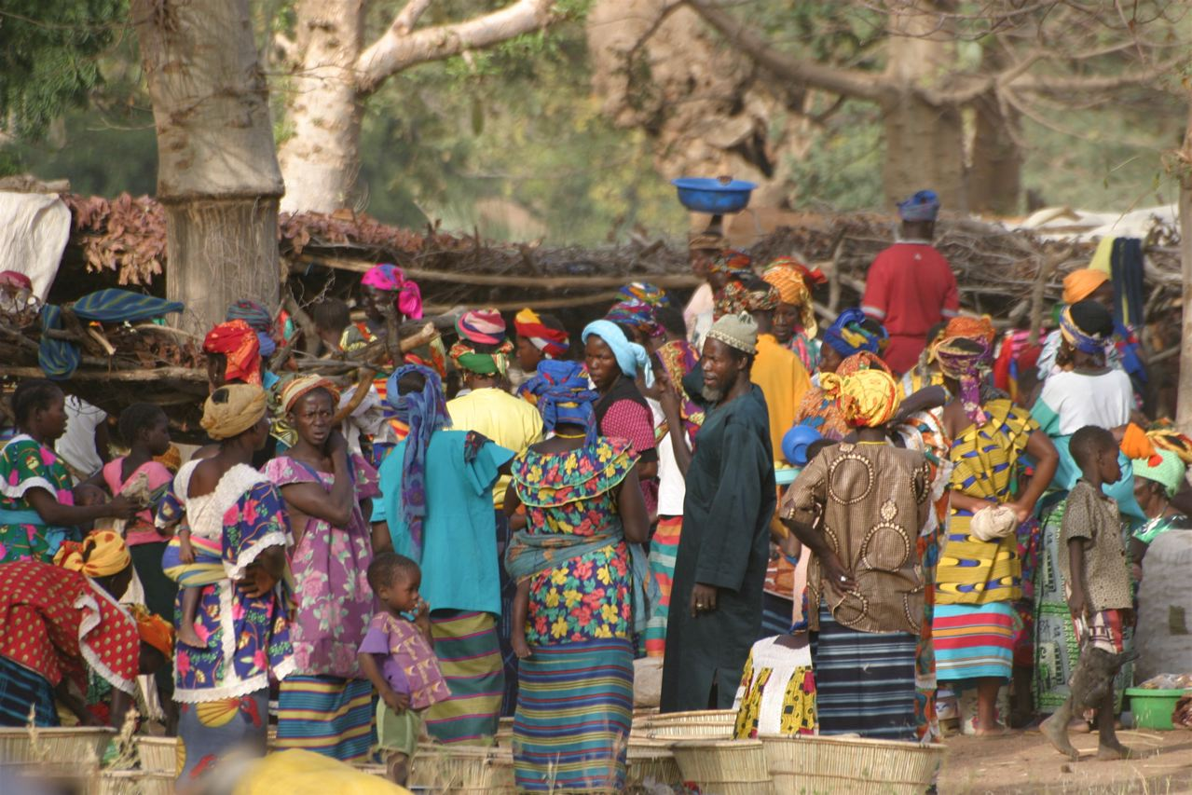

Slide 5
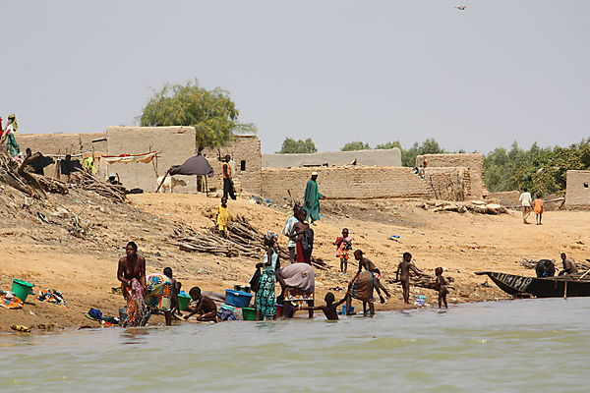

Slide 6
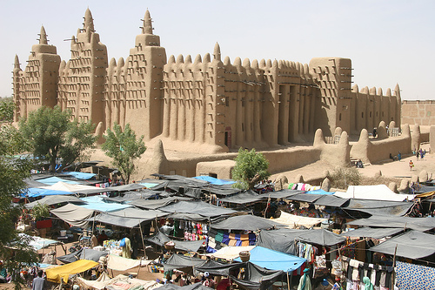

Slide 7
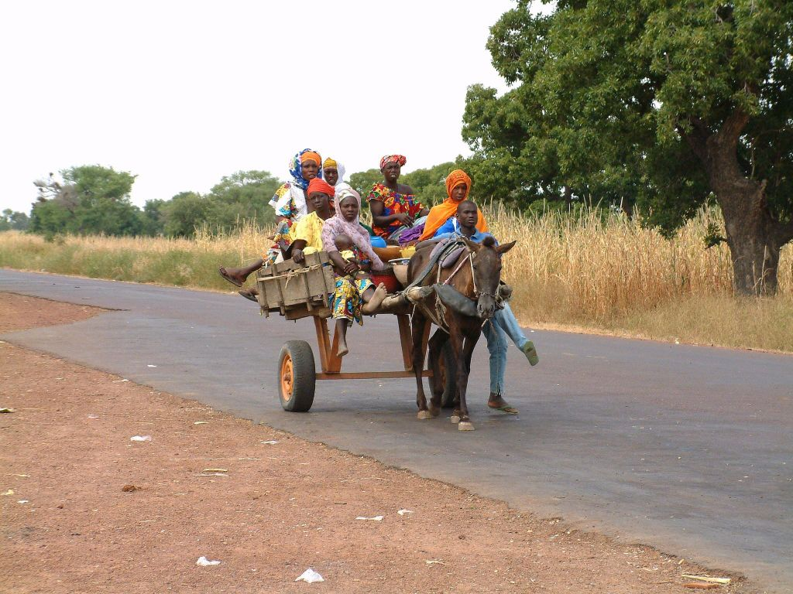

Slide 8
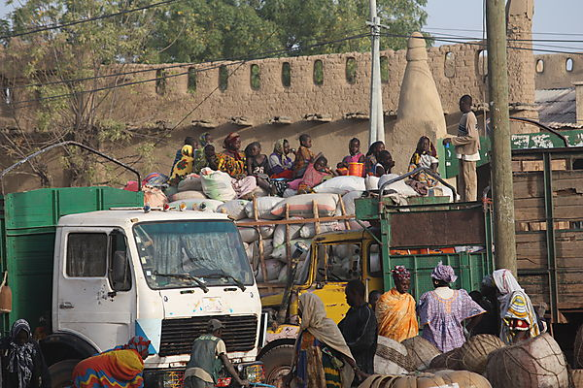

Slide 9
Mali by Numbers
Population 15,370,000
U.S. 310,384,000
Gross national income per capita (international $) $1,030
U.S. $47,310
Life expectancy at birth m/f (years) 50/56
U.S. 76/81
Probability of dying under five (per 1 000 live births) 176
U.S. 8

Slide 10
Total Expenditure on Health
Total expenditure on health per capita (Intl $, 2010) $56
U.S. $8,362
Total expenditure on health as % of GDP (2010) 5.0%
U.S. 17.9%
Notes:
Gross domestic product (GDP) is the market value of all officially recognized final goods and services produced within a country in a given period of time.

Slide 11
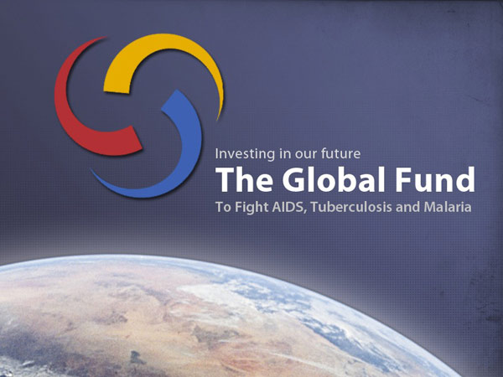
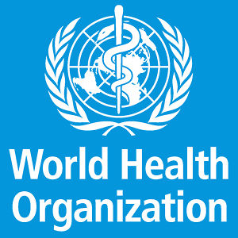
What is Mali doing to Combat and Prevent TB?

Slide 12
The Global Fund programs
WHO DOTs (directly observed treatment) program
A community approach to: education, awareness, overcrowding, sanitation, stigmas associated with the disease, early detection
Notes:
Treating existing cases of TB and preventing future instances of the disease has been a hard fought battle for both the Malian government, as well as, world health organizations. The treatment and prevention of diseases such as TB and HIV/AIDs has been going on for a long period of time in Mali. However, as with many other third world countries there is often a shortage of funding for these types of programs. Two of the largest TB programs in Mali include: the global fund program, and the World Health organization’s DOTs program. Both of these programs aim at the prevention and treatment of the disease through testing and treating existing cases of TB. They also work at education about the disease through national radio, print, and television advertisements (encouraging people to get tested, lesson stigma of the disease, traditional use of herbal/medicinal/natural remedies). Through these programs individuals will receive free TB testing and treatment. Along with treatment of disease many world humanitarian organizations are working to improve living conditions for the people of Mali by providing them access to safe drinking water, fighting malnutrition, overcrowding, and unsanitary conditions. In addition to HIV/AIDS education All of these improvements in living conditions for these individuals will help create healthier people less susceptible to disease.

Slide 13
Sources
http://www.who.int/countries/mli/en/
http://www.who.int/countries/usa/en/
http://www.who.int/reproductivehealth/topics/fgm/prevalence/en/index.html
https://www.cia.gov/library/publications/the-world-factbook/rankorder/2102rank.html?countryName=Mali&countryCode=ml&regionCode=afr&rank=206#ml
http://www.who.int/bulletin/volumes/85/5/06-036210/en/

Slide 14
Sources Cont’d
http://allafrica.com/stories/201108030084.html

Slide 15
New TB Vaccine Article
http://www.irinnews.org/Report/96557/HEALTH-New-TB-vaccine-on-the-horizon

