Slide 1
Globalization in Health Care
NCA I
1/22/13
Katy Pennell
Amanda Reinhart

Slide 2
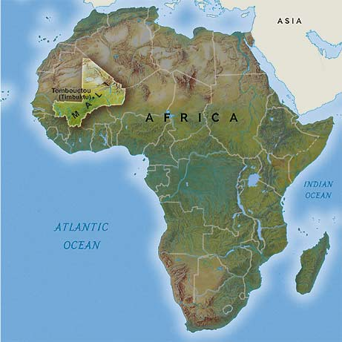
Tuberculosis in Mali
Notes:
Mali is a landlocked country in West Africa. Most of the country lies in the southern portion of the Sahara.
Capital City is Bamako. The majority of the people who reside in Mali are Muslim.
The country's economic structure centers on agriculture. Large exporter of cotton.
Some of Mali's prominent natural resources include gold, the third largest producer of gold in the African continent, and salt.
About half the population lives below the international poverty line of US$1.25 a day.
Mali faces many health challenges related to poverty. Malnutrition, inadequate hygiene and sanitation are commonplace.
2010 estimates that 62-65% of the population does not have access to safe drinking water.
85-91% of Mali’s girls and women have experienced female genital mutilation.

Slide 3
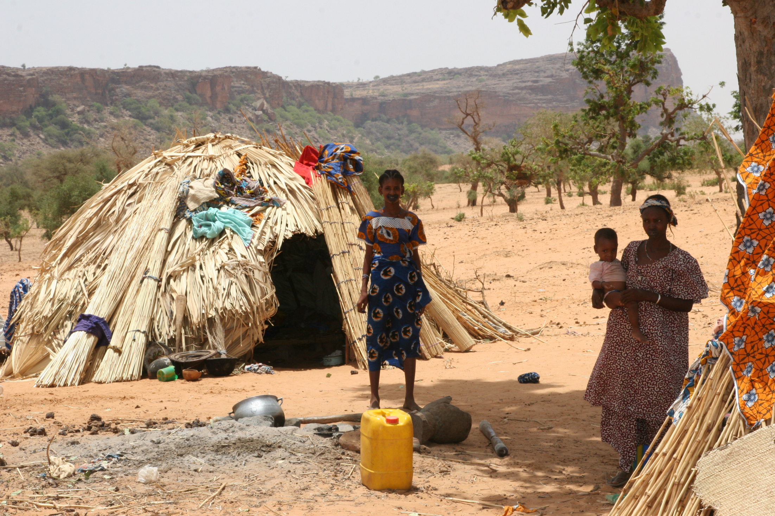

Slide 4
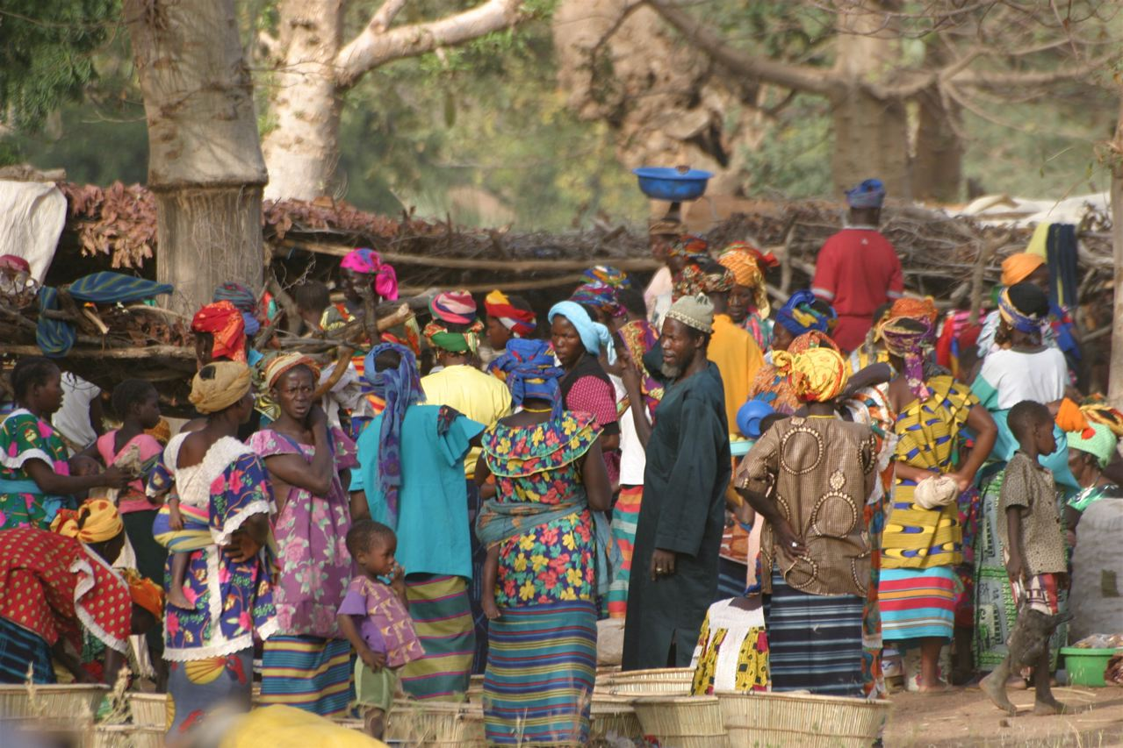

Slide 5
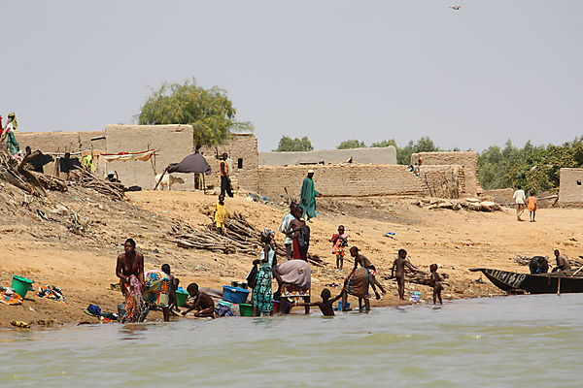

Slide 6
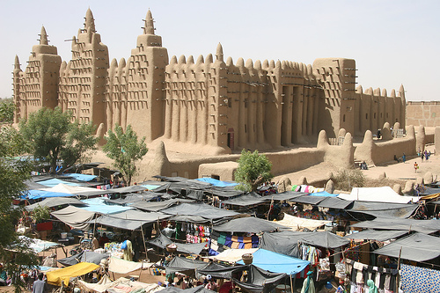

Slide 7
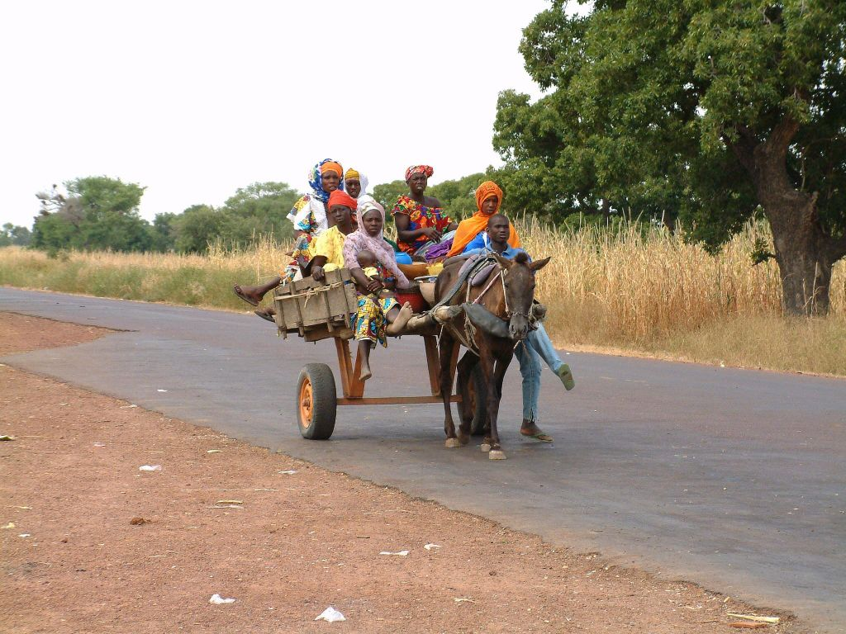

Slide 8
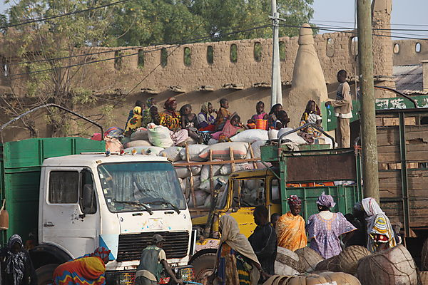

Slide 9
Mali by Numbers
Population 15,370,000
U.S. 310,384,000
Gross national income per capita (international $) $1,030
U.S. $47,310
Life expectancy at birth m/f (years) 50/56
U.S. 76/81
Probability of dying under five (per 1 000 live births) 176
U.S. 8

Slide 10
Total Expenditure on Health
Total expenditure on health per capita (Intl $, 2010) $56
U.S. $8,362
Total expenditure on health as % of GDP (2010) 5.0%
U.S. 17.9%
Notes:
Gross domestic product (GDP) is the market value of all officially recognized final goods and services produced within a country in a given period of time.

Slide 11
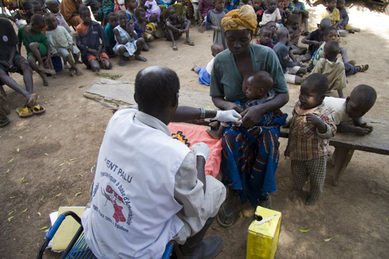
Impacted Yearly
It is estimated that almost 37,000 Malians have TB.
Notes:
Of these the program DOTS has estimated that only about 4900 have been diagnosed.

Slide 12
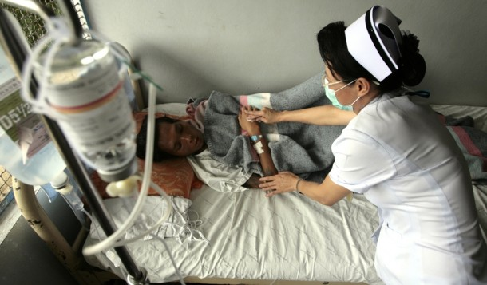
Living with the disease
Only 20% of Malians who have TB are diagnosed which leaves 80% that are not diagnosed and not seeking treatment

Slide 13
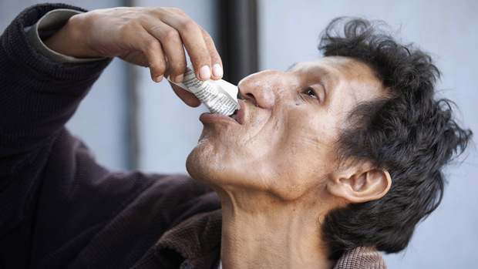
Treatment
Notes:
Although free treatment is offered to Malians, they cannot benefit from the treatment if they remained undiagnosed.
Free treatment is provided from the government and government programs such as GAIA Global Awareness Interdisciplinary Alliance which is a world program to bring awareness and create programs to help with ecological awareness and discipline within countries who need help.
The normal treatment is multiple antibiotics over a course of 6 months. They try to screen anyone in contact also to see if they also need the treatment. If this treatment is not completed then the disease can become resistant to drugs and is called MDR-TB.

Slide 14
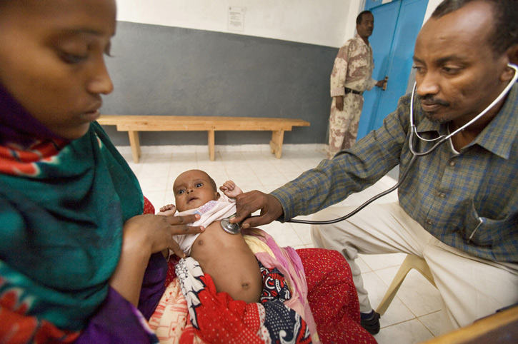
Notes:
The success rate of treatment for TB was 78% in 2009. This was the success rate for the cases that were registered. This was an increase from 2001 when the rate was only 50%.

Slide 15
Cost of the disease
5.6% of the yearly GPD in Mali goes toward health.
NTP
2008 it was at its highest funding
In 2009 the funding dropped to about $3 million.
Both years only about $0.9 million was from government funding. A majority of the rest of the funding was coming from Global funding.
Notes:
5.6% of the yearly GPD in Mali goes toward health.
Most fundings come from different programs in Mali and from world organizations. One program is the NTP. In 2008 it was at its highest funding with a total of almost $3.7 million (US) coming in . In 2009 the funding dropped to about $3 million. Both years only about $0.9 million was from government funding. A majority of the rest of the funding was coming from Global funding.
Of the $3 million in money received only about 4% can goes to TB/HIV and 7% goes to MDR-TB a multidrug resistant form of TB

Slide 16
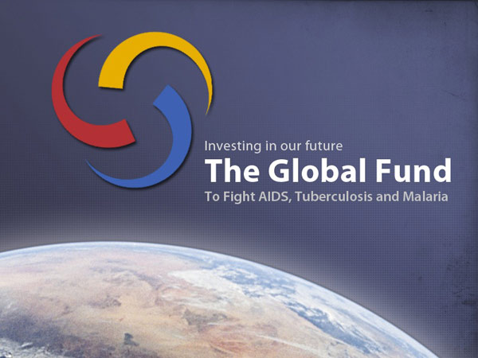
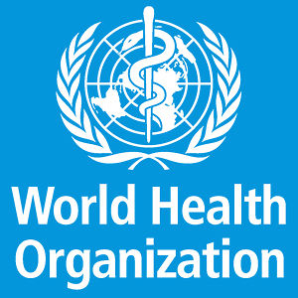
What is Mali doing to Combat and Prevent TB?

Slide 17
The Global Fund programs
WHO DOTs (directly observed treatment) program
A community approach to: education, awareness, overcrowding, sanitation, stigmas associated with the disease, early detection
Notes:
Treating existing cases of TB and preventing future instances of the disease has been a hard fought battle for both the Malian government, as well as, world health organizations. The treatment and prevention of diseases such as TB and HIV/AIDs has been going on for a long period of time in Mali. However, as with many other third world countries there is often a shortage of funding for these types of programs. Two of the largest TB programs in Mali include: the global fund program, and the World Health organization’s DOTs program. Both of these programs aim at the prevention and treatment of the disease through testing and treating existing cases of TB. They also work at education about the disease through national radio, print, and television advertisements (encouraging people to get tested, lesson stigma of the disease, traditional use of herbal/medicinal/natural remedies). Through these programs individuals will receive free TB testing and treatment. Along with treatment of disease many world humanitarian organizations are working to improve living conditions for the people of Mali by providing them access to safe drinking water, fighting malnutrition, overcrowding, and unsanitary conditions. In addition to HIV/AIDS education All of these improvements in living conditions for these individuals will help create healthier people less susceptible to disease.

Slide 18
Sources
http://www.who.int/countries/mli/en/
http://www.who.int/countries/usa/en/
http://www.who.int/reproductivehealth/topics/fgm/prevalence/en/index.html
https://www.cia.gov/library/publications/the-world-factbook/rankorder/2102rank.html?countryName=Mali&countryCode=ml&regionCode=afr&rank=206#ml
http://www.who.int/bulletin/volumes/85/5/06-036210/en/

Slide 19
Sources Cont’d
http://allafrica.com/stories/201108030084.html
http://www.afro.who.int/index.php?option=com_docman&task=doc_download&gid=309
http://www.ruralpovertyportal.org/country/statistics/tags/mali
http://www.globalgiving.org/projects/aids-in-africa-9/
http://www.who.int/bulletin/volumes/85/5/06-036210/en/index.html

Slide 20
New TB Vaccine Article
http://www.irinnews.org/Report/96557/HEALTH-New-TB-vaccine-on-the-horizon

