Slide 1
Sweden
Diabetes
Official Name: Kingdom of Sweden

Slide 2
Area: 173,731 sq. mi.--slightly larger than California.
In the capital city of Stockholm, daily average temperatures fall to 27°F in February, and get up to 64°F in July.

Slide 3
Population: 9,373,379
Ethnic groups: Indigenous Swedes, ethnic Finns, and ethnic Sami (reindeer herders).
Immigrants (2010 est.): 14.1% of all people living in Sweden are born abroad.
Education: Years compulsory—9 (ages 7-16). Literacy--99%.
Health: Infant mortality rate (2010 est.)--2.75/1,000. Life expectancy --men 78.59 years, women 83.26 years.
An estimated 350,000 people
have diabetes.

Slide 4
Swedes have a social welfare system which provides childcare and parental leave, a limit on health care costs, pensions, and sick leave.
Sweden has one of the world's longest life expectancies and lowest birth rates.

Slide 5
Major employment is in information technology and telecommunications, biotechnology, manufacturing of paper products, machinery and metal products, and the auto industry.
Areas of shortage are pre-school teachers, engineers, IT professionals, accountants, and healthcare professionals including doctors, dentists, and nurses.
Sweden depends heavily on exports including machinery and transport equipment, chemical and rubber products, clothing, textiles and furniture, wood products, and food.
Major companies in Sweden include Astrazeneca, Saab, Ikea, Ericsson, and Electrolux.

Slide 6
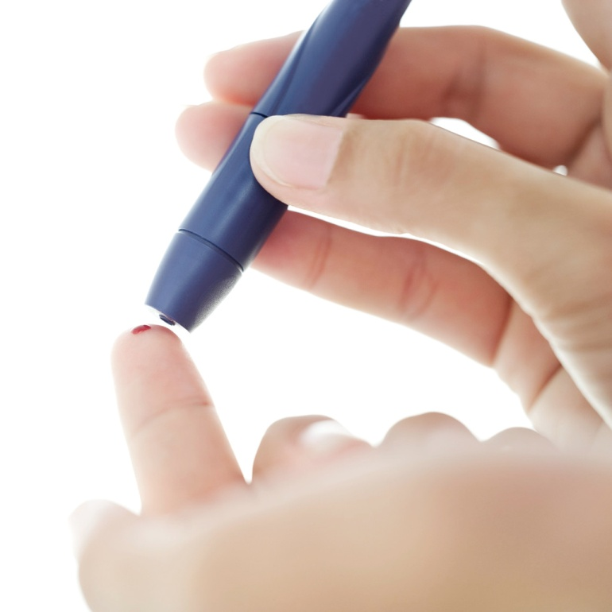
The estimated total healthcare cost and productivity losses as a result of diabetes in 2005 were $1.23 billion (EUR920m) for Sweden.
With an estimated 350,000 people affected nationally, the number of people impacted yearly is immeasurable.

Slide 7
What is the country doing to treat? What they are doing for prevention is not working!!!!!
Stockholm Diabetes Prevention Program
In 1995 a prevention program was implemented to help combat the growing number of type 2 diabetes in Sweden – lots of community based prevention.
Targets of the program are obesity, poor diet, inactivity, and tobacco use.

Slide 8
The program continues to be implemented for educational purposes while interest and responsibility continue to grow.
Poorer lifestyle habits and an excess of fatty foods are thought to be the reasons behind the constant increase of type 2 diabetes among children, young people and adults.

Slide 9
Many of those suffering from a heart attack have or discover that they have diabetes when they seek care. Of all those suffering heart attacks, over 75 percent have diabetes or the first stages of the illness.
The number of cases of type 1 diabetes has doubled among children aged under 15-years-old over the past 20 years with around 800 children getting sick each year. It is estimated that 4% of the population have Type 2 diabetes.

Slide 10
http://onlinelibrary.wiley.com/doi/10.1111/j.1464-5491.2009.02786.x/abstract
http://translate.googleusercontent.com/translate_c?hl=en&sl=sv&u=http://www.diabetesfonden.se/Om-diabetes/&prev=/search%3Fq%3Dswedish%2Bdiabetes%2Bassociation%26hl%3Den%26rls%3Dcom.microsoft:en-us:IE-SearchBox%26rlz%3D1I7DKUS_en%26prmd%3Divns&rurl=translate.google.com&usg=ALkJrhjDQf6wUUwFgQKS5Dm5jG7eGj7hUw
http://www.state.gov/r/pa/ei/bgn/2880.htm
http://www.prospects.ac.uk/sweden_job_market.htm
http://heapro.oxfordjournals.org/content/17/4/317.abstract
http://www.thelocal.se/30196/20101113/

