Slide 1
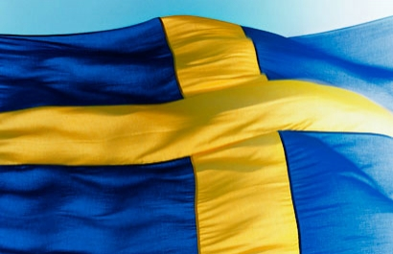
Diabetes Mellitus in Sweden
Revenge of the Meatballs

Slide 2
.Sweden by the numbers
Capitol: Stockholm
Area: 174,000 sq mi (450,000 km²)
Population: 9,088,728
Government: Constitutional Monarchy
Monarch: King Carl XVI Gustav
Language: Swedish
Religion: Evangelical Lutheran (87%)
Notes:
Stolckholm is also highest populated sity
It is slightly larger than california
USA is at 311,800,00 in population
Other 13% of religions include Roman Catholic, Baptist, Orthodox, Jewish, Muslim, buddist

Slide 4
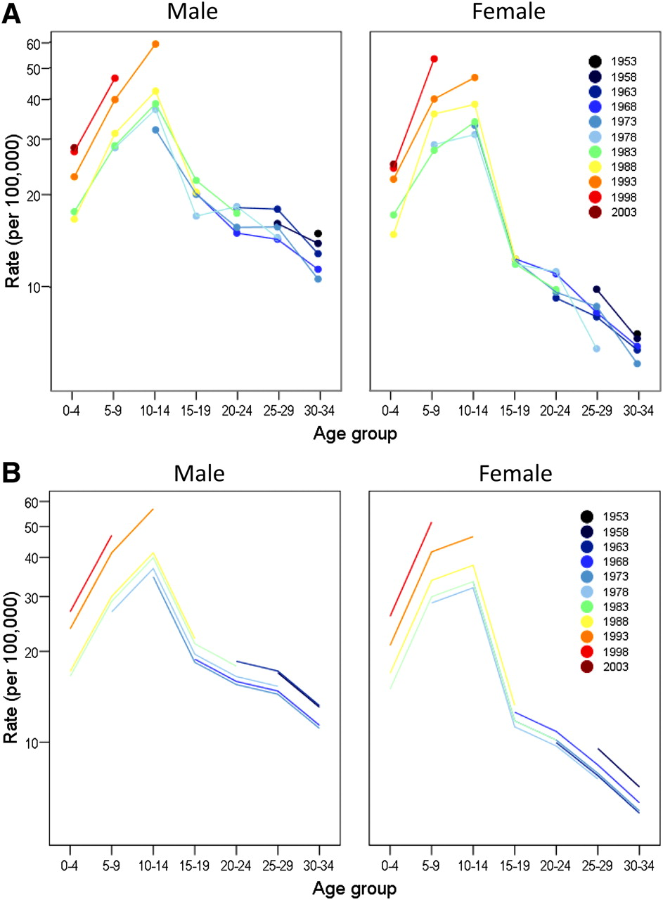

Observed incidence rates by 5-year birth cohort (A) and fitted incidence rates obtained from the age-cohort model (B) for male and female subjects, respectively.
Dahlquist G G et al. Dia Care 2011;34:1754-1759
Copyright © 2011 American Diabetes Association, Inc.
Notes:
Observed incidence rates by 5-year birth cohort (A) and fitted incidence rates obtained from the age-cohort model (B) for male and female subjects, respectively.

