Slide 1
Strokes in Poland
Allison Stevens and Toni Baker

Slide 2
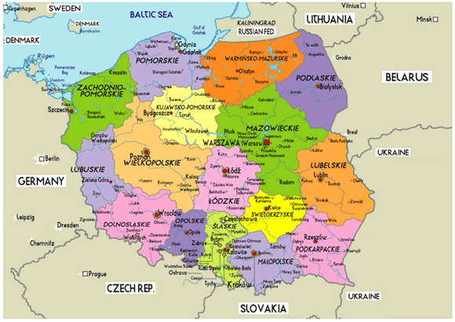
Poland

Slide 3
Poland
(as of July 2011)
Population: 38,415,284; 313,847,465
Birth Rate: 9.96 births/1,000 population; 13.68 births/1,000 population
Death Rate: 10.24 deaths/1,000 population; 8.39 deaths/1,000 population
Infant Mortality Rate: 6.42 deaths/1,000 live births; 5.98 deaths/1,000 live births
Life Expectancy Rate at Birth: 76.25 years; 78.49 years
Literacy Rate: 99.8%; 99%
Notes:
Orange Font- USA

Slide 4
Poland
Health Expenditures: 7.1% of GDP (2009); 16.2% of GDP (2009)
Physicians Density: 2.144 physicians/1,000 population (2008); 2.672 physicians/1,000 population (2004)
Hospital Bed Density: 6.62 beds/1,000 population (2008); 3.1 beds/1,000 population (2008)
Obesity (adult prevalence): 18% (2001); 33.9% (2006)
Notes:
Orange Font- USA

Slide 5
Poland
Annual incidence of cerebral strokes: 60,000
177/100,000 in males
125/100,000 in females
Notes:
In Poland the annual incidence of cerebral stroke is 60,000 and half these patients die within one year.
while the remaining one-half has permanent consequences of central nervous system damage.
The incidence of stroke is in Poland similar to that in other European countries /the incidence rate is 177/100,000 in males and 125/100,000 in females/ but the death rate of 106/100,000 in males and 79/100,000 in females is among the highest in Europe.
One of the main causes of this high death rate is the high mortality in early phase of stroke.
On the basis of prospective epidemiological studies of the population in a district of Warsaw it was shown that extracerebral complication were one of the main causes of death in stroke patients.
The analysis of the results of these studies served for construction of a model of independent factors increasing the risk of early death after stroke. These factors include age, stroke type, intensity of neurological signs and coexistence of other diseases. In Poland the high prevalence of the risk factors for vascular diseases and frequent coexistence of heart diseases are among the main causes of the high death rate in stroke. Cardiovascular diseases in stroke patients affect both the early and the late mortality through increasing the risk of systemic complication and second stroke.

Slide 6
Citations
"Poland Demographics Profile 2012."Index Mundi - Country Facts. N.p., n.d. Web. 22 Feb. 2013. <http://www.indexmundi.com/poland/demographics_profile.html>.
"United States Demographics Profile 2012." Index Mundi - Country Facts. N.p., n.d. Web. 22 Feb. 2013. <http://www.indexmundi.com/united_states/demographics_profile.html>.
"[Epidemiology of cerebral stroke in Pol... [Neurol Neurochir Pol. 1999] - PubMed - NCBI." National Center for Biotechnology Information. N.p., n.d. Web. 22 Feb. 2013. <http://www.ncbi.nlm.nih.gov/pubmed/11107570>.

