Slide 1
Stroke: Korea
Stephanie Salyer
Samantha Heydinger

Slide 2
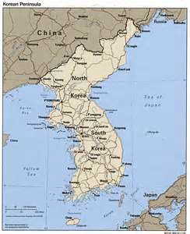
Map of Korea
Separated into North and South
*N. Korea has approx. 25mil ppl
*S. Korea has approx. 50mil ppl
* About the size of Utah, located on penninsula

Slide 3
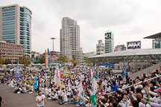
population
Highly dense
Most of population found on western coastal plains
Inhabited by mostly Koreans, very small groups of other ethnicities
People migrating to cities from rural areas due to war and lack of rural jobs
Birth rate has dropped to below replacement level, making for older population

Slide 4
Education and Income
Education | Salary Entries | Average Gross Salary | Gross (USD)
Less Than High School | 3 | 12,200,000 KRW | $10,755
High School | 14 | 33,965,000 KRW | $29,942
Some College | 7 | 41,333,790 KRW | $36,438
Bachelors Degree | 134 | 65,977,204 KRW | $58,163
Masters Degree | 62 | 72,319,352 KRW | $63,754
Doctorate Degree | 13 | 59,515,384 KRW | $52,467
Less than high school = 1.3%
High School = 6%
Some college = 3%
Bachelor’s degree = 57.5%
Master’s = 26.6%
Doctorate = 5.6%

Slide 5
Family Dynamics
Families headed by men.
Daughters play little to no role in family because they leave to marry into another family
Younger generation responsible for older generation
Strong respect for their elders
Discipline is with held until school age in which case it becomes a priority seeing as how unruly children are seen as a disgrace to the family
Children with disabilities are seen as punishment to parents from the older generation

Slide 6

Nutrition
Mostly vegetables and rice
Small amounts of meat
3 meals daily usually eaten in silence
Generally lower intake of calories, sugar, and fat
Common Seasonings: garlic, ginger, red and black pepper, green onion, sesame oil, and soy sauce
Mixed veggies and rice

Slide 7
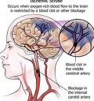
Stroke
A stroke is a sudden death of brain cells due to inadequate blood flow

Slide 8
Stroke in Korea
Stroke is second leading health problem in Korea
Annually, 105,000 people experience new/recurring stroke
Estimated 26,000 die from stroke
Accounts for 1 out of 10 deaths
795,000 koreans believed to be living with stroke in > 30 year olds

Slide 9
Stats
Total cost of care was estimated to be 3,737 billion Korean won ($3.3 billion USD) in 2005
90 day mortality rate = 3-7% ischemic stroke, 17% intracerebral hemorrhage
High population suffering from stroke also has diabetes, HTN, and high cholesterol
48% of Koreans smoke

Slide 10
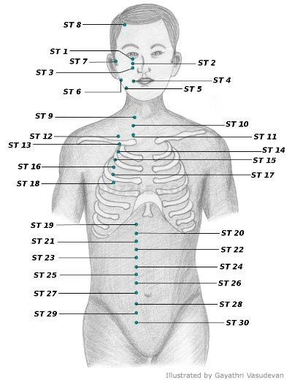
Care
Use of stroke intensive care units to help decrease mortality rate
Goal is to receive treatment within 48hrs of incident
Stroke ICU can reduce 50% patient dependency
Acupunture to alleviate clotting and inflammation caused by stroke

Slide 11
prevention
Treatment of hyperlipidemia
In symptomatic ischemic stroke target LDL cholesterol= <100mg/dl
Smoking cessation, and avoidance of second hand smoke
Reduction of alcohol use
Weight loss, physical activity
Reduction of Na intake, increasing K intake
Antiplatelet therapy, 50-300mg aspirin daily

Slide 12
References
www.cotf.edu. Chris Kreger. Last updated April 28.2005.
www.-nt.who.int/whosis/statistics
Journal of Stroke 2013;15(1):2-20.Published online 2012 Nov.30.
http://Stroke.anajournals.org/content/39

