Slide 1
Stroke in England
Jeremiah James Bunce III
Nicholas Adam Simonovich

Slide 2


Slide 3
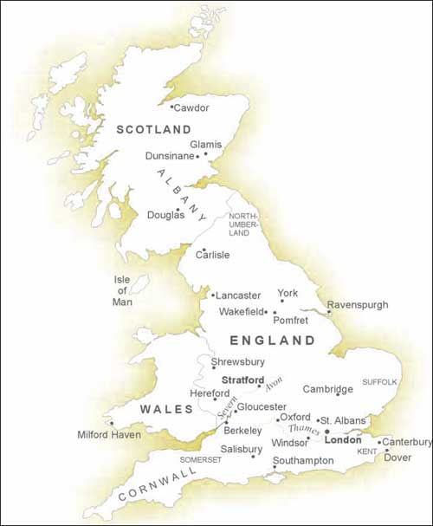
DEMOGRAPHICS
Size
England makes up 80 % of United Kingdom
Population
Over 50,000,000 inhabitants
Equally Male and Female population
Median age is (36) and (37)
90% Caucasian

Slide 4

RELIGION
70% of residents belong to a Christian church
15% of residents identify themselves as agnostic or atheist
Other Religions:
  Hinduism
  Islam
  Buddhism
  Judaism

Slide 5
DEMOGRAPHICS
HOUSE HOLD
Life Expectancy
  Male-77 years old
  Female-81 years old
Income
  Median Household income :
  £21,316
  $28,516
70% of households have no children
50% of households are married

Slide 6
Healthcare in England
The National Health Service provides free healthcare for all residents of the UK
The English NHS cares for 49 million people
US public healthcare currently covers about 83 million
33 hospital beds per 10,000 people
27 physicians per 10,000 people
101 nurses per 10,000 people
  Compared to 98/10,000 in the U.S.
Notes:
The NHS is funded by general taxation and is run by the Department of Health
49 million=100% of the population of England
83 million=around 28% of the US population

Slide 7
Stroke Statistics
Stroke is the leading cause of adult disability
More than half are left dependent on others for ADL’s
Increased BP is the highest risk factor for stroke
  Approx. 50% of all strokes
1/5 of strokes are fatal
In 2010, stroke was the 4th largest cause of death in the UK
Notes:
1/5=
7% of death in men
10% of deaths in women
2010=causing almost 50,000 deaths

Slide 8
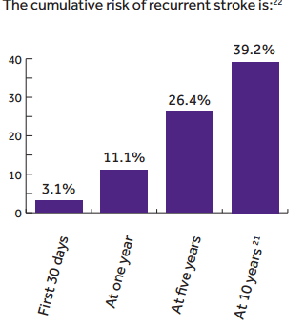
Statistics cont..
Yearly incidence of stroke in England:
  178 per 100,000 men
  139 per 100,000 women
Prevalence of stroke:
  2.4% in men
  2.2% in women
Total number of deaths from stoke 2010
  15,824 Males
  24,743 Females
  40,567 Total
Over 80,000 people are admitted to the hospital after stroke each year in England
There are currently over 900,000 people living in England who have had a stroke
  300,000 who are living with a moderate to severe disability as a result
Notes:
80,000=25,00 each year for TIA
900,000=300,000 who are living with a moderate to severe disability as a result
Every 5 minutes someone in England will have a stroke

Slide 9
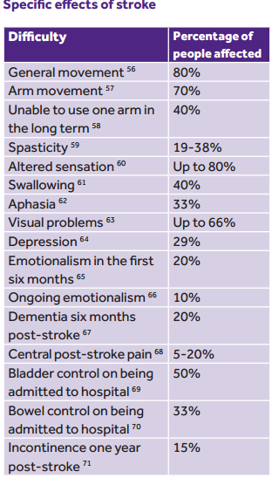
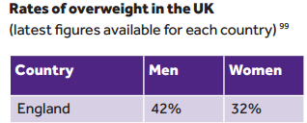
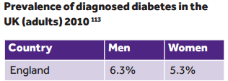
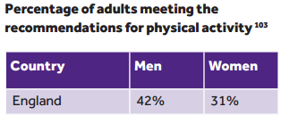
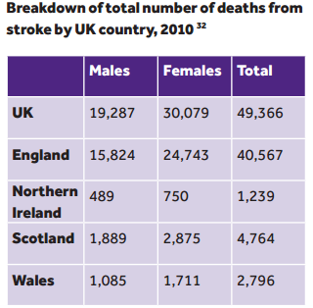

Slide 10
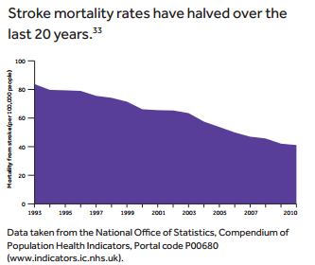
Statistics
Deaths by age:
  Under 35
    91 Males
    62 Females
  35-44
    224 Males
    131 Females
  45-54
    515 Males
    425 Females
  55-64
    1,126 Males
    813 Females
  65-74
    2,883 Males
    2,326 Females
  75+
    14,448 Males
    26,322 Females

Slide 11
Cost
It is estimated to cost England’s economy $9.4 billion per year
Costs of informal care of $3.2 billion
Costs because of lost productivity and disability of $2.4 billion
Stroke patients occupy around 20% of all acute hospital beds and 25% of long-term beds
Notes:
9.4 billion=$7.4 million per 100,000 people
For every cancer pt in the UK, $396 is spent each year on medical research compared to $30 for every stroke pt

Slide 12
Treatment
A rapid response to a 999 call for suspected stroke
Prompt transfer to a hospital providing specialist care
An urgent brain scan
  CT scan
Immediate access to a high quality stroke unit
Early multidisciplinary assessment, including swallowing screening
Stroke specialized rehabilitation
Notes:
Same as 911 in the U.S

Slide 13
Treatment
Ischemic:
  Alteplase (tPa)
    “clot-buster” must be given within four and a half hours of symptoms
  Aspirin
  Heparin, Warfarin, Rivaroxaban
  BP medications (beta-blockers)
  Cholesterol lowering agent (Statin)
  Carotid stenosis
Hemorrhagic:
  Craniotomy
  ACE inhibitors to lower BP to prevent further strokes
Carotid endarterctomy reduces the risk of stroke by 16% in people with severe stenosis
Notes:
Craniotomy-small section of the skull is cut away to repair blood vessels and blood clots

Slide 14
Treatment
For every 1,000 patients who receive thrombolytic therapy, 80 will live more independently
Only 5% of patients received thrombolytic treatment in 2010
Patients cared for in a defined stroke unit with organized stroke services are more likely to survive, have fewer complications, and gain independence more quickly than pt’s on general medical wards
There are over 21,000 surgical procedures related to stoke each year in England
Notes:
5%=Improvement from 1.8% in 2008
Mean length of stay for stroke patients has decreased significantly
32 days in 2000
20 days in 2010

Slide 15
Preventing Stroke
Smoking
Inactivity
Alcohol
Diet
Losing weight
Notes:
smokers are twice at risk
people who are physically inactive are at twice the risk than those who are moderately active
binge drinking and regular heavy alcohol intake increase the risk of stroke
Weight=this can reduce substantially the chances of developing diabetes and high blood pressure, two major risk factors for stroke

Slide 16
Stroke Prevention
The NHS have given the go-ahead for a drug that could revolutionize stroke prevention
Pradaxa, the first anti-clotting agent to be developed in 60 years, could prevent up to 5,000 strokes per year
  Almost one million patients suffering an irregular heartbeat could be eligible
Pradaxa, also known as dabigatran, works as well as warfarin, and is almost one-third more effective at reducing the risk of stroke
Patients taking the capsules do not have to be constantly checked, can eat what they like and it is much easier to use with other medicines

Slide 17
NHS Health Check
The Department of Health offers the NHS Health Check to all people between the ages of 40 and 74 in England
The NHS Health Check assesses people’s risk of heart disease, stroke, kidney disease and diabetes by looking at their age, gender, family history, height and weight, as well as their blood pressure and cholesterol levels
Everyone receives a personal assessment, setting out personal levels of risk and strategies to reduce it.
  Those at the highest risk might require preventive medication with statins or blood pressure treatment.
NHS Health Checks have the potential to prevent 1,600 heart attacks and strokes and save up to 650 lives each year.

Slide 18
References
http://www.dailymail.co.uk/health/article-2115136/New-blood-thinning-drug-stop-5-000-strokes-year.html
http://www.stroke.org.uk/resource-sheet/stroke-statistics
http://www.nice.org.uk/media/87D/33/StrokeCostingCommissioningAssessment.pdf
http://www.cqc.org.uk/sites/default/files/media/documents/supporting_life_after_stroke_national_report.pdf

