Slide 1


Strokes in England
Angela Risaliti
Kurtis Hupp
Tommy Manuguerra

Slide 3
A little about England…
England is 130,400 sq/km (size of Oregon)
Its population consist of 50.5 million people
Life expectancy for males is 77
Life expectancy for females is 81
Median age 36-37
Hosted the first hot chocolate store in 1600
Gulp down more tea than any other country
More then 300 languages spoken in England
1,135 Hospital (4.2 per 1000 for Hospital Beds)

Slide 4
A little more about England..
Ranked 3rd for obesity (23%)
Ranked 160 for stroke death rate (39.6 per 1000)

Slide 5
Healthcare in England
is called “National Health Service”
11% per pound weekly is contributed by citizens
Provides free walk-ins with few extra charges
More geared for the elderly and disabled
86% of prescriptions are provided free
They also offer private insurance funded by contributions
This private insurance is used by a limited number of people
Patients with the private health care are treated quicker, but Emergency situations still come first

Slide 6
Strokes in England
Every 5 minutes someone in England suffers from a stroke
One in four expected to have stroke by 85 years of age
110,000 new strokes, 30,000 recurrent strokes (795,000 in US)
Responsible for 11% of deaths leaving about 250,000 disabled per year
Over 900,000 are living in England with a previous stroke
The 3rd largest cause of death in England (behind coronary artery disease and cancer)
Strokes cost the health care system 7 billion euros a year ($9.2 billion)

Slide 7
Stroke treatment in England
England uses many of the same options as us including:
Anticoagulant therapy
ACE inhibitors (even patients with normal BP)
Antithrombotic therapy (4 1/2 hour window for England)
Thiazine Diuretics
CT scan asap/MRI
England does have Primary Stoke Centers just like us that are stacked with:
24/7 specially trained doctors and staff for TPA administration (neurologist, neurosurgeons, nurses, lab techs and CT techs)

Slide 8
Pradaxa
Anticoagulant
Clinical studies found it reduced brain attacks by more than 1/3 among the elderly with atrial fibrillation compared to warfarin.
As opposed to warfarin, there are absolutely no diet restrictions on Pardaxa (vitamin K)
The pill cost 2.52 euros a day ($3.31)
Just approved in the United States in 2010

Slide 9
Prevention tactics England
Doctors encourage Exercise, Healthy Diet, Cholesterol/BP management
The Act F.A.S.T Campaigned
Launched in 2009
Face, Arm, Speech and Time
Helps people to recognize signs of stroke for emergent treatment

Slide 10
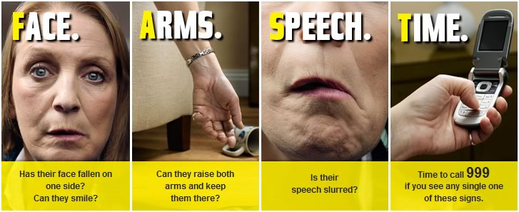
ACT F.A.S.T. to Prevent a Stroke

Slide 11
References
http://www.dh.gov.uk/en/Healthcare/Primarycare/PMC/index.htm
http://www.trcb.com/health-and-fitness/healthcare-systems/englands-health-care-system-2505.htm
http://www.uky.edu/PR/News/Archives/2005/Apr2005/050412_stroke_center.htm
http://www.worldlifeexpectancy.com/cause-of-death/stroke/by-country/
http://www.strokeunitglos.nhs.uk/strokeunitgl280692.html
http://www.hospitalsworldwide.com/countries/uk.php
http://www.nhs.uk/conditions/Stroke/Pages/Introduction.aspx?WT.mc_id=110901

