Slide 1
Pulmonic stenosis
Stephany claus and danielle gangluff

Slide 2
Description of defect
Congenital Heart Defect
It is classified as an obstructive defect. This means that there is obstruction of blood that is exiting the heart due to the narrowing of blood vessels. The narrowing of the blood vessels normally occurs near a valve.
It occurs due to abnormal development of the fetal heart during the first eight weeks of gestation.

Slide 3
Description of defect
Pulmonic Stenosis is the narrowing of the pulmonary artery. This causes resistance to blood flow which leads to right ventricular hypertrophy. This decreases blood flow to the lungs. The extreme form is pulmonary atresia; this means that there is total fusion of the commissures and no blood flow to the lungs. The right ventricle may be hypoplastic.
In children these problems include a valve with partially fused leaflets; A valve with thick leaflets that do not open all the way or a narrowing above or below the pulmonary valve.

Slide 4
Types of pulmonary stenosis
Valvar: The leaflets are thickened and/or narrowed.
Supravalvar: The artery just above the valve is narrowed.
Subvalvar (infundibular): The muscle under the valve is thickened narrowing the outflow from the right ventricle.
Branch Peripheral: Right and/or left pulmonary artery is narrowed.

Slide 5
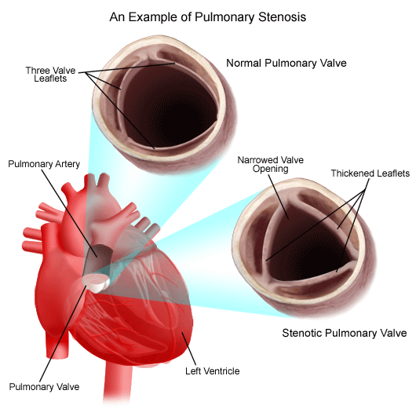

Slide 6
Pathophysiology
Pulmonic Stenosis causes resistance to blood flow which results in right ventricular hypertrophy. If right ventricular failure develops right arterial pressure increases this causes the foramen ovale to reopen. This pushes the unoxygenated blood into the left atrium causes systemic cyanosis. If pulmonic stenosis is severe CHF may occur this results in systemic venous engorgement . PDA (patent ductus arteriosus) this compensates for the obstruction by pushing the blood from the aorta to the pulmonary artery into the lungs. Some of these may have a genetic link causing heart problems to occur more in certain families.

Slide 7
Clinical manifestations
Patients may be asymptomatic
If the patient has CHF some mild cyanosis may occur. As the narrowing progresses the symptoms increase. Newborns that have cyanosis also have severe narrowing along with a loud systolic ejection murmur at the sternal border on the left side. However, the murmur may be softer in ill patients due to shunting of blood and decreased cardiac output. On chest films there is evidence of cardiomegaly, this increases the risk of bacterial endocarditis. Some other symptoms include heavy or rapid breathing, SOB, fatigue, tachycardia, decreased output, and swelling in the feet, ankles, face, eye lids, and/or abdomen, chest pain, and fainting.

Slide 8
Surgical treatment
In infants closed transventricular valvotomy also known as Brock procedure is performed. In children pulmonary valvotomy with cardiopulmonary bipass is performed. However, the need for surgical treatment is rare with the use of balloon angioplasty techniques. Valvectomy to widen the outflow into the pulmonary artery may be performed, also patch enlargement may be selected to enlarge the narrowed areas. Pulmonary valve replacement to replace the valves that are defective.

Slide 9
Nonsurgical treatment
Balloon angioplasty is used to dilate the valve, a catheter is inserted through the femur into the stenotic pulmonic valve to the pulmonary artery where the balloon is inflated and passed through the narrowed opening. This procedure is highly effected with few complications. It is the treatment of choice for discrete pulmonary stenosis and is done safely in neonates.

Slide 10
Medical treatment
Most cases do not require treatment. Moderate-severe stenosis is treated with non surgical treatment or surgical treatment. When symptoms are mild then treatments are not usually needed and they are required to have routine checkups.
In mild to moderate cases lifestyle changes such as dietary modifications, stress reduction, and exercise may contribute to increased wellness. However they should talk with their physician first.

Slide 11
Prognosis
Risk is low for both surgical and non surgical procedures. Both balloon dilation and surgical valvotomy leave the pulmonic valve incompetent because the opening of the fused valve leaflets. These patients are clinically asymptomatic, and long term problems with restenosis or valve incompetence may occur. 1/3 of patients with mild stenosis get better while 1/3 also stay the same, and 1/3 become worse. Some valves may wear down, but others can last for decades.

