Slide 1
Pulmonic Stenosis
Sandra Bockmore
Louise Cook
Nancy Montgomery

Slide 2
Pulmonic Stenosis
Condition in which the flow of blood from your heart to your lungs is slowed by a deformed pulmonary valve, narrowing at the entrance to the pulmonary artery, or a deformity above or below the valve. Although pulmonary valve stenosis is the most common type of pulmonary stenosis there are two other types:
Subvalvular- occurs below the valve
Suprvalvular- occurs above the valve
Resistance to blood flow causes right ventricular hypertrophy and decreased pulmonary blood flow.
Usually develops at birth, but occasionally adults have the condition as a complication of another illness.
Pulmonary Atresia- extreme form of PS. Total perfusion of the commissures and no blood flow to the lungs. The right ventricle may be hypoplastic.

Slide 3
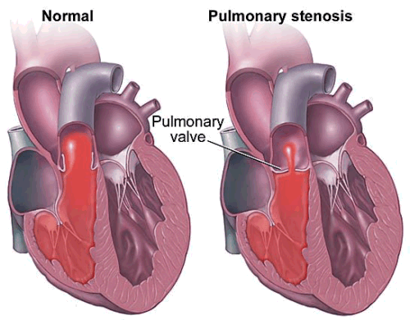
heart’s filling and pumping cycle can be disturbed as the muscle becomes abnormal.

Slide 4
Pathophysiology
If PS present, resistance to blood flow causes right ventricular hypertrophy. If right ventricular failure develops, right atrial pressure increases, may result in reopening of the foramen ovale, shunting of unoxygenated blood into the left atrium.
If PS severe: CHF occurs, systemic venous engorgement is noted.
An associated defect, such as patent ductus arteriosus, partially compensates for the obstruction by shunting blood from the aorta to the pulmonary artery and into the lungs.

Slide 5
Clinical Manifestations
PS symptoms vary, depending on the extent to which the valve is obstructed.
May be asymptomatic
Mild cyanosis or CHF
Shortness of breath, especially on exertion
Chest pain
Loss of consciousness (fainting)
fatigue
Newborns with severe narrowing will be cyanotic
Loud systolic ejection murmur at the upper left sternal border. In severely ill patient’s the murmur may be softer due to decreased cardiac output and shunting of the blood
Cardiomegaly, heart enlargement, is evident on radiographic films
Patient’s are at risk for bacterial endocarditis, infection of either the heart’s inner lining (endocardium) or the heart valves.

Slide 6
Risk Factors
Because most causes develop before birth, there are not many known risk factors. However, certain conditions can increase your risk of developing PS, including:
Carcinoid Syndrome- Carcinoid syndrome is a group of symptoms associated with carcinoid tumors -- tumors of the small intestine, colon, appendix, and bronchial tubes in the lungs
Rheumatic Fever- Rheumatic fever is an inflammatory disease that may develop after an infection with Streptococcus bacteria (such as strep throat or scarlet fever). The disease can affect the heart, joints, skin, and brain.
Noonan’s Syndrome- Noonan syndrome is a disease passed down through families (inherited) that causes abnormal development in many parts of the body. It used to be called Turner-like syndrome.

Slide 7
Complications
Complications of mild to moderate PS generally don’t cause complications. However, severe PS may be associated with:
Infection-endocarditis
Heart pumping problems- right ventricle must pump harder to force blood into the pulmonary artery. Pumping against increased pressure causes the muscular wall of the ventricle to thicken and the chamber within to enlarge. Eventually the heart becomes stiff and may become weakened.
Heart Failure-if right ventricle becomes weak and unable to pump, heart failure develops. Result; swelling of legs and abdomen, and can also cause fatigue and shortness of breath
Irregular heartbeat (arryhthmia)- Unless PS is severe, irregular heartbeats are not life-threatening.

Slide 8
Test and Diagnosis
PS is often diagnosed in childhood, but sometimes it isn’t detected until later in life. If a murmur is heard in the left upper area of your chest a doctor may suspect PS.
A variety of tests may be used to confirm the diagnosis:
Electrocardiogram
Echocardiography
MRI
CT
Cardiac catheterization

Slide 9
Treatment
Some cases of PS are mild and don’t require treatment except for routine checkups.
If severe treatment may be:
Balloon valvuloplasty- tends to be first choice of treatment. During this procedure, a small tube is thread through a vein in your leg to your heart. A balloon is placed through the opening of the narrowed pulmonary valve and then inflated opening up the narrowed pulmonary valve and increasing the area available for blood flow. The balloon is then removed. balloon valvuloplasty can not be used for cases of PS that occur above or below the pulmonary valve.
Open-heart surgery- A doctor repairs the pulmonary artery or the valve to allow blood to pass through more easily. In some cases the pulmonary valve may be replaced with an artificial valve.

Slide 10
Treatment
In the past, people with heart valve problems were advised to take antibiotics before certain dental and surgical procedures to prevent bacteria from causing infection. However, recommendations from the American College of Cardiology and the American Heart Association advise that antibiotics are no longer necessary for people who have only PS. If the pulmonary valve was replaced, you may still need preventive antibiotics before procedures. Talk to the physician for specific recommendations.
Pregnancy generally is not a problem for women with mild to moderate PS. If patient has severe PS, risks of complications during labor and delivery are higher than those for women without the condition. If necessary, it is possible to undergo balloon valvuloplasty during pregnancy.

Slide 11
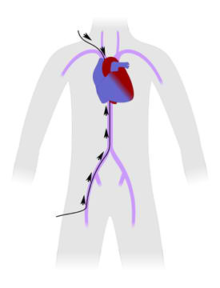
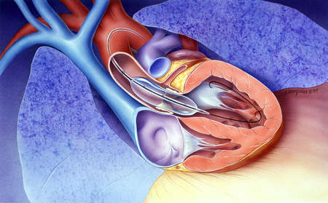
Balloon valvuloplasty

Slide 12
Prognosis
The outcome is good. Patients with mild pulmonary stenosis do quite well, less than 5% will have progressive obstruction. On the other hand, if the obstruction is moderate-severe, then most of the time they will require Balloon Valvuloplasty. Balloon valvuloplasty is quite effective but will leave some degree of leakage (pulmonary regurgitation) in the pulmonary valve. These patients, however, usually do not require any further intervention. The life expectancy in patients with PS is normal. They will not have any restrictions.
In cases of critical pulmonary stenosis in newborns, the prognosis may depend on the size of the right ventricle and its function. As time passes, the size of the right ventricle may improve.
Virtually all patients with PS will be able to participate in competitive sports.

