Slide 1
Major Milestones during the Toddler Years
Age (mo) | Gross Motor | Fine Motor | Sensory | Socialization
15 | Walks w/o help (usually since 13mo) Creeps up stairs Runs clumsily | Constants casting of objects onto the floor Builds towers of cubes Uses cup but rotates spoon before reaching mouth | Places round object into appropriate hole Able to recognize geometric forms | Tolerates some separation from parent Begins imitating parents Kisses and hugs parents Less fear of strangers
18 | Stands w/o support Walks up stairs with one hand held Pulls and pushes toys jumps in place w/both feet Throws ball overhand w/o falling | Builds tower of 3-4 cubes Turns pages of book Manages spoon w/o rotation |  | Temper tantrums Great imitator Unzips, takes off shoes socks Aware of ownership(my toy) Dependence on transitional objects (blankie)
Age | Gross Motor | Fine Motor

Slide 2
Major Milestones during the Toddler Years
Age (mo) | Gross Motor | Fine Motor | Sensory | Socialization
24 | Goes up/down stairs alone Runs fairly well w/wide stance Picks up object w/o falling Kicks ball forward w/o overbalancing | Builds tower of 6-7 cubes Aligns 2 or more cubes like train Turns book pages 1 at time Turns doorknob When drawing imitates vertical/circular strokes | Accommodation well developed Able to insert square block into oblong space | Stage of parallel play Sustained attention span Temper tantrums decreasing Pulls people to show them something Increases independence from parents Dresses self in simple clothing Develops visual recog. and verbal self reference (Me big)
Age | Gross Motor | Fine Motor

Slide 3
Major Milestones during the Toddler Years
Age (mo) | Gross Motor | Fine Motor | Sensory | Socialization
30 | Jumps with both feet Jumps from chair to step Stands on 1 foot momentarily Takes a few steps on tiptoe | Build tower of 8 cubes Adds chimney to train of cubes Good hand finger coordination (holds crayon w/fingers rather than fist) Moves fingers independently In drawing imitates vertical/horizontal strokes makes 2 or more strokes for a cross |  | Separates more easily from parents In play, helps put things away Can carry breakable objects Pushes w/good steering Begins to notice sex differences; knows own sex May attend to toilet needs except wiping Emotions expand to include pride, shame, guilt, and embarrassment
Age | Gross Motor | Fine Motor

Slide 4

Psychosocial Development of Toddlers
Tasks to be dealt with include:
-Differentiation of self from others, particularly the mother
-toleration of separation from parent
-ability to delay gratification
-control over body functions
-acquisition of socially acceptable behavior
-verbal means of communication
-ability to interact with others in a less egocentric manner
Some of these tasks may not be completed until adolescence.

Slide 5

Developing a sense of autonomy (Erikson)
The developmental task of toddlerhood is acquiring a sense of autonomy while overcoming a sense of doubt and shame.
To promote autonomy allow the toddler to perform tasks independently.
During this struggle to achieve autonomy characteristics such as negativism are common. The word no becomes persistent and rapid mood swings can be involved. This can lead to temper tantrums. When scolded the child almost instantly needs comforted.
Parents can try to offer the child choices when appropriate and when child
is negative parents need to proceed as plannedand make the choice for the child.
Ritualism is also common. Maintaining sameness and reliability
provides a sense of comfort in the environment which allows the child
to safely exert their autonomy.

Slide 6
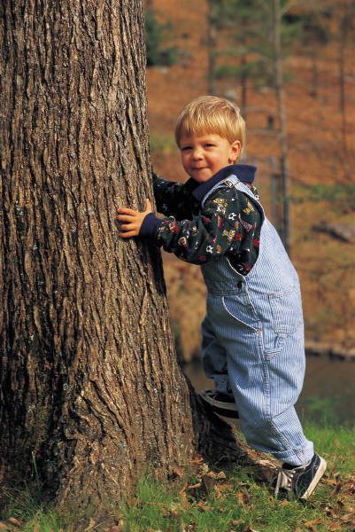
Toilet Training: Assessing Readiness
1. Physical readiness is usually by 18-24 mo of age
2. Child needs to have the ability to stay dry for two or more hours and have regular bowel movements.
3. Child needs to recognize the urge to defecate or urinate, be able to communicate the need, and then follow directions for the appropriate behavior.
4. Child needs to express willingness to please parents, have the ability to sit on potty for 5-10 minutes w/o fussing, and shows an immediate need to change a wet/dirty diaper.
5. Parents need to recognize child’s readiness and be willing to invest the time necessary for toilet training.

Slide 7
Toilet Training Tips for Parents
Begin when toddler demonstrates readiness.
Provide a pleasant mood.
Use a potty seat or potty chair.
Be aware that the child is curious about excretion products
Don’t refer to bowel movements as being “dirty” or “yucky”.
Teach hand washing.
Teach front to back wiping.

Slide 8
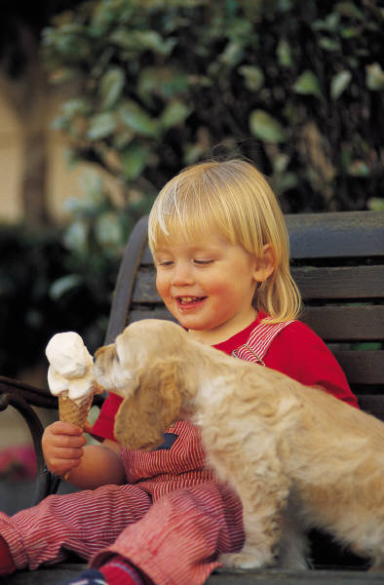
Toddler Nutrition
From 12-18 mos growth rate slows, decreasing the child’s need for calories, protein, and fluid. These needs should be based on the Food Pyramid guidelines for example milk intake decreases to 2-3 servings a day. Portions should not be adult size and be appropriate for their age. Use the guidelines:
-1tbsp of solid food per year of age or 1/4 to 1/3 the size of the adult portion.
Decreased appetite is apparent (physiologic anorexia); child may appear to be a picky eater. They are unaware of the nutritional value of food and begin to recognize the pleasure of eating and the social aspect of mealtime. They may refuse to eat a food that they see someone else refuse.
Do not force a toddler to eat this can promote future eating problems instead offer finger foods and provide choices.

Slide 9
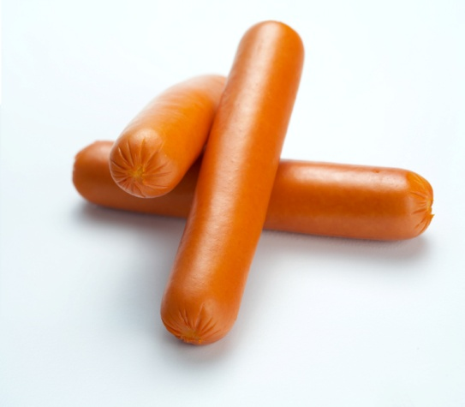
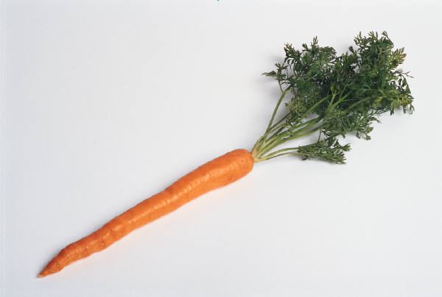

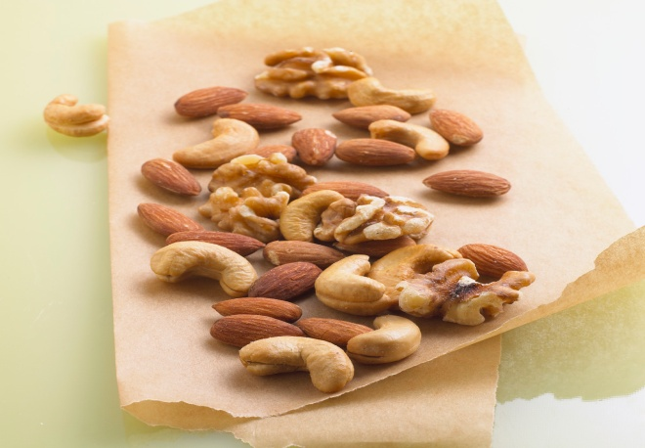


Dangerous Foods for Toddlers
Some foods are easily aspirated by toddlers.
Foods to avoid include:
Nuts
hotdogs
grapes
candy
carrots
popcorn
fruit gel snacks

