Slide 1

MULTIPLE SCLEROSIS
BY: DOT AUSTIN

Slide 2
MULTIPLE SCLEROSIS
A chronic, often disabling neurologic disease that affects
the myelin sheath (a highly conductive fatty material that protects the nerve fibers) of the white matter of the central nervous system (CNS), which is made up of the brain, spinal cord, and optic nerves.
MS is classified as an autoimmune disease, in which your
T cells (lymphocytes) attack its own cells.
Characterized by chronic inflammation, demyelination and
Gliosis (scarring) in the CNS.
MS affects quality rather than duration of life.

Slide 3
MULTIPLE SCLEROSIS
The damaged myelin is replaced by the glial scar tissue
which forms hard, sclerotic plaques in multiple areas of the CNS, often referred to as lesions.
When any part of the myelin sheath is damaged or
destroyed, nerve impulses traveling from the brain and spinal cord are distorted or interrupted, producing the variety of symptoms that can occur.
MS is unpredictable and has a variety of symptoms
No person will have exactly the same symptoms and each persons symptoms can change and fluctuate over time.

Slide 4
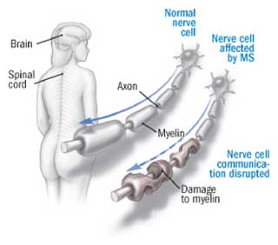

Slide 5
Ms incidence
Most common disabling disease in young to middle age adults, more than 400,000 Americans are affected, which 390,000 are adults.
Most common demyelinating disorder.
Approximately 70% of patients experience the onset of MS between ages 20-50.
Affecting women 2 to 3 times more than men.
More common in whites as contrasted with other races and ethnicities.

Slide 6
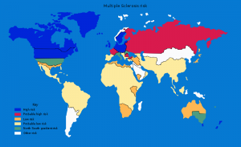
MS is 5 times more prevalent in temperate climates
(between 45 and 65 degrees of latitude), such as
Those found in northern United States, Canada and
Europe.

Slide 7
Etiology
The cause of MS is unknown, although research suggest that MS is related to infectious (viral), immunologic, genetic and environmental factors.
MS appears to be inherited- first, second and third generations of MS patients are at a slightly increased risk of acquiring the disease.
Possible precipitating factors include emotional stress, pregnancy, infection, physical injury, excessive fatigue and a poorer state of health.

Slide 8
Signs and Symptoms
Weakness or paralysis of the limbs, trunk or head
Numbness and tingling and other paresthesias
Severe fatigue
Diplopia
Nystagmus
Scototomas (patchy blindness)
Blurred vision
Vertigo
Tinnitus
Decreased hearing
Ataxic gait
Dysarthria
Dysphagia
Bowel/Bladder problems
Sexual dysfunction
Chronic neuropathic pain
Headache
Difficulties with short-term
memory, attention and
Information processing.

Slide 9
Signs and symptoms
Loss of temperature sensation
Uhtoff’s sign- decreased motor function after taking
a hot bath or shower.
Heat intolerance
Seizures
Loss of balance
Poor coordination
Muscle spasticity

Slide 10
Test and diagnosis
There is not a specific diagnosis for MS, ultimately the
goal is to rule out other conditions that may produce the same
symptoms.
Blood test- can help rule out some infections and inflammatory
diseases.
Spinal tap (lumbar puncture)- can show abnormalities found
in MS, high amounts of WBC , myelin proteins or oligoclonal bands.
MRI- can reveal lesions, indicative of myelin loss in the
brain and spinal cord.
Evoked potential test – this test measures the electrical
signals sent by your brain in response to stimuli with the use
of electrical impulses.

Slide 11
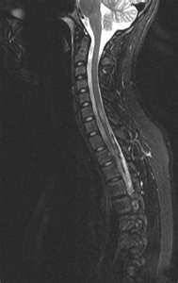
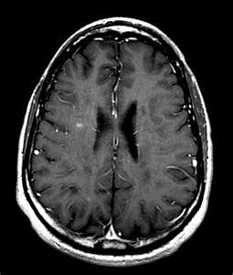
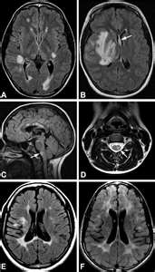
Images of lesions in the brain and spinal cord

Slide 12
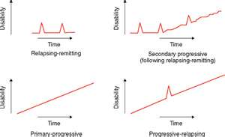
Courses of ms
Relapsing-remitting: Clearly relapsing phase with full
recovery.
85% initially diagnosed with this type of MS
Primary-progressive: slowly worsening neurologic function
from the beginning with no distinct relapses or remissions.
About 10% are diagnosed with this type of MS

Slide 13
Courses of ms
Secondary-progressive: a relapsing-remitting initial course,
followed by progression with or without occasional relapses,
minor remissions, and plateaus.
About 50% of people with relapsing-remitting MS develop this
type within 10 yrs of onset
Progressive-relapsing: progressive disease from onset,
with clear acute relapses, with or without full recovery; periods between relapses are characterized by continuing progression.
Only 5% experience this type MS

Slide 14
Treatments and medications
There is no cure for multiple sclerosis, treatments
typically focuses on strategies to treat attacks, to
modify the course of the disease and treat symptoms.
some people have such mild symptoms that no treatment
is necessary.
STATEGIES TO TREAT THE ATTACKS
Corticosteroids
-Oral prednisone and IV Methyl prednisone
Plasma exchange (plasmapherisis)

Slide 15
Treatments and medications
STRATEGIES TO MODIFY THE DISEASE
Beta Interferons- slow the rate of symptoms over time.
-Avonex, Betaseron, Extavia and Rebif
Glatiramer (Copaxone)- Works by blocking the immune
Systems attack on myelin.
Natalizumab (Tysabri)-Works by interfering with the
movement of potentianally damaged immune cells from the bloodstream to the brain and spinal cord.
Fingolimod (Gilenya)-Oral medication that work by trapping
Immune cells in lympnodes.
Mitoxantrone (Novantrone- Immunosopressant drug and
only given in severe, advanced MS.

Slide 16
Treatments and medications
STRATAGIES TO TREAT SYMPTOMS
Physical and Occupational therapy- Can teach stretching and strengthening exercises, along with proper use of assistant devices to help with ADL’s (w/c, walker, cane, special utensils and cups…)
Muscle relaxants-To help with pain and spasms
Medication to treat fatigue – May help reduce fatigue
amantadine (Symmetrel)
Other Medications- Other medications may be prescribed for pain, bowel and bladder problems and depression.
baclofen (Lioresal) and tizanidine (Zanaflex)

Slide 17
nursing management
Impaired physical mobility
Altered urinary elimination
Constipation
Activity intolerance
Knowledge deficit regarding:
-home safety, disease process,
and treatment regimens
Self esteem disturbance
Skin breakdown
Risk for self care deficit
Risk for falls
Anxiety

