Slide 1


Strokes in England
Angela Risaliti
Kurtis Hupp
Tommy Manuguerra

Slide 2
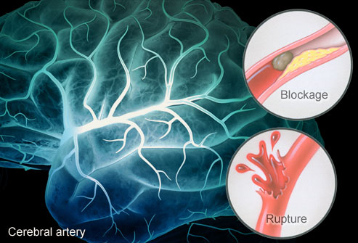

Slide 3
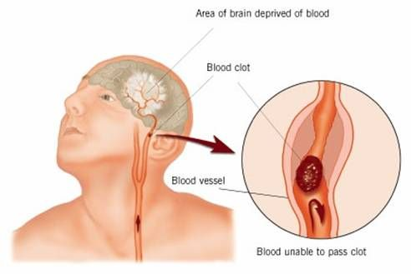
Ischemic stroke

Slide 4
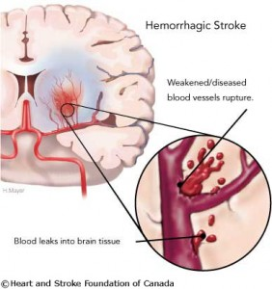
Hemorrhagic stroke

Slide 5

Breast stroke

Slide 6
A little about England…
England is 130,400 sq/km (size of Oregon)
Population = 50.5 million
Life expectancy for males is 77
Life expectancy for females is 81
Median age 36-37
Hosted the first hot chocolate store in 1600
Gulp down more tea than any other country
>300 languages spoken
1,135 Hospital (4.2 per 1000 for Hospital Beds)
Notes:
England is one of the most famous & wealthiest countries in the world.
It’s 75 times smaller than the US.

Slide 7

A little more about England..
Ranked 3rd for obesity (23%)
Ranked 160 for stroke death rate (39.6 per 1000)
Notes:
Nurses yearly wages are from £35,035 to £48,185 ($55,581.41 to $76,443.28)

Slide 8
Healthcare in England
is called “National Health Service” (NHS)
11% per pound weekly is contributed by citizens
Provides free walk-ins with few extra charges
More geared for the elderly and disabled
86% of prescriptions are provided free
They also offer private insurance funded by contributions
This private insurance is used by a limited number of people
Patients with the private health care are treated quicker, but Emergency situations still come first

Slide 9
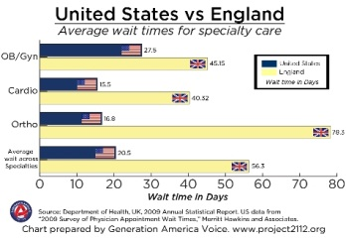

Slide 10
Strokes in England
Every 5 minutes someone in England suffers from a stroke
1 in 4 expected by 85 years of age
110,000 new strokes, 30,000 recurrent strokes (795,000 in US)
Responsible for 11% of deaths leaving about 250,000 disabled per year
Over 900,000 are living in England with a previous stroke
The 3rd largest cause of death in England (behind coronary artery disease and cancer)
Strokes cost the health care system 7 billion euros a year ($9.2 billion)

Slide 11
Stroke treatment in England
England uses many of the same options as us including:
  Anticoagulant therapy
  ACE inhibitors (even patients with normal BP)
  Antithrombotic therapy (4 1/2 hour window for England)
  Thiazine Diuretics
  CT scan asap/MRI
  England does have Primary Stoke Centers just like us that are stacked with:
          24/7 specially trained doctors and staff for TPA administration (neurologist, neurosurgeons, nurses, lab techs and CT techs)

Slide 12
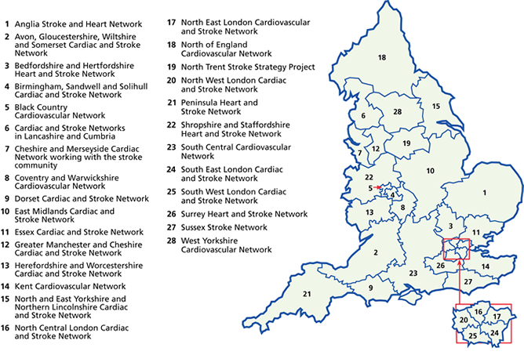
Stroke Centers in England
Notes:
“certified” stroke centers in England as of 2009

Slide 13
Pradaxa
Anticoagulant
Clinical studies found it reduced brain attacks by more than 1/3 among the elderly with atrial fibrillation compared to warfarin.
As opposed to warfarin, there are absolutely no diet restrictions on Pradaxa (vitamin K)
The pill cost 2.52 euros a day ($3.31)
Just approved in the United States in 2010
Notes:
Pradaxa is a direct thrombin inhibitor
Warfarin is a Vitamin K antagonist- both are blood thinners

Slide 14
Prevention tactics England
Doctors encourage Exercise, Healthy Diet, Cholesterol/BP management
The Act F.A.S.T Campaigned
  Launched in 2009
  Face, Arm, Speech and Time
  Helps people to recognize signs of stroke for emergent treatment

Slide 15
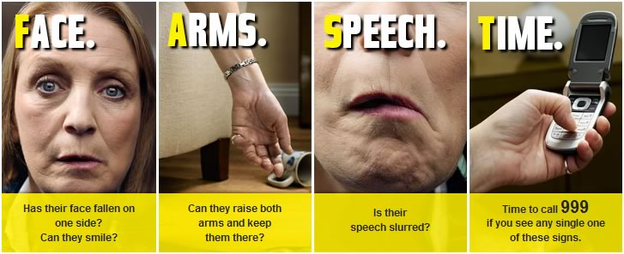
ACT F.A.S.T. to Prevent a Stroke

Slide 16
Goshen, M. (n.d.). England’s Health Care System - TRCB. TRCB.com - Article Marketing for Massive Exposure and Reward. Retrieved February 26, 2012, from http://www.trcb.com/health-and-fitness/healthcare-systems/englands-health-care-system-2505.htm
Primary medical care : Department of Health - Health care. (n.d.). Department of Health | Public health, adult social care, and the NHS. Retrieved February 26, 2012, from http://www.dh.gov.uk/en/Healthcare/Primarycare/PMC/index.htm
STROKE DEATH RATE BY COUNTRY. (n.d.). World Life Expectancy. Retrieved February 26, 2012, from http://www.worldlifeexpectancy.com/cause-of-death/stroke/by-country/
Stroke - NHS Choices. (n.d.). NHS Choices - Your health, your choices. Retrieved February 26, 2012, from http://www.nhs.uk/conditions/Stroke/Pages/Introduction.aspx?WT.mc_id=110901
Stroke Unit Glos - . (n.d.). Stroke Unit Glos - . Retrieved February 26, 2012, from http://www.strokeunitglos.nhs.uk/strokeunitgl280692.html
UK Hospital Named Certified Stroke Center. (n.d.). University of Kentucky. Retrieved February 26, 2012, from http://www.uky.edu/PR/News/Archives/2005/Apr2005/050412_stroke_center.htm
References

