Slide 1
Evaluation Tool for High-Fidelity Simulation
Michelle Bussard, RN, MSN, ACNS-BC, CNE
Holly Myers, RN, MSN
Notes:
Good afternoon, I am Michelle Bussard and this is Holly Myers, today we will discuss an evaluation tool for HFS.

Slide 2
Introduction
Objectives:
Describe a reliable and valid evaluation tool used in conjunction with high-fidelity simulation (HFS)
Identify how to implement Lasater’s Clinical Judgment Rubric in high-fidelity simulation
Notes:
The objective are to: 1. describe a reliable and valid evaluation tool for HFS and 2. identify how to implement LCJR into HFS.

Slide 3
Problem
Ineffective measurement of clinical judgment in HFS with medical/surgical nursing students
Debriefing only
Debriefing with Satisfactory, needs improvement, or unsatisfactory rating
Debriefing with a tool using a point system (1 point for completing the skill or 0 points for not completing skill)
Notes:
When I began using HFS in 2007, I did not have a method to evaluate clinical judgment development with HFS scenarios. Students came unprepared for the simulations and did not take the scenarios seriously. I initially used oral debriefing as a means of helping students form clinical judgments as well as evaluate them. However, I found that was not as effective as we were hoping for. In 2009, I decided to incorporate the use of the clinical evaluation tool with competencies specific to the simulation scenarios. Students were rated as Satisfactory, Needs Improvement, or Unsatisfactory. However, students that received a NI or U felt very demoralized and many times left the simulation lab in tears because they were fearful that the NI or U would result in failure from clinical. I tried developing a tool where I could rate the student with points, one point that he or she completed a skill such as identified the patient or performed a sterile dressing correctly, or gave an IM injection correctly. However, it was identified that not every student participating in the scenario did all the skills listed on the tool, so the student grades were very low.
Finally, in 2011 I found the Lasater Clinical Judgment Rubric and implemented it in the junior medical/surgical nursing course. This tool has been beneficial in helping faculty communicate with students what his or her clinical judgment is within each simulation scenario. Holly will be discussing the rubric in more depth.

Slide 4
Purpose
To compare the progression of clinical judgment after four HFS scenarios in one medical/surgical nursing course using Lasater’s Clinical Judgment Rubric (LCJR)
Notes:
In the med/surg nursing course, we do four progressive simulation scenarios. The scenarios become more complex as the students gain more knowledge and skills throughout the semester. Students are evaluated in each scenario using LCJR in all four scenarios.
The purpose of this nonexperimental descriptive study was to compare the rubrics from the first scenario to the fourth scenario to identify the effectiveness of using LCJR for evaluating the development of clinical judgment after four scenarios.

Slide 5
Significance to Nursing
Increased use of HFS
Clinical judgment is essential for the graduating nurse
Evaluation of HFS is necessary to identify clinical judgment
Notes:
HFS has increased greatly over the last 15 years because of a lack of clinical sites, clinical opportunities, and clinical faculty. Traditionally, a student participated in clinical experiences and the faculty would evaluate the student with a clinical evaluation tool. Students need to pass clinical with a satisfactory rating. Now that HFS is being used to supplement, replace, and enhance some of the clinical hours, the students progress in clinical judgment with HFS also needs to be evaluated.
Clinical judgment is salient to the nursing profession and employers expect new graduates to enter the workforce with established clinical judgment skills. Faculty of schools of nursing need to evaluate a students progress in developing clinical judgment so that he or she knows that a student is ready to graduate and enter the nursing profession.

Slide 6
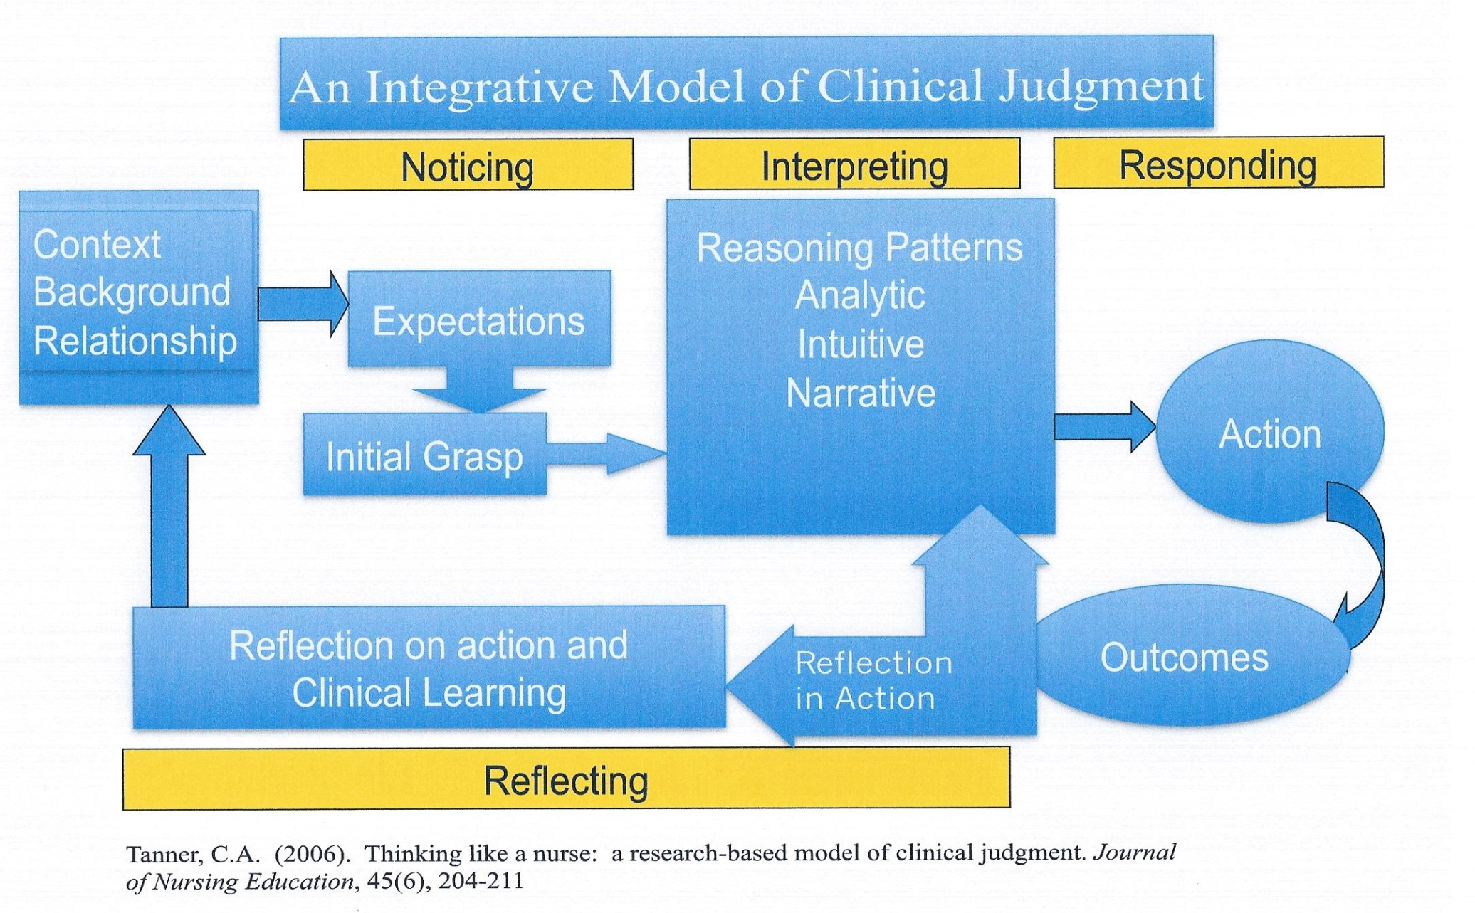
Theoretical Model
Notes:
Tanner (2006) developed a clinical judgment model to assist nurses, nurse educators, and nursing students to better understand how clinical judgment decisions are made. After an extensive review of the nursing literature, Tanner (2006) identified several themes pertaining to clinical judgment and those themes lead to the development of the model. The model has four concepts: noticing, interpreting, responding, and reflecting.
Noticing is the nurse’s initial grasp of a situation, expectations of a patient situation, knowledge of the patient’s normal patterns, knowledge of similar or previous patient situations, and knowledge from a textbook. In the interpretation phase of the model, the nurse is using the data from noticing to formulate meaning. Responding occurs next when the meaning of the data is used to determine appropriate nursing interventions to care for the patient. Reflection is the last phase of the model. Reflection-in-action occurs when the nurse assesses the patient situation to determine if the interventions have been effective. Alteration in the plan of care may be done during this reflective period. Reflection-on-action occurs after the clinical encounter and the nurse assimilates the learned knowledge to future patient situations.
Within nursing education, the Clinical Judgment Model is a salient concept. Nurse educators use HFS as a learning activity that promotes the development of clinical judgment. Developing HFS clinical scenarios assists nursing students in noticing specific patient situations, interpreting data, responding to the situation, and reflecting about the situation. Debriefing is a method of reflection that nurse educators can use to promote reflection-on-action. Guided debriefing questions within a reflection journal that uses language from the clinical judgment model may help students to formulate cognitive frameworks and decision-making abilities in future patient encounters.

Slide 7
Literature Review
Clinical judgment is salient to nursing and as a pre-licensure educational outcome
HFS improves clinical judgment
Oral Debriefing is essential
LCJR has reliability and validity as an evaluation tool for HFS
Notes:
The literature shows strong evidence to support the use of HFS as a mechanism to develop prelicensure nursing student clinical judgment. Oral debriefing sessions should be held immediately after the HFS scenario and this assists nursing students in forming cognitive frameworks and developing clinical judgments that can be used in future patient situations.
Various studies indicate that the LCJR is a reliable and valid tool to evaluate a students progression of clinical judgment in HFS. The tool can be used as a communication between faculty and students and can also be used to assist in assigning student clinical experiences.
STRONG EVIDENCE supports HFS and oral debriefing for the development of clinical judgment.

Slide 8
Lasater’s Clinical Judgment Rubric
Developed from Tanner’s Model:
Effective Noticing, Effective Interpreting, Effective Responding, and Effective Reflecting.
Eleven Dimensions:
Four developmental categories based on student performance.
Beginning, developing, accomplished, exemplary
Notes:
Each of these 4 stages are described through several dimensions that explain what is meant by each phase. There are a total of 11 dimensions.
A beginning student is defined as one who may be confused, ineffective in decision-making, unable to observe multiple facets of information to make a decision, focused on one aspect of care rather than the whole patient, have difficulty with communication, unable to perform nursing skills efficiently, unwilling to improve self or unable to see flaws.
The developing student is able to see clusters of data but is unable to make an informed decision, misses some important key pieces of information during data collection, is able to take simple pieces of patient data to form patterns, becomes disorganized easily, communication is difficult but somewhat successful, is hesitant with nursing skills, and makes some effort to become self-aware and improve oneself.
The accomplished student uses subjective and objective data to make decisions, focuses on important aspects of data but can also identify less important pieces of data, compares patient data to the patients known patterns, is calm in stressful situations, is a leader, communicates well, prioritizes patient care, is proficient in nursing skills, and is able to identify strengths and weakness and alternative methods in caring for patients.
An exemplary student is able to recognize subtle pieces of data to make appropriate clinical decisions, is able to make sense of conflicting and confusing data, delegates and communicates appropriately, individualizes patient interventions, is masterful in skills, and independently self-analyzes to improve future patient encounters.

Slide 9
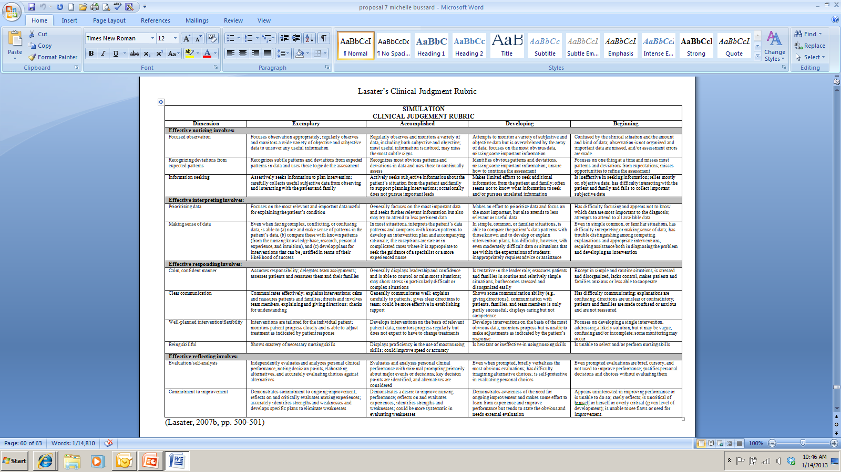
Lasater’s Clinical Judgment Rubric
Notes:
Copyright obtained from Lasater.

Slide 10
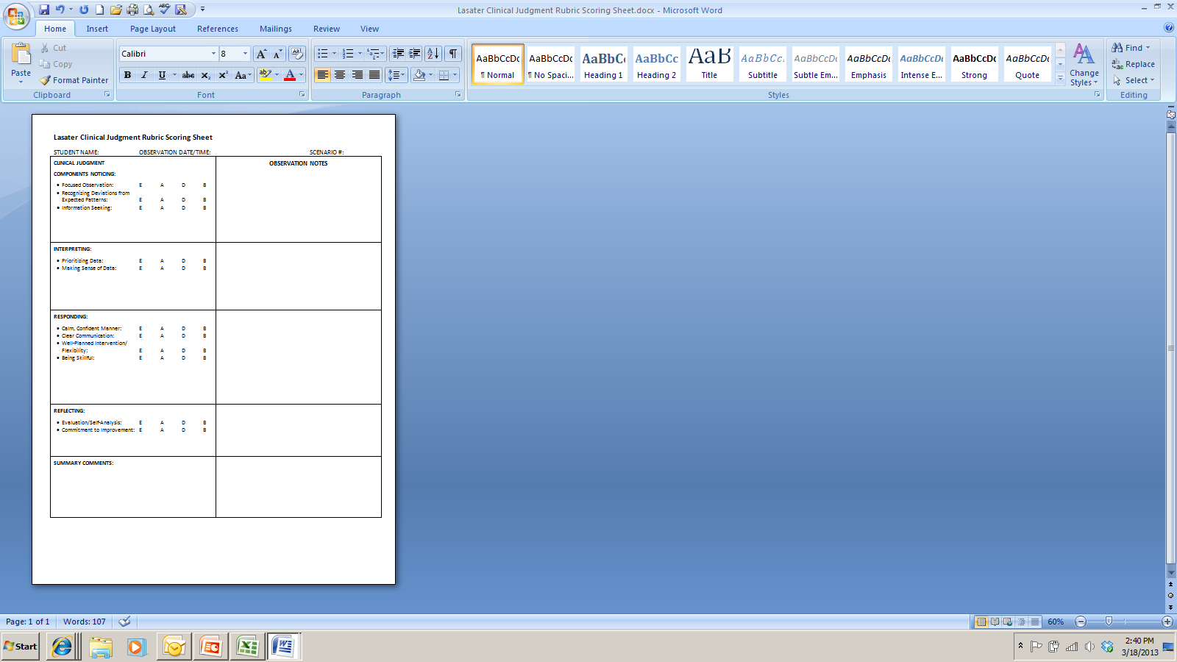
Lasater Clinical Judgment Rubric Scoring Sheet
Notes:
Lasater's clinical judgment rubric scoring sheet is used as a communication tool between the students and I. I used key terms / language from the main rubric to guide my feedback to the students, this provided an connection between the scoring sheet with my comments and the rubric itself. For example…. See next slide. Not only does it facilitate my communication of the students performance in the scenario to the student, but it also provides the faculty and students a “common language” to encourage feedback and discussion about the scenario. This communication between the faculty and student then promotes clinical judgment. Also, the students are able to track their progress towards their personal development of clinical judgment.
After the HFS scenario is completed, the simulation facilitator completes the scoring sheet. The sheet is then emailed to the individual student as a method of communicating a common language of clinical judgment. Also, the scoring sheet can be emailed to faculty that teach theory or clinical with the students so that follow through can take place in the classroom or clinical setting.

Slide 11
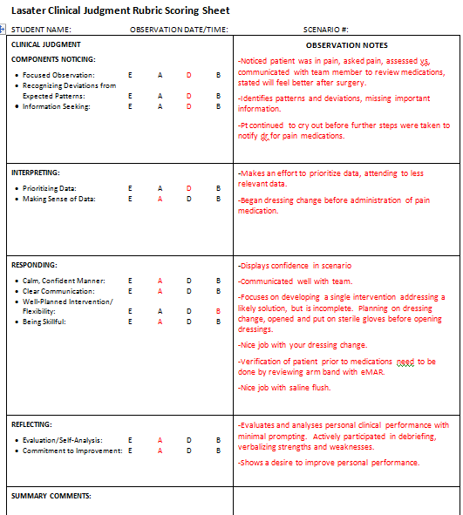

Slide 12
Research Design and Method
Quantitative
Nonexperimental descriptive study

Slide 13
Sample
Convenience Sample
Inclusion
Enrolled in NCA I
Participated in all 4 progressive scenarios
Rubric completed for all the scenarios
Exclusion
Rubrics not completed
Notes:
Junior nursing students enrolled in Nursing Care of Adults 1 – med/surg students.

Slide 14
Findings
Statistics
N= 19
Age
42% age 21-23
Gender
84% female
Job in healthcare
37%

Slide 15
Findings
Notes:
Scenario 1
Beginner 16%
Developing 58%
Accomplished 26%
Exemplary 0
Scenario 4
Beginner 0
Developing 22%
Accomplished 34%
Exemplary 44%
Are results indicate that the students showed a progression of clinical judgment from beginner to expemplary in a med/surg nursing course

Slide 16
Limitations
Convenience sample
Selection bias
Timing
Different instructor raters
Notes:
Selection – med/surg students only reviewed and not the NF, maternal/child or critical care students.
Timing – this was data only reviewed during one nursing course and not multiple courses throughout a curriculum.
Different instructors rated the first scenario and the final scenario, however interrater reliability has been proven with this tool.

Slide 17
Implications
Clinical judgment is essential to the nursing profession
Need to evaluate clinical judgment before graduation
Use of the tool to communicate with students and other faculty
Assignment of clinical experiences that are reflective of the students clinical judgment development
Notes:
Evaluation of clinical judgment development throughout the nursing curriculum which can then guide clinical experiences reflective of the learning process in HFS scenarios.
Communication between clinical faculty and faculty who teach in the classroom so to try and decrease the theory practice gap. Example – doing a diabetes simulation and nursing students were unable to connect foot assessment that was taught in the classroom to the simulation situation. Another example, students were unable to connect the neuro assessment taught in the classroom to the stroke simulation scenario.
An example of how we can use this as a communication tool – students struggled with interpreting insulin slide scales in simulation lab. I can then notifiy the clinical faculty to assign that student to a patient who requires insulin so that the student can integrate the lessons learned in theory, simulation, and then apply it to the clinical setting.
Another example of how we can communicate to faculty – I had a student who struggled putting a foley catheter in during sim lab. She was able to verbalize all the steps but when she went to put the catheter in she froze. So she was referred to the skills lab coordinator for foley remediation.
Another example of how we can use this as a communication to faculty – one year I had multiple students not know how to waste a medication, we realized that the content was not taught in the classroom so we added the content.

Slide 18
Future Research
Evaluating LCJR in additional nursing courses
Evaluating clinical judgment from junior to senior year
Reflective journaling after simulation scenarios
Video recording of simulation scenarios
Notes:
Aditional research that can be done:
Use the Clinical Judgment rubric in additional nursing courses and evaluate its effectiveness in evaluating clinical judgment
Use the rubric to identify if a student progresses in the development of clinical judgment between the junior and senior year. Use the same clinical scenario and then evaluate the student with rubric. This will help identify if students progress in clinical judgment and also if retention of knowledge is obtained. In personal communication between myself and Kathie Lasater who created the Lasater rubric, she said that students should be in the accomplished level of all 11 dimensions upon graduation. I think it would be beneficial to evaluate a student between junior and senior year to see if all 11 dimensions are at least accomplished.
I am currently working on my dissertation with the topic of clinical judgment development with associated reflection journals after students participate in four progressive simulation scenarios. The purpose is to see if reflective journaling is a good strategy to assist nursing students in the development of clinical judgment
Another study would be to have an experimental study to identify if video recording of the simulation scenarios and then students viewing the scenarios improves clinical judgment. Currently, I have the students view a video of each simulation experience and then write a reflective journal. Research needs to be done to identify if viewing of the videos results in an improvement in clinical judgment.

Slide 19
Conclusion
LCJR is an effective tool to measure a pre-licensure nursing students clinical judgment development after participating in progressive HFS in a medical surgical nursing course.

Slide 20
QUESTIONS

Slide 21
References
Adamson, K. A., Gubrud, P., Sideras, S., & Lasater, K. (2012). Assessing the reliability, validity, and use of the Lasater clinical judgment rubric: Three approaches. Journal of Nursing Education, 51(2), 66-73. doi: 10.3928/01484834-20111130-03
Arafeh, J., Snyder-Hansen, S., & Nichols, A. (2010). Debriefing in simulated-based learning: Facilitating a reflective discussion. Journal of Perinatal Neonatal Nursing, 24(4), 302-309. Retrieved from journals.lww.com/jpnnjournal/Pages/default.aspx
Bambini, D., Washburn, J., & Perkins, R. (2009). Outcomes of clinical simulation for novice nursing students: Communication, confidence, clinical judgment. Nursing Education Perspectives, 30(2), 79-82. doi: 10.1043/1536-5026-030.002.0079

Slide 22
References
Blum, C., Borglund, S., & Dax, P. (2010). High-fidelity nursing simulation: Impact on student self-confidence and clinical competence. International Journal of Nursing Education Scholarship, 7(1), 1-14. doi: 10.2202/1548-923X.2035
Cato, M. L. (2012). Using simulation in nursing education. In P. R. Jeffries (Ed.), Simulation in nursing education: From conceptualization to evaluation (2nd ed.) (pp. 1-12). New York, NY: National League for Nursing.
Curtin, M. M. & Dupuis, M. D. (2008). Development of human patient simulation programs: Achieving big results with a small budge. Journal of Nursing Education, 47(11), 522-523. Retrieved from www.slackjournals.com/jne

Slide 23
References
Del Bueno, D. (2005). A crisis in critical thinking. Nursing Education Perspectives, 26(5), 278-282. doi: 10.1043/1536-5026(2005)026[0278:ACICT]2.0.CO;2
Dillard, N., Sideras, S., Ryan, M., Hodson-Carlton, K., Lasater, K., & Siktberg, L. (2009). A collaborative project to apply and evaluate the clinical judgment model through simulation. Nursing Education Perspectives, 30(2), 99-104. doi: 10.1043/1536-5026-030.002.0099
Elfrink, V. L., Kirkpatrick, B., Nininger, J., & Schubert, C. (2010). Using learning outcomes to inform teaching practices in human patient simulation. Nursing Education Perspectives, 31(2), 97-100. Retrieved from www.nln.org/nlnjournal/index.htm

Slide 24
References
Harder, B. N. (2010). Use of simulation in teaching and learning in health sciences: A systematic review. Journal of Nursing Education, 49(1), 23-28. doi: 10.3928/01484834-20090828-08
Hayden, J. (2010). Use of simulation in nursing education: National survey results. Journal of Nursing Regulation, 1(3), 52-57. Retrieved from http://jnr.metapress.com/home/main.mpx
Howard, V. M., Englert, N., Kameg, K., & Perozzi, K. (2011). Integration of simulation across the undergraduate curriculum: Student and faculty perspectives. Clinical Simulation in Nursing, 7(1), e1-e10. doi: 10.1016/j.ecns.2009.10.004
Hovancsek, M. T. (2007). Using simulation in nursing education. In P. R. Jeffries (Ed.), Simulation in nursing education: From conceptualization to evaluation (pp. 1-9). New York, NY: NLN.
Idczak, S. E. (2007). I am a nurse: nursing students learn the art and science of nursing. Nursing Education Perspectives, 28(2), 66-71. doi: 10.1043/1536-5026(2007)028[0066:IAANNS]2.0.CO;2

Slide 25
References
Jeffries, P. R. & Rogers, K. J. (2012). Theoretical framework for simulation design. In P. R. Jeffries (Ed.), Simulation in nursing education: From conceptualization to evaluation (2nd ed.) (pp. 25-42). New York, NY: National League for Nursing.
Johnson, E. A., Lasater, K., Hodson-Carlton, K., Siktberg, L., Sideras, S., & Dillard, N. (2012). Geriatrics in simulation: Role modeling and clinical judgment effect. Nursing Education Perspectives, 33(3), 176-180. doi: 10.5480/1536-5026-33.3.176
Kaddoura, M. A. (2010). New graduate nurses’ perceptions of the effects of clinical simulation on their critical thinking, learning, and confidence. The Journal of Continuing Education in Nursing, 41(11), 506-511. doi: 10.3928/00220124-20100701-02
Kantar, L. & Alexander, R. (2012). Integration of clinical judgment in the nursing curriculum: Challenges and perspectives. Journal of Nursing Education, 51(8), 444-453. doi: 10.3928/01484834-20120615-03.

Slide 26
References
Kardong-Edgren, S., Starkweather, A., & Ward, L. (2008). The integration of simulation into a clinical foundations of nursing course: Student and faculty perspectives. International Journal of Nursing Education Scholarship, 5(1), 1-16. Retrieved from http://www.degruyter.com/view/j/ijnes
Lapkin, S., Levett-Jones, T., Bellchambers, H., & Fernandez, R. (2010). Effectiveness of patient simulation manikins in teaching clinical reasoning skills to undergraduate nursing students: A systematic review. Clinical Simulation in Nursing, 6(6), e207-e222. doi: 10.1016/j.ecns.2010.05.005
Lasater, K. (2007a). High-fidelity simulation and the development of clinical judgment: Students’ experiences. Journal of Nursing Education, 46(6), 269-276. Retrieved from www.slackjournals.com/jne
Lasater, K. (2007b). Clinical judgment development: Using simulation to create an assessment rubric. Journal of Nursing Education, 46(11), 496-503. Retrieved from www.slackjournals.com/jne
Lasater, K. (2011). Clinical judgment: The last frontier for evaluation. Nurse Education in Practice, 11(2011), 86-92. doi: 10.1016/j.nepr.2010.11.013

Slide 27
References
Lasater, K. & Nielsen, A. (2009). Reflective journaling for clinical judgment development and evaluation. Journal of Nursing Education, 48(1), 40-44. Retrieved from www.slackjournals.com/jne
Mann, J. (2012). Critical thinking and clinical judgment skill development in baccalaureate nursing students. The Kansas Nurse, 87(1), 26-31. Retrieved from http://www.ksnurses.com
Neill, M. A. & Wotton, K. (2011). High-fidelity simulation debriefing in nursing education: A literature review. Clinical Simulation in Nursing, 7(5), e161-e168. doi: 10.1016/j.ecns.2011.02.001
Nickerson, M., & Pollard, M. (2010). Mrs. Chase and her descendants: A historical view of simulation. Creative Nursing, 16(3), 101-105. doi:10.1891/1078-4535.16.3.101

Slide 28
References
Nielsen, A., Stragnell, S., & Jester, P. (2007). Guide for reflection using the clinical judgment model. Journal of Nursing Education, 46(11), 513-516. Retrieved from www.slackjournals.com/jne
Reese, C., Jeffries, P., & Engum, S. (2010). Learning together: Using simulation to develop nursing and medical student collaboration. Nursing Education Perspectives, 31(1), 33-37. doi: 10.1043/1536-5026-31.1.33
Rizzolo, M. A. (2012). Summary and future considerations. In P. R. Jeffries (Ed.), Simulation in nursing education: From conceptualization to evaluation (2nd ed.) (pp. 231-238). New York, NY: National League for Nursing.
Schiavenato, M. (2009). Reevaluating simulation in nursing education: Beyond the human patient simulator. Journal of Nursing Education, 48(7), 388-394. doi: 10.3928/01484834-20090615-06

Slide 29
References
Shinnick, M. A., Woo, M., Horwich, T. B., & Steadman, R. (2011). Debriefing: The most important component in simulation? Clinical Simulation in Nursing, 7(3), e105-e111. doi: 10.1016/j.ecns.2010.11.005
Strouse, A. (2010, July). Multidisciplinary simulation centers: Promoting safe practice. Clinical Simulation in Nursing, 6(4), e139-e142. doi: 10.1016/j.ecns.2009.08.007
Swenty, C. F. & Eggleston, B. M. (2011). The evaluation of simulation in a baccalaureate nursing program. Clinical Simulation in Nursing, 7(5), e181-e187. doi: 10.1016/j.ecns.2010.02.006
Tanner, C. (2006). Thinking like a nurse: A research-based model of clinical judgment in nursing. Journal of Nursing Education, 45(6), 204-211. Retrieved from www.slackjournals.com/jne

Slide 30
References
The INACSL Board of Directors (2011). Standard I: Terminology. Clinical Simulation in Nursing, 7(4S), s3-s7. doi: 10.1016/j.ecns.2011.05.005
Thomas-Dreifuerst, K. T. (2009). The essentials of debriefing in simulation learning: A concept analysis. Nursing Education Perspectives, 30(2), 109-114. doi: 10.1043/1536-5026-030.002.0109
Thomas-Dreifuerst, K. T. & Decker, S. I. (2012). Debriefing: An essential component for learning in simulation pedagogy. In P. R. Jeffries (Ed.), Simulation in nursing education: From conceptualization to evaluation (2nd ed.) (pp. 105-130). New York, NY: National League for Nursing.
Wickers, M. P. (2010). Establishing the climate for a successful debriefing. Clinical Simulation in Nursing, 6(3), e383-e386. Retrieved from doi: 10.1016/j.ecns.2009.06.003

