Slide 1
MOOD DISORDERS
ESSENTIALS OF PSYCHIATRIC
MENTAL HEALTH NURSING, 5th Ed.
MARY C. TOWNSEND
CHAP. 15 & 16
AMY M. ROCKWELL, MSN, RN

Slide 2
Introduction
Depression is the oldest and most frequently described psychiatric illness.
Transient symptoms are normal, healthy responses to everyday disappointments in life.

Slide 3
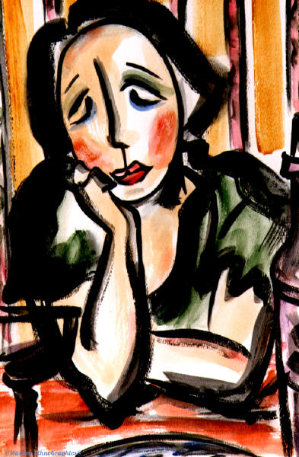
Epidemiology
Approximately 9.5 million persons reported a depressive episode in 2008.
During their lifetime, about 21% of women and 13% of men will become clinically depressed.

Slide 4
Epidemiology (cont’d)
Age
Depression more common in young women than young men.
The gender difference is less pronounced between ages 44 and 65, but after age 65, women are again more likely to be depressed than men.

Slide 5
Epidemiology (cont’d)
Social class: there is an inverse relationship between social class and report of depressive symptoms
Race and culture: no consistent relationship between race and affective disorder has been reported; one recent survey revealed
Depression is more prevalent in whites than blacks
Depression is more severe and disabling in blacks
Blacks are less likely to receive treatment than whites

Slide 6
Epidemiology (cont’d)
Marital status: single and divorced people more likely to experience depression than married persons or persons with a close interpersonal relationship (differences occur in various age groups)

Slide 7
Epidemiology (cont’d)
Seasonality: affective disorders are more prevalent in the spring and in the fall

Slide 8
Predisposing Factors to Depression: Biological
Biological Theories
Genetics: hereditary factor may be involved
Monozygotic twins: hereditability of recurrent major depression 37%
Major depression is 1.5-3 times more common among first-degree biological relatives of people with the disorder than among the general population

Slide 9
Predisposing Factors to Depression: Biological
Biochemical influences: deficiency of neurotransmitters
norepinephrine, serotonin, and dopamine has been implicated
Acetylcholine: An imbalance of this
neurotransmitter and those above may
influence depression and mania

Slide 10
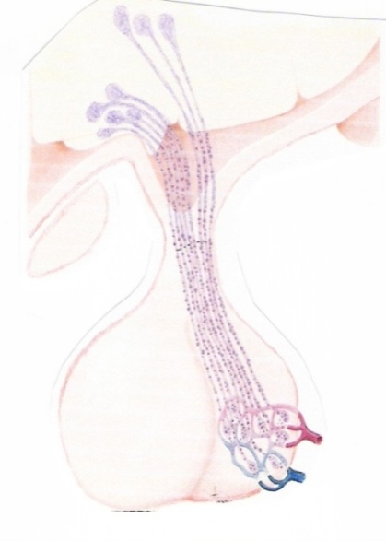
Predisposing Factors to Depression: Biological
Neuroendocrine disturbances
Possible failure within the hypothalamic-pituitary-adrenocortical axis
Possible diminished release of thyroid- stimulating hormone

Slide 11
Predisposing Factors to Depression: Biological
Physiological influences
Depressive symptoms that occur as a consequence of a non-mood disorder
Depressive symptoms that occur as an adverse effect of certain medications
Termed as a Secondary Depression

Slide 12

Predisposing Factors to Depression: Biological
Physiological influences
Medication Side Effects
Certain drugs may cause a depressive syndrome
Anxiolytics
Antipsychotics
Sedative-hypnotics
Antihypertensives
Steroids
Hormones
Antibacterial/Antifungal
Antineoplastics
Analgesics/Anti-inflammatory
Antiulcer

Slide 13
Predisposing Factors to Depression: Biological
Physiological influences
Neurological Disorders
CVA
Brain Tumor (esp. temporal lobe)
Alzheimer’s Disease
Parkinson’s Disease
Huntington’s Disease
Multiple Sclerosis

Slide 14
Predisposing Factors to Depression: Biological
Physiological influences
Electrolyte Disturbances
Sodium Bicarbonate: excess
Calcium: excess
Magnesium: deficit
Sodium: deficit
Potassium: both excess and deficit

Slide 15
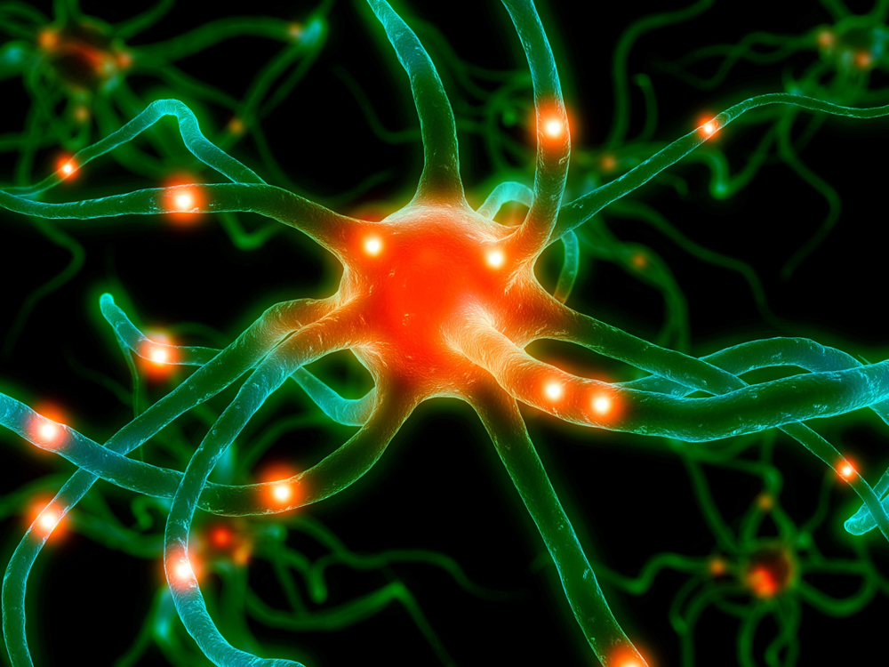
Predisposing Factors to Depression: Biological
Physiological influences
Hormonal Disturbances
Dysfunction of Adrenal Cortex
Addison’s Disease
Cushing’s Syndrome
Others include:
Hypoparathyroidism
Hyperparathyroidism
Hypothyroidism
Hyperthyroidism
Estrogen Imbalance
Progesterone Imbalance

Slide 16
Predisposing Factors to Depression: Biological
Physiological influences
Nutritional Deficiencies
May produce symptoms of depression:
Vitamin B1
Vitamin B6
Vitamin B12
Niacin
Vitamin C
Iron
Folic Acid
Zinc
Calcium
Potassium

Slide 17
Predisposing Factors to Depression: Biological
Physiological influences
Other conditions:
Collagen disorders
Systemic Lupus Erythematosus (SLE)
Polyarteritis nodosa
Cardiovascular disease
Cardiomyopathy
Congestive Heart Failure
Myocardial Infarction
CVA (stroke)
Infection
Encephalitis
Hepatitis
Mononucleosis
Pneumonia
Syphilis
Metabolic Disorders
Diabetes
Porphyria

Slide 18
Predisposing Factors to Depression: Psychosocial
Psychosocial theories
Psychoanalytical theory (Freud)
Mourning
Melancholia
Cessation of interest in outside world
Loss of capacity to love
Inhibition of all activity
Lowering of self-regarding feelings
Occurs after loss of a loved object
Death
Emotional by rejection

Slide 19

Predisposing Factors to Depression: Psychosocial
Psychosocial theories (cont’d)
Learning theory (Seligman)
Learned helplessness
Experience of numerous failures (real or perceived)
Repeated failure to control life, leading to feelings of helplessness and dependence on others
A possible predisposition to depression

Slide 20
Predisposing Factors to Depression: Psychosocial
Object Loss Theory
Experiences loss of significant other during first 6 months of life
Absence of attachment: Physical or Emotional
Feelings of helplessness and despair
Early loss or trauma may predispose client to lifelong periods of depression
Psychosocial theories (cont’d)

Slide 21
Predisposing Factors to Depression: Psychosocial
Psychosocial theories (cont’d)
Cognitive theory (Beck): views primary disturbance in depression as cognitive rather than affective
Three cognitive distortions that serve as the basis for depression
Negative expectations of the environment
Negative expectations of the self
Negative expectations of the future
Cognitive therapy focuses on helping the individual to alter mood by changing the way he or she thinks

Slide 22

Developmental Implications
Childhood
Major depressive disorder in children can be identified using criteria similar to those used for adults
Symptoms of depression in childhood may be manifested differently
Changes with age

Slide 23
Childhood
Up to age 3: Feeding problems, tantrums, lack of playfulness, lack of emotional expressiveness, failure to thrive, delays in speech and gross motor development
3-5: Accident proneness, phobias, aggressiveness, excessive self-reproach for minor infractions
6-8: Vague physical complaints, aggressive behavior, cling to parents, avoid new people and challenges, behind in social skills and academic competence
9-12: Morbid thoughts, excessive worrying, lack of interest in friends

Slide 24
Childhood
Precipitating factors:
Physical or emotion detachment by primary caregiver
Parental separation or divorce
Death of loved one (person or pet)
Move
Academic failure
Physical illness
Common denominator: Loss

Slide 25
Developmental Implications
Adolescence
Symptoms include
Anger, aggressiveness
Running away
Delinquency
Social withdrawal
Sexual acting out
Substance abuse
Restlessness; apathy

Slide 26
Adolescence (cont’d)
Best clue that differentiates depression from normal stormy adolescent behavior
A visible manifestation of behavioral change that lasts for several weeks
Most common precipitant to adolescent suicide: perception of abandonment by parents or close peer relationship

Slide 27
Adolescence (cont’d)
Treatment with
Supportive psychosocial intervention
Antidepressant medication
NOTE: All antidepressants carry an FDA black box warning for increased risk of suicidality in children and adolescents

Slide 28
Senescence
Bereavement overload
High percentage of suicides among elderly
Symptoms of depression often confused with symptoms of dementia
Treatment
Antidepressant medication
Electroconvulsive therapy
Psychosocial therapies

Slide 29
Postpartum depression
May last for a few weeks to several months
Associated with hormonal changes, tryptophan metabolism, or cell alterations
Treatments: antidepressants and psychosocial therapies
Symptoms include
Fatigue
Irritability
Loss of appetite
Sleep disturbances
Loss of libido
Concern about inability to care for infant

Slide 30
Types of Depressive Disorders
Major depressive disorder
Dysthymic disorder
Premenstrual dysphoric disorder
Mood disorder due to a general medical condition
Substance-induced mood disorder

Slide 31
Types of Depressive Disorders
Major depressive disorder
Characterized by depressed mood
Loss of interest or pleasure in usual activities
Social and occupational functioning impaired for at least 2 weeks
No history of manic behavior
Cannot be attributed to use of substances or a general medical condition

Slide 32
MAJOR DEPRESSION: CLASSIFICATIONS
Transient depression
Symptoms at this level of the continuum not necessarily dysfunctional
Affective: the “blues”
Behavioral: some crying
Cognitive: some difficulty getting mind off one’s disappointment
Physiological: feeling tired and listless

Slide 33
MAJOR DEPRESSION: CLASSIFICATIONS
Mild depression
Symptoms of mild depression are identified by clinicians as those associated with normal grieving
Affective: anger, anxiety
Behavioral: tearful, regression
Cognitive: preoccupied with loss
Physiological: anorexia, insomnia

Slide 34
MAJOR DEPRESSION: CLASSIFICATIONS
Moderate depression
Symptoms associated with dysthymic disorder
Affective: helpless, powerless
Behavioral: slowed physical movements, slumped posture, limited verbalization
Cognitive: retarded thinking processes, difficulty with concentration
Physiological: anorexia or overeating, sleep disturbance, headaches

Slide 35
MAJOR DEPRESSION: CLASSIFICATIONS
Severe depression
Includes symptoms of major depressive disorder and bipolar depression
Affective: feelings of total despair, worthlessness, flat affect
Behavioral: psychomotor retardation, curled-up position, absence of communication
Cognitive: prevalent delusional thinking, with delusions of persecution and somatic delusions; confusion; suicidal thoughts
Physiological: a general slow-down of the entire body

Slide 36
CONTINUUM OF DEPRESSION
TRANSIENT DEPRESSION: LIFE’S EVERYDAY DISAPPOINTMENTS
MILD DEPRESSION: NORMAL GRIEF RESPONSE
MODERATE DEPRESSION: DYSTHYMIC DISORDER
SEVERE DEPRESSION: MAJOR DEPRESSIVE DISORDER

Slide 37
Mood Disorders: Major Depressive Symptoms
Apathy (anhedonia)
Sadness
Sleep disturbances
Hopelessness
Helplessness
Worthlessness
Guilt
Anger
Total despair
Fatigue
Thoughts of death
Decreased libido
Ruminations
Psychomotor agitation
Verbal berating of self
Spontaneous crying
Dependency
Passiveness
Most common
Other symptoms

Slide 38
Types of Depressive Disorders
Dysthymic disorder
Sad or “down in the dumps”
No evidence of psychotic symptoms
Essential feature is a chronically depressed mood for
Most of the day
More days than not
For at least 2 years

Slide 39
Types of Depressive Disorders
Premenstrual Dysphoric Disorder
Markedly depressed mood
Excessive anxiety
Mood swings
Decreased interest in activities during week prior to menses; subsides shortly after onset of menstruation
Interferes with work, school, or social activities

Slide 40
Client/Family Education
Nature of the illness
Stages of grief and symptoms associated with each stage
What is depression?
Why do people get depressed?
What are the symptoms of depression?

Slide 41
Client/Family Education (cont’d)
Management of the illness
Medication management
Assertive techniques
Stress-management techniques
Ways to increase self-esteem
Electroconvulsive therapy

Slide 42
Client/Family Education (cont’d)
Support services
Suicide hotline
Support groups
Legal/financial assistance

Slide 43
Treatment Modalities
Individual psychotherapy
Group therapy
Family therapy
Cognitive therapy
Electroconvulsive therapy
Transcranial magnetic stimulation
Light therapy
Notes:
Townsend: Fifth Ed.
Pages 378-382
Read and review each treatment modality

Slide 44
Psychopharmacology
Psychopharmacology
Tricyclics Antidepressants
SSRIs: Selective Serotonin Reuptake Inhibitors
MAO (Monoamine Oxidase) inhibitors
Heterocyclics
SNRIs: Serotonin-Norepinephrine Reuptake Inhibitors

Slide 45
Psychopharmacology
Antidepressants
Tricyclics (TCAs)
Elavil, Anafranil, Sinequan, Pamelor
Heterocyclics: 2nd generation
Ludiomil, Asendin, Desyrel, Wellbutrin, Remeron
Serotonin-norephirine reuptake inhibitors (SNRIs)
Effexor, Serzone, Cymbalta
Selective serotonin reuptake inhibitors (SSRIs)
Prozac, Paxil, Zoloft, Celexa

Slide 46
Psychopharmacology (cont’d)
Action
TCAs, heterocyclics, SSRIs, SNRIs
Block reuptake of norepinephrine, serotonin, and/or dopamine
MAOIs
Inhibit monoamine oxidase, an enzyme known to inactivate norepinephrine, serotonin, and dopamine
As these drugs take effect and mood begins to lift, the individual may have increased energy with which to implement a suicide plan. Suicide potential often increases as level of depression decreases. The nurse should be particularly alert to sudden lifts in mood.

Slide 47

Psychopharmacology
Monoamine Oxidase (MAOIs) Inhibitors
Marplan, Nardil, Parnate
Adverse side effect
Hypertensive crisis
Symptoms develop within 2 hrs of ingestion of food or drug with tyramine
Severe occipital & or temporal H/A
Photophobia
Choking sensation
Palpitations and feeling of ‘dread’ marked by systolic & diastolic hypertension
May experience a stiff neck

Slide 48
Psychopharmacology
Avoid foods and medications high in tyramine when taking MAOIs, including
Aged cheese
Wine; beer
Chocolate; colas Pickled herring
Coffee; tea
Sour cream; yogurt
Smoked and processed meats
Beef or chicken liver
Canned figs
Yeast products
Diet pills
Broad beans
Caviar
Raisins
Soy sauce
Cold remedies

Slide 49
Psychopharmacology (cont’d)
Contraindications/precautions
Contraindicated in known hypersensitivity (SSRIs, MAOIs, tricyclics); acute phase of recovery from myocardial infarction; angle-closure glaucoma (tricyclics); and concomitant with MAOIs (TCAs, heterocyclics, SSRIs, SNRIs)
Caution with elderly or debilitated clients; clients with hepatic, cardiac, or renal insufficiency; psychotic clients; clients with benign prostatic hypertrophy; and those with history of seizures (tricyclics, MAOIs)

Slide 50
Psychopharmacology (cont’d)
Interactions (with tricyclics)
Increased effects of tricyclics with bupropion, cimetidine, haloperidol,
SSRIs, and valproic acid
Decreased effects of tricyclics with rifamycin, carbamazepine, and barbiturates
Hyperpyretic crisis, convulsions, and death can occur with MAOI inhibitors
Hypertensive crisis can occur with clonidine
Decreased effects of levodopa and guanethidine
Potentiation of pressor response with direct-acting sympathomimetics

Slide 51
Psychopharmacology (cont’d)
Interactions (with MAOIs)
Hypertensive crisis with amphetamines, methyldopa, levodopa, dopamine, epinephrine, norepinephrine, reserpine, vasoconstrictors, or foods with tyramine
Hypertension, hypotension, coma, convulsions, and death with narcotic analgesics
Additive hypotension with antihypertensives
Additive hypoglycemia with antihyperglycemic agents
Potentially fatal reactions with all other antidepressants, carbamazepine, buspirone, sympathomimetics, tryptophan, dextromethorphan, CNS depressants, and amphetamines (avoid use within 2 weeks of each other)

Slide 52
Psychopharmacology (cont’d)
Interactions (with SSRIs)
Toxic, sometimes fatal, reactions have occurred with concomitant use of MAOIs
Increased effects of SSRIs with cimetidine, L-tryptophan, and lithium
Concomitant use of SSRIs may increase effects of hydantoin, tricyclic antidepressants, benzodiazepine, beta-blockers, carbamazepine, clozapine, haloperidol, phenothiazine, St. John’s wort, sumatriptan, sympathomimetics, tacrine, theophylline, and warfarin
Concomitant use of SSRIs may decrease effects of buspirone and digoxin
Serotonin syndrome can occur with concurrent use of other drugs that increase serotonin

Slide 53
Psychopharmacology (cont’d)
Side effects
May occur with all chemical classes
Dry mouth, sedation, nausea
Discontinuation syndrome with abrupt withdrawal
Most commonly occur with tricyclics and heterocyclics
Blurred vision, constipation, urinary retention, orthostatic hypotension, reduction of seizure threshold, tachycardia, arrhythmias, photosensitivity, weight gain

Slide 54
Psychopharmacology (cont’d)
Side effects (cont’d)
Most commonly occur with SSRIs and SNRIs
Insomnia, agitation, headache, weight loss, sexual dysfunction, serotonin syndrome
Most commonly occur with MAOIs
Hypertensive crisis
Application site reactions (transdermal system)
Miscellaneous side effects
Priapism (with trazadone)
Hepatic failure (with nafazodone)

Slide 55
Psychopharmacology (cont’d)
Client/family education related to antidepressants
Therapeutic effect may not be seen for as long as 4 weeks
Do not discontinue use of the drug abruptly
Avoid smoking and drinking alcohol
Be aware of risks of taking antidepressants during pregnancy

Slide 56

THE SUICIDAL INDIVIDUAL
Suicide is not a diagnosis or a disorder; it is a behavior.
Approximately 95 percent
of suicides are by individuals
with a diagnosed mental disorder.
Depressive disorders account for 80 percent of this figure.

Slide 57
The Suicidal Individual: Epidemiological Factors
Approximately 30,000 persons
in the United States end their lives
each year by suicide.
Suicide is the
3rd leading cause of death among
Americans 15 to 24 years of age
2nd leading cause of death for ages 25 to
34
4th leading cause of death for ages 35-44
5th leading cause of death for ages 45-54
8th leading cause of death for ages 55 to
64

Slide 58
The Suicidal Individual: Risk Factors
Marital status
The suicide rate for single
persons is twice that of
married persons.
Gender
Women attempt suicide more often, but more men succeed.
Men commonly choose more
lethal methods than women.

Slide 59
The Suicidal Individual: Risk Factors
Age
Risk of suicide increases with age, particularly among men.
Religion
Protestants are at greater risk than Catholics or Jews
Socioeconomic status
Individuals in the very
highest and lowest social
classes have higher suicide
rates than those in the middle class

Slide 60

The Suicidal Individual: Risk Factors
Ethnicity
Whites are at highest risk for suicide, followed by Native Americans,
African Americans, Hispanic Americans,
and Asian Americans.
Occupation
Professional health-care personnel and business executives are at highest risk.
Other high-risk occupations include law enforcement, attorneys, and mechanics

Slide 61
The Suicidal Individual: Risk Factors
Mood disorders are the most common of psychiatric illnesses that precede suicide. Other psychiatric disorders that account for suicidal behavior include substance-related disorders
* substance-related disorders
* schizophrenia
* personality disorders
* anxiety disorders
Severe insomnia is associated with increased risk of suicide.

Slide 62
The Suicidal Individual: Risk Factors
Use of alcohol and barbiturates
Previous suicide attempt
Affliction with a chronic painful or
disabling illness
Family history of suicide
Impulsive and/or aggressive tendencies
Barriers to accessing mental health treatment
Easy access to lethal methods, esp. guns

Slide 63
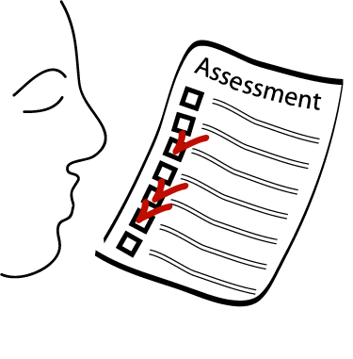
The Suicidal Individual: Assessment
Be direct
Ask about suicidal ideation
Plan
Method
Prevention of rescue
Talk openly and matter-of-factly about suicide
Actively listen
Encourage expression of feelings
Encourage expression of anger
Use a nonjudgmental manner

Slide 64

The Suicidal Individual: Interventions
Assess for depression
Have there been previous attempts to commit suicide?
Is there a plan & method?
Be direct and talk matter of fact about suicide
Provide a safe environment
Establish a no-suicide contract with the client.

Slide 65
The Suicidal Individual: Interventions
Take any hint of suicide seriously.
Do not keep secrets.
Be a good listener.
Express to the client
feelings of personal worth.
Know about suicide
intervention resources.
Restrict access to firearms
or other means of self-harm.

Slide 66
The Suicidal Individual: Interventions
Interventions for Family and Friends of a Suicide Victims
Encourage the individual to talk about the suicide.
Discourage blaming and scapegoating.
Listen to feelings of guilt and self-perception.
Talk about personal relationships with the victim.
Recognize differences in styles of grieving.
Assist with development
of adaptive coping strategies.
Identify resources that provide
support.

Slide 67
Mood Disorders: Bipolar Disorder
Characterized by cycles of Mania and Depression

Slide 68
Bipolar Disorder
It is characterized by mood swings from profound depression to extreme euphoria (mania), with intervening periods of normalcy.
Delusions or hallucinations may or may not be part of clinical picture.
Onset of symptoms may reflect seasonal pattern.

Slide 69
Bipolar Disorder: Mania
Mania is an alteration in mood that is expressed by feelings of elation, inflated self-esteem, grandiosity, hyperactivity, agitation, and accelerated thinking and speaking.
Mania can occur as a biological (organic) disorder, or as a response to substance use or a general medical condition.
A somewhat milder form of mania is called hypomania.

Slide 70
Bipolar Disorder: Historical Perspective
The modern concept of manic-depressive illness began to emerge in the 19th century, with terms such as “dual-form insanity” and “circular insanity.”
The term manic-depressive was first coined in 1913, and the American Psychiatric Association adopted the term bipolar disorder in 1980.

Slide 71
Bipolar Disorder: Epidemiology
Bipolar disorder affects approximately 5.7 million American adults.
Gender incidence roughly equal: ratio of women to men about 1.2 to 1
Average age at onset is the early 20s.
Occurs more often in the higher socioeconomic classes.
Sixth leading cause of disability in the middle age group.

Slide 72
Bipolar Disorder: Types
Bipolar I disorder
Is experiencing, or has experienced, a full syndrome of manic or mixed symptoms
May also have experienced episodes of depression

Slide 73
Bipolar Disorder: Types
Bipolar II disorder
Characterized by bouts of major depression with episodic occurrence of hypomania
Has never met criteria for full manic episode
Bipolar disorder, mixed
Symptoms include rapidly alternating moods (sadness, irritability, euphoria) accompanied by symptoms associated with both depression and mania.

Slide 74
Bipolar Disorder: Types
Cyclothymic disorder
Chronic mood disturbance
At least 2-year duration
Numerous episodes of hypomania and depressed mood of insufficient severity to meet the criteria for either bipolar I or II disorder
Other bipolar disorders
Bipolar disorder due to a general medical condition
Substance-induced bipolar disorder

Slide 75
Bipolar Disorder: Predisposing Factors
Biological theories
Strong hereditary implications
Biochemical influences: possible excess of norepinephrine and dopamine
Physiological influences
Brain lesions
Medication side effects

Slide 76
Bipolar Disorder: Predisposing Factors
Psychosocial theories
Credibility of psychosocial theories has declined in recent years.
Bipolar disorder is viewed as a disease of the brain.
Transactional model
Bipolar disorder most likely results from an interaction between genetic, biological, and psychosocial determinants.

Slide 77
Bipolar Disorder: Developmental Implications
Childhood and adolescence
Lifetime prevalence of pediatric and adolescent bipolar disorders is estimated at about 1%.
Diagnosis is difficult.
Guidelines for diagnosis and treatment have been developed by the Child and Adolescent Bipolar Foundation (CABF)
Address diagnosis, comorbidity, acute treatment, and maintenance treatment

Slide 78
Bipolar Disorder: Developmental Implications
Childhood and adolescence (cont’d)
The CABF recommends the use of FIND (frequency, intensity, number, and duration) in making a diagnosis of bipolar disorder in children and adolescents.
FIND
Frequency: symptoms occur most days in a week
Intensity: symptoms are severe enough to cause extreme disturbance
Number: symptoms occur 3 or 4 times a day
Duration: symptoms occur 4 or more hours a day

Slide 79
Bipolar Disorder: Developmental Implications
Childhood and Adolescence (cont’d)
Symptoms include
Euphoric/expansive mood: extremely happy, silly, or giddy
Irritable mood: hostility and rage, often over trivial matters
Grandiosity: believes abilities to be better than everyone else’s
Decreased need for sleep: may sleep for only 4 or 5 hours per night and wake up feeling rested

Slide 80
Bipolar Disorder: Developmental Implications
Childhood and adolescence (cont’d)
Symptoms (cont’d)
Pressured speech: loud, intrusive, difficult to interrupt
Racing thoughts: rapid change of topics
Distractibility: unable to focus on school lessons
Increase in goal-directed activity/psychomotor agitation: activities become obsessive; increased psychomotor agitation

Slide 81
Bipolar Disorder: Developmental Implications
Childhood and adolescence (cont’d)
Symptoms (cont’d)
Excessive involvement in pleasurable or risky activities: exhibits behavior that has an erotic, pleasure-seeking quality about it
Psychosis: may experience hallucinations and delusions
Suicidality: may exhibit suicidal behavior during a depressed or mixed episode or when psychotic

Slide 82
Bipolar Disorder: Treatment
Childhood and adolescence (cont’d)
Treatment strategies
Psychopharmacology
Lithium
Divalproex
Carbamazepine
Atypical antipsychotics
ADHD is the most common comorbid condition.
ADHD agents may exacerbate mania and should be administered only after bipolar symptoms have been controlled
Family interventions
Psychoeducation about bipolar disorder
Communication training
Problem-solving skills training

Slide 83
Bipolar Disorder: Mania
Symptoms may be categorized by degree of severity
Stage I—Hypomania
Symptoms not sufficiently severe to cause marked impairment in social or occupational functioning or to require hospitalization
Stage II—Acute mania
Marked impairment in functioning of mood, cognition and perception, and activity and behavior; usually requires hospitalization
Stage III—Delirious mania
A grave form of the disorder, characterized by severe clouding of consciousness and representing an intensification of the symptoms associated with acute mania; the condition is rare since the advent of antipsychotic medication

Slide 84
Mania: Nursing
Nursing interventions are aimed at
Protection from injury due to hyperactivity
Protection from harm to self or others
Restoration of nutritional status
Progression toward resolution of the grief process
Improvement in interactions with others
Acquiring sufficient rest and sleep

Slide 85
Mania: Client/Family Education
Nature of the illness
Causes of bipolar disorder
Cyclic nature of the illness
Symptoms of depression
Symptoms of mania
Management of the illness
Medication management
Assertive techniques
Anger management
Support services
Crisis hotline
Support groups
Individual psychotherapy
Legal/financial assistance

Slide 86
Treatment Modalities for Bipolar Disorder: Mania
Individual psychotherapy
Not therapeutic for many mania patient’s
Group therapy
Peer support may provide sense of security
Family therapy
Initiate or restore adaptive family functioning
Cognitive therapy
Individual taught to control thought distortions
Electroconvulsive therapy
Used when individual does not tolerate or fails to respond to medication, or when life is threatened by dangerous behavior or exhaustion

Slide 87
Psychopharmacology
For mania
Lithium carbonate
Anticonvulsants
Verapamil
Atypical antipsychotics
For depressive phase
Use antidepressants with care (may trigger mania)

Slide 88
Psychopharmacology
Mood-stabilizing agents
Indications: prevention and treatment of manic episodes associated with bipolar disorder
Examples: lithium carbonate, clonazepam, carbamazepine, valproic acid, lamotrigine, gabapentin, topiramate, oxcarbazepine, verapamil, atypical antipsychotics
Action
Lithium
May modulate the effects of certain neurotransmitters, such as norepinephrine, serotonin, dopamine, glutamate, and GABA, thereby stabilizing symptoms associated with bipolar disorder
The action of anticonvulsants, verapamil, and atypical antipsychotics in the treatment of bipolar disorder is not fully understood

Slide 89
Psychopharmacology: Lithium
Side effects
Monitor for side effects of lithium
Drowsiness, dizziness, headache
Dry mouth; thirst; GI upset; nausea/vomiting
Fine hand tremors
Hypotension; arrhythmias, pulse irregularities
Polyuria; dehydration
Weight gain
Potential for toxicity
Lithium toxicity
Therapeutic range
1.0 to 1.5 mEq/L (acute mania)
0.6 to 1.2 mEq/L (maintenance)
Initial symptoms of toxicity include
Blurred vision, ataxia, tinnitus, persistent nausea and vomiting, and severe diarrhea
Ensure that client consumes adequate sodium and fluid in diet

Slide 90
Client/Family Education
Lithium
Take the medication regularly
Do not skimp on dietary sodium
Drink 6 to 8 glasses of water each day
Notify physician if vomiting or diarrhea occur
Have serum lithium level checked every 1 to 2 months, or as advised by physician
Notify physician if any of the following symptoms occur
Persistent nausea and vomiting
Severe diarrhea
Ataxia
Blurred vision
Tinnitus
Excessive output of urine
Increasing tremors
Mental confusion

Slide 91
Client/Family Education
Verapamil
Do not discontinue the drug abruptly
Rise slowly from sitting or lying position to prevent sudden drop in blood pressure
Report following symptoms to physician
Irregular heart beat; chest pain
Shortness of breath; pronounced dizziness
Swelling of hands and feet
Profound mood swings
Severe and persistent headache
Anticonvulsants
Refrain from discontinuing the drug abruptly.
Report the following symptoms to the physician immediately: skin rash, unusual bleeding, spontaneous bruising, sore throat, fever, malaise, dark urine, and yellow skin or eyes.
Avoid using alcohol and over-the-counter medications without approval from physician.
The use of anticonvulsant drugs increases the risk for suicidal thoughts and behaviors.
These patients should be monitored for worsening of depression, suicidal thoughts or behaviors, or any unusual changes in mood or behavior.

Slide 92
Client/Family Education
Antipsychotics
Do not discontinue drug abruptly
Use sunblock lotion when outdoors
Rise slowly from a sitting or lying position
Avoid alcohol and over-the-counter medications
Continue to take the medication, even if feeling well and as though it is not needed; symptoms may return if medication is discontinued
Report the following symptoms to physician
Sore throat; fever; malaise
Unusual bleeding; easy bruising; skin rash
Persistent nausea and vomiting
Severe headache; rapid heart rate
Difficulty urinating or excessive urination
Muscle twitching; tremors
Darkly colored urine; pale stools
Yellow skin or eyes
Excessive thirst or hunger
Muscular incoordination or weakness

