Slide 1
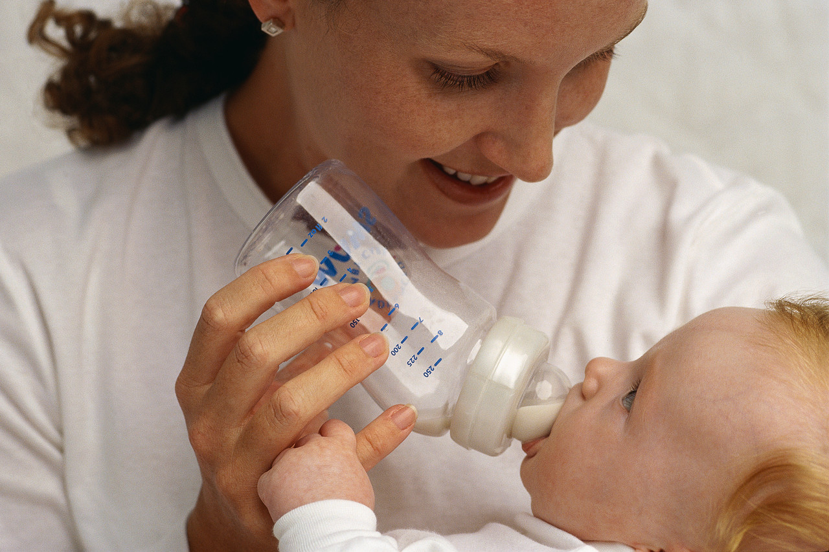
Infants Nutritional Needs first six months
Age | Total Formula Amount per Feeding | Number of Feedings per Day | Total Formula Amount per Day
0-1 Month | 1/2 to 4 ounces | 6 to 8 times per day | 12 to 24 ounces
1-4 Months | 4 to 6 ounces | 5 to 6 times per day | 24 to 36 ounces
4-6 Months | 5 to 7 ounces | 5 to 6 times per day | 24 to 36 ounces

