Slide 1
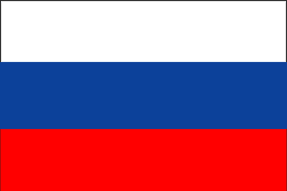
HIV/AID Russia
Kurtis Hupp
Tommy Manuguerra

Slide 2
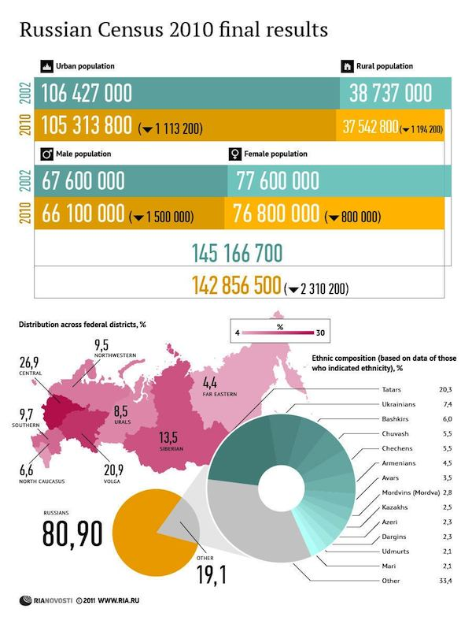

Slide 3
Russia
Central and Volga districts
Further east, less dense population
Very ethnically diverse country
Languages
Religions
Cities
Population
Life Expectancy
Hospitals/Beds
Notes:
-Two thirds of the population live in the central and volga federal districts
-The further east you go, past Siberia. the land gets cold and barren, the conditions are harder to live in
-Over 170 different ethnic groups( 81%=Russians, 3.9% =TarTars, 1.4%=Ukrainians, 1.2%=Bashkirs, 1.1%=Chuvashs, 1%=Chechens)
-Russian is the main languages spoken but there are over 27 other official languages spoken in Russia
-73%=Orthodox Christians, 20%=Non-religious, 6%=Muslims, 1%=Other religious groups
-The capital, which is also the largest, is Moscow with population of 11.5 million people. Almost three times the size of the second largest city in Russia. 6th Largest city in the world.
-According to the 2010 census, the population is roughly 142 million. More people are moving into the urban areas for employment but the population has been declining for two decades since the soviet union collapsed in 1991. Although, in 2009 there was a slight increase of around 20,000, but this was due to a falling death rate and an increase birth rate since the government was paying mothers $10,000 if they had more then three children.
-Life expectancy of a man is 63. Life expectancy for a woman is 75. Reasons for men’s life expectancy is decreased is due to alcoholism due to a fall in living standards.
-Hospital beds (per 1000 people) was 9.7 in 2006. The highest value over the past 21 years was 13.19 in 1989, while its lowest value was 9.70 in 2005. There are 5,993 Hospitals, 7,951 Health Centers, 2,330 Out Patient institutions and 827 dental clinics.

Slide 4
HIV/AIDs in Russia
People impacted yearly
Living with HIV
Cost
Notes:
Many experts believe Russia has the fastest growing HIV rate in the world, with new cases doubling every 12 months.
- About 62,000 people were diagnosed with HIV in Russia in 2011, which is five percent more than in the previous year. Women account for more than 50 percent of all newly diagnosed HIV
Between 840,000 and 1.2 million people are living with HIV in Russia. The gap is because there are MANY unregistered cases. Contaminated needles are responsible for 57 percent of all the HIV infections as Russia has an estimated 5 million drug addict. 40 percent of the people contracting HIV in 2011 having done so through sex.
The Russian government has earmarked 19 billion rubles ($600 million) on HIV prevention and treatment in 2012-2013.

Slide 5
Treating HIV/AIDs in Russia
ART
Women receiving assistance
Relief programs
Cost?
Notes:
The main HIV treatment is antiretroviral therapy, even though it is very limited, because people living with HIV must attend government-funded clinics. These clinics are often in remote places, isolated from the rest of the healthcare system. People also fear going to the clinics because they will be labeled "HIV-infected" and face prejudices and stigmas. Only 97,000 Russians received state-funded antiretroviral therapy last year. The number increased 77% between 2007-2008
83% of HIV positive women are receiving assistance from programs to help prevent mother to child transmission of HIV. Mainly drug treatment
HIV relief programs screen and treat HIV positive people. They reached 86,000 people in 2009. Some programs are: US Agency for International Development (U-SAID), US President Emergency Plan for AIDs relief (PEPFAR),
The cost of the anti-HIV/AIDs drugs are sold at a much higher price then most countries due to the Russian system of drug registration. Which means, many manufactures are forbidden to enter the market and competition always leads to lower prices.

Slide 6
Preventing HIV/AIDs in Russia
Non-extent?
Again, Relief programs
IVDU
Methadone
Medical Workers
Notes:
As of 2007, prevention services are falling short of what was promised. Some would argue that they are "non-existent“, but few still are in effect. Lack or loss of funding is still a big issue in supporting prevention options.
Relief programs not only treat and screen, but also help prevent.
"harm reduction" program. Harm reduction is just what the name implies. They are programs that assume risky behavior will occur so they teach individuals how to reduce the risk of harm from these behaviors (sex education).
IVDU (IV Drug Users) Russia is encouraging IVDUs to stop using drugs altogether. The oral drug methadone is being substituted for IV drugs in hopes of decreasing their use. Methadone is prescribed in clinics that also provide substance abuse counseling in hopes of treating substance abuse issues all together.
Methadone clinics are the long-term options, The detoxification centers are short-term options
Methods are underway to properly train medical workers in the science of HIV testing, prevention, and treatment in hopes of improving HIV prevention education.

Slide 7
Healthcare in Russia
Soviet Union
2006 and beyond
Russian Healthcare Reforms
How its Funded
Good or Bad?
Nationalized Health Care System
Notes:
The healthcare in Russia was inherited from the Soviet Union and since the fall of the Soviet Union, there has been no major health care reform…Until 2006. (health care was free to all citizens and they were the first and only ones to have a 1:1 ratio between hospital beds and people. But, many of the hospitals were inadequate lacking plumbing, heat, running water, hot water, bathrooms or showers)
Until 2006
Russia spent roughly 3.2 billion to reform their health care. The main focus was to shift from quantity (Soviet Union) to quality (post-Soviet union). Many specialists were to be eliminated in hopes of more physicians to become generalized practitioners. Many of the new clinics opened were polyclinics. Clinics that basically cover anything. There are very few specialties in Russia.
55% from Federal and Local Healthcare funds, 30% from employee payroll taxes and rest from optional purchases of supplemental insurance and out of pocket.
Good or Bad? Mostly Bad. Lack or consistency. Some coverage will not exist in other regions of Russia. Technology. Many doctors do not have the technology in Russia available to them to offer the best care possible. Cost. Most residents cannot afford coverage and do not have the proper documentation because they live remote areas.
Though they are the largest country in the world, they rank 130th in quality of their health care system.

Slide 8

THANKS FOR LISTENING!

Slide 9
References
"Population of Russia 2012." World Population Review |. N.p., n.d. Web. 21 July 2012. <http://worldpopulationreview.com/population-of-russia-2012/>.
World Health Organization. (2005, December). Summary country profile for hiv/aids treatment scale-up. Retrieved from http://www.who.int/hiv/HIVCP_RUS.pdf
"HIV and AIDS in Russia, Eastern Europe & Central Asia." HIV & AIDS Information from AVERT.org. N.p., n.d. Web. 21 July 2012. <http://www.avert.org/aids-russia.htm>.
"HIV - HIV in Russia." HIV Symptoms - HIV - The Symptoms of HIV. N.p., n.d. Web. 21 July 2012. <http://aids.about.com/od/clinicaltrials/a/russia_3.htm>.
New HIV Cases Increased in Russia in 2011 | Society | RIA Novosti." RIA Novosti. N.p., n.d. Web. 21 July 2012. <http://en.rian.ru/society/20120312/172115119.html>.
http://www.medical.siemens.com/siemens/en_US/rg_marcom_FBAs/files/brochures/magazin_medsol_2010_09/p-74-78-Essay_Russia_01.09-9.pdf
http://www.rferl.org/content/russian_healt_car_provides_no_real_safety_net/24296527.html

