Slide 1
HIV in Russia
John Muscetta and Caitlin Morris

Slide 2
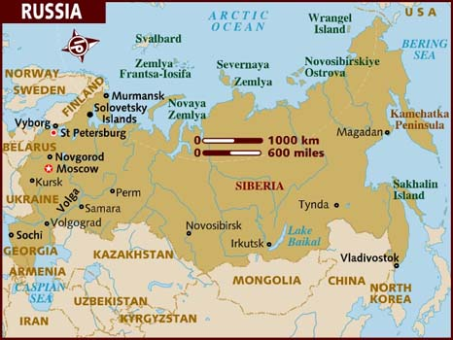
Russia

Slide 3
Country Overview
Russia is located between Europe and Asia.
There are about 138,739, 892 people living there (2011).
Most of the population is between 15 and 64.
Their population is shrinking at a rate of -0. 47 (2011).
73% of their population lives in the city (2011).
Life expectance is 59.8 years for men and 73.17 for women.
Notes:
Note the large difference in the life expectancy for men and women

Slide 4
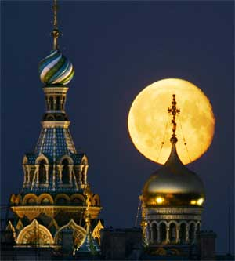
Country Overview
Most of the population is ethnically Russia.
There are large chunks of the population with no religious affiliation. However, the largest religious population is the Russian Orthodox.

Slide 5
Incidence in Russia
The number of new infections each year is equal to 250,000 people.
About 980,000 (2009) live with the disease each year.
90,000 people die from AIDS yearly.

Slide 6
Incidence in Russia
Many of the people getting HIV are contracting the disease from people who do not know they have it.
There is an extremely fast growth of HIV in people with whom the virus is unregistered or unrecognized.
There are significant numbers of unregistered cases with estimates reaching up to 228,588 people in 2002.
Notes:
Specific data can be hard to obtain because of bureaucratic problems in Russia.

Slide 7
Incidence in Russia
Drug abuse is the most common route of infection.
However, sexual transmission is the fastest growing route of transmission, especially among the 15-29 year olds.
Sex trafficking is another source of infection. Trafficking is a growing problem in Russia that is not being met with adequate resistance.

Slide 8
Incidence in Russia
Other at risk populations include prison inmates and women.
The WHO estimates that it would take 90 million with subsequent annual investments of US$ 9-10 million to successfully fight the AIDS Epidemic.

Slide 9
Russia’s Efforts to Treat HIV
The law guarantees HIV treatment for everyone who needs it.
This promise is rarely carried through. Less than 5% of the HIV population actually get the treatment they need.
There are state run clinics where HIV patients can get meds. However these are not always accessible. People also worry about being labeled as “AIDS” patients by going there.

Slide 10
Russia’s Efforts to Treat the Disease
Another problem is poorly educated health care professionals. They are often not knowledgeable about HIV tests or treatments.

Slide 11
Russia’s Efforts to Prevent the Disease
“Harm reduction programs” assume that risky behaviors will happen but try to teach people to decrease the risks associated with the activity. For example, drug users exchange dirty needles for clean ones.
They are also programs intended to get people off of IV drugs since IV drugs are a big risk factor for AIDS infection.

Slide 12
Russia’s Efforts to Prevent the Disease
Unfortunately, there is not enough financial support available for these programs. There simply are not the resources needed to make a big enough difference. There is also a lot of stigma against people who engage in high risk behaviors like drug use. This stigma tends to lead society to write these people off rather than to try to help them.

Slide 13
How Healthcare is Delivered in Russia
Promises for a wide range of services including free medical care were inherited from the Soviet Union.
Even though the care is free, it may be hard for citizens to access the care.
Russia holds to this guarantee of free medical care.
30% of the population gets medical services through work.

Slide 14
How Healthcare is Delivered in Russia
Some jobs such as police, railroad workers, and high level politicians gets special health services.
There are four different kinds of hospitals including rural health posts, health centers urban polyclinics, special focus polyclinics.
Children up to 19 get treated at special focus polyclinics

Slide 15
How Healthcare is Delivered in Russia
Rural Health Posts- basic health checks
Health Centers- primary care services
Urban Polyclinics- general practice and specialties
There are also 17,500 pharmacies in the country

Slide 16
Resources
Mishkhina, Svetlana, Vadim Poktovsky, Nikolai Mashkilleyson, and Dmitri Pomazkin. "A Model of Social Policy Costs of HIV/AIDS in the Russian Federation." ILOAIDS. Web.
"Background Note: Russia." U.S. Department of State. U.S. Department of State. Web. 28 May 2012. <http://www.state.gov/r/pa/ei/bgn/3183.htm>.
"Map of Russia." Map of Russia. Web. 28 May 2012. http://www.lonelyplanet.com/maps/europe/russia/.
CichockiR.N.,, Mark. "HIV Around the World - The Russian Federation What's Being Done?" (2010). Web.

