Slide 1
HIV AND Aids in France “Liberty, Equality, Fraternity”
R. Buie
K. Davis

Slide 2
demographics
Population: 65,350,0000 (2012)
Capitol: Paris
Language: French
Political: Republic
President: Nicolas Sarkozy
Currency: Euro
GDP: 1,907.2 Billion

Slide 3
demographics
Most expansive European country with a variety of landscapes; over 3,400 miles of coastline
Shares its borders with Belgium and Luxembourg in the north, Germany, Switzerland and Italy in the east, and with Spain in the south.
The leading agricultural producer in the European Union, while its viticulture is particularly important since France is the global leader in the production of wines and spirits.

Slide 4
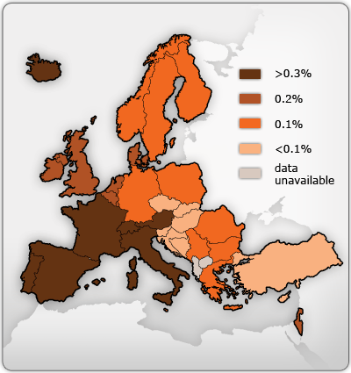
adult HIV prevalence in 2009

Slide 5
HIV Statistics
A cumulative total of 349,077 HIV infections had been diagnosed in Western Europe by the end of 2009:
40% probably acquired HIV through heterosexual contact;
37% became infected through male-to-male sexual contact;
4% became infected through injecting drug use;
28% were female;
and 10% were 15 to 24 years old.

Slide 6
AIDS Statistics
In 2009 there were 4,361 diagnosed cases of AIDS reported in Western European countries. The highest rates of AIDS diagnoses were in Portugal, Spain, and Switzerland.
AIDS mortality has also decreased as antiretroviral therapy has become widely available. Far fewer people died from AIDS in 2009 (1,083) than in 2004 (3,229).

Slide 7
Number of people impacted yearly with Hiv and aids
France: 3,952
United States: 42,959

Slide 8
Number of people living with hiv and Aids
France: 150,000
United States: more than 1,000,000

Slide 9
Aids related Deaths
France: 1,700
United States: more than 500,000
The main causes of death among people living with HIV in Europe are TB and end-stage liver disease caused by viral hepatitis C.

Slide 10
Yearly cost of hiv and Aids
First-line Therapy
HAART
$10,000 - $15,000 a year in 1996
triple combination therapy: stavudine (d4T)+lamivudine (3TC)+nevirapine (NVP).
$295 - $350 a year in 2001
Second-line Therapy
lamivudine+tenofovir+ritonavir-boosted lopinavir
$554 - $692 in 2009

Slide 11
Treatment
Antiretrovials
Reasons why treatment fails:
A high number of late diagnoses
Access to treatment and care for migrants
Drug resistance
Ageing and disease progression

Slide 12
prevention
Preventing mother-to-child transmission (PMTCT)
Preventing HIV transmission in healthcare settings
Harm reduction measures
Preventing HIV transmission among men who have sex with men (MSM)
Preventing heterosexual HIV transmission
Migrant groups and HIV prevention

Slide 13
healthcare
Universal healthcare system; la couverture maladie universelle
Two general categories of hospitals:
Public sector
Private hospital

Slide 14
Sources
http://www.france.fr
http://www.avert.org/aids-europe
http://www.medicalnewstoday.com/articles/9994

