Slide 1


School Age Child: Growth and Development
Lara Wilken
Samantha Paris
John Muscetta

Slide 2
School Age Child Basics
Age range is from 6-12 years old
This part of the lifespan is often referred to as the school age or the school years
Time when children enter into the world of school which plays an important role on development and relationships
The school age years are a time of gradual growth in both the emotional and physical aspects of development

Slide 3


Physical Changes
These years begin with the shedding of the first tooth and ends at puberty
During these years children will gain their final permanent teeth
Between the ages of 6-12 children will grow 2 inches per year, while gaining and average of 4.5-6.5 lbs per year
Boys tend to be slightly heavier and taller then girls
Notes:
At the end of these years a child will have added almost one to two feet to their height and will almost double their weight
The average 6 year old is 45 7/10 inches tall and weighs about 46 pounds , the average 12 year old is about 59 inches tall and weighs about 88 pounds
In the end of school age girls tend to surpass boys in both height and weight often to the discomfort of both girls and boys

Slide 4
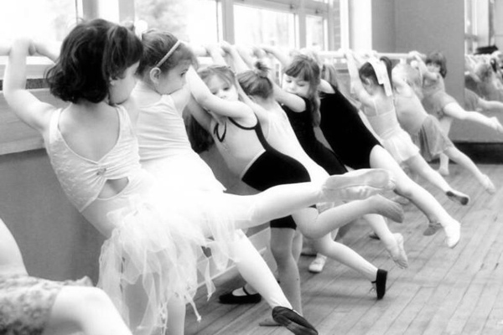
Physical Changes
School age children become more proportional during this period
They are more graceful and steadier on their feet
By the end of the school age years children double in strength, physical activities, and steady consistent coordination increases poise and skill
Notes:
Ugly Duckling stage- when the permanent teeth appear too large for the face
Proportional Development
SA are more graceful and steadier, appearing with slimmer, longer legs
Posture improves along with use of arms & legs, making climbing, bicycling & other activities easier
Fat diminishes & its distribution patterns change, body wt increases R/T muscle tissue
By the end of SA double in strength and physical activities, steady consistent coordination increases poise and skill
Muscles are immature & easily damaged due to overuse
Decrease in head circumference
Decrease in waist circumference
Correlation in physical indications of maturity and success in school
Face grows faster in R/T the remainder of the cranium
Skull and brain grow slowly and increase little in size
Proportional Development
SA are more graceful and steadier, appearing with slimmer, longer legs
Posture improves along with use of arms & legs, making climbing, bicycling & other activities easier
Fat diminishes & its distribution patterns change, body wt increases R/T muscle tissue
By the end of SA double in strength and physical activities, steady consistent coordination increases poise and skill
Muscles are immature & easily damaged due to overuse
Decrease in head circumference
Decrease in waist circumference
Correlation in physical indications of maturity and success in school
Face grows faster in R/T the remainder of the cranium
Skull and brain grow slowly and increase little in size

Slide 5


Physical Changes
THE BODY SYSTEMS MATURE!!!
Kids caloric needs are decreased, and they do not need to be fed as carefully
Physical Maturation is evident in other body tissues and organs
Changes occur in the GI, Urinary, Cardiovascular, Skeletal, and Immune systems
Notes:
GI System:
Fewer upset stomachs
Better BG levels
Retention of food for longer periods
Caloric needs are less than before
Urinary system:
Bladder capacity > in girls than boys
Cardiovascular:
Heart grows more slowly
Smaller in R/T rest of the body
HR & RR decrease and BP increases
Immune System:
Stronger, localizes infections, producing antibody antigen response
Higher infection rate due to exposure 1st 1-2 yrs of school
Bones:
Continue to ossify, yield to pressure, muscle pulls more readily
(Caution heavy loads, distribute wt evenly)
Wider physical changes can effect self esteem and may create emotional problems these changes occur at the end of MCH.

Slide 6



Physical Changes - Prepubescence
Lasts from ages 11-13
No universal age at which these characteristics appear
Usually evident in a 12-13 year old
Onset of secondary sex characteristics
Time of physical change and growth
Notes:
Prepubescence:
Lasting two years 11- 13 y.o.a.
Rapid growth of ht & wt esp. in girls
First signs appear in girls at age 9 and are evident by age 11
Onset of secondary sex characteristics
Emotional period of time
Puberty at 10 in girls & 12 in boys or as early as 8 y.o.a in both

Slide 7

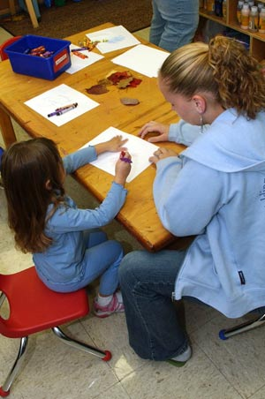

Developmental Milestones
Lots of developmental milestones occur
Areas of Development
  Psychosocial- Freud and the latency period
  Self Concept
  Body Image
Notes:
Psychosocial Development:
Freud: The Latency Period
Tranquility of the Oedipal phase of ECH & the Eroticism of Adolescence
Developing a Self Concept:
Self concept includes awareness of self perceptions, physical characteristics, abilities, values, self ideals, expectations, and self in relation to others, body image, self esteem and sexuality.
Parents, peers, and teachers provide valuable input during MCH
Each small success in a child’s environment increases a child’s self image
Positive self concept leads to self respect, self confidence, and happiness.
Developing Body Image:
SA children have accurate and positive body image, but like themselves less as they grow older, the head is the most important part of SA child image of self
Body image is influenced by significant others
Children are aware of their body, the bodies of peers and adults, deviations from the norm.

Slide 8
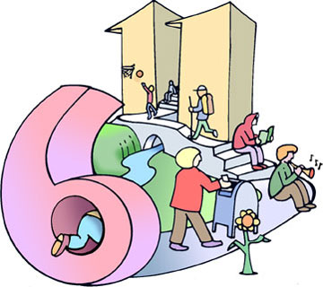
Developing a Sense of Industry (Erikson)
Occurs between 6 years old and adolescence
Acquire a sense of personal & interpersonal competence
Receive systematic instruction from their culture
Develop skills to be useful members of society
They want tasks that allow them a sense of accomplishment
MCH the child learns the value of doing things w/ others, the benefits of the division of labor in the accomplishment of goals
Peer approval is motivating power
Danger of inferiority R/T physical and mental limitations
Children must learn they can’t master everything
Children want and need achievement

Slide 9
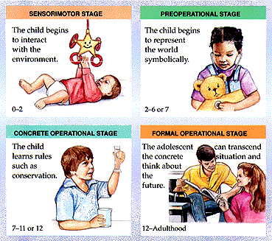
Cognitive Development (Piaget)
Concrete operations: ability to relate a series of events to mental representations expressing verbally and symbolically
Mental process allows children to see things from another’s view
Shift from perceptual thinking to conceptual thinking
Master symbols, and uses past experience to evaluate the present
Master the concepts of conservation, reversibility of numbers, classification skills, relational terms, reciprocal roles, they learn to tell time, and to combine time and space, they learn to read.

Slide 10
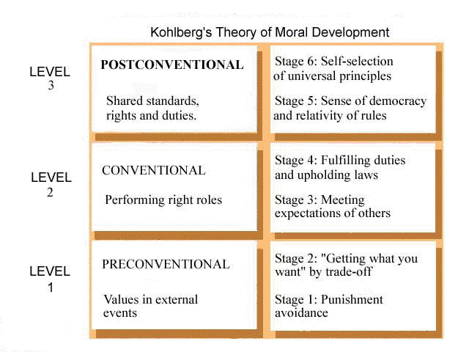
Moral Development
(Kohlberg)
Young children believe rules and standards come from w/out, not from w/in
They learn rules and values from their parents and feel guilty when they don’t abide by them
6-7 know the rules, do not understand the reasoning
Able to accept the concept of treating others as they want to be treated
May interpret accidents or misfortunes as punishment for bad acts
Older children can judge an act by what prompted it rather than its consequences
They consider the situation, as well as the morality of the rule itself, influences reactions.

Slide 11

Spiritual Development
Think in concrete terms, envision God as human
Fascinated with heaven and hell
Fear hell for misbehavior, want & expect punishment for misbehavior
May view illness or injury as punishment
Religious beliefs come from family and church rather than peers
Begin to learn the difference between natural & supernatural
Religious concepts must be presented in concrete terms
Able to discuss their feelings about faith and how it relates to life

Slide 12


Developmental Milestones - Social
One of most important socializing agents in SA : Peer Group
Through peer relationships children learn dominance, hostility, how to relate to persons of authority, leadership, how to explore ideas and physical environment
Helps to gain independence from parents, security to risk moderate parental rejection
Concept of appropriate sex role
Early school years few gender differences matter in play
Notes:
Social Relationships and Cooperation:
Children join groups with enthusiasm & steady participation
Children learn to appreciate others viewpoints w/in a group
Become aware of the limits of their own point of view
Significant influence on decreasing the egocentric outlook of the child
They learn to argue, persuade, bargain, cooperate, compromise to maintain friendships
Children modify their behavior for acceptance
Interaction among peers leads to intimate friendships, best friends
These relationships where a child experiences love & closeness for a peer are an important foundation for adult relationships
Peer group identification & association are essential to a child’s socialization
Relationships w/ Families
Parents are the primary influence of in shaping the child’s personality & standards of behavior, and establishing values.
Family values usually take precedence over peers
MSC want to begin to spend more time w/ peers than family
Children become intolerant to and critical of parents
They question parents and authority, but still need and want restrictions
They feel more secure having an authority figure, they respect adults that set limits
Children needs parents as adults not friends, they need stable secure strength from mature adults that they can turn to with troubles
A secure base in a loving family allows self confidence, and maturity needed to be independent

Slide 13
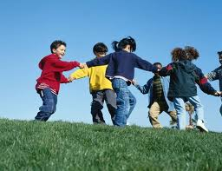

It’s Play Time!!
Play takes on a new scope that reflects many developmental changes
Shows changes in:
  Increased physical skill
  Intellectual ability
  Fantasy
A sense of belonging comes from joining in teams, clubs, or groups
Play involves changes to rules and rituals, team play, quiet games and activities, ego mastery
Notes:
Part of enjoying a game is knowing the rules, because knowing the rules means belonging
Conformity & ritual permeate their play and are also evident in their behavior & language
Children derive a sense of power & pleasure from childhood sayings
Team play teaches children to modify or exchange personal goals of the group, it teaches that division of labor is an effective strategy for attaining a goal
Team play also contributes to children’s social, intellectual, & skill growth., team play helps stimulate cognitive growth due to rules, judgments about rules, strategies, assessment of strengths & weakness of both team and opposing members
Children expand their world through knowledge acquired in quiet play such as reading books
Play affords children the means to acquire mastery over themselves the environment and others
Ego mastery- play affords children the means to acquire mastery over themselves their environment and others

Slide 14
Focus on Healthy Family Functioning
Age 6 years
  Food preferences changes, refusal may occur, increased appetite, erratic mood changes, increased chance for illness, increased interest outside the home
Age 7-10 years
  Improvement in health but risk for increased allergies, increase in minor injuries, increasing involvement with peers, encourage independence with limits, prepare for prepubescent changes in girls and boys

Slide 15

Focus on Healthy Family Functioning
Age 11-12 years
  Body changes of pubescence, growth spurt in girls, sex education, allow aggressive behavior when needed, support need to “grow up,” education on experimentation with potentially harmful activities

Slide 16

Family Functioning
Relationships with families
  Family values take precedence over peer values
  Children will want to spend more time with peers
  Increased independence is the goal of childhood and should be supported by parents
  Children need their parents as adults and not as friends
  Parents share responsibility for helping children achieve their maximum potential
Notes:
Relationships w/ Families
Parents are the primary influence of in shaping the child’s personality & standards of behavior, and establishing values.
Family values usually take precedence over peers
MSC want to begin to spend more time w/ peers than family
Children become intolerant to and critical of parents
They question parents and authority, but still need and want restrictions
They feel more secure having an authority figure, they respect adults that set limits
Children needs parents as adults not friends, they need stable secure strength from mature adults that they can turn to with troubles
A secure base in a loving family allows self confidence, and maturity needed to be independent

Slide 17


Family Functioning - Discipline
Many factors influence the amount and manner of discipline as well as the limits imposed on school age children
Some factors are:
  Parents Psychosocial Maturity
  Parents childhood
  Childrearing experiences
  Child’s temperament
  Context of misconduct
  Child’s response to rewards and punishments
Notes:
When children develop an ability to see a situation from anothers point of view they are also able to understand the effects of their reactions on themselves and others
Discipline should take place in a positive supportive environment with use of strategies to instruct and guide desired behaviors and eliminate undesired behaviors
Disciplinary strategies- with holding priveliges requiring compensation, imposing penalities, and contracting

Slide 18

Dishonest Behavior
Dishonest Behavior in school age children includes:
  Lying- “story telling,” means to escape punishment
  Cheating- they don’t realize this behavior is wrong and do this automatically
  Stealing – children may steal for several reasons
Notes:
When parents set examples of honesty the children are more likely to conform this
Reasons for stealing- revenge, bribery, attempt to acquire a coveted item,

Slide 19

Promoting ADL’S
Nutrition
Adequate sleep and rest
Independence promotion
Regular Exercise and Activity
Safety
Hygiene
  Teeth Brushing/ Flossing
  Bathing
Notes:
Children should be able to bathe themselves at age 6

Slide 20


Health- Nutrition
Parents need to promote a healthy balanced diet for the increased growth needs of adolescence
The quality of a child’s diet depends on the family’s pattern of eating
Likes and dislikes established at an early age continue into middle childhood
The easy availability of high calorie foods w/ sedentary lifestyles has contributed to an epidemic of childhood obesity.
Nutrition education should can and should be integrated in the curriculum throughout school years

Slide 21

Sleep and Rest Exercise and Activity
Amount is individualized in MCH depending on age, activity level, & state of health
SA sleep 11 hours per night, with little trouble going to bed
MCH must be reminded to go to bed 8-9 and 11yr old are resistant
Unaware they are tired, fatigued the next day
12 yrs, often retire to bed on own
Children in SA years may appear larger & stronger, but may not be ready for strenuous physical activity
All growing children need regular exercise and opportunities for experiences to develop likes & dislikes
Exercise is essential for muscle development & tone, refinement of balance and coordination, increased strength & endurance & stimulation of body functions & metabolic functions.
Children with disabling conditions or hesitant involvement in active play require special assessment & help to find activities that will appeal and be compatible with their special needs

Slide 22

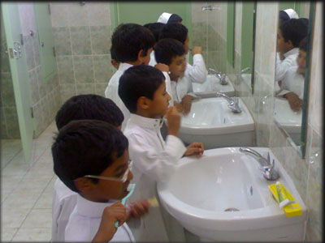
Dental Care
Because permanent teeth erupt during school age years dental hygiene & regular attention to dental caries are important parts of health supervision during this period.
Correct brushing as well as education regarding carbonated beverages should be taught & reinforced
Regular dental supervision & continued fluoride supplementation are integral parts of the health maintenance program
The most effective means of preventing dental caries is proper oral hygiene
Teeth should be brushed after meals, snacks, and at bedtime, children who practice this regularly will maintain the habit throughout their life
Through cleaning is more important than a specific method, parents should perform flossing until ages 8 or 9

Slide 23

Health- Safety
The most common cause of severe injury and death in school-age children is motor vehicle accidents either as a pedestrian or passenger
Three automobile safety measures have been found to reduce the severity of injuries: effective car restraints, door-lock mechanisms, and appropriate passenger-seating locations in the motor vehicle.
The American Academy of Pediatrics advises rear vehicle seat is the safest for children under the age of 13
SA child’s desire for riding bicycles increases risk of injury on streets
Most injuries occur in or near the home or school, the most effective means of prevention is education of the child & family regarding the hazards of risk taking & the improper use of equipment
Because head injury is the major cause of bicycle safety is to encourage the rider to wear a protective helmet
Trampolines in the home environment, routine physical education classes, or outdoor playgrounds are not recommended for children of any age
The prevalence of injuries depends on the dangers in the environment, the protection offered by adults, and the children’s behavior patterns

Slide 24
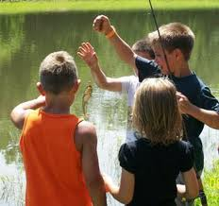

Conclusion
Lots of changes occur during this time
Physical growth is gradual, w/ even progress in both physical & emotional aspects
They reach many milestones during these years including:
  Thought process shifts from perceptual to conceptual thinking
  They are able to understand treat others as they want to be treated
  A secure base in a loving family allows self confidence, and maturity needed to become independent

Slide 25
QUIZ TIME
What is a normal relationship change in regards to family functioning that parents should expect during the school age years?
Children needs parents as friends rather than adults
Children typically spend more time with peers at this age
Independence is not encouraged by parents at this age
Children become more tolerant and less critical of parents at this time
What is important regarding injuries in school age children?
Most injuries occur in or near school or home.
Wearing a helmet when using a bicycle, skates, or skateboards is not an important safety measure
Sitting in the front seat is the safest location for a school age child to sit in the car
The most common cause of severe injury in school age children is sports related injures
Notes:
What is a normal relationship change in regards to family functioning that parents should expect during the school age years?
Children needs parents as friends rather than adults
Children typically spend more time with peers at this age
Independence is not encouraged by parents at this age
Children become more tolerant and less critical of parents at this time
Answer is B
Question 2 answer is A

Slide 26
WORKS CITED
Source:
Perry, S. E., Hockenberry, M. J., Lowdermilk, D. L., & Wilson, D. (2010). Maternal child nursing care. (4th ed.). Maryland Heights, Missouri: Mosby.
Pictures:
http://openparachute.files.wordpress.com/2011/04/morality.jpg?w=500
http://dentistinbeaumont.com/images/beaumont-dentist-dental-caries-prevention.jpg
http://stores.intuitwebsites.com/NutritionMattersInc/catalog/PreschoolChildNutritionPoster.jpg

Slide 27
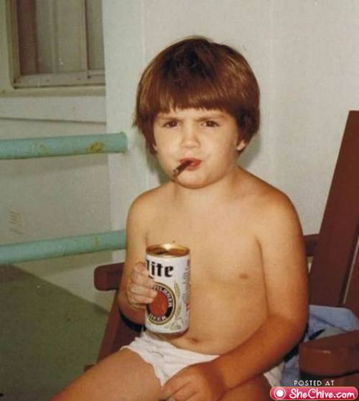
How Not To Reach Your Developmental
Milestones!!!!!

