Slide 1
Growth and Development: The Preschool Years
June Baker, Rachel Buie, Kristin Davis, Lori Logan

Slide 2
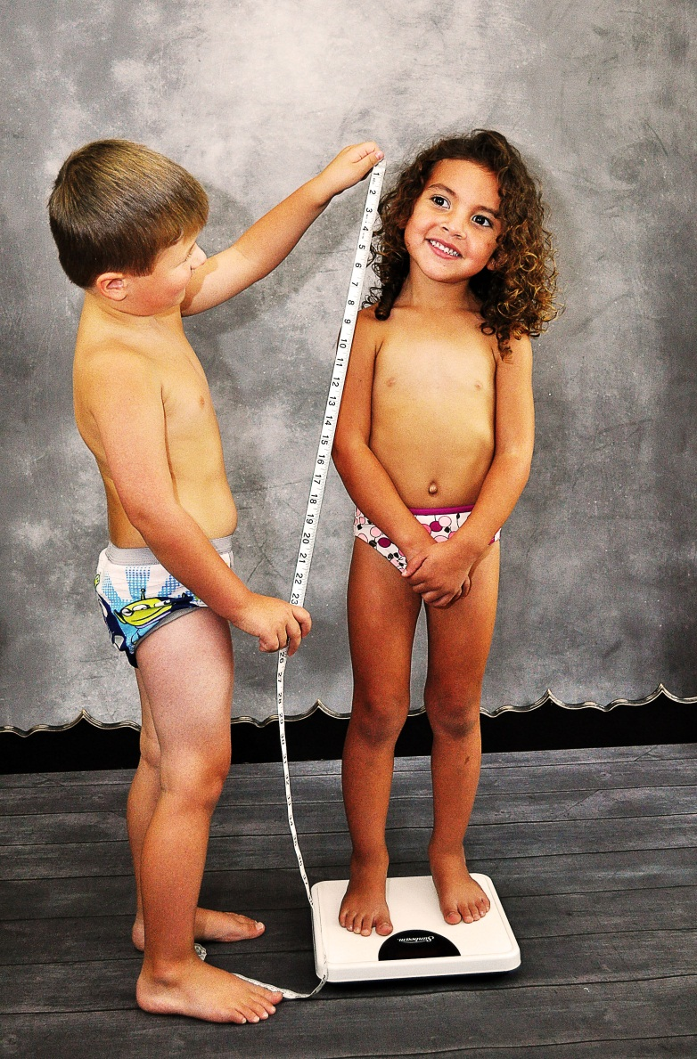
Physical Growth Changes
Average Weight is 32 lbs-41.5 lbs.
Height increases every year by 2.5 in.-3.5 in.

Slide 3
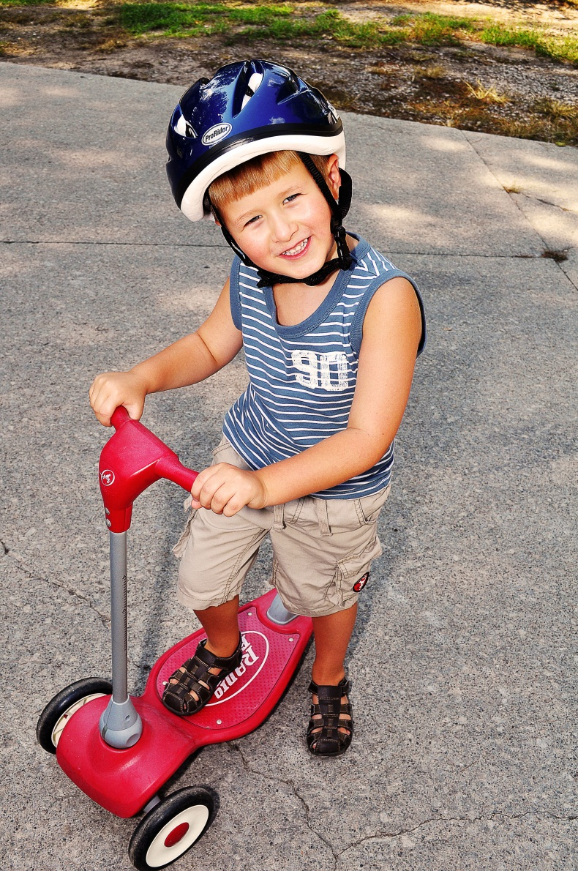

Physical Growth Changes
Refined eye-hand coordination
Increased skillful manipulation

Slide 4
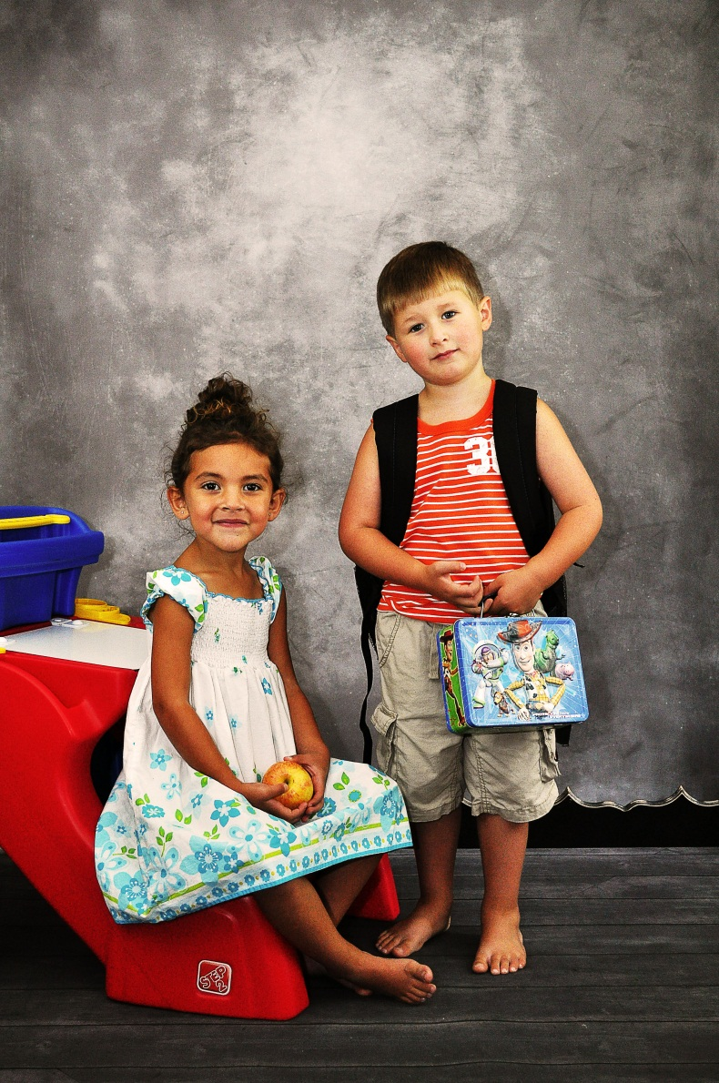
Developmental Milestones
Entrance into School
Increased attention span and memory

Slide 5


Language, Emotional, Cognitive
Increased vocabulary to more than 2100 words
Advancement in sentence structure, grammatical usage, and intelligibility

Slide 6
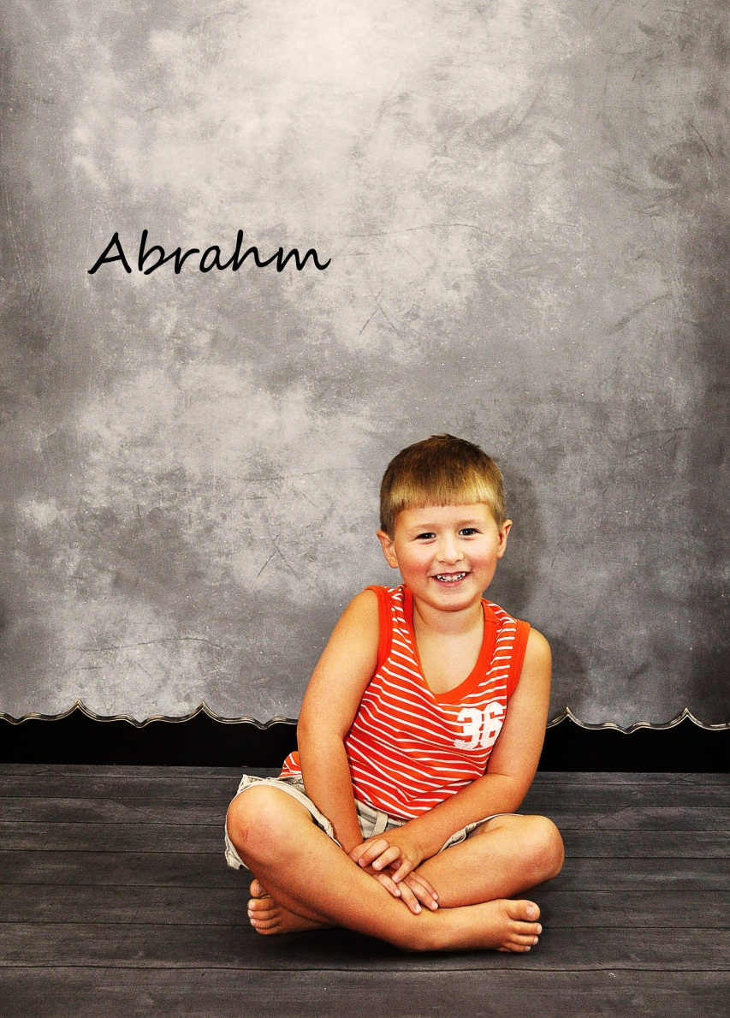
Language, Emotional, Cognitive
Use of several words to convey message (prepositions, adjectives, variety of verbs)
Can define simple things by describing their use, shape, or general category of classifciation

Slide 7

Morality
An action is good or bad depending on whether it results in reward or punishment

Slide 8
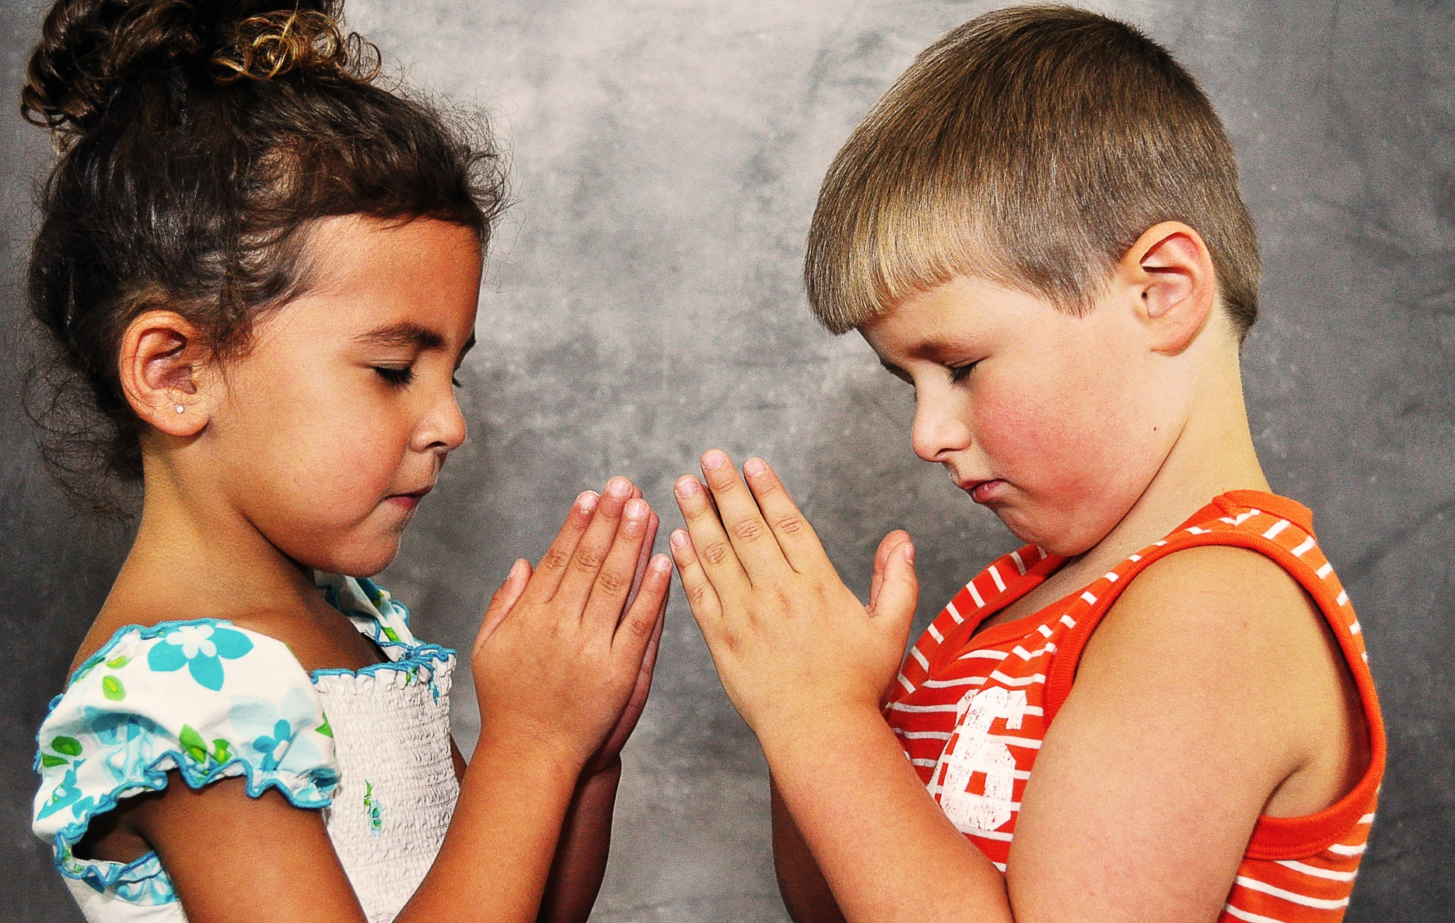
Spirituality
Faith and religion learned from parents
Concrete concept of God

Slide 9

Safety

Slide 10
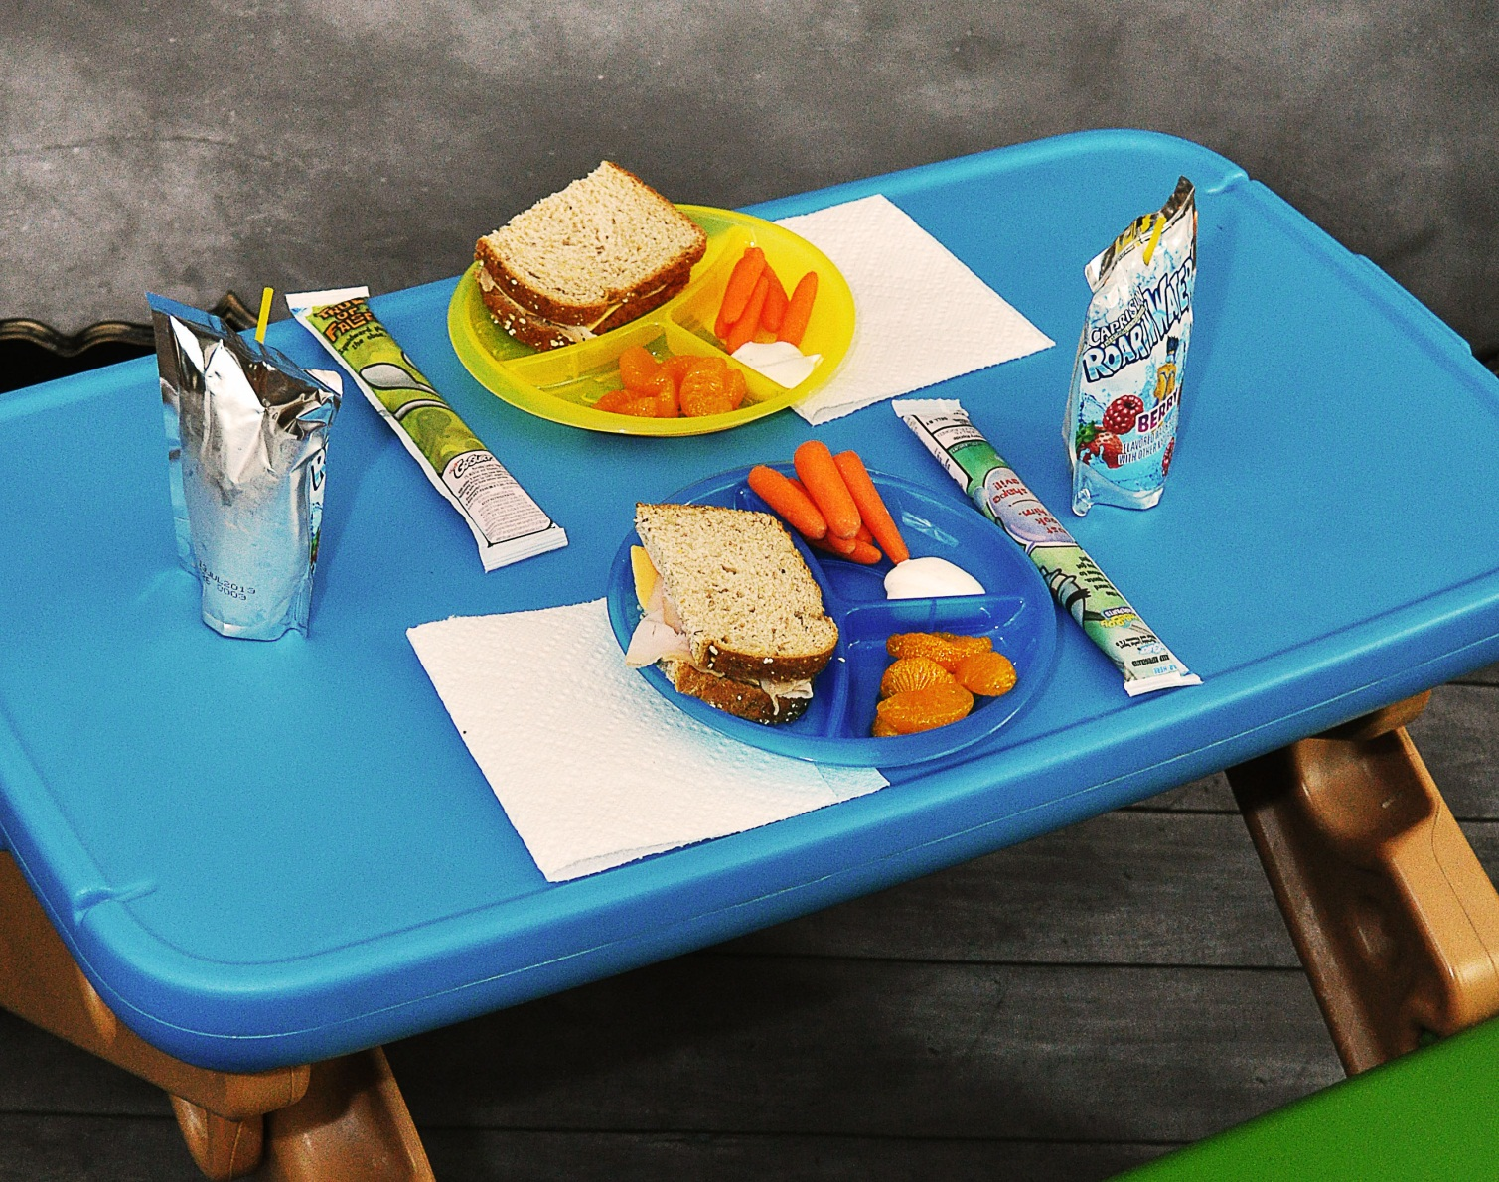
Nutrtional

Slide 11
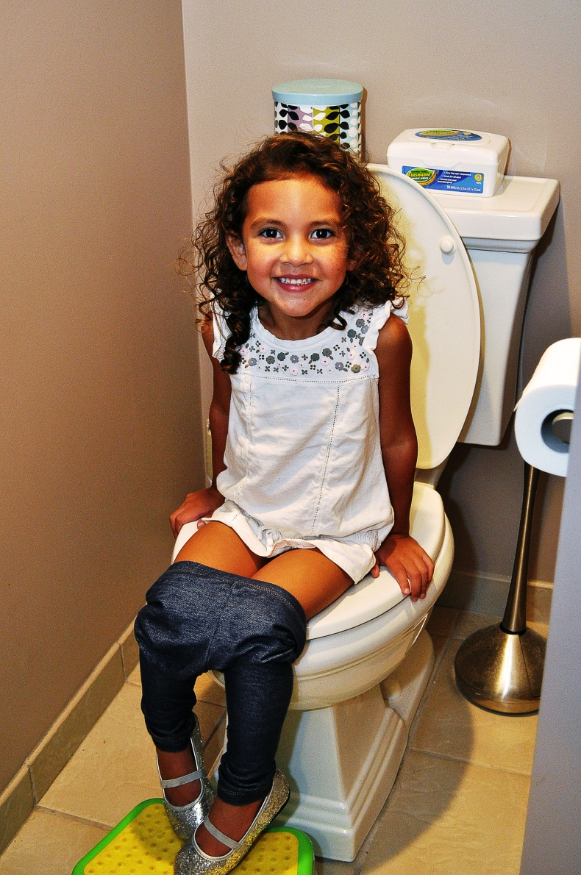
Promoting Development in ADLs

Slide 12
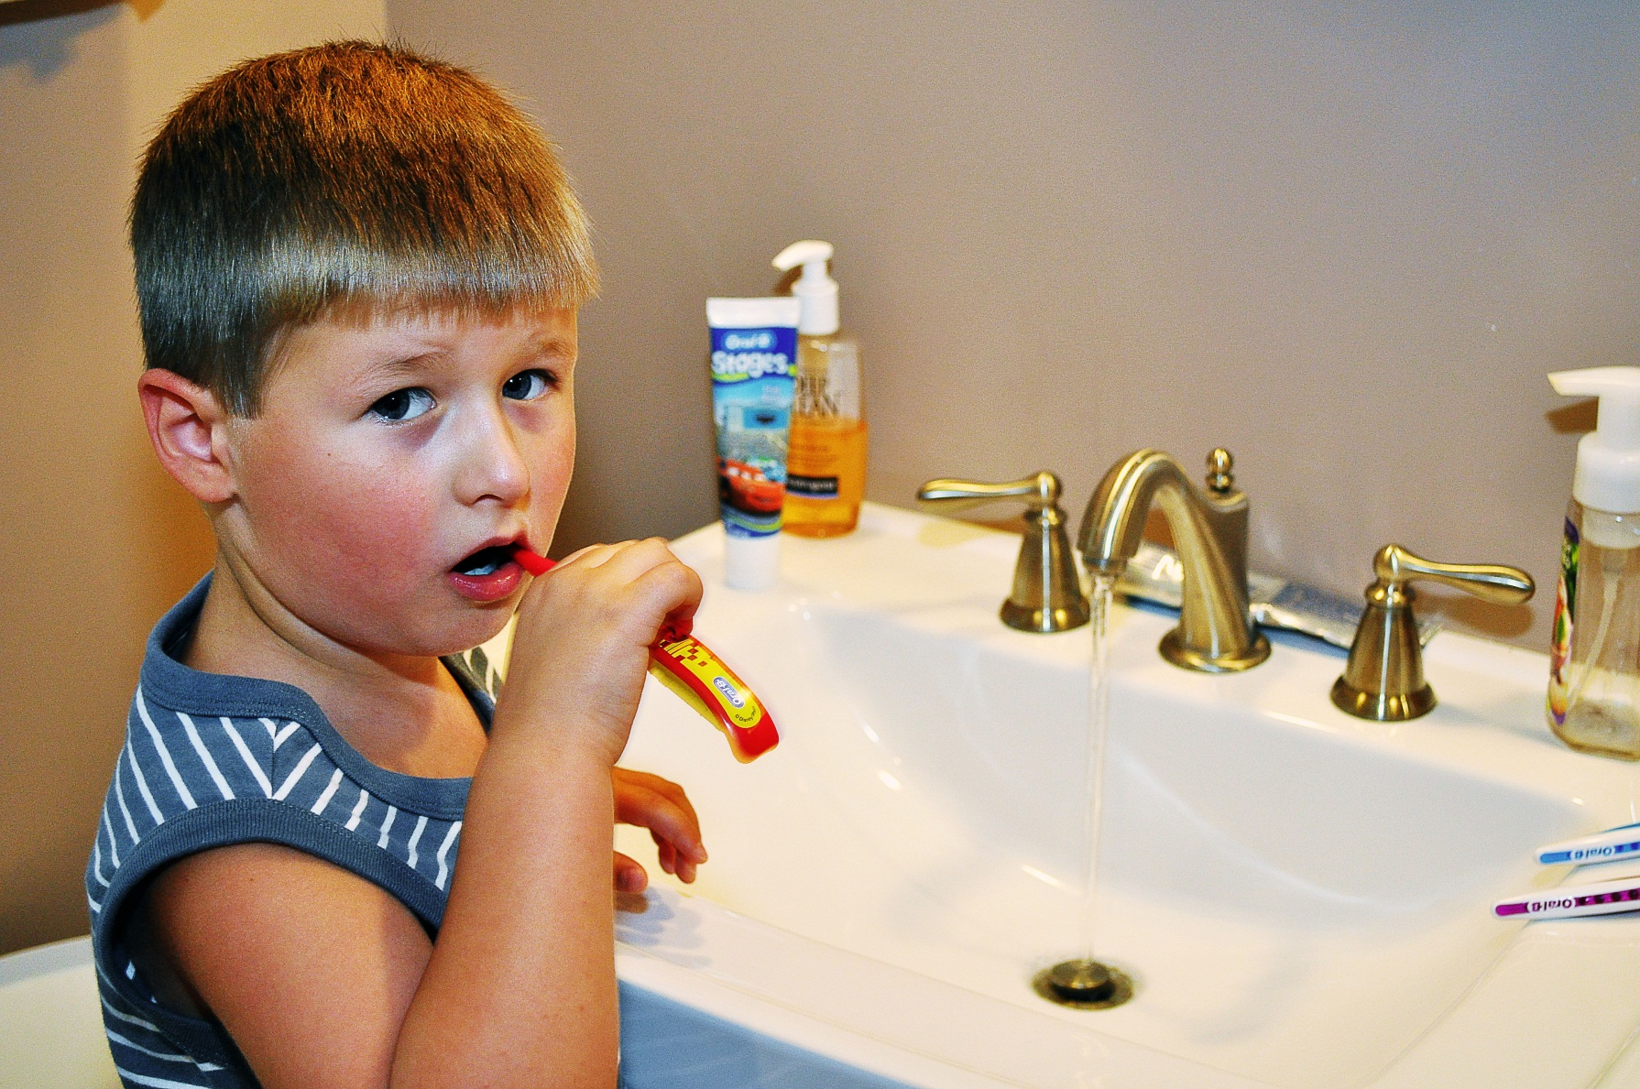
Promoting Development in ADLs

Slide 13

Promoting Healthy Family Functioning

Slide 14
Quiz Questions

