Slide 1
Growth and Development: Preschool Period
Erica Friend
Mike Gedridge
Louise Cook
Nancy Montgomery

Slide 2
Introduction
The preschool period is from 3 to 5 years of age. Successful achievement of previous levels of growth and development during the toddler years is essential. In the preschool stage, tasks learned previously are refined. The combined achievements during the preschool period prepare children for their most significant lifestyle change: entrance to school.

Slide 3
Physical Growth
Rate of physical growth slows and stabilizes.
Average weight at 3 years = 32lbs
Average weight at 4 years = 37lbs
Average weight at 5 years = 41.5lbs
The average weight gain per year remains around 4.5 to 6.5 pounds

Slide 4
Physical Growth
Growth in height remains steady with a yearly increase of around 2.5 to 3.5 inches. This growth occurs mainly in the legs rather than the trunk. The preschooler is slender but sturdy, agile and posturally erect. There is little difference in gender except by dress and hairstyle.
Average height at 3 years = 37.5 inches
Average height at 4 years = 40.5 inches
Average height at 5 years = 43.5 inches

Slide 5
During this period most children are toilet trained, motor development increases with increases in strength and refinement of previous skills such as running, walking and jumping. Muscle development and bone growth is far from mature. Excessive activity and overexertion can injure delicate tissues. During this period, good posture, appropriate exercise and adequate nutrition and rest are essential for optimal development.
Insert picture of toilet training here
Notes:
Louise, I don’t know if this cuts into your Milestone section. Go ahead and cut it out or make changes if it does overlap with yours.

Slide 6
Nutrition
Nutritional requirements are similar to those for toddlers.
Caloric requirements continue to decrease slightly.
Caloric requirements = 90kcal/kg for an average intake of 1800cal per day
Fluid requirements may also decrease slightly to around 100ml/kg/day but depend on activity level, climate conditions and state of health.

Slide 7
Nutrition
The American Academy of Pediatrics recommends the following intake levels for children over the age of 2
Protein intake of 13-19g/day
Saturated fats : less than 10% of total calories, with a total fat intake over several days between 20 and 30%
Evidence has shown the decreased incidence of chronic disease with lower levels of fat intake.

Slide 8
Nutrition
Recommended daily calcium intake for children 1 to 3 years = 500mg , children 4 to 8 years = 800mg.
Milk and dairy products are excellent sources of calcium and vit D.
Insert some sort of milk drinking picture here

Slide 9
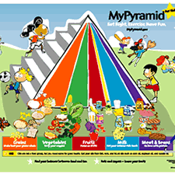
Nutrition
MyPyramid for Kids is appropriate for preschoolers and children as young as 2 years of age.

Slide 10
Nutrition
Excessive consumption of fruit juices has been associated with adverse health effects such as cavities and GI symptoms. Limit intake of fruit juice to 4 to 6 ounces/day for children 1 to 6 years of age. Be aware of nonnutritious fruit drinks containing less than 10% fruit juice and lots of sugar.
Maybe put in a picture of some nasty teeth

Slide 11
Nutrition
Some preschoolers still have strong taste preferences and food fads. Around the age of 4, children enter another stage of picky eating. It is important for the parents to be adequate role models in regards to food intake and dietary habits.
Insert pictures of us eating fast food, and healthy food

Slide 12
Nutrition
Things to avoid
Having the child remain at the table until the plate is clean. This promotes poor eating habits and overeating. Instead, give the child small portions of each item.
Expecting perfect table manners : The 5 year old is normally ready for the social side of eating, but the 3 or 4 year old still has difficulty sitting still through a long family meal.
Worrying about everything your child is eating. Remember, quality is much more important than quantity at this time.

Slide 13
Promoting Development in ADL’s
Playing helps preschoolers develop in their ADL’s
Play should provide for physical, social and mental development
Play activities for physical growth and refinement of motor skills include jumping, running, and climbing
Play activities for muscle development and coordination include tricycles, wagons, gym and sports equipment, sandboxes, wading pools and activities at water parks

Slide 14
Promoting Development in ADL’s
Swimming and skating teach safety as well as muscle development and coordination
Children often enjoy playing with common household items or even items adult consider junk (boxes, sticks, rocks and dirt)
The preschooler’s imaginative mind enjoys playing for its own sake

Slide 15
Promoting Development in ADL’s
Manipulative, constructive, creative and educational toys provide for quiet activities, fine motor development, and self expression. Easy construction sets, large blocks of various sizes and shapes, a counting frame, alphabet or number flash cards, paints, crayons, simple carpentry tools, musical toys, illustrated books, simple sewing or handicraft sets, large puzzles and clay are suitable toys. (list of suitable toys pg1047)
Electronic games and computer programs are especially valuable in helping children learn basic skills such as letters and simple words

Slide 16
Promoting Development in ADL’s
The most characteristic and pervasive preschool activity is imitative, imaginative, and dramatic play
Toward the end of the preschool period, children are less satisfied with make believe or pretend objects and enjoy doing the actual activity, such as cooking or carpentry
Imaginary companions serve many purposes, they become friends in times of loneliness, they accomplish what the child is still attempting and the child may even blame it for wrong doing, or play parent with it and punish them for wrongdoing and assume control and authority in a safe situation
Imaginary playmates are very normal and useful

Slide 17
Promoting Healthy Family Functioning
Parental security, reassurance, guidance and approval is needed by the child, especially when entering preschool or elementary school
Comfort the child when stressed, but remember discipline
Give your child options to make simple decisions for themselves

Slide 18
Promoting Healthy Family Functioning
Incorporate the child into daily activities such as cooking and organizing, make games out of activities.

Slide 19
Promoting Healthy Family Functioning
When entering another child into the family, the child requires special attention to prevent feelings of desertion and resentment
Preschoolers believe in the power of words and take them literally, remember to say which actions are bad when disciplining the child, remember not to call the child bad because they take it personally and interpret themselves as a bad person.

Slide 20
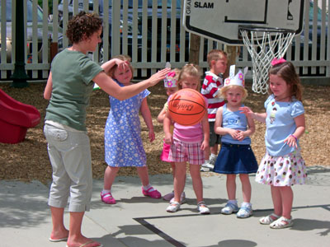
Developmental Milestones of the preschooler
Physical Milestones of 3 year Old:
Average weight 32 pounds
Average Height 37.5 inches
Usual weight gain is 4 to 6 pounds
May have achieved night time control of bladder

Slide 21
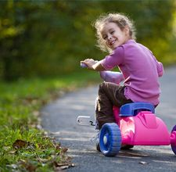
Developmental Milestones of the preschooler
Gross Motor 3 Year Old
Jumps off bottom step
Stands on one foot for a few seconds
Rides tricycle
Goes upstairs using alternating feet but comes down using both feet
Broad jumps, hops on one foot
Tries to balance self but not adequate
Climbs well
Runs easily
Bends over easily without falling

Slide 22

Developmental Milestones of the Preschooler
Fine Motor Skills 3 Year old
Builds tower of 9-10 cubes
Makes up and down, side to side & circular lines with pencil or crayon. Can not draw stick figure. Names what has been done
Builds bridge with 3 cubes
Places pellets in narrow necked bottle
Turns book pages one at a time
Screws & unscrews jar lids, nuts & bolts
Turns rotating handles
Feeds self, gets own drink of water, brushes teeth

Slide 23

Developmental Milestones of the Preschooler
Language 3 Year Old
Vocabulary of 900 words
Uses telegraphic speech
Uses complete sentences of 3-4 words
Talks incessantly regardless of whether anyone is paying attention
Repeats sentences of 6 syllables
Asks many questions, “Why?”
Recognizes & identifies almost all common objects & pictures
Expresses affection openly

Slide 24
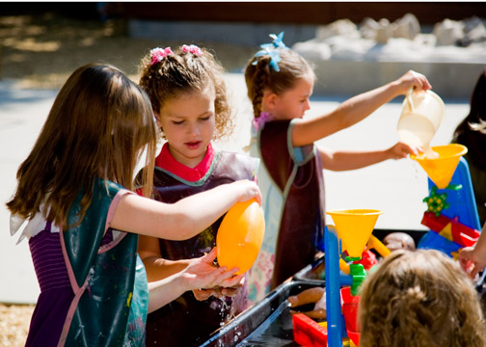
Developmental Milestones of the Preschooler
Socialization 3 Year Old
Dresses self with some assistance with buttons & told which shoe is right or left
Pulls on shoes
Has increased attention span
Can prepare simple meals such as cereal & milk
Can helps set table, can dry dish without breaking it
May have fears esp. of dark & going to bed
Knows own gender & gender of others
Play is parallel & associative, begins to learn simple games
Begins to share
Imitates parents & playmates
Is egocentric but understands concept of “mine” & “his/hers”

Slide 25

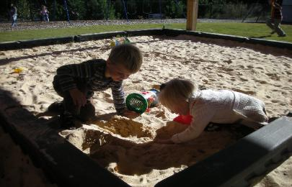
Developmental Milestones of the Preschooler
Cognition 3 Year Old
Is in preconceptual phase
Egocentric in thought & behavior
Has beginning understanding of time, talks about past & future as much as about present. Pretends to tell time
Improved concept of space as demonstrated by understanding prepositions & ability to follow directional commands
Beginning ability to view concepts from another perspective

Slide 26
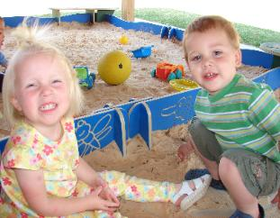

Developmental Milestones of the Preschooler
Family Relations of 3 Year Old
Attempts to please parents & conform to their expectations
Is less jealous of younger sibling
Is aware of family relationships & sex role function
Boys tend to identify more with father or other male figure
Increased ability to separate easily & comfortably from parents for short periods

Slide 27
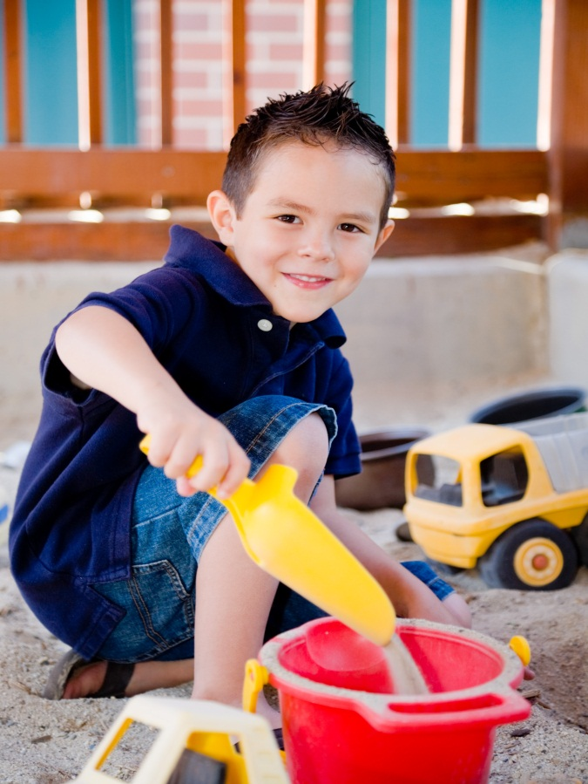
Developmental Milestones of the Preschooler
Physical of 4 Year Old
Pulse & respirations decrease slightly
Average weight 36 4/5 pounds
Average height 40 ½ inches
Length at birth is doubled
Maximum potential for development
amblyopia

Slide 28
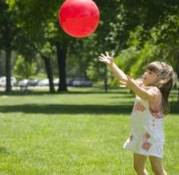
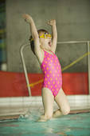
Developmental Milestones of the Preschooler
Gross Motor of 4 Year Old
Skips & hops on one foot
Throws ball overhead & catches ball reliably
Walks downstairs using alternate footing

Slide 29

Developmental Milestones of the Preschooler
Language of 4 Year Old
Vocabulary of 1500 words or more
Uses sentences of 4-5 words
Questioning is at a peak
Tells exaggerated stories
Knows simple songs
May use mildly profane language when around other children & may say something to shock you
Obeys 4 prepositional phrases such as under, on top of, beside, in back of or in front of
Names one or more colors

Slide 30

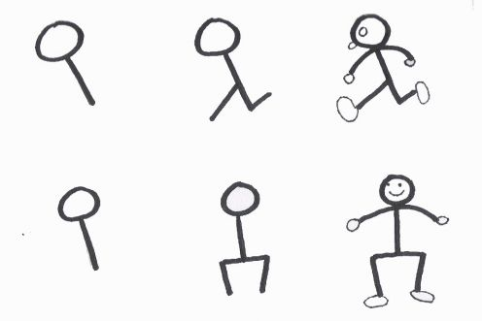
Developmental Milestones of the Preschooler
Fine Motor of 4 Year Old
Uses scissors successfully to cut out picture following outline
Able to lace shoes but not able to tie bow
Able to copy a square, traces a cross & diamond adds 3 parts to a stick figure

Slide 31
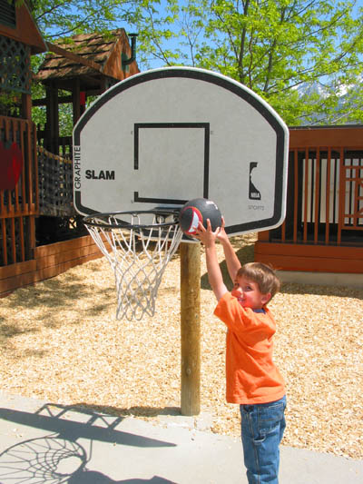
Developmental Milestones of the Preschooler
Socialization of 4 Year Old
Very independent, has mood swings
Tends to be selfish & impatient
Physically & verbally aggressive
Takes pride in accomplishment,
Enjoys entertaining & shows off dramatically
Tells family tails to others with no restraint
Play is associative, still has many fears
Imaginary playmates are common
Uses dramatic, imaginative & imitative devices
Sexual exploration & curiosity is demonstrated through play (Doctor or Nurse)

Slide 32
Developmental Milestones of the Preschooler
Cognition of 4 Year Old
Is in phase of intuitive thought
The Cause of something is related to proximity of the event
Understands time in terms of sequence of daily events. Judges everything in one dimension according to weight, height, width or order
Beginning to develop more social awareness
May count accurately but has poor mathematic concept of numbers
Obeys because parents have set limits not because of understanding of right or wrong
Understands analogies as if ice is cold then fire is ______.
Has mood swings

Slide 33
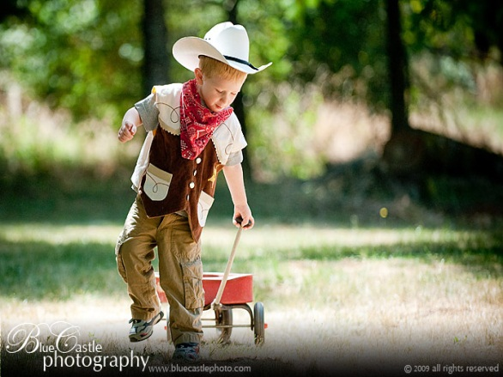

Developmental Milestones of the Preschooler
Family Relations of 4 Year Old
Rebels if parent expects to much, may run away from home
Takes aggression & frustrations out on parents or siblings
Do’s & don’ts become important
May have rivalry with older or younger siblings & may resent older siblings privileges & younger siblings invasion of privacy

Slide 34
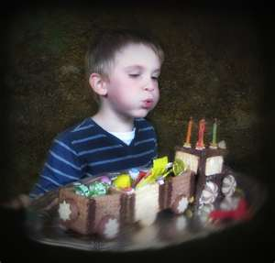
Developmental Milestones of the Preschooler
Physical of 5 Year Old
Pulse & respirations decrease slightly
Average weight 41.2 pounds
Eruption of permanent teeth may begin
Handedness is established (90% right handed)

Slide 35
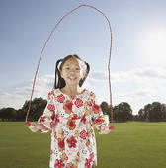
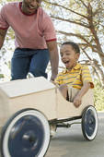
Developmental Milestones of the Preschooler
Gross Motor of 5 Year Old
Skips & hops on alternate feet
Throws & catches ball well
Jumps rope
Skates with good balance
Walks backward with heel to toe
Jumps from height of 12 inches & lands on toes
Balances on alternate feet with eyes closed

Slide 36

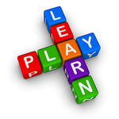
Developmental Milestones of the Preschooler
Fine Motor of 5 Year Old
Ties shoes
Uses scissors, simple tools, or pencil very well
Draws copies of diamond & triangle, adds 7-9 parts to stick figure, prints a few letters, numbers or words such as first name

Slide 37
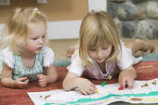
Developmental Milestones of the Preschooler
Language of 5 Year old
Vocabulary of 2100 words
Uses sentences of 6-8 words with all parts of speech
Names coins ex. nickel/dime/penny
Names 4 or more colors
Describes drawings or pictures with much comment & elaboration
Knows the days of week, months, & other time associated words
Knows composition of objects such as, “A shoe is made of____.”
Able to follow 3 commands in succession

Slide 38
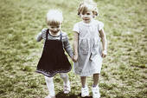
Developmental Milestones of the Preschooler
Socialization of 5 Year Old
Less rebellious & quarrelsome that at age 4
More settled & eager to get down to business
Not as open with their thoughts & behaviors as previous years
Independent but trustworthy, not foolhardy; more responsible
Has fewer fears & relies on authority to control world
Eager to do things right& try to please; tries to live by the rules
Has better manners
Cares for self with only minimal assistance
Not ready for concentrated close work or small print because of slight farsightedness & still unrefined eye-hand coordination
Play is associative, tries to follow the rules but may cheat to avoid losing

Slide 39
Developmental Milestones of the Preschooler
Cognition of 5 Year old
Begins to question what parents think by comparing them with others their age & other adults
May notice prejudice & bias in outside world
Is more able to view others perspective but only tolerates difference rather than understanding them
May begin to show understanding of conservation of numbers through counting objects regardless of order & arrangement
Uses time oriented words with increased understanding
Cautious about accepting or believing information
Can follow 3 commands in succession. Understands time & sequential order.
Wants to do things alone
Uses imagination to create stories

Slide 40

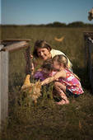
Developmental Milestones of the Preschooler
Family Relations 5 Year Old
Gets along well with parents
May seek out parent more often than at age 4 for reassurance & security esp. when entering school
Begins to question parents thinking & principles
Strongly identifies with parent of same sex esp. boys with their fathers
Enjoys activities such as sports, cooking & shopping with parent of same sex

Slide 41
Developmental Milestones of the Preschooler
Moral Development of 3 to 5 year old
Preconventional or Premoral Level (Kohlberg)
Most basic level
Little to no concern about why something is wrong
Behavior is related to freedom or restriction placed on their actions by authorities
Ages 2-4 years old judge an action as good or bad depending on reward or punishment (punishment & obedience orientated children)
Punishment for an action = bad action
No punishment for action = good action
Naïve Instrumental Orientation (4-7 year old) actions are directed toward satisfying their needs & less frequently the needs of others
Ages 4-7 have concrete senses of justice & fairness

Slide 42

Developmental Milestones of the Preschooler
Moral Development of 3-5 Year Old
Goal is the development for capacity of empathy
Parents Should: 1) Model helpfulness & empathy themselves. 2)Talk about your feelings & be honest with the child, explain why you feel this way. 3) Express concern for or consideration of others as reasons for rules or moral decisions EX: “I know you want the last piece of cake but chris will be sad if he doesn’t get a piece.” 4) Make connections between your child’s behavior & the feelings of others EX: “Did you see how the baby smiled when you gave her the rattle? That’s her way of saying thank you.” 5) Emphasizing the Golden Rule: Treat others as you want to be treated.

Slide 43

Spirituality of the Preschooler

Slide 44
Spirituality of the Preschooler
May be an important part of family life
Knowledge of faith & religion is learned from parents or caregivers
Imitate the religious practices of the parents or Caregivers
Have concrete concept of God with physical characteristics (much like imaginary friend)
Understand simple Bible stories
Memorizes short prayers
Misinterpret illness as punishment from God
Important to view God as one who bestows unconditional love
Observing religious traditions & participating in religious community helps them to cope in stressful periods

Slide 45
Language, Emotional, Cognitive
The most critical period for speech development occurs between ages 2 and 4.
The vocabulary for 2 year old is about 300 words. By the end of age 5 the vocabulary is increased dramatically to more than 2100 words.
Stuttering and stammering are normal characteristics of language development in children ages 2 to 5. (This affects boys more frequently than girls and usually resolves during childhood.)
Preschool children learn to express feelings of frustration or anger through language without acting them out.

Slide 46
Language, Emotional, Cognitive
Common causes for speech problems are:
Hearing loss
Developmental delay
Autism
Lack of verbal or psychosocial stimulation

Slide 47
Language, Emotional, Cognitive
LANGUAGE: 3 year olds
Follow a 2-3 part command
Recognizes and identifies almost all common objects and pictures
Understands most sentences
Understands placement on space (on, in, under)
Uses 4-5 word sentences
Can say name, age, and sex
Uses pronouns (I, you, me, we, they) and some plurals (cars, dogs, cats)
Strangers can understand most words
Asks many questions

Slide 48
Language, Emotional, Cognitive
LANGUAGE: 4 year olds
Has mastered some basic rules of grammar
Speaks in sentences of 5-6 words
Speaks clearly enough for strangers to understand
Tells stories
Knows simple songs
Questioning is at its peak
LANGUAGE: 5 year olds
Recalls part of a story
Speaks sentences of more than 5 words
Uses future tense
Tells longer stories
Says name and address

Slide 49
Language, Emotional, Cognitive
EMOTIONAL: 3 year olds
Expresses affection openly
Expresses a wide range of emotions
Separates easily from parents
Objects to major change in routine
EMOTIONAL: 4 year olds
Imagines that many unfamiliar images may be “monsters”
Views self as a whole person involving body, mind, and feelings
Often cannot tell the difference between fantasy and reality

Slide 50
Language, Emotional, Cognitive
EMOTIONAL: 5 year olds
Aware of gender
Able to distinguish fantasy from reality
Sometimes demanding, sometimes eagerly cooperative

Slide 51
Language, Emotional, Cognitive
Piaget’s Preoperational Phase for cognitive theory is from ages 2 to 7. This phase is split into 2 stages: the preconceptual phase (ages 2 to 4) and the phase of intuitive thought (ages 4 to 7).
Main transitions during these phases:
Shift from totally egocentric thought to social awareness
Ability to consider other viewpoints

Slide 52
Language, Emotional, Cognitive
COGNITIVE: 3 year olds
In the preconceptual phase
Egocentric in thought and behavior
Makes mechanical toys work
Matches an object in hand or room to a picture in a book
Plays make believe with dolls, animals, and people
Sorts objects by shape and color
Completes puzzles with 3 to 4 pieces
Understands concept of “2”

Slide 53
Language, Emotional, Cognitive
COGNITVE: 4 year olds
In the phase of intuitive thought
Correctly names some colors
Understands the concept of counting and may know a few numbers
Tries to solve problems from a single point of view
Begins to have a clearer sense of time
Follows 3 part commands
Recalls parts of a story
Understands the concept of “same” and “different”
Engages in fantasy play

Slide 54
Language, Emotional, Cognitive
COGNITIVE: 5 year olds
Can count 10 or more objects
Correctly names at least 4 colors
Better understands the concept of time
Knows about things used every day in the home (money, food, appliances)

Slide 55
Safety
Accidents are the leading cause of death for children!
Safety tips for preventing harm to a child are:
Use a toddler/convertible safety seat in the back seat of the car. Continue to use it until your child outgrows it (about 40 lbs.) and then use a booster seat until the lap and shoulder belts fit correctly (child weighs 80 lbs and is 4ft 9 in tall).
Never place child in the front seat of a car that has a passenger aide airbag.
Make sure the used or hand-me-down equipment (car seats, strollers, toys, cribs, etc.) haven’t been recalled for safety reasons.
consumer product safety commission: 1-800-638-2772 or www.cpsc.gov
Install smoke and corbon monoxide detectors. Have an escape plan in case of a fire, use flame retardant sleepware and teach about fire safety

Slide 56
Safety
Maintain smoke free environments for children
Avoid exposing children to too much sun (USE SUNSCREEN)
If there is a gun in the house, keep it and the bullets in a separate locked place
Teach pedestrian (crossing streets, etc) and playground safety
Teach stranger awareness
Always wear a bicycle helmet and avoid bicycling near traffic
Practice sports safely: teach to wear all appropriate safety equipment

Slide 57
Safety
Child proofing your house:
Use covers on electrical outlets and latches on cabinets
Set the temperature of your hot water heater between 120 and 130 degrees F to prevent scalding burns
Keep household cleaners, chemicals, and medicines completely out of reach and always store them in their original containers. Buy and use products with child resistant caps. KNOW your local POISON CONTROL CENTER number!!!
Use stair gates and window guards
Remove breakables from low tables and shelves
Tie cords of blinds, curtains, and appliances up out of reach

Slide 58
Safety
To prevent drowning , empty all water from bathtubs and pails, keep the door to the bathroom closed and never leave your child alone near any container of water
Use life jackets on boats at all times
Child proof swimming pool by enclosing it in a fence with a self-closing and self-latching gate and never leave your child alone in a swimming area (even if they are good swimmers!!!).
Keep list of emergency numbers near the phone
Lock rooms not child proof
Place burning candles, incense, hot foods, and cigarettes out of reach
Keep electrical wires hidden or out of reach

Slide 59
Safety
Administer medicines as a drug not “candy”
Do not let electric cord from iron, curling iron, or other appliances hang within child’s reach
Caution against eating non-food items such as plants
Remove unsecured or scatter rugs
Keep doors locked or use child proof doorknob covers at entry to stairs, high porch, or other elevated area, including laundry chute
Store all dangerous tools and garden equipment in locked cabinet
Be alert to danger of supervised animals and household pets
Avoid giving sharp or pointed objects (knives, scissors, or toothpicks), especially when walking or running

Slide 60
Safety
Prevent choking:
Cut food into bite size pieces. Be careful with foods like grapes, hotdogs, raw carrots, celery sticks, etc
Do not let your child eat while playing or running
Avoid foods such as peanuts, hard candy, whole grapes, popcorn, and whole hotdogs, since they can easily cause choking
Avoid allowing your child to play with rubber or latex balloons. They can play with Mylar balloons instead.
Take a first-aid course to learn what to do if your child is choking

