Slide 1
Growth & Development
Toddlers (12-36 months)
Jill Dahnke, Nina Kuharick, & Kelly Wolbert

Slide 2
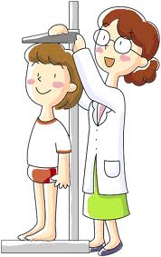
Physical Growth Changes
Growth slows during these years
Average weight gain is 1.8-2.7 kg (4-6 lb)
Height increase is mainly in the legs rather than the trunk
Average height of a 2 year-old is 86.6 cm (34 in.)
Accurate measurement of height and weight during toddler years should be a steady growth curve that is step-like as opposed to linear (linear is the characteristic growth spurt during the early childhood years)
Anterior fontanel closes 12-18 months of age

Slide 3
Physical Growth Changes
Sensory Changes
Normal visual acuity is 20/40
Depth perception is still developing
Senses of hearing, smell, taste, and touch become well-developed, coordinated with each other, and associated with other experiences
All of the sense are used by the toddler to explore the environment
Taste preferences are developed

Slide 4
Physical Growth Changes
Maturation of Systems
Most of the physiologic systems are relatively mature by the end of toddlerhood
Volume of the respiratory tract and growth of associated structures increase, which lessens some of the factors that predisposed the infant to frequent and serious infections
Respiratory rate and heart rate slow
Blood pressure increases
Respirations are abdominal

Slide 5
Physical Growth Changes
Maturation of Systems, Continued
Renal system function matures, decreasing risk of dehydration
Digestive processes complete by the beginning of toddlerhood
Acidity of gastric contents increases and has a protective function
Stomach capacity increases to allow for consumption of 3 meals a day
Voluntary control of elimination is the most prominent change of the gastrointestinal system
Complete myelination of the spinal cord results in control of the anal and urethral sphincters
The physiologic ability to control these sphincters probably occurs between 18-24 months of age
Bladder capacity increases and by 14-18 months of age the child can retain urine for up to 2 hours or longer
More efficient defense mechanisms of the skin and blood compared to infancy

Slide 6

Physical Growth Changes
Gross Motor Development
Development of locomotion
By 12-13 months toddlers walk alone using a wide stance for extra balance
By 18 months they try to run but fall easily
By 2-3 years of age, refinement of the upright, biped position and there is improved coordination and equilibrium
By 2 years of age toddlers can walk up and down stairs
By the end of 2 years they can stand on one foot, walk on tiptoe, and climb stairs with alternate footing

Slide 7
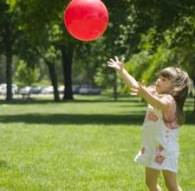
Physical Growth Changes
Fine Motor Development
Increasingly skillful manual dexterity
Casting or throwing objects and retrieving them becomes almost obsessive activities at about 15 months

Slide 8
Cognitive Development
Sensorimotor & Preoperational Phase (Piaget)
12-24 months of age is a continuation of the final 2 stages of the sensorimotor phase
Cognitive processes develop rapidly and may seem similar to those of mature thinking
Reasoning skills are still primitive and need to be understood

Slide 9
Cognitive Development
Sensorimotor Phase (Piaget)
Tertiary Circular Reactions - In the 5th stage of the sensorimotor phase (13-18 months), the child uses active experimentation to achieve previously unattainable goals
Beginning of rationnal judgment and intellectual reasoning
Differentiation of one’s self from objects (child can tolerate longer periods of separation from parents)
Categorizing data into distinct classes and subclasses
Discovery of objects as objects leads to awareness of their spatial relationships
Object permanence (awareness of objects behind closed doors)

Slide 10
Cognitive Development
Sensorimotor Phase (Piaget)
Invention of New Means Through Mental Combinations – final sensorimotor phase (19-24 months), child completes the more primitive, autistic-like thought processes of infancy and is prepared for the more complex mental operations that occur during the phase of preoperational thought
Object permanence
Infer a cause only when experiencing the effect
Domestic mimicry (imitating household activities)
Gender-role behavior

Slide 11
Cognitive Development
Preoperational Phase (Piaget)
At about 2 years of age child enters the preconceptual phase of cognitive development, which lasts until about 4 years
Preconceptual phase is a subdivision of the preoperational phase and is a phase of transition that bridges the purely self-satisfying behavior of infancy and the rudimentary socialized behavior of latency
Preoperational thought: children cannot think in terms of operations (the ability to manipulate objects in relation to each other in a logical fashion)
Toddlers think primarily on the basis of their perception of an event
“why” and “how”
Thinking is concrete and tangible

Slide 12
Cognitive Development
Characteristics of Preoperational Thought
Egocentrism: inability to envision situations from perspectives other than one’s own
Transductive Reasoning: reasoning from the particular to the particular
Global Organization: reasoning that changing any one part of the whole changes the entire whole
Centration: focusing on one aspect rather than considering all possible alternatives
Animism: contributing lifelike qualities to inanimate objects
Irreversibility: inability to undo or reverse the actions initiated physically
Magical Thinking: Believing that thoughts are all-powerful and can cause events
Inability to conserve: inability to understand the idea that a mass can be changed in size, shape, volume, or length without losing or adding to the original mass

Slide 13
Language
Increasing level of comprehension
The ability to comprehend and understand speech is much greater than the number of words the child can say
Progresses from using one-word sentences/holophrases to multiword sentences, to simple sentences
By 3 years of age there is a mastering of grammatical rules
5 or 6 new words are acquired daily
Once language is sufficiently mastered, gestures phase out and the pace of word learning increases

Slide 14

Emotional
Temper Tantrums
Toddlers may assert their independence by violoently objecting to discipline
Tantrums are an indiciation of the child’s inability to control emotions
Toddlers are prone to tantrums because their strong drive for mastery and autonomy is frustrated by adult figures or lack of motor and cognitive skills
Temper tantrums represent normal developmental behaviors

Slide 15

Temper Tantrums
http://youtu.be/XpdPl31HH-E

Slide 16
Emotional
Negativism
Persistent “no” response to every request
Is not an expression of being stubborn or insolent, but a necessary assertion of self-control

Slide 17
Emotional
Regression
The retreat from one’s present pattern of functioning to past levels of behavior
Usually occurs in instances of discomfort or stress
Common in toddlers because almost any additional stress interferes with their ability to master present developmental tasks
Any threat to their autonomy (illness, separation from parents, adjustment to a new sibling, etc) represents a need to revert to earlier forms of behavior (refusal to use potty chair, temper tantrums, loss of newly learned motor, language, social, & cognitive skills, etc)
Loss of newly acquired achievements is frightening and threatening because the toddlers are aware of their helplessness
Is a child's way of saying “I can’t cope with this present stress and perfect this skill as well, but I will if given patience and understanding.”

Slide 18
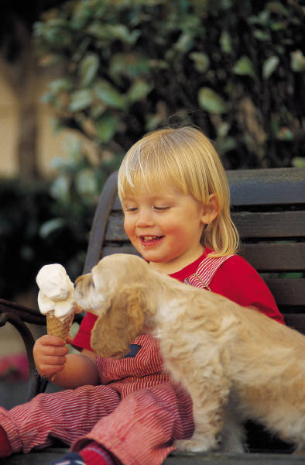
Safety
Toddler years are from 12-36months of age. Our book states that children 15-17 months of age have the highest rate of childhood injury because of their small size, inability to protect themselves, and that they are unaware of the dangers around them.

Slide 19
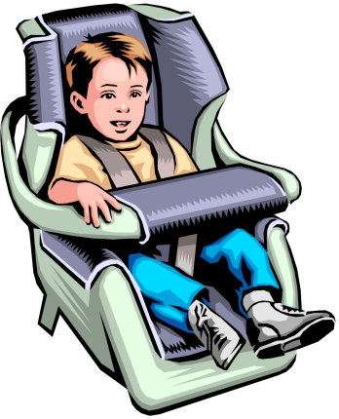
Safety
Motor Vehicles
Child can walk, open doors, ride toy vehicles
Use federally approved car restraints, do not allow child to play on curb or behind a parked car, lock fences and doors if not directly supervising toddler
MVA are responsible for almost half of accidental deaths of children 1-4yrs. Many of these can be prevented by a properly installed car seat. Also, children need to be taught the importance of looking for traffic (parents make a good role model when it comes to practicing traffic safety.)

Slide 20
Safety
Drowning
Has great curiosity, may consider any body of water just like the bath tub and want to play
Keep bathroom doors closed and lid down on toilet, have fence around pool.
Teaching swimming and water safety can be helpful, but cannot be relied on to ensure a toddlers safety.

Slide 21
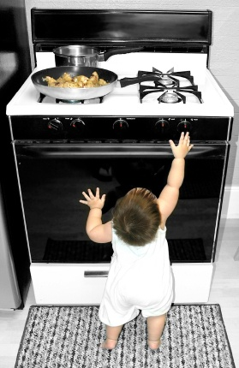
Safety
Burns
Pulls objects, unaware of potential sources of heat or fire.
A major source of burns is from scalds, so keep handles towards back of stove and knobs out of reach. The usual water heater setting is 54 degrees C(130degrees F). This can cause a full thickness burns within 30 seconds.

Slide 22

Safety
Poisoning
Explores by putting objects in mouth and cannot read labels.
Place all potentially toxic agents out of reach or in a locked cabinet. Do not store toxic liquid in an empty pop bottle or empty milk jug.
Improper storage is the main reason for poisoning. Some meds are not packaged with safety caps like transdermal patches and cough lozenges.

Slide 23
Safety
Falls
Goes up and down stairs, depth perception is unrefined
Place gates at top and bottom of stairs and select play areas with soft ground cover and safe equipment.
Want grass, wood chips, or sand under play equipment and proper restraint and supervision of high chairs, strollers, and car seats are essential.

Slide 24
Safety
Choking and Suffocation
Puts things in mouth and may swallow hard pieces of food.
Avoid large round chunks of food (hot dogs should be sliced lengthwise and into short pieces). Avoid fruits with pits , hard candy, and marshmallows.
Aspiration of foreign object is most common at 2 yrs. Give large sturdy toys. Old fridges, ovens, and large appliances are a suffocation risk.

Slide 25
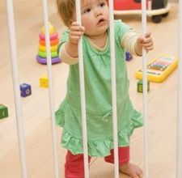
Safety
Bodily Damage
Still clumsy and easily distracted from tasks.
Do not allow lollipops or similar objects when walking or running. Use safety glass and decals on sliding glass doors.
Go by the age ranges on toys and restrict children from running, jumping, or wrestling near glass structures.

Slide 26

Promoting Healthy Family Functioning
Part of our responsibility as nurses is to provide opportunities for parents to express their feelings and to meet their physical, mental, and spiritual needs.

Slide 27
Promoting Healthy Family Functioning
12-18 months
Prepare parents for expected behavioral change’s of toddler, encourage weaning from bottle, potential dangers and safety proofing the home. Emphasize brief periods of separation, and dental hygiene.

Slide 28
Promoting Healthy Family Functioning
18-24 months
Prepare child for new experiences, such as another sibling, discuss discipline methods with parents and if they are effective.
Prepare parent for signs of regression in times of stress and point out expected changes of the next year (longer attention span, less negativism, and an increased concern for pleasing others).

Slide 29
Promoting Healthy Family Functioning
24-36 months
Discuss approaches toward toilet training, stress that discipline must still be structured and concrete because verbal reasoning only may lead to injuries, confusion, and misunderstanding. Start to discuss which preschool or day care parents are planning on enrolling children in before completion of their second year of life.

Slide 30
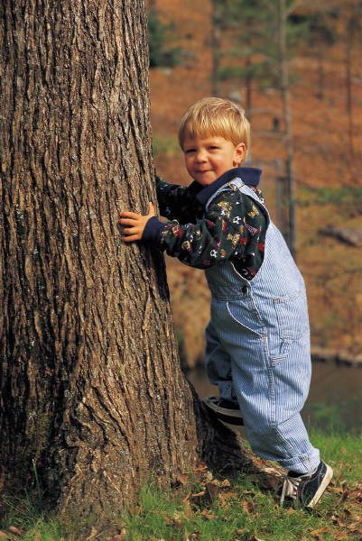
Activities of Daily Living
Toddler activities of daily living are focused on play:
Undressing (most clothing items)
Assisting with brushing teeth
Potty training
Using a spoon to eat
Weaning from the bottle to a sippy cup or regular cup
Scribbling with crayon on paper
Stacking blocks
Riding a tricycle by third birthday
Jumping
Climbing
Domestic mimicry
Increasing language skills

Slide 31
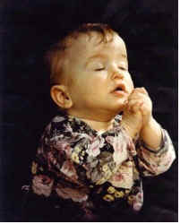
Spiritual Development
Toddler spirituality is guided by the family’s values, beliefs, and customs. Toddlers learn about God through those closest to them. If God is spoken about with great respect, then toddlers understand God is associated with something special. Toddlers imitate what they see such as folding hands to pray at bedtime or before meals.

Slide 32
Moral Development
Toddlers are at the pre-conventional level. They are learning right from wrong by the consequences that follow. They avoid punishment and obey whoever is the ruler without thought to the reasons behind the rules. Toddlers may show some evidence of sharing or fairness, but there is no sense of justice or loyalty.

Slide 33
Major Milestones
Age (mo) | Gross Motor | Fine Motor | Sensory | Socialization
15 | Walks w/o help (usually since 13mo) Creeps up stairs Runs clumsily | Constants casting of objects onto the floor Builds towers of cubes Uses cup but rotates spoon before reaching mouth | Places round object into appropriate hole Able to recognize geometric forms | Tolerates some separation from parent Begins imitating parents Kisses and hugs parents Less fear of strangers
18 | Stands w/o support Walks up stairs with one hand held Pulls and pushes toys jumps in place w/both feet Throws ball overhand w/o falling | Builds tower of 3-4 cubes Turns pages of book Manages spoon w/o rotation |  | Temper tantrums Great imitator Unzips, takes off shoes socks Aware of ownership(my toy) Dependence on transitional objects (blankie)

Slide 34
Major Milestones, Continued
Age (mo) | Gross Motor | Fine Motor | Sensory | Socialization
24 | Goes up/down stairs alone Runs fairly well w/wide stance Picks up object w/o falling Kicks ball forward w/o overbalancing | Builds tower of 6-7 cubes Aligns 2 or more cubes like train Turns book pages 1 at time Turns doorknob When drawing imitates vertical/circular strokes | Accommodation well developed Able to insert square block into oblong space | Stage of parallel play Sustained attention span Temper tantrums decreasing Pulls people to show them something Increases independence from parents Dresses self in simple clothing Develops visual recog. and verbal self reference (Me big)

Slide 35
Major Milestones, Continued
Age (mo) | Gross Motor | Fine Motor | Sensory | Socialization
30 | Jumps with both feet Jumps from chair to step Stands on 1 foot momentarily Takes a few steps on tiptoe | Build tower of 8 cubes Adds chimney to train of cubes Good hand finger coordination (holds crayon w/fingers rather than fist) Moves fingers independently In drawing imitates vertical/horizontal strokes makes 2 or more strokes for a cross |  | Separates more easily from parents In play, helps put things away Can carry breakable objects Pushes w/good steering Begins to notice sex differences; knows own sex May attend to toilet needs except wiping Emotions expand to include pride, shame, guilt, and embarrassment

Slide 36

Psychosocial Development
Tasks to be dealt with include:
Differentiation of self from others, particularly the mother
toleration of separation from parent
ability to delay gratification
control over body functions
acquisition of socially acceptable behavior
verbal means of communication
ability to interact with others in a less egocentric manner
Some of these tasks may not be completed until adolescence.

Slide 37

Developing a Sense of Autonomy
(Erikson)
The developmental task of toddlerhood is acquiring a sense of autonomy while overcoming a sense of doubt and shame.
To promote autonomy allow the toddler to perform tasks independently.
During this struggle to achieve autonomy characteristics such as negativism are common. The word no becomes persistent and rapid mood swings can be involved. This can lead to temper tantrums. When scolded the child almost instantly needs comforted.
Parents can try to offer the child choices when appropriate and when child
is negative parents need to proceed as plannedand make the choice for the child.
Ritualism is also common. Maintaining sameness and reliability
provides a sense of comfort in the environment which allows the child
to safely exert their autonomy.

Slide 38
Toilet Training: Assessing Readiness
Physical readiness is usually by 18-24 mo of age
Child needs to have the ability to stay dry for two or more hours and have regular bowel movements.
Child needs to recognize the urge to defecate or urinate, be able to communicate the need, and then follow directions for the appropriate behavior.
Child needs to express willingness to please parents, have the ability to sit on potty for 5-10 minutes w/o fussing, and shows an immediate need to change a wet/dirty diaper.
Parents need to recognize child’s readiness and be willing to invest the time necessary for toilet training.

Slide 39
Toilet Training Tips for Parents
Begin when toddler demonstrates readiness.
Provide a pleasant mood.
Use a potty seat or potty chair.
Be aware that the child is curious about excretion products
Don’t refer to bowel movements as being “dirty” or “yucky”.
Teach hand washing.
Teach front to back wiping.

Slide 40
Toddler Nutrition
From 12-18 mos growth rate slows, decreasing the child’s need for calories, protein, and fluid. These needs should be based on the Food Pyramid guidelines for example milk intake decreases to 2-3 servings a day. Portions should not be adult size and be appropriate for their age. Use the guidelines:
1tbsp of solid food per year of age or 1/4 to 1/3 the size of the adult portion.
Decreased appetite is apparent (physiologic anorexia); child may appear to be a picky eater. They are unaware of the nutritional value of food and begin to recognize the pleasure of eating and the social aspect of mealtime. They may refuse to eat a food that they see someone else refuse.
Do not force a toddler to eat this can promote future eating problems instead offer finger foods and provide choices.

Slide 41

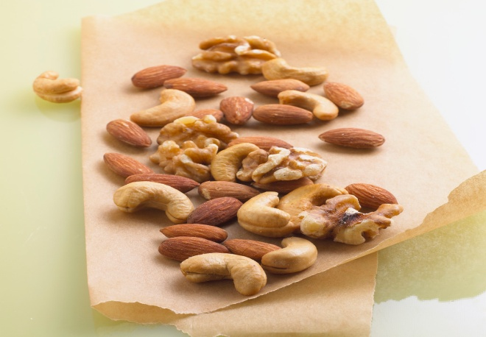



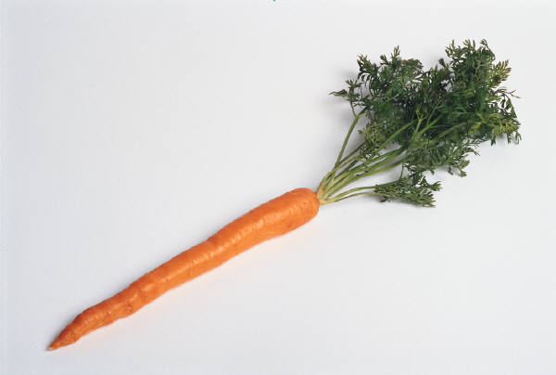
Dangerous Foods For Toddlers
Some foods are easily aspirated by toddlers.
Foods to avoid include:
Nuts
Hotdogs
Grapes
Candy
Carrots
Popcorn
Fruit gel snacks

Slide 42
Question
What is uncommon for children to do during the toddler age?
A.Temper tantrums
B. Tie their shoelaces
C. Walk and run
D. Use the Potty

Slide 43
The answer is….
B
usually this is a skill mastered at around age 5. All of the others occur during toddlerhood.

Slide 44

The End!

