Slide 1
Globalization in Health Care
Strokes: Switzerland
June Baker and Rachel Buie

Slide 2
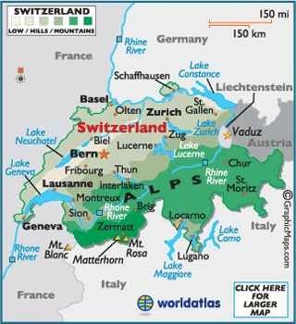

Slide 3
Swiss Confederation
Area: 41,285 sq. km. (15,941 sq. mi.); about the size of Vermont and New Hampshire combined.
Cities: Capital--Bern (population about 123,000).
Terrain: 40% mountains, the remainder hills and plateau. More than 75% of the population lives in the central plain, which stretches between the Alps and the Jura Mountains and from Geneva in the southwest to the Rhine River and Lake Constance in the northeast.
Climate: Temperate, varying with altitude and season.
Switzerland’s currency is so stable, therefore exchange rates do not fluctuate greatly. The approximate exchange rates between the Swiss Franc the US dollar the exchange rate is 1CHF = $0.80.

Slide 4
Population
7,639,961 (est. July 2011)
Median Age is 41.7 years
Male is 40.6 years
Female is 42.8 years
Growth Rate
0.21%
Life Expectancy
Male is 78.24
Female is 84.05

Slide 5
Nationality and Languages
Nationality of Switzerland is Swiss
Four major languages are spoken
German (64%)
French (20%)
Italian (7%)
Romansh (0.5%)

Slide 6
Government
Federal State
Established independence from Holy Roman Empire in 1499
3 branches of government: Executive, Legislative, Judicial
Political parties: Swiss People's Party (SVP), Social Democratic Party (SP), Free Democratic Party (FDP), Christian Democratic Party (CVP)

Slide 7
Economy
GDP (2010): $475.8 billion
Annual growth rate: 2.6%
Unemployment: 3.4%
Per capita income: $66,367
Avg. inflation rate: 1.1%
Natural resources: Water power, timber, salt.

Slide 8
Education
99% Literacy Rate
25% of the Adult Population hold a diploma of Higher Learning

Slide 9
Swiss Healthcare
Universal coverage attained through a mandate that every individual purchase a basic insurance plan.
The majority of the population buys supplemental policies, often purchased from the insurer providing basic coverage.
Require that insurers accept all applicants and prohibit variations in premiums by health status—community rating, with guaranteed offer and renewal.
The Swiss insurance system is highly decentralized, with plans operating and setting premiums at the canton (state) level.

Slide 10
Swiss Healthcare con’t
The 10 largest of some 85 carriers insure 80 percent of the population.
Currently, Swiss premiums vary widely by health risks of insured pools across the country and within regions.
Swiss patients have open access to physicians and can self-refer to specialists. Swiss provider fees are generally set by negotiations between provider associations and insurance associations.
Deductibles range from $300-$2500

