Slide 1


Breast and prostate cancer in Australia

Slide 2
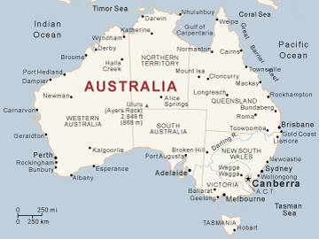
Demographics in the Australia
Population:
21,766,711
Age structure:
0-14 years: 18.3%
15-64 years: 67.7%
65 year and older: 14%
Median Age:
Total: 37.7
Male: 37
Female; 38.4
Birth rate:
12.33 births/1,000 population
Death rate:
6.88 deaths/1,000 population
Sex ratio:
At birth: 1.055 male/female
Under 15 years: 1.05 male/female
15-64: 1.03 male/female
65 years and over: 0.84 male/female
Total population: 1 male/female
Life expectancy at birth:
Total population: 81.81 years
Male: 79.4 years
Female: 84.35 years

Slide 3
Demographics in the Australia
Nationality: Australian
Ethnic groups: white 92%, Asian 7%, other 1%
Religions: Protestant 27.4%, Catholic 25.8%, Eastern Orthodox 2.7%, other Christian 7.9%, Buddhist 2.1%, Muslim 1.7%, other 2.4%, unspecified 11.3%, none 18.7
Languages: English 78.5%, Chinese 2.5%, Italian 1.6%, Creek 1.3%, Arabic 1.2%, Vietnamese 1%, other 8.2%
Literacy: age 15 and over can read and write
Male:99%
Female 99%

Slide 4
Demographics in Australia
Health expenditures:
8.5% of GDP
Physicians density:
2.991 physicians/1,000 population
Hospital bed density:
3.82 beds/1,000 population
Obesity (adult prevalence rate):
16.4%
HIV/AIDS (adult prevalence rate)
0.1%
HIV/AIDS (people living with HIV/AIDS)
20,000
HIV/AIDS (death)
Fewer than 100

Slide 5

Who is covered?
Medicare: It coexists with a private health system. It is funded by 1.5% of an income tax levy with an additional 1% for high-income earners.
It provides free treatment in a public hospital
Provides free or subsidized payments to health care professionals for services
Subsidized on some treatments by participating specialists and dentists
Medicare does not pay for everything, there is a Medicare gap.

Slide 6

Medicare Gap
Doctor:
Cost: $67.00
Medicare paid: $34.90
Gap Payment: $32.10
Doctor (Specialist):
Cost: $155.00
Medicare paid: $69.00
Gap payment: $86.00
Dentist: (6 monthly exam and clean)
Cost: $ 135.00
Medicare payment: $135.00
Gap payment: $0
“Bulk Bill” Medicare is when you don’t pay anything out of pocket
Medicare will pay a portion of a service but you will have to pay out of pocket the rest, known as the “Medicare Gap”

Slide 7

Health Care
Private health care insurance:
Represents about 11% of health care funding
Can either be a private hospital or in a public hospital
Wider option of doctors and hospitals
Cover some services that Medicare doesn’t; optical, physiotherapy, podiatry, and dental services
Biggest choice is weather to opt for hospital cover or ancillary cover only
    - Hospital cover allows you to choose when to have your treatment, which hospital to go into, and which doctor or consultant to have. Not all cost are covered by every fund. You still may have to cover some of the cost within that gap.
    - Ancillary cover is known as the essentials or extras, it covers treatment that Medicare doesn't such as dental, optical, physiotherapy, and podiatry.

Slide 8
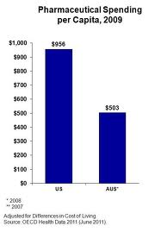
Health care
Pharmaceutical Benefit:
The government provides high subsidies on a number of prescription medicines.
Available to all Australian residents

Slide 9
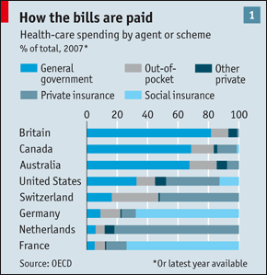
Health Care Spending

Slide 10

Breast Cancer

Slide 11

Risk for breast cancer
Early menarche
Late menopause
Either nulliparous or older than 30 years of age at the birth of first child
Incidence higher with age
Family history
Female
Personal history of breast, colon, endometrial, and ovarian cancer
Weight gain and obesity after menopause
Exposure to ionizing radiation
Alcohol consumption
Physical inactivity

Slide 12

Number of people impacted
Incidence:
    Breast cancer is the most common cancer among Australia women, accounting for 27% of all cancer diagnoses in 2007
    The number has increased from 5,291 in 1982 to 12,567 in 2007
    By 2015 the number of new breast cancer cases among women is projected to be 22% higher than in 2006, with an estimated 15,409 women to be diagnosed with breast cancer
    1 in 9 women will be diagnosed with breast cancer before the age of 85
    The average age of first diagnosed is women 60 years of age in 2007
    The number of men with breast cancer has increased from 62 in 1982 to 103 in 2007

Slide 13

Mortality of breast cancer
Breast cancer and lung cancer are the leading causes of cancer-related death in Australia women
There were 2,680 female deaths in 2007
There were 26 male deaths in 2007
A women’s risk from dying to breast cancer before the age of 85 has dropped from 1 in 29 risk in 1982 to 1 in 37 risk in 2007

Slide 14

Survival of breast cancer
There is a increase in relative survival after diagnosis of breast cancer between 1982-1987 and 2000-2006 increased from 72.6% to 88.3%
In 2006 survival was 98.2% for women with 0-10 mm tumors, 94.7% for women with 11-15mm tumors , 93% for women with 16-19mmtumors, 87.9% for women with 20-29mm tumors, 73.1% for women with 30mm or greater tumors.
Five-year relative survival was 96.5% with negative nodal status, 80.2% for women with positive nodal status in 2006

Slide 15
Prevalence of breast cancer
Burden of disease
- Breast cancer was the leading cancer cause of burden of disease for females accounting for 61,100 disability-adjusting life years. (40,600 years of life lost due to premature death and 20,500 years of healthy life lost due to disease, disability, or injury) in 2010
- it’s estimated that in 2006 there were 143,967 women alive who had been diagnosed with breast cancer in the previous 25 years

Slide 16
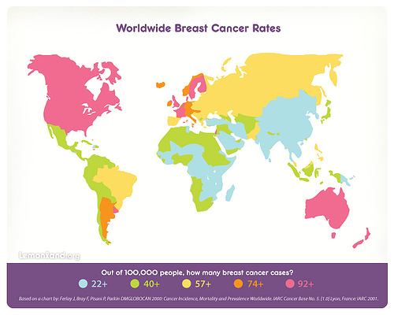

Slide 17
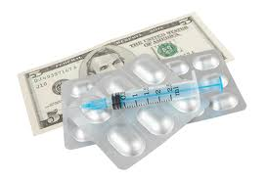
The cost of breast cancer
Breast cancer causes a large financial burden on society with total expense of $331million in 2004-05, when $92 million was spent on hospital admitted patient services, $68 million on out-of-hospital medical expenses, $53 million on prescription pharmaceuticals, and $118 million on cancer screening.
The hidden cost faced by many sufferers include extended time away from work, while enduring increased expenses, the effect on long term employment, as well as the impact on unpaid work, such as the breadwinner need to take care of a sick family member.
Out of pocket expenses include; transportation, medication, specialist clothing and mobility devices, childcare, and housekeeping cost.
Its estimated that the lifetime cost of breast cancer per person is $653,600, comprising a financial cost of $64,300 and a burden of a disease cost of $589,300

Slide 18

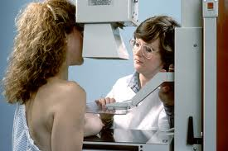
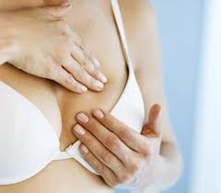
Prevention of Breast cancer
Eat balanced diet
Exercise regularly
Adequate rest
Health examination on a regular basis
Eliminate/reduce/avoid stress or stressors
Self examination
Limit alcohol
Mammogram screening for ages 50-69 (free mammograms every 2 years)
Mammograms screening free for ages 40-49
Education for what to look for
Breast exams every year after age 20
Gene testing for BRCA1 and BRCA2
Breast cancer awareness

Slide 19
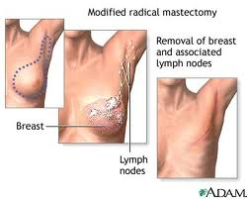
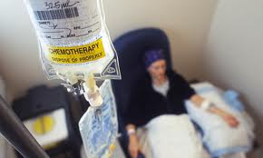
Treatment for breast cancer
Breast conserving surgery (Lumpectomy)
Mastectomy
Radiation therapy
Chemotherapy
Hormone treatment
Diet therapy
Exercise therapy
Joining cancer support groups for emotional treatment

Slide 20

Breast Reconstruction
The National External Breast Prostheses Reimbursement Program is an Australian Government initiative that provides reimbursement for both new and replacement external breast prostheses to all eligible women who have had a mastectomy as a result of breast cancer. Costs limits apply.
    The government provides a reimbursement of up to $400 for each new or replacement external breast.

Slide 21

Prostate cancer

Slide 22

Risk FOR PROSTATE CANCER
Age
Ethnicity
Family history
African Americans
Diet high in red meat
High fat diet

Slide 23
NUMBER OF PEOPLE IMPACTED
3,300 people a year die of prostate cancer
20,000 new cases diagnosed each year
1/9 men will develop prostate cancer
¼ men after age 85 will develop prostate cancer
2nd most common type, following non melanoma skin cancer
32 men a day learn they have this disease

Slide 24
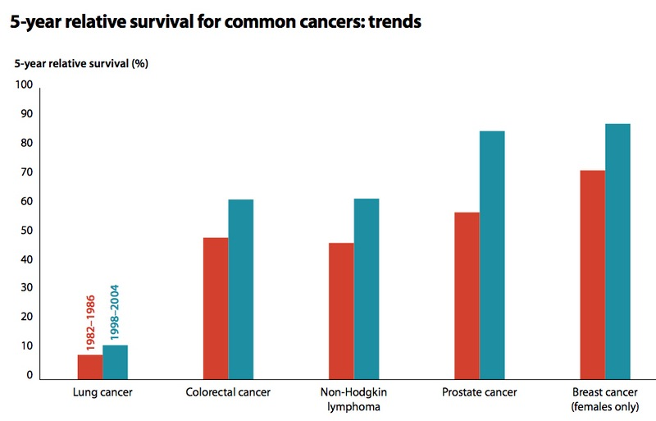

Slide 25
Treatment for prostate cancer
Digital Rectal Exam (DRE)- Looking for lumps in rectum
Prostate Specific Antigen (PSA)- blood test noting abnormal growth
Low grade disease of prostate may be watched if no symptoms
Radical Prostatectomy- curative intent
Radical radiotherapy- curative intent, external radiation or radioactive seeds (brachytherapy)
Hormone therapy- reduce stimulus of male hormones
Radiation/chemotherapy
10-15 year survival rate is 77-93%

Slide 26

Prevention of prostate cancer
There is no proven measures
PSA can detect early disease
Men > 50 should talk to their doctor
Men with family history should talk to
their doctor

Slide 27

Prostate cancer foundation of Australia
Dedicated to reducing this disease by:
Promotes funding and world leading
Implementing awareness campaigns
Education programs
Providing support for families and friends

Slide 28
Works cited
Breast cancer in australia . (n.d.). Retrieved from http://www.canceraustralia.nbocc.org.au/breastcancer
Cancer council australia . (n.d.). Retrieved from http://www.cancer.org.au/aboutbreastcancer
"Health Care Australia 2012 - What Does It Cost?" Health Care Australia 2012 - What Does It Cost? N.p., n.d. Web. 12 July 2012. <http://www.aussiemove.com/healthcare/>.
"Health Care in Australia." Health Care in Australia. N.p., n.d. Web. 12 July 2012. <http://www.expatforum.com/articles/health/health-care-in-australia.html>.
"Index Mundi - Country Facts." Index Mundi - Country Facts. N.p., n.d. Web. 12 July 2012. <http://www.indexmundi.com/>.
"Life Insurance." Life Insurance. N.p., May 2010. Web. 12 July 2012. <http://www.xlife.com.au/>.
" Prostate cancer." Cancer Council Australia. N.p., n.d. Web. 23 July 2012. <http://www.cancer.org.au/policy/positionstatements
" Australian Prostate Cancer Research (APCR)." Australian Prostate Cancer Research (APCR). N.p., n.d. Web. 23 July 2012. <http://www.prostatecancerresearch.org.au/new-apcr/>.
"Prostate Cancer Foundation of Australia." Prostate Cancer Foundation of Australia. N.p., n.d. Web. 23 July 2012. <http://www.prostate.org.au/articleLive

