Slide 1
Infant Growth & Development Birth to 12 months
Megan Cuevas
Tammy Duncil
Andrea Flewelling
Kurtis Hupp

Slide 2

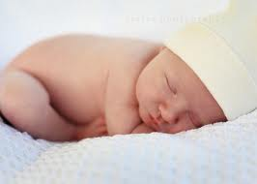

Physical Growth Changes: Weight
Proportional Changes
By 5-6 months birth weight has at least doubled
Average weight for 6 month old child is 16 lbs
By one year, birth weight is tripled
Average is 21.5 lbs

Slide 3
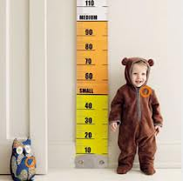
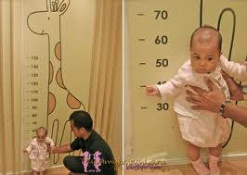
Physical Growth Changes: Height
Average height at 6 months is 25 ½ inches
Growth is most rapid during first 6 months
Average height at 12 months is 29 inches
Growth rate slows greatly after 6 months

Slide 4
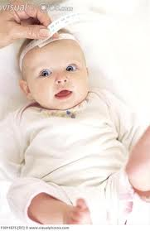
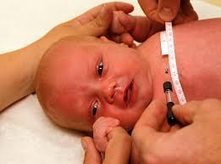
Physical Growth Changes: Head & Chest
Head growth is rapid
By the end of first year, brain has increased in wt about 2 ½ times
Chest assumes a more adult contour
The width of the heart is approximately 55% of the chest width

Slide 5
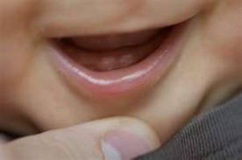

Physical Growth Changes
By 2 months the posterior fontanel closes
By 12 months the anterior fontanel is almost closed
At 4 months of age drooling begins
Followed by beginning tooth eruption at 5 months

Slide 6
Physical Growth Changes: Teething
Teething begins by 6 months
Lower incisors typically first
watch out for chewing & biting!!
Upper central incisors erupt by 7 months
Upper lateral incisors begin by 9 months
Lower lateral incisors begin by 11 months
By 12 months there should be 6-8 deciduous (baby) teeth

Slide 7
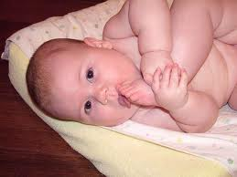
Developmental Milestones: Fine Motor Development: Birth-6 Months
At 1 month, hands are closed
By 3 months, hands are mostly open
Grasping as a reflex occurs during first 2-3 months
Gradually becomes a voluntary action
At 3 months they can actively hold a rattle if placed in their hands
By 5 months the infant can voluntarily grasp an object
At 6 months they can hold their bottle and grasp their feet to chew on toes

Slide 8
Developmental Milestones: Fine Motor Development: 7-12 Months
At 7 months they can transfer objects from one hand to the other
By 8-9 months the infant uses crude pincer grasp
Progresses to a neat pincer grasp by 11 months
In other words infant can use thumb and index finger to pick up items such as a raisin
At 11 months they can put objects into a container and remove them
By one year they can attempt to build with blocks

Slide 9

Developmental Milestones: Gross Motor Development: Head Control
Head control by 1 month is minimal
Can turn head from side to side when prone
Lifts head momentarily from bed
By 4 months they can lift the head and front portion of the chest approximately 90° above the table bearing the wt on their forearms
By 6 months head control is well established

Slide 10
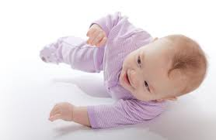
Developmental Milestones: Gross Motor Development: Rolling Over
Around 5 months an infant can roll from their tummy to their back
By 6 months they can go from their back to their abdomen
The parachute reflex (a protective response to falling) appears by 7 months

Slide 11
Developmental Milestones: Gross Motor Development: Sitting
For the first 3-4 months the back is uniformly rounded preventing sitting
As the spinal column straightens the infant can be propped into a sitting position
By 7 months they can sit alone leaning forward on their hands for support
By 8 months they can sit well while unsupported
By 10 months they can maneuver from a prone to a sitting position all by themselves

Slide 12
Developmental Milestones: Gross Motor Development: Locomotion
Around 4-6 months an infant has increasing coordination in their arms
This coordination allows them to propel their body backwards
By 6-7 months they are able to bear all their wt on their legs with assistance
By 9 months infants progress to crawling
At the same time they can pull themselves up with furniture
But cannot sit back down without falling
By 11 months they can walk with furniture assistance
By age one they may be able to walk with one hand being held

Slide 13
Language Birth to six months
Up to 1 month child cries to express displeasure
By 2 months a child’s cries become distinct and differentiated, cooing begins
By 3 months of age a baby will vocalize when smiling and “talks” back when being spoken to.
By 6 months infant can:
LOL
Makes cooing vowel sounds
Begins to imitate sounds
Babbling resembles one syllable utterances

Slide 14
Language 6 months to 12 months
By 7 months: Vowel sounds and chained syllables (baba, mama) and “Talks” when others are talking
By 10 months baby can:
Listen selectively to familiar words
Respond to simple verbal commands (No No!)
Says “dada and mama” with meaning
By 12 months baby can:
Comprehends meaning of several words
Say 3-5 words besides Dada and Mama
Recognizes objects by name

Slide 15
Emotional/Cognitive development
Attachment
Requires ability to discriminate “Mother” from others and the achievement of object permanence
Formation of attachment requires 4 stages
First few weeks - infants respond indiscriminately to anyone
From 8-12 weeks – infants will cry, smile, and vocalize more to mom then anyone, but will still respond to others
By 6 months infants have a distinct preference for mom
Around 7 months infants start to attach to other members of the family (father)
Reactive Attachment Disorder (RAD)
Due to maladaptive or absent attachment between infant and parent
Physical abuse
Parental alcoholism, substance abuse
Mental illness
Foster care
Parental abandonment
Parental incarceration
Child may not be as cuddly, have poor impulse control

Slide 16
emotional/Cognitive Development
Separation Anxiety
Begins between 4-8 months
Gains awareness that mother is separate from self
By 11-12 months departure is anticipated and protest begins before departure
Stanger Fear
Begins around 6-8 months
R/T infants ability to discriminate between familiar and unfamiliar people

Slide 17
Safety Birth to 4 months
Aspiration
Baby powder
Propping bottles
Know Heimlich Maneuver for babies
One piece pacifier construction
Burns
Smoke detectors
Microwaving bottles
Bathwater
Cigarettes
Flame retardant clothes
Car seat buckles on bare skin

Slide 18
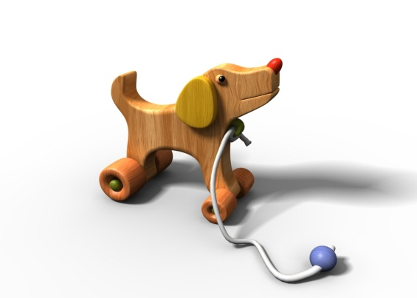
Safety Birth to 4 months
Suffocation and Drowning
Plastic bags
Loose blankets and clothes in crib
Strings, necklaces, bibs
Baths
Motor Vehicle Accidents
Know infant car seat safety
Do not leave in hot cars
Falls
Crib rails should be raised
Restrain in a car seat if setting on a high surface
Always use safety straps on baby equipment (strollers, high chairs)

Slide 19

Safety Birth to 4 months
Poisoning
Start baby proofing now for the crawling stage!
Bodily Damage
Sharp objects out of crib
Sharp objects on broken toys
Diaper pins

Slide 20


Safety 4 to 7 months
Aspiration
All small objects out of reach
Appropriate toys
Appropriate food (hard candy, nuts, pits, hot dogs)
Child should be sitting up straight to eat solids
Suffocation
Balloons out of reach
No crib toys
Burns
Water faucets
Reaching for stoves
Limit sun exposure – use sun screen

Slide 21

Safety 4 to 7 months
Falls
Starting to crawl – block steps
Poisoning
Know poison control phone number (800) 222-1222
Lock up all cleaning and paint supplies
Bodily Damage
Broken toys, sharp objects

Slide 22
Safety 8 to 12 months
Aspiration
Solid table food
Bodily damage
Placing safety straps on furniture
Falls
Starting to walk – good shoes and stairs
Suffocation and Drowning
Climbing into closed spaces (refrigerators, dryer..)
Popped balloons
Swimming pools, baths, toilets, buckets
Keep bathroom doors closed
Poisoning
Child proof lids, safe storage area for meds and cleaners
Burns
Electrical wires, fireplaces, outlets, candles, stove tops

Slide 23
Morality and Spirituality of Infants
Morality of Infants
Infants will learn to imitate the moral standards of their caregivers. They understand “Good” & “Bad” behavior, along with consequences
A study was done to determine if morality is innate or learned
Showed infants puppet shapes – one shape was trying to get up a hill. Infants were shown one shaped helping it go up the hill and another hindered the shape from going up the hill
Results determined that 6-10 month olds are able to make evaluations of others, especially that of trust, because of the observations made during this puppet study
Notes:
“ In this study, 6- and 10-month-old infants watched a short puppet show in which a “climber” shape was struggling to climb up a hill. In some trials, the climber is helped by another shape, and in other trials, the climber is hindered by a third shape. By using simultaneously two methods common in infant studies, the researchers attempted to discern whether young infants were evaluating other individuals on the basis of their behavior.
The first method was the traditional looking-time measurement, also known as the violation of expectation paradigm. This method works because infants tend to look longer at something that is unexpected or surprising. After habituating the infant to alternating “helping” and “hindering” puppet shows, the “climber” would approach either the helpful shape or the harmful shape. If the infants had formed representations of the intentions of the “helper” and “hinderer” based on their actions, then the infants should be surprised – and therefore look longer – when the climber goes to hang out with the hinderer, than when the climber goes to hang out with the helper. The 10-month-olds looked significantly longer when the climber approached the hinderer, suggesting that they were surprised by the climber’s behavior. However, the 6-month-olds showed no preference, and looked equally at both displays.
The second method was the toy-choice measurement, also known as the choice paradigm. After viewing the presentations, the infants were offered a tray from which they could reach for a replica of the helper and hinderer shapes used in the puppet shows. Would the babies rather play with the helper or the hinderer? The infants overwhelmingly reached for the helper: 87.5% of the 10-month-olds, and 100% of the 6-month-olds.
Why would it be that the six-month-olds would appear to have accurately encoded the social actions when using the choice task but not the looking-time measurement? It appears that both 6- and 10-month-olds can engage in the social evaluation of others, more generally, and therefore reached for the helper shape. However, it is possible that 6-month-olds are unable to infer the social evaluations of others, while 10-month-olds are. In order to be surprised that the climber chose to approach the hinderer, the infant would have to possess at least a rudimentary theory of mind. He or she would have to know that the climber had a mind that was also evaluating the behavior of the helper and hinderer.
In social situations, individuals must decide relatively quickly, based on limited information, whether or not to trust somebody else. That the ability to rapidly evaluate another individual on the basis of its actions towards another unrelated individual emerges so early in infancy suggests that it is critical to the processing of the social environment. This ability also seems critical for the development of more complex moral reasoning. The ability to distinguish the more fuzzy notions of right and wrong may emerge from the more basic evaluations of positive and negative actions. Indeed, the authors make exactly such an argument: “The social evaluations we have observed in our young subjects have (at least) one crucial component of genuine moral judgements: they do not stem from infants’ own experiences with the actors involved…Their evaluations were made on the basis of witnessed interactions between unknown individuals: the infant, as an unaffected, unrelated (and therefore unbiased) third party, is nonetheless rendering a judgement about the value of a social act.”
These findings support the claim that the social evaluations of others forms one building block for more complex moral thinking, and is potentially innate.”
Cite:
Hamlin JK, Wynn K, & Bloom P (2007). Social evaluation by preverbal infants. Nature, 450 (7169), 557-9 PMID: 18033298 Found on October 28, 2012 from http://scienceblogs.com/thoughtfulanimal/2010/09/23/origins-of-morality-puppet-sho/.
“Not long ago, a team of researchers watched a 1-year-old boy take justice into his own hands. The boy had just seen a puppet show in which one puppet played with a ball while interacting with two other puppets. The center puppet would slide the ball to the puppet on the right, who would pass it back. And the center puppet would slide the ball to the puppet on the left . . . who would run away with it. Then the two puppets on the ends were brought down from the stage and set before the toddler. Each was placed next to a pile of treats. At this point, the toddler was asked to take a treat away from one puppet. Like most children in this situation, the boy took it from the pile of the “naughty” one. But this punishment wasn’t enough — he then leaned over and smacked the puppet in the head. “
Cite:
Bloom, Paul. (2010). The moral life of babies. Found on October 28, 2012 from http://www.nytimes.com/2010/05/09/magazine/09babies-t.html?pagewanted=all&_r=0

Slide 24
Morality and Spirituality of Infants
Spirituality
Babies are Baptized in some religions during early infancy (Ex. Catholic)
In the Jewish tradition, babies are circumcised on their 8th day of life
Hindu
Jatakarma samskara immediately at birth
Namakarana on the 10th-12th day – a ceremony
likened to Baptism
Muslim
The father whispers the adhaan into the infants right ear so that this is the first words the infant hears.
On the 7th day the baby’s head is shaved (may also be done in Hindu religions)
Baby boys are circumcised at 7 days old
The baby’s name is chosen on the 7th day and the ageegah celebration is prepared
Notes:
“Jatakarma samskara is performed where the umbilical cord is cut and the father welcomes his new-born child into the world, while praying for his long life, intelligence and well-being, and feeds it with honey and ghee (clarified butter) on a gold ring while reciting a sacred mantra (chant) in his right ear. This ceremony can also be performed by another member of the family if the father is not present after consulting with the family priest. The ghee and honey cleanses the child's digestive tract by assisting the newborn to pass meconium and also nourishes and strengthen until the first breastfeeding takes place.
On the tenth, eleventh or twelve day, depending on region and local custom, Namakarana is performed and the child is given an auspicious Hindu name that will bring him good fortune, strength of character, intelligence, and brilliance in all his actions. A Hindu priest is present and the child is blessed and mantras are chanted in the presence of the Supreme (god). The child formally enters the Hindu fold and will be brought up in the Hindu way of life. As in a Hindu home, religion is not reserved for a particular day of the week or on special occasions but he will be practising the beliefs taught by his parent and family during his every waking breath. This ceremony can be likened to a baptism.
After the sixth month, when the child is ready for solid food, Annaprasana is performed when the baby is fed his first ever solid food. The goddess Anapurna blesses the child amidst mantras and chants invoking her.”
http://www.helium.com/items/1421823-hindu-rituals-samskaras-sanskara-new-born-ritual
“The Muslim call to prayer or adhaan ("God is great, there is no God but Allah. Muhammad is the messenger of Allah. Come to prayer.") are the first words a newborn Muslim baby should hear. They are whispered into the right ear of the child by his or her father.
The baby's first taste should be something sweet, so parents may chew a piece of date and rub the juice along the baby's gums. It was a practice carried out by the Prophet Muhammad and is believed to help tiny digestive systems to kick in.
There are a number of events that take place on or after the seventh day.
After seven days the baby's head is shaved (a tradition also carried out by Hindus). This is to show that the child is the servant of Allah. Although Hindus may take the baby's hair to India and scatter it in the holy river Ganges, Muslims weigh it and give the equivalent weight in silver to charity.
Ideally, Muslim baby boys are circumcised when they are seven days old although it can take place any time before puberty. It is also tradition to choose a name for the baby on the seventh day.
The aqeeqah is also traditionally carried out on the seventh day. This is a celebration which involves the slaughter of sheep. Sheep are sacrificed (in Britain the meat is ordered at the butchers) and the meat is distributed to relatives and neighbours and also given to the poor.”
http://www.bbc.co.uk/religion/religions/islam/ritesrituals/birth.shtml

Slide 25
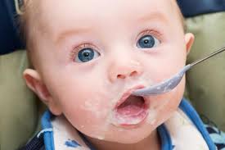
Infant Nutrition
0-6 months: human milk or iron fortified formula only
Can begin iron fortified infant cereal around 7 months
Can be mixed fruit juice so that vitamin C can enhance iron absorption
By 8-9 months finger foods like cooked veggies, raw fruit or cheese can be started
By one year well cooked table foods can be given

Slide 26
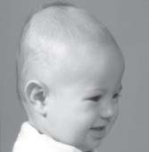

Promoting Development In ADL’s
Don’t tell me you held me all the time!
All ADL’s need to be carried out by caregiver
Periodontal care
Cleaning
Pain relief
Hygiene
Bathing
Peri care
Locomotion
Promote activity
Prevent injury
Positional Plagiocephaly
SIDS
Immunizations
Feeding
I Pooped!
Fix it!

Slide 27



Promoting Healthy Family Functioning
Infant
Trust vs. Mistrust
Interaction with all family members
Sharing of tasks
Sharing of time w/ and w/o infant
Child care

Slide 28
A new mother calls her health care providers office to ask the nurse what she can do to relieve her 5 month olds teething pain. The nurse should suggest which of the following techniques? (select all that apply)
Motrin
Tylenol
Chilled teething ring
Sugar free chewing gum

Slide 29
The best advise a nurse can give to parents of an 11 month old about safety during bath time include:
Keep a baby monitor in the bathroom so that you can listen to or watch your baby while she plays
Bath time should be limited to 30 minutes due to risks of hypothermia
Always be within arms length of your infant during a bath
Keep water temp below 135 Degrees F to protect your baby from burns

