Slide 1
Growth and Development:
The Preschool Years
June Baker, Rachel Buie, Kristin Davis, Lori Logan

Slide 2
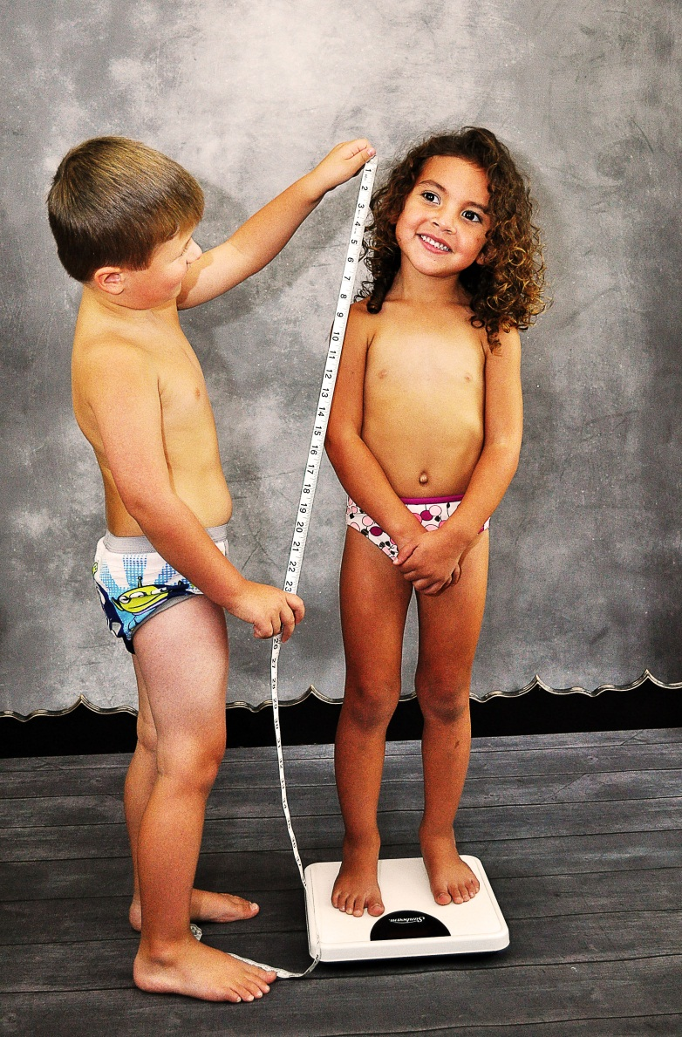
Physical Growth Changes
Average Weight is 32 lbs-41.5 lbs.
Height increases every year by 2.5 in.-3.5 in.
Notes:
Rate of physical growth slows and stabilizes during preschool years
Average weight is 32 lbs at 3 years; 36 ⅘ lbs at 4 years; 41.5 lbs at 5 years
Average weight gain per year is 4.5-6.5 lbs
Height increases 2.5-3.5 inches a year
Average height is 37.5 in at 3 years; 40.5 at 4 years; 43.5 at 4 years
Slender, but sturdy; graceful, agile, posturally erect

Slide 3
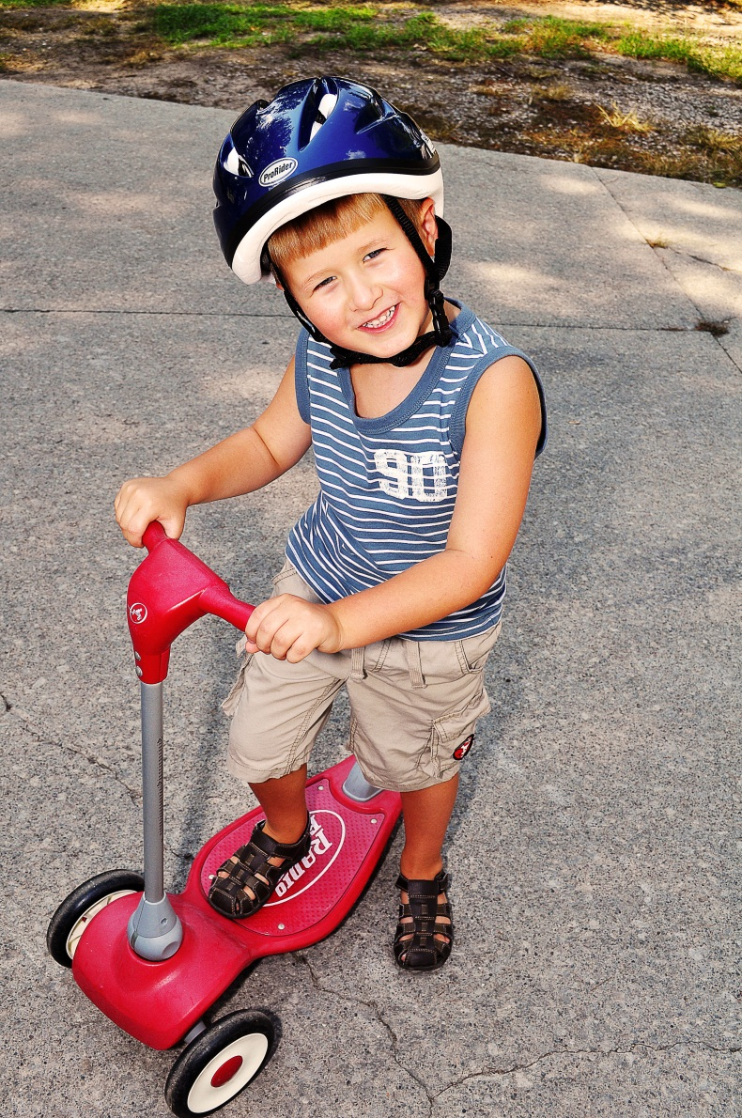
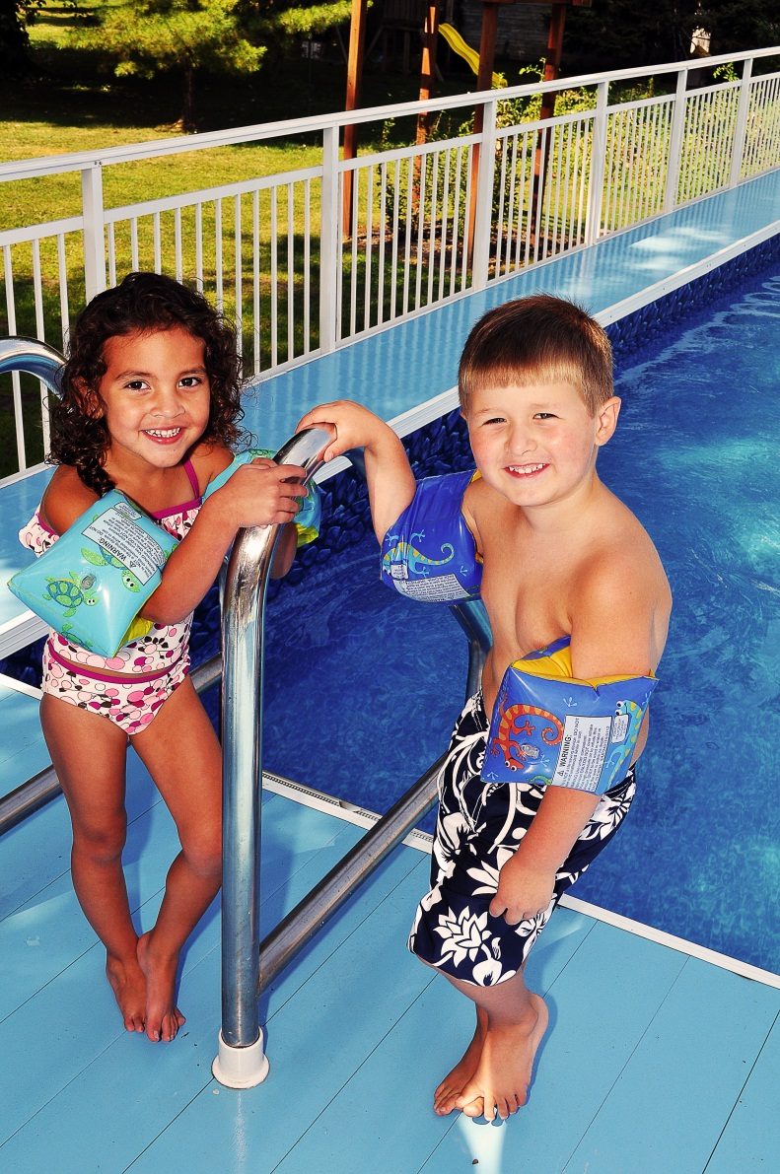
Physical Growth Changes
Refined eye-hand coordination
Increased skillful manipulation
Notes:
Most children are toilet trained
Increase in strength
Refinement of previously learned skills (walking, running, jumping)
Muscle development and bone growth still far from mature

Slide 4
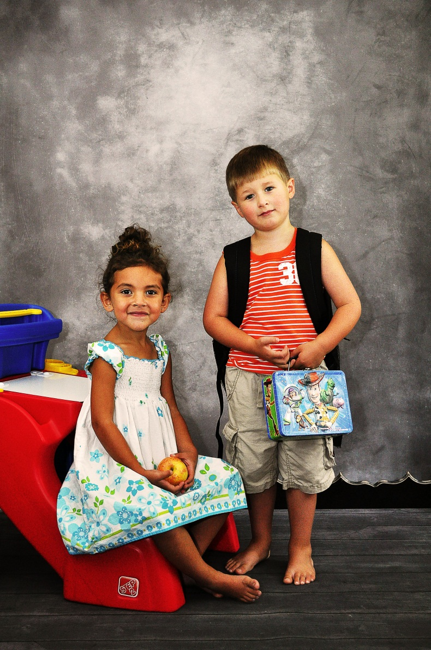
Developmental Milestones
Entrance into School
Increased attention span and memory
Notes:
Most significant change is ENTRANCE INTO SCHOOL
Control of bodily functions
Experience of brief and extended periods of separation
Ability to interact with other children and adults
Use of language for mental symbolization
Increased attention span
Increased memory

Slide 5


Language, Emotional, Cognitive
Increased vocabulary to more than 2100 words
Advancement in sentence structure, grammatical usage, and intelligibility
Notes:
Is more sophisticated and complex
Vocabulary influenced by environment and role models
Major mode of communication and social interaction
Advancement in sentence structure, grammatical usage, and intelligibility
Age 3-4 years
Three to four word sentences
Termed “telegraphic”
Age 4-5
Use longer sentences
Prepositions, adjectives, and variety of verbs
Can follow simple directional commands
Can define people/objects by use, shape or general category of classification

Slide 6
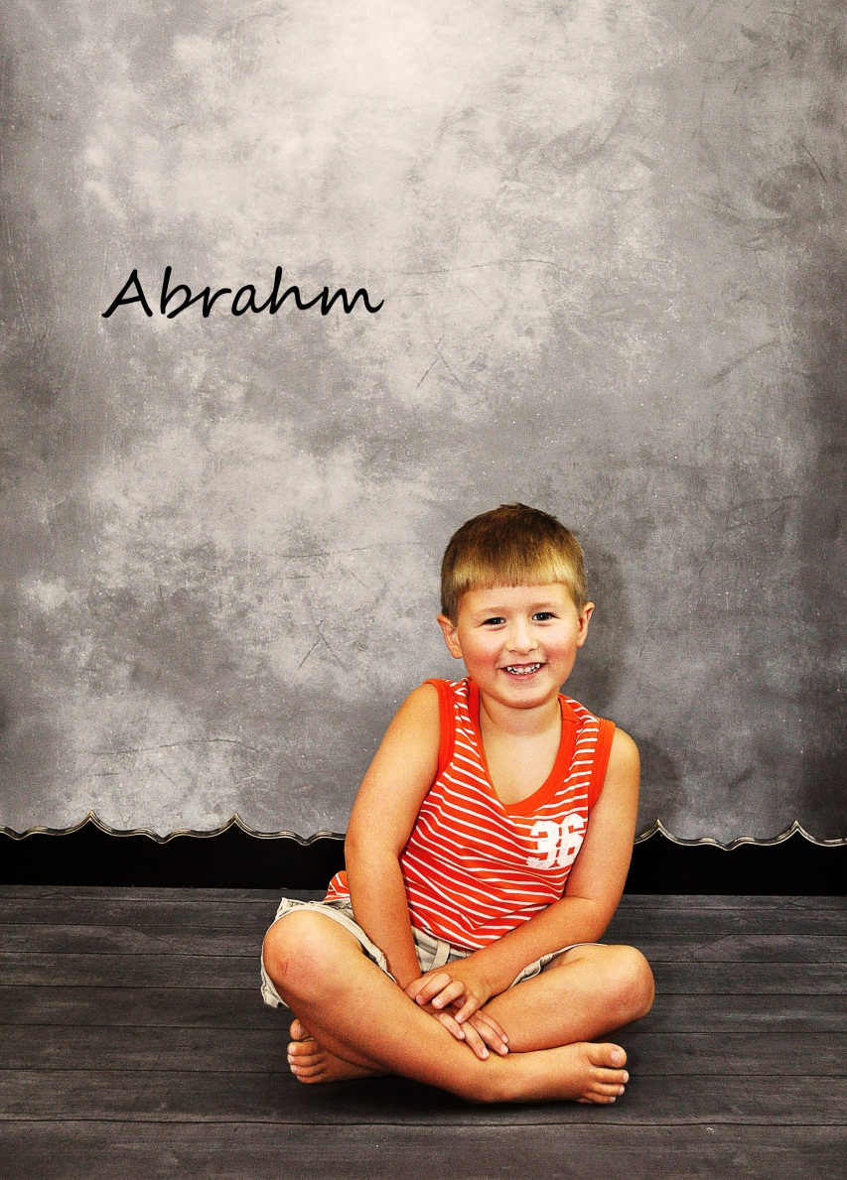
Language, Emotional, Cognitive
Use of several words to convey message
Can define simple things

Slide 7

Morality
An action is good or bad depending on whether it results in reward or punishment
Notes:
Learning right from wrong is a major task that a child must learn and thus is the beginning of morality. Kohlberg called this the preconventional or premoral stage. The child’s behavior from 2-4 years is called the punishment and obedience orientation stage. This is where they learn if an action is good or bad depending on the results of the action. Kohlberg believes this time frame is divided and the second phase occurs between 4-7 years. His theory calls it the naïve instrumental orientation phase and it involves further development of the child having a solid sense of justice and fairness, yet is still directed at satisfying themselves more than others.

Slide 8
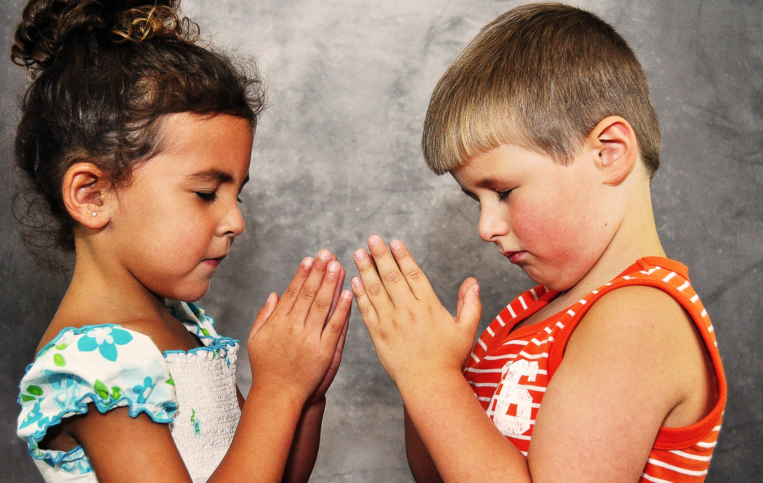
Spirituality
Faith and religion learned from parents
Concrete concept of God
Notes:
Development through the end of the toddler years involves beginning to have a conscience or superego. The conscience is strongly related to spirituality and at this time a child’s spirituality is developing also. A child has a good belief in God, although they see him as more of a human feature with arms and legs.

Slide 9
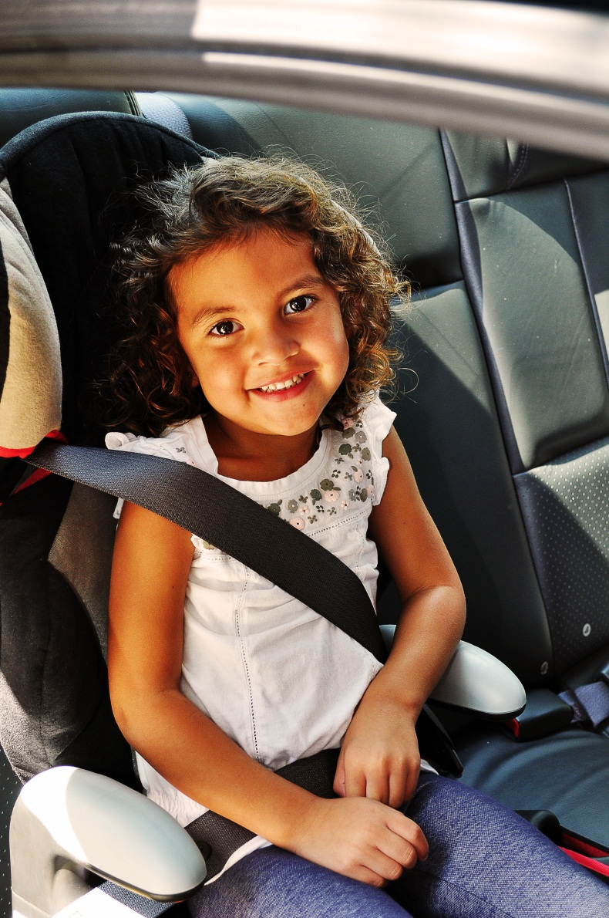
Safety
Less prone to falls than toddlers; listen more to parental rules; aware of potential dangers
Emphasis is now on education concerning safety and potential hazards
Notes:
Parents should be knowledgeable when it comes to keeping their child safe and knowledge should range from prevention of injury up to and include abuse protection and prevention. As nurses we can instruct and demonstrate safety on proper use and manufacturing of car seats and booster seats. We need to stress the importance of supervision at many ages. Installation of locks on doors, gates, cupboards etc. need to be done to prevent poisoning, running out in the street, or falling down stairs. Children should be taught water safety and how to swim but still never left unattended. Common things such as bicycle helmets and knee and elbow pads are a must while riding bikes or scooters. At last but may be one of the most critical, teach children stranger safety. Advise parents not to label clothing or book bags on the outside where it may be visible to strangers. Teach them what is acceptable or appropriate touching from others and that if they feel uncomfortable how to say no. An example of how to be safe is called stranger danger. It teaches the child to lay or sit down and keep kicking and moving in a circular motion while screaming. This makes it harder for an abduction to happen due to the child’s center of gravity being lowered and from the continuous motion making harder for someone to grab on to the child. Teach your child his name, address, and phone number. But most importantly be intuitive, pay attention to what your child says or his or her actions. Always listen to your child and always believe them.

Slide 10
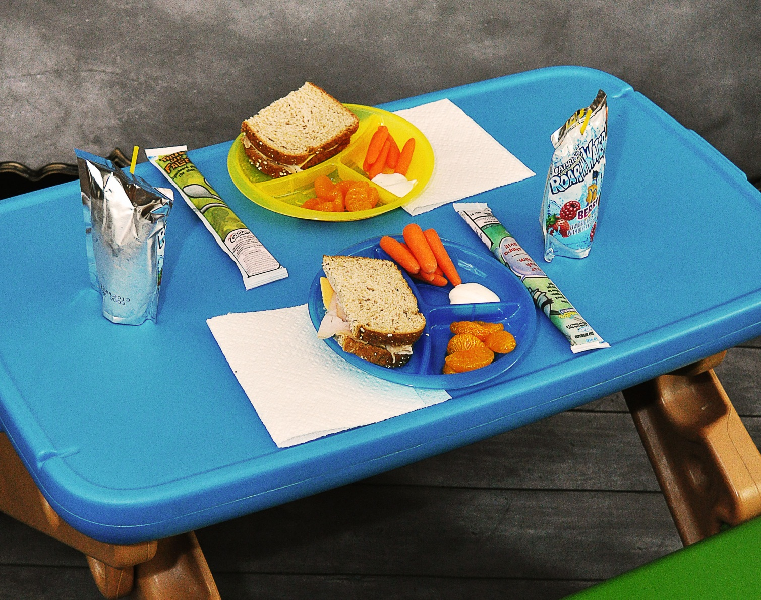
Nutrition
Average Daily Intake of 1800 calories
Protein- 13-19 grams/day Fat-less than 10% of total caloric intake Calcium- 500 mg/day
Notes:
Requirements for preschoolers are similar to toddlers. Consumption should be 90kcal/kg with daily intake total of 1800 calories. Fluid intake should be 100ml/kg/day taking into considerations such as health of the child, climate conditions, and the activity level of the child. Keep in mind the trials and tribulations that may occur at this age. Children at age four may become picky eaters and show a sense of rebellion during meal time but will lessen closer to age five. Always offer food items in small portions which may help in getting them to eat and explore new things. Important factors to stress to parents are limiting fruits juices to 4-6 oz/day due deter dental caries, and not to force a child to finish everything on their plate. This has been shown to promote eating disorders and/or obesity.

Slide 11
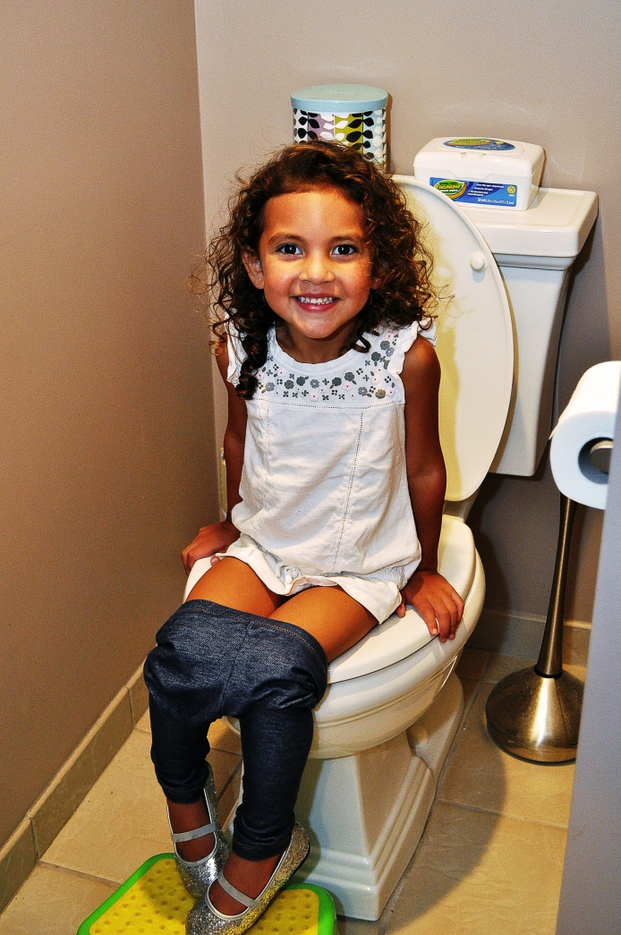
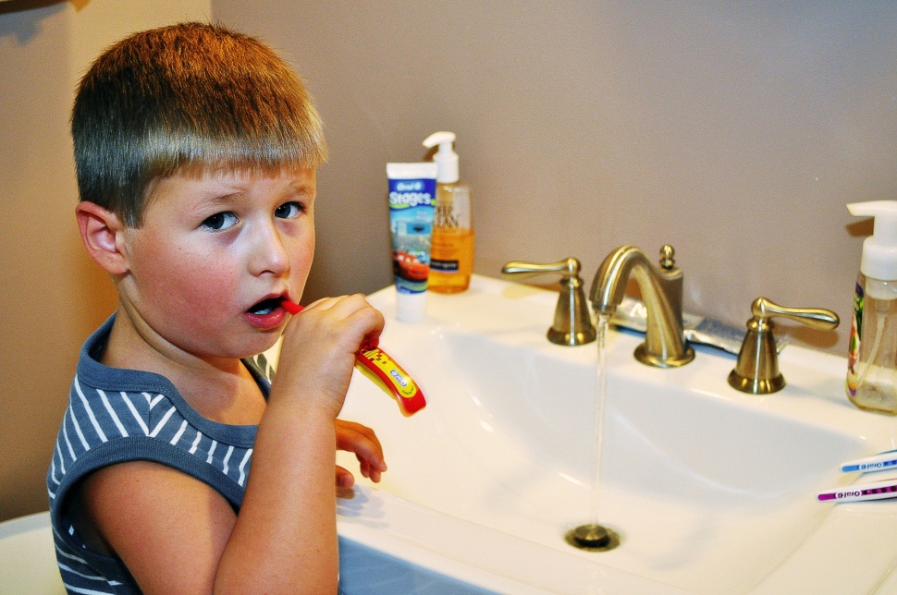
Promoting Development in ADLs
Little if any assistance with dressing, eating, or toileting
Still require assistance and supervision with brushing
Notes:
Activity
Motor activity levels continue to be high
This allow for environment exploration and the learning of physical games and sports
Keep sedentary activities to a minimum (TV and video games)
Formalized training activities is controversial subject
Preschool/Kindergarten
Learned group cooperation
Adjusting to sociocultural differences
Coping w/frustration and using language to communicate rather than hitting

Slide 12


Promoting Development in ADLs
Fears
Play
Notes:
New types of “playing”
Associative play-group play in similar or identical activities w/o rigid organization/rules
Imitative/Imaginative/Dramatic play
Imaginary playmates
Mutual play
Fears
Can sometimes interfere w/ ADLs
If fear disrupts family life professional help may be needed
Sleep
Averages 12 hours of sleep/night
Prime time for sleep disturbances
Bedtime fears, waking in the night, nightmares/sleep terrors
Keep bedtime consistent
Use of nightlight, favorite toy, or drink of H20 by bed may help
Helping children slow down like bathing or storytelling

Slide 13
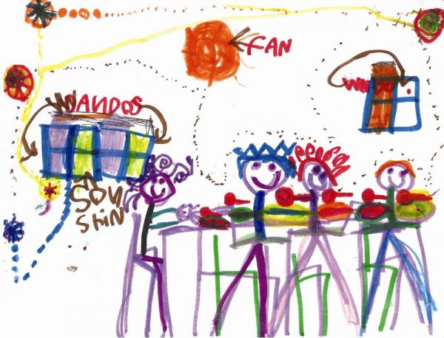
Promoting Healthy Family Functioning
Am I good or bad?
Dolls, play objects, and drawings are used to act out family situations
Notes:
At this stage in the preschooler’s life they are at the psychosocial stage of development that deals with Initiative vs. Guilt. The main subject matter is them deciding whether they are good or bad. These questions get answered by the parents. With all of the initiation going on at this stage of development the preschoolers are deciding in which aspects of life they can have control over. This control that they are seeking can sometimes get them into trouble when they cross boundaries that the parents have set forth. Also during this time they are learning how to lead, within their peer groups as well as in the home. Children need to begin asserting control and power over the environment. Success in this stage leads to a sense of purpose. Children who try to exert too much power experience disapproval, resulting in a sense of guilt.
Developing a conscious implies learning the sociocultural mores of the family’s heritage. (Perry 1044) Children at this stage also pick up on the family’s approved behaviors, and will also absorb how to be tolerant, biased, or prejudicial concerning their ethnic, religious, and social background of those similar to them. This does not usually become apparent until they are socializing with children who are from different backgrounds. So it is for each individual family to decide what is acceptable for the social setting.
In a healthy family setting children may play out family matters with the use of dolls and play objects. They are acting out different fears, fantasies and anxieties with play that represents each member of the family. (Perry 1046)

Slide 14
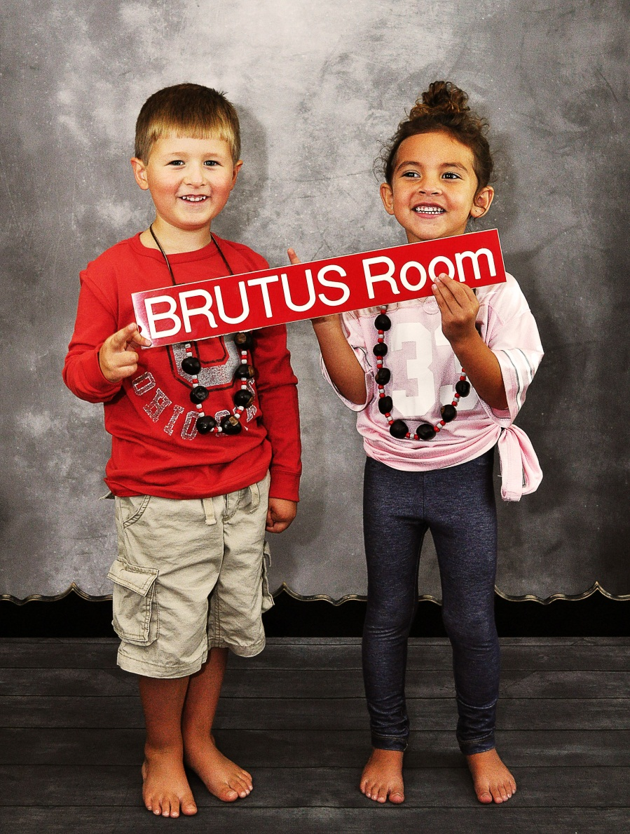
Promoting Healthy Family Functioning
Children imitate family’s approved behaviors
Notes:
Developing a conscious implies learning the sociocultural mores of the family’s heritage. (Perry 1044) Children at this stage also pick up on the family’s approved behaviors, and will also absorb how to be tolerant, biased, or prejudicial concerning their ethnic, religious, and social background of those similar to them. This does not usually become apparent until they are socializing with children who are from different backgrounds. So it is for each individual family to decide what is acceptable for the social setting.
In a healthy family setting children may play out family matters with the use of dolls and play objects. They are acting out different fears, fantasies and anxieties with play that represents each member of the family.

Slide 15
Quiz Question One
Which depict an average physical assessment of a five-year old (SATA)?
Slight increase in pulse and respiration
Average weight of 18.7 kg or 41.2 lbs
Average height of 110 cm or 43.5 inches
Handedness is established; about 90% are left-handed

Slide 16
Answer
b) Average weight of 18.7 kg or 41.2 lbs
c) Average height of 110 cm or 43.5 inches
There is a slight DECREASE in pulse and respiration and handedness is established; about 90% are RIGHT-HANDED

Slide 17
Quiz Question Two
What is the number of vocabulary words of an average 3-year old?
700
900
1200
1500

Slide 18
Answer
b) 900
A 4-year old uses about 1500 words and a 5-year old uses about 2100.

