Slide 1
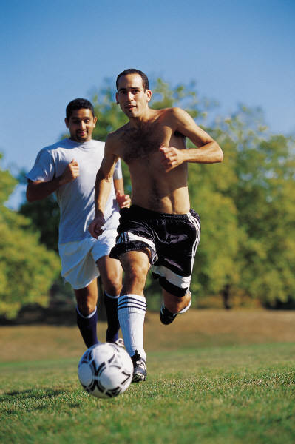
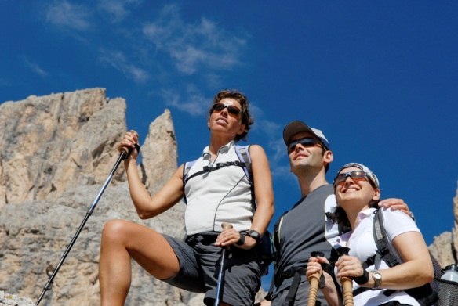
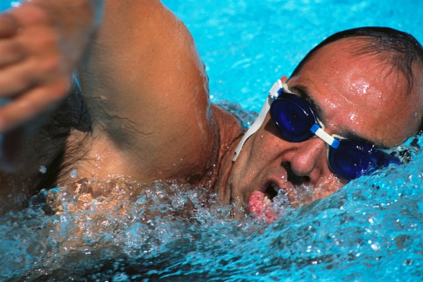
MUSCLE CRAMPS
Explain the symptoms of muscle cramps
Painful, involuntary tightening of muscles in arms, legs or stomach that will not relax – “Charlie horse”
Can last a few seconds, up to 15 minutes or longer
Usually occurs after physical exertion, or due to heat exhaustion, or dehydration
Notes:
“Weak muscles are more likely to get overexerted when exercising and this overexertion depletes the muscle of oxygen. Without oxygen, waste product builds up in the muscle causing the fibers to spasm and shorten the muscle. Keeping muscle fibers strong and long (this means stretching) helps them do their job much better. Yep, stretching is key.” http://www.fitsugar.com/Skinny-Muscle-Cramps-78331

Slide 2
MUSCLE CRAMPS
What action needs to be taken for first aid of muscle cramps
Move person to a cool place
Give person sips of cool water, gulping down water, or giving ice cold water may cause abdominal cramping, nausea, and vomiting
Apply firm pressure or gently massage muscle that is cramping
Stretch the contracted muscle if possible

Slide 3
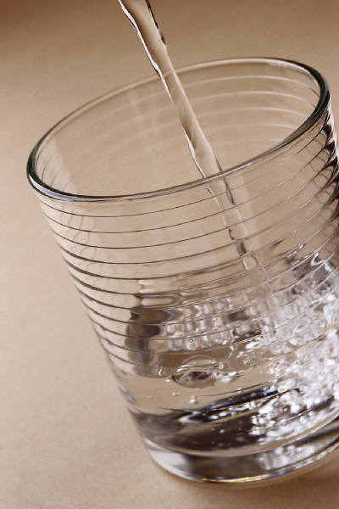
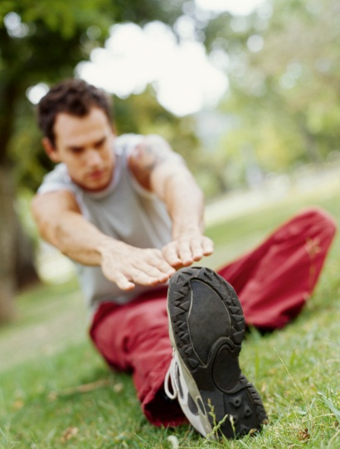
MUSCLE CRAMPS
What actions can be used for prevention of muscle cramps
Stay hydrated – drink lots of water
If working in the outdoors in the heat
Hard or unusual exercise
Stretch before exercising or doing heavy work

Slide 4

HEAT STROKE (Sunstroke)
What is the difference between heat stroke and heat exhaustion
Less common and much more severe than heat exhaustion
The body gets so overheated that its natural mechanisms for controlling body temperatures are completely shut off
Heat stroke can be life threatening

Slide 5
HEAT STROKE (Sunstroke)
Explain the symptoms of heatstroke
Body temperature may be 102°F to 105°F or higher
Red, hot, and dry skin
No sweating – sweating is a natural mechanism that is shut down during heat stroke
Extremely rapid pulse
Confusion, disorientation
Fainting, unconsciousness
Convulsions – seizures

Slide 6

HEAT STROKE (Sunstroke)
What action needs to be taken for first aid of heatstroke
Take the victim to a shaded spot or a cool place
Place victim face up with head and shoulders raised
Cool down the victim’s body quickly
Take off the victim’s clothes
Sponge bare skin with cold water and soak underclothing with cool water
Drape bare skin with wet cloths
Apply cold packs
Use a fan
Place victim in a cold water bath
Dry the skin once body temps reach 101°F
When victim is able to drink on their own safely – give them as much water as they want
Treat shock
Call for medical assistance ASAP

Slide 7
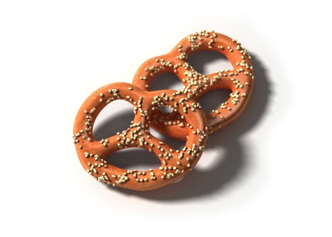
HEAT STROKE (Sunstroke)
What actions can be used for prevention of heatstroke
Stay in the shade during hot weather
Wear a hat and light-colored clothing when working out in the sun to stay cooler
Only work or play for 30 minutes at a time in the direct sunlight
Drink plenty of water
Increase your salt intake by a very
small amount – this will help hold
water in and keep your body hydrated
Plan strenuous work and activities for the morning and evening when it is typically cooler

Slide 8

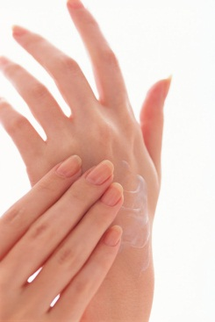
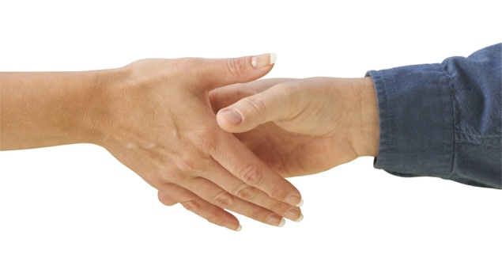
POISONOUS PLANTS
All poisonous plants create an oil (urushiol) that irritates the skin of most people
Oil can be spread to other parts of the body through skin on skin contact or clothing to skin contact

Slide 9
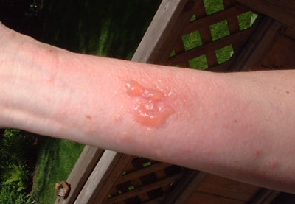
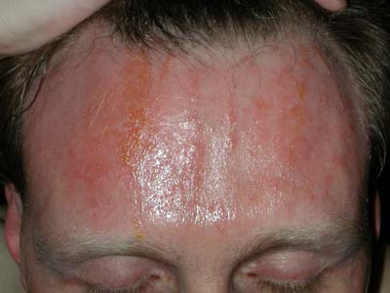
POISONOUS PLANTS
Signs and symptoms of allergic reaction to a poisonous plant
Skin rash
Redness
Swelling
Itching
Burning
Fever
Headache
In severe cases blisters may appear – they may break open and crust over

Slide 10
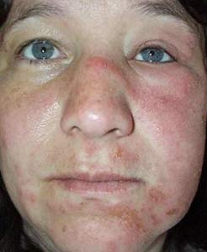
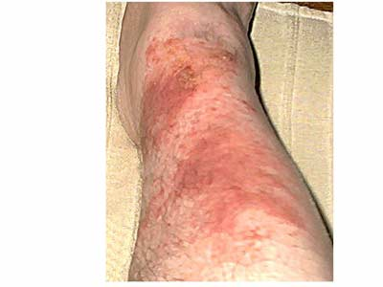
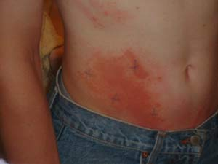
POISONOUS PLANTS
Typical Rashes from Poisonous Plant exposure
Pictures were retrieved from: http://poisonivy.aesir.com/view/rashes.html

Slide 11

POISONOUS PLANTS
How to treat reactions to poisonous plants
Remove and wash all contaminated clothing and exposed skin with soap and water
Wipe exposed area with rubbing alcohol
Apply calamine lotion or soothing skin
lotion for mild rashes
Seek medical attention for severe rashes
or any rashes on the face or genitals
Seek medical attention if the plant
parts were chewed or swallowed

Slide 12
POISONOUS PLANTS
How to prevent getting contaminated by poisonous plants
Learn what poisonous plants look like – they appear different depending on the season
All 3 of these poisonous plants have white, tan, or yellowish berries
Wear protective clothing when working outdoors around unfamiliar plants
When handling tools, clothes, camping gear or any item that might be contaminated be very careful
Be cautious petting animals that might have been around poisonous plants as their fur might be carrying the oils
Wash with soap and water if you suspect you have been contaminated

Slide 13
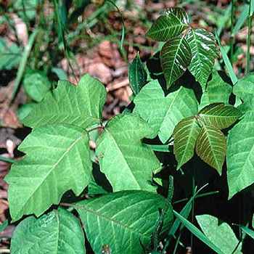
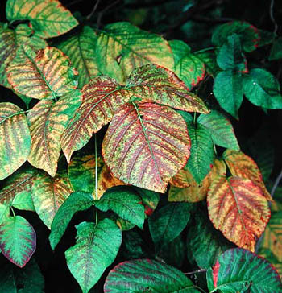
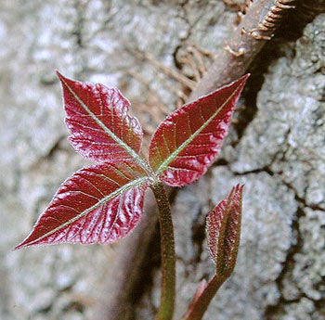
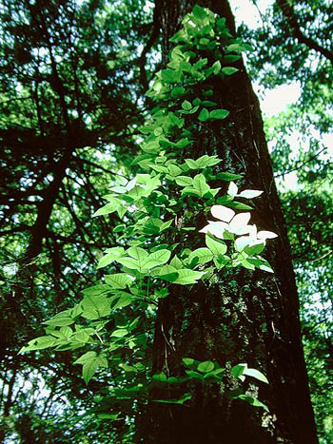
POISON IVY
All Poison Ivy Pictures retained from: http://www.poison-ivy.org/
Found throughout all of mainland USA
“Usually has three broad, spoon-shaped leaves or leaflets, but it can have more. The phrase, “Leaves of three? Let it be.” May help you remember what poison ivy looks like.
Grows as a climbing vine or a low, spreading vine that sprawls through grass (more common in eastern states) or as a shrub (more common in northern states, Canada, and the Great Lakes region).
Often grows along rivers, lake fronts, and ocean beaches.
Has bright red leaves and white or cream berries in the autumn.”
(Information retained from: http://www.everydayhealth.com/health-center/habitat-and-description-of-poison-ivy-oak-and-sumac-info.aspx)

Slide 14
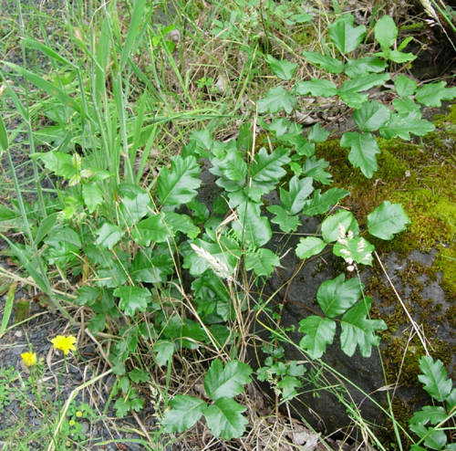
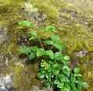
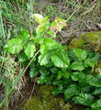
POISON OAK
Pictures retained from: http://walking.about.com/od/medfirstaid/ig/Poison-Oak-Photos/index_g.htm
** “Poison oak is most common in the western United States, although it is also found in eastern states. It rarely is found in Midwestern states.
** Has leaves that look like oak leaves, usually three leaflets but sometimes up to seven per leaf group.
** Grows as a vine or a shrub.”
Information retained from:
http://www.everydayhealth.com/health-center/habitat-and-description-of-poison-ivy-oak-and-sumac-info.aspx

Slide 15

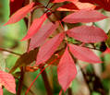

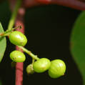

POISON SUMAC
“Poison sumac is much less common than poison ivy or poison oak. It is found in wooded, swampy areas, such as Florida and parts of other southeastern states. It is also found in wet, wooded areas in the northern United States.
Has 7 to 13 leaflets per leaf stem. The leaves have smooth edges and pointed tips.
Grows as a shrub or small tree.”
All pictures retained from http://landscaping.about.com/od/weedsdiseases/ig/Poison-Sumac-Pictures/
Information retained from: http://www.everydayhealth.com/health-center/habitat-and-description-of-poison-ivy-oak-and-sumac-info.aspx

Slide 16
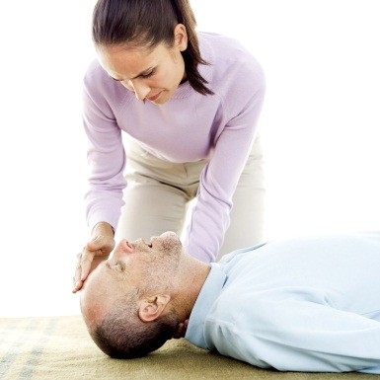
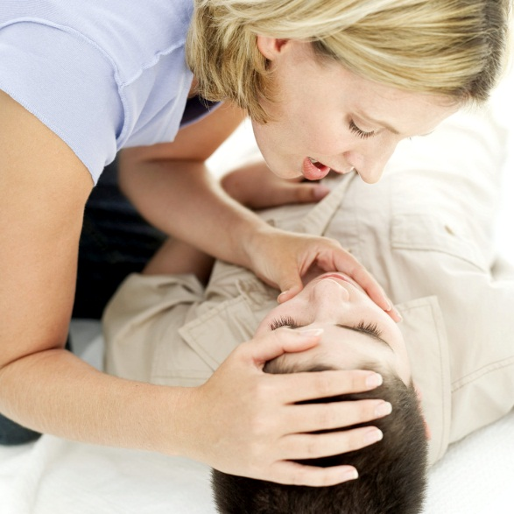
What if…Someone is not Breathing!!
Show what to do for “hurry” cases of stopped breathing
Check for breathing by placing your ear to the victim’s mouth and nose, or watch their chest rise and fall
Maintain an open airway
Start rescue breathing
Call for help immediately

Slide 17
What if…Someone is Bleeding A LOT!!!
Show what to do for “hurry” cases serious bleeding
Use a clean cloth or sterile dressing as a pad, apply direct and firm pressure over the wound to stop the bleeding. Use gloves if possible, or washed hands
Raise the wound above the victim’s heart
Do not release your hand unless the bleeding has stopped
Put a fresh dressing over the old one if blood has soaked through
Press your palm to a pressure point in the groin or armpit area if need be
Once bleeding stops, secure a pad firmly to the area
Feel for a pulse below the wound
Use a tourniquet as a last resort
Treat for shock if need be

Slide 18
What if….Someone ate a Poisonous Plant or Berry??
Show what to do for “hurry” cases ingested poisoning of these plants
Seek medical attention immediately
Poison control number: (800) 222-1222
Maintain an open airway
Ingestion of these poisonous plants may cause nausea, vomiting, and possibly even death

Slide 19
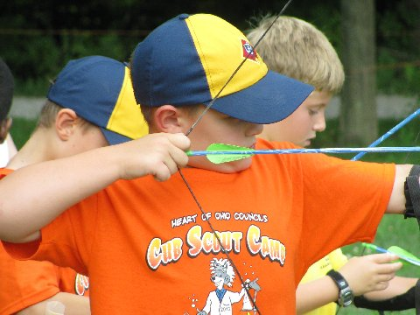
Most of this section’s information is taken from the BSA Handbook’s First Aid Section

Slide 21
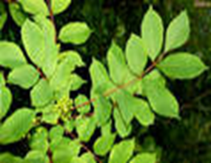

Slide 22


Slide 23


Slide 24
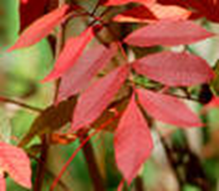

Slide 25


Slide 26


Slide 27
Name 2 things that will BOTH prevent and treat muscle cramps.

Slide 28
WATER AND STRETCHING

Slide 29
What 4 things do you do when someone stops breathing.

Slide 30
1. Check for breathing
2. Maintain an open airway
3. Start rescue breathing
4. Call for help immediately

Slide 31
True or False:
Rinse off your skin with a hose as soon as you suspect you have come into contact with poison ivy.

Slide 32
False: You must use soap and water

Slide 33
True or False:
Poison Plant rashes are infectious - do not touch anyone else if you have been infected.

Slide 34
False: It is the oil from the plant that causes an allergic reaction - it might appear to "spread" because a person has not totally washed all of the oil from the infected spot and spread the oil to another location or another person.

